Slide 1
Why New Customers Stopped Coming Back
Diagnosing a hidden decline in repeat purchase — and what to do about it
E-commerce order log, Jan 2024 – Jun 2025 (simulated data) · github.com/Newnew-niu/ecommerce-repeat-purchase-analysis
Notes:
Portfolio project. The order log is simulated (src/00_make_dataset.py); the analysis rediscovers the planted patterns from the CSV without reading the generator's parameters. Methods transfer to real data; absolute numbers do not.

Slide 2
The reported KPI looked stable while new-customer repeat fell by 16%
−2.0pp
−7.5pp
−7.6pp
Headline 30-day repeat
New-customer 30-day repeat
Cohort M+1 retention
58.2% → 56.3%. What the business reported
46.2% → 38.7% (p < 0.001)
34.7% → 27.2%, cohorts since Nov 2024
1
Support tickets: Repeat collapses at the 3rd ticket (odds ratio 0.22); orders with a ticket rose from 14% to 27%
2
Electronics & Home: Highest order values, lowest repeat; tickets per order up 2.9x and 1.7x
3
Coupon dependency: Customers who habitually buy on coupon repeat ~15pp less; a single coupon has no measurable effect
Baseline = 2024Q2–Q3, recent = 2025Q1–Q2. Sources: outputs/tables/05_kpi_summary.csv, 02_cohort_retention.csv
Notes:
Headline KPI moved only ~2pp because loyal, high-frequency customers became a larger share of orders. Measured per new customer and per cohort, the decline is 7.5-7.6pp. Three drivers are significant with user-clustered standard errors. Recommendation: switch the KPI immediately, fix Electronics/Home post-purchase experience, and test service recovery and coupon-dependency reduction before rollout.

Slide 3
Repeat customers drive most revenue, so a retention leak is expensive
Questions this analysis answers
80%
1
Is repeat purchase really declining, or is it noise?
of GMV comes from repeat customers, who are 54% of customers
2
Which customers are affected: new or established?
They spend less per order ($87 vs $111) but order 4.7 times on average. Their value comes from coming back, which makes the first-to-second order step the key lever.
3
What is associated with the decline: service, category, coupons or channel?
4
Which actions are worth funding, and how do we prove they work?
Repeat customer = 2+ orders in the observation window. Source: outputs/tables/05_customer_type_comparison.csv
Notes:
Audience: e-commerce / CRM leadership. Objective: explain whether and why repeat purchase is declining and which actions to fund.

Slide 4
Approach: clean, measure without bias, explain, then size and test
1
2
3
4
5
Data
Clean
Measure
Explain
Size & check
42,776 raw order rows, ~14,000 customers, 9 fields; 10 realistic data-quality issues
97.7% of rows kept; every removal counted; last 30 days censored
Order-, customer- and cohort-level KPIs; segment profiles
Logistic regression (user-clustered SEs) + gradient boosting, forward-in-time holdout AUC 0.72
Break-even business cases, sensitivity grid, SQL cross-check (9/9 pass)
Data provenance. No production data was available, so the order log is simulated with known patterns. The analysis never reads the simulator's settings; it rediscovers them from the data. This deck therefore demonstrates analytical method. The numbers are not real-world facts.
Pipeline: src/00–06 · Full detail: REPORT.md · Logs: logs/
Notes:
Key safeguards: right-censoring of the last 30 days, point-in-time features, clustered standard errors, forward-in-time model validation, de-confounded coupon analysis, every business case tested against a break-even gate.

Slide 5
Three repeat metrics, three different questions
KPI | Unit | Numerator ÷ denominator | Use it for
Order-level 30-day repeat | Order | Orders followed by another order ≤30 days ÷ orders ≥30 days before snapshot | What was reported; distorted by customer mix
New-customer 30-day repeat | Customer | First-time customers who reorder ≤30 days ÷ first-time customers ≥30 days before snapshot | Primary KPI for acquisition quality
Cohort M+1 retention | Customer × month | Cohort customers ordering in the next calendar month ÷ cohort size | Retention trend by acquisition month
Average order value | Order | GMV ÷ orders | Basket value; compare segments
Why it matters: repeat rate, retention rate and cohort retention use different units and denominators. Mixing them up is how this decline went unnoticed.
Full definitions: docs/kpi_definitions.md · Implemented once in src/kpis.py and re-checked in SQL

Slide 6
The headline rate hid the decline as loyal customers grew as a share of orders
42%
of orders from loyal customers
Customers with 4+ prior orders, May 2025 (0% in Jan 2024). They repeat at ~70%.
So the average barely moved, while each new cohort came back less often. Track new-customer repeat and cohort retention, not the blended headline.
Source: outputs/tables/02_monthly_trend.csv, 02_order_mix_drift.csv · Orders within 30 days of the snapshot excluded

Slide 7
Every cohort acquired since November 2024 retains worse, at any time window
Is it just the 30-day window?
Window | Baseline | Recent | Change
30 days | 46.2% | 39.5% | −6.8pp
60 days | 49.9% | 42.9% | −7.0pp
90 days | 54.2% | 46.4% | −7.8pp
No. The gap holds at 30, 60 and 90 days (all p < 1e-10). New-customer repeat, share of customers who order again. Baseline cohorts Apr–Sep 2024 (n=4,932); recent Nov 2024–Mar 2025 (n=4,195).
Source: outputs/tables/02_cohort_retention.csv, 05_window_sensitivity.csv · Robustness uses the same customers under each window

Slide 8
Repeat purchase collapses at the third support ticket, and ticket load has doubled
0.22
14%→27%
Odds ratio, 3+ tickets
Orders with a ticket
95% CI 0.16–0.30, after controls
Jan 2024 → Jun 2025
Where the strain landed: Electronics tickets per order rose from 0.24 to 0.69, Home from 0.25 to 0.42. These are the highest-value categories. The ticket gradient holds within every category.
Source: outputs/tables/05_ticket_robustness.csv, 03_odds_ratios.csv, 02_ticket_trend.csv, 02_ticket_by_category_month.csv
Notes:
Only 261 scoreable orders have 3+ tickets, so the lever is deep but narrow. Association, not proven causation: customers who are already leaving may complain more. The model-based counterfactual used for sizing is far smaller than the raw gap.

Slide 9
Coupons are not the problem; coupon dependency is
0.96
0.50
Coupon on this order
Habitual coupon use
Not significant (p = 0.28)
Always vs never; p < 0.001
Implication: do not stop couponing. Break the habit for customers who only buy on discount. This is also the weakest causal link (low-intent customers may seek coupons), so test it before rollout.
Customers with 3+ prior orders only, to avoid one-order customers having a 100% coupon rate by construction. Source: 02_tipping_discount.csv, 03_odds_ratios.csv

Slide 10
Service and coupon dependency explain about half of the decline; the rest needs new data
Share of the controlled decline in 30-day repeat (log-odds scale)
13%
36%
51%
Support tickets & returns
Coupon dependency
Not observable in the order log
Hidden by mix
Partly explained
Next data to collect
Measured naively the period effect is not significant (OR 0.96, p = 0.10). With controls it is clear (OR 0.77).
Tickets, returns and coupon dependency absorb 49% of it. These are the levers in the recommendations.
Delivery times, stockouts and assortment changes. The order log cannot see them, and they are the best candidates for the rest.
Logit ladder on the post-Oct-2024 period effect, with lifecycle, category, channel and order-value controls. Source: 03_mediation_ladder.csv

Slide 11
Four actions, ordered by strength of evidence and value
1
Switch the KPI
2
Fix Electronics & Home after-sales
This week · no cost
Base case $172k net / yr
Report new-customer repeat and cohort M+1 weekly; keep the headline as a secondary metric.
Product information, proactive delivery updates and inbound quality checks to cut tickets at the source.
Measure: adopted in the weekly business review
Measure: tickets per order ≤ 0.35; staged rollout by category
3
Recover at the 2nd ticket
4
Test coupon-habit reduction
Base case $50k net / yr
Base case $18k net / yr if proven
Automated recovery at 2 tickets; senior-agent callback at 3+. Tiering follows from break-even costs.
Targeted CRM for customers who buy ≥60% on coupon. Weakest causal evidence.
Measure: 2 tickets: 10% holdout, fewer escalations; 3+: 50/50 test, repeat
Measure: A/B test before any rollout; repeat and margin
Net contribution = base-case annual planning estimate (10% sample assumption). Source: outputs/tables/04_business_cases.csv
Notes:
Each recommendation states evidence, target, action, expected outcome and how to measure it. Effect sizes come from model counterfactuals with a realisation haircut, not from experiments, so recommendations 2-4 ship with a holdout or staged rollout.

Slide 12
Base case: ~$240k net contribution a year, but only if the uplift is proven
$240,321
Net contribution / yr
on $323,170 cost · net ROI 0.74x · $852,230 incremental GMV
Risks, stated up front
13 of 18 sensitivity scenarios are value-positive.
With zero repeat uplift the portfolio loses $117,615; savings alone do not pay for it.
Effects come from observational models, so run the controlled tests first.
Annualised, contribution margin 42%, assumes the data is a 10% customer sample. Source: 04_business_cases.csv, 04_sensitivity.csv

Slide 13
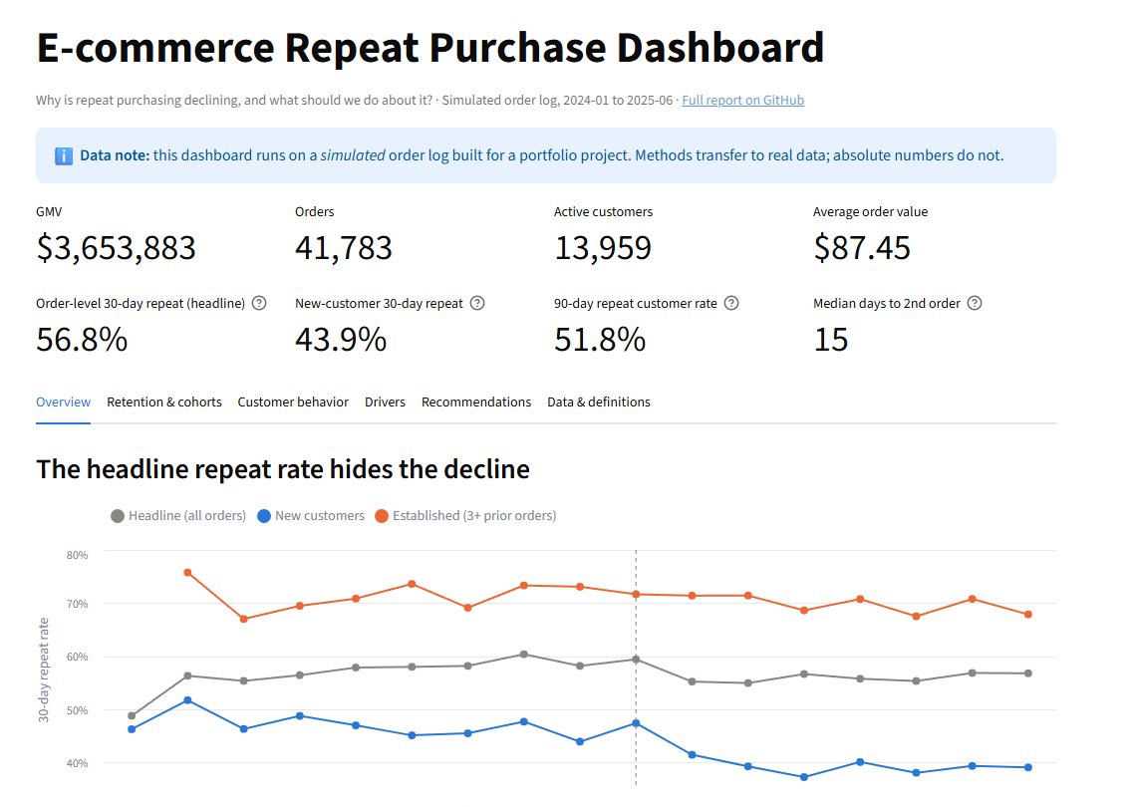
An interactive dashboard keeps the right KPIs in front of the team
KPI tiles use the same code as the analysis (src/kpis.py); automated tests check they match
Filters: month range, acquisition channel, category
Tabs: overview, cohorts, customer behaviour, drivers, recommendations, definitions
Every chart has hover tooltips and a plain-English caption
Screenshot of dashboard/app.py running locally (Streamlit). Run: streamlit run dashboard/app.py

Slide 14
Roadmap: change the metric this week, prove the levers within six months
1
2
3
4
5
Week 1–2
Week 3–8
Month 2–5
Month 3–6
Month 4+
Switch reporting to new-customer repeat & cohort M+1; real-time alert at 2 tickets
Launch automated recovery (10% holdout) and callbacks (50/50 test, ~6 months)
Electronics/Home: product content, delivery updates, inbound QC; staged rollout
Randomised test of coupon-habit reduction; scale only on a significant result
Instrument delivery time, stockouts and assortment to explain the remaining ~50%
Analytics, Data Eng
Customer Service Ops
Merchandising, Fulfilment
CRM, Analytics
Data Eng
Owners are suggested functions. Dates are relative to approval.

Slide 15
What this shows, and what it does not
Conclusion
Limitations
The repeat decline is real, concentrated in new customers, and was hidden by the KPI definition.
Support tickets, Electronics/Home after-sales and coupon habits are the measurable levers.
Change the metric now; fund the levers through controlled tests.
Simulated data: methods transfer, numbers do not
Observational models; no experiment has been run
About half of the decline is unexplained by the available fields
Dollar figures rely on a 10% sample assumption and planning costs
Ticket and return timing may overlap the 30-day outcome window
Full report, code and dashboard: github.com/Newnew-niu/ecommerce-repeat-purchase-analysis

