Slide 1
Online Grocery
Customer Journey
PORTFOLIO PROJECT · ONLINE CUSTOMER ANALYTICS
What customers complain about, where they drop off online, what keeps them loyal, and how we would test a fix.
Faye (Xuefei) Niu
Real public data · October 2026 · None of it is Tesco data
Notes:
One portfolio project, four modules, one story. Every number in this deck comes from code that ran on real public data. None of the datasets is Tesco data, and I say where each one comes from.

Slide 2
Four questions, four real datasets
1 · COMPLAINTS
2 · FUNNEL
3 · LOYALTY
4 · TEST
What do app users complain about?
Where do shoppers drop off online?
Who are the valuable customers?
How would we test a fix?
2,091 app reviews of Tesco Ireland, Dunnes Stores and SuperValu
Real baselines from the funnel in Module 2
360,129 GA4 sessions from the Google Merchandise Store
2,467 households, The Complete Journey (84.51°)
Only 20% go from viewing to adding to cart
App speed and login hurt most
21% of households bring 46% of spend
A designed A/B test: 2,959 users per group
The datasets cannot be joined. They are linked by the type of customer problem, not by the same customers.
Notes:
The story runs left to right. Complaints tell us what hurts. The funnel shows where people leave. Transaction data shows who matters and whether promotions work. The last module designs a test for the top fixable problem.

Slide 3
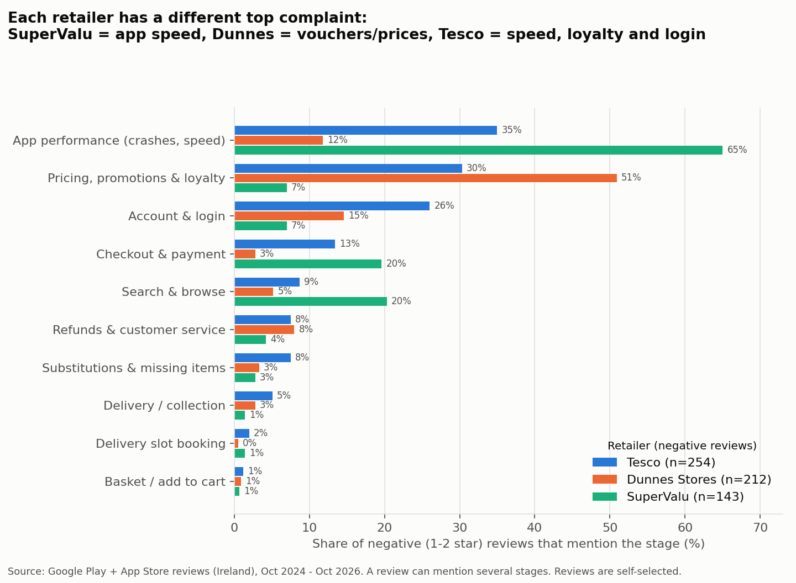
Each app has a different top complaint
SuperValu
65% of negative reviews mention a slow or freezing app
Dunnes Stores
51% are about vouchers and prices, a pricing-policy issue
Tesco Ireland
App speed 35%, loyalty 30%, login 26%, often at the till
Source: Google Play + App Store reviews (Ireland), Oct 2024 to Oct 2026. Reviews are self-selected and skew negative.
Notes:
609 of the 2,091 reviews are negative (one or two stars). One review can mention several stages. Delivery is not the main problem: reviews that mention delivery average 4.25 stars, so most of them are praise.

Slide 4
Login problems get the lowest ratings of any stage
1.65
34%
0.86
average stars when a review mentions login (all reviews: 3.67)
of negative reviews mention app speed or crashes, the most common stage
precision of the keyword rules on 100 hand-labelled test reviews (recall 0.74)
Rules were improved on a separate dev sample, so the test score is not inflated.
Notes:
How I checked the tagging: I hand-labelled two random samples of 100 negative reviews. The first was used to fix the rules. The second was never used to write rules, so its score is the honest one. The stage shares from the rules and from the hand labels were almost the same.

Slide 5
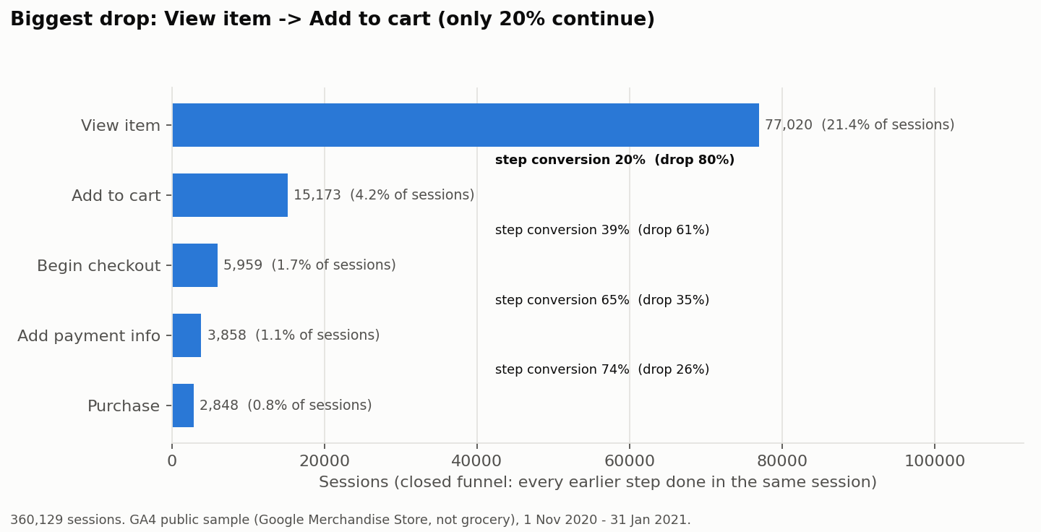
Most shoppers leave before the cart
1.35%
of sessions buy
81.3%
cart abandonment
28.9%
drop between payment info and purchase
$68.97
average order value
Source: GA4 public sample in BigQuery (Google Merchandise Store, real e-commerce, not grocery), Nov 2020 to Jan 2021.
Notes:
One SQL query turns raw GA4 events into 360,129 sessions with a flag for each step. It scans 1.16 GB, inside the free sandbox. The chart is a closed funnel: a session counts at a step only if it did every earlier step in the same visit. 2,000 purchases happened in visits with no add-to-cart, so people often fill the basket one day and buy another day.

Slide 6
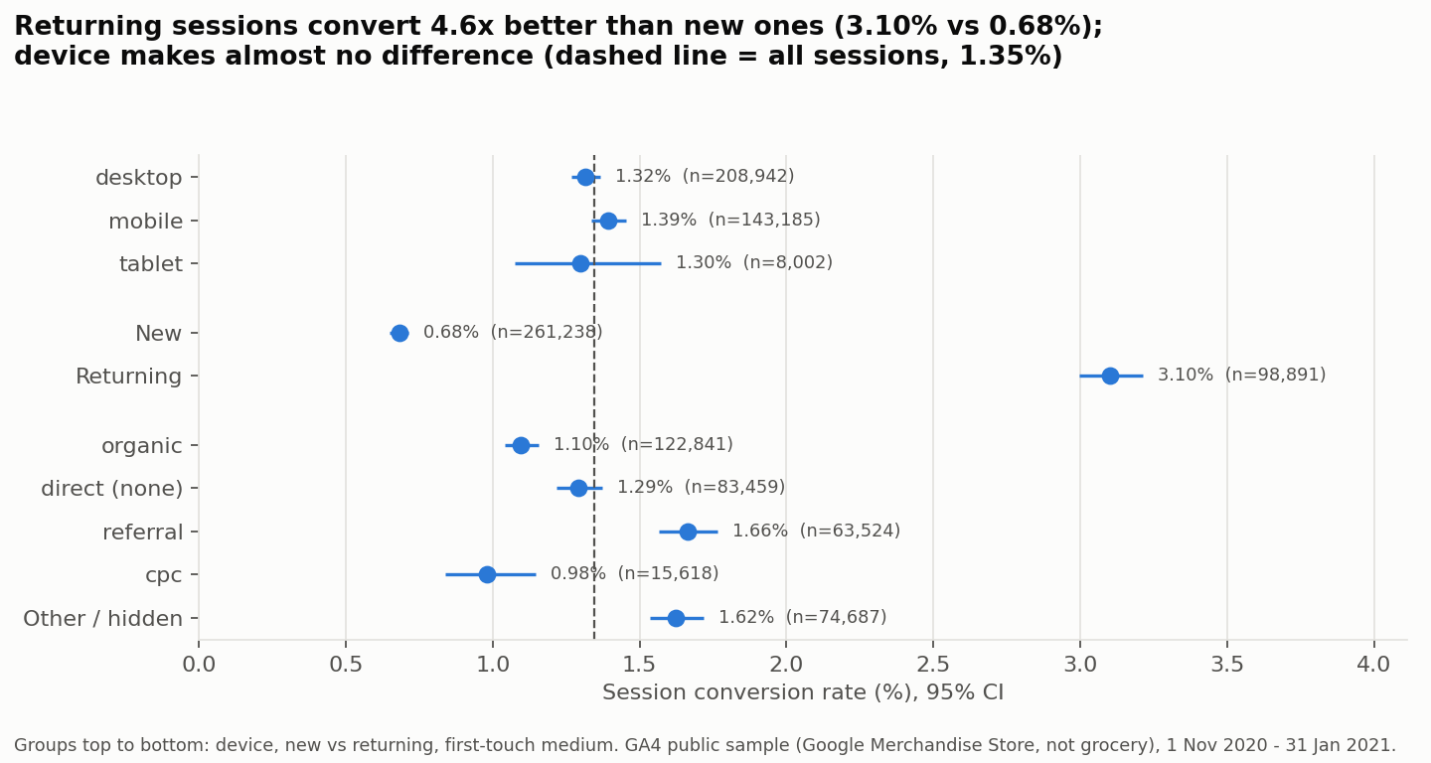
New users are the weak segment, not mobile
4.6×
Returning sessions convert at 3.10%, new ones at 0.68%
48%
of new users go from checkout to payment (returning: 83%)
≈ same
conversion on desktop, mobile and tablet (1.30–1.39%, p = 0.14)
Source: GA4 public sample (Google Merchandise Store), 360,129 sessions. Chi-square tests and Wilson 95% intervals.
Notes:
This links back to Module 1. Login complaints have the lowest ratings, and here first-time users lose more than half their sessions between checkout and payment, where they must sign in or create an account. Device was not the problem in this data.

Slide 7
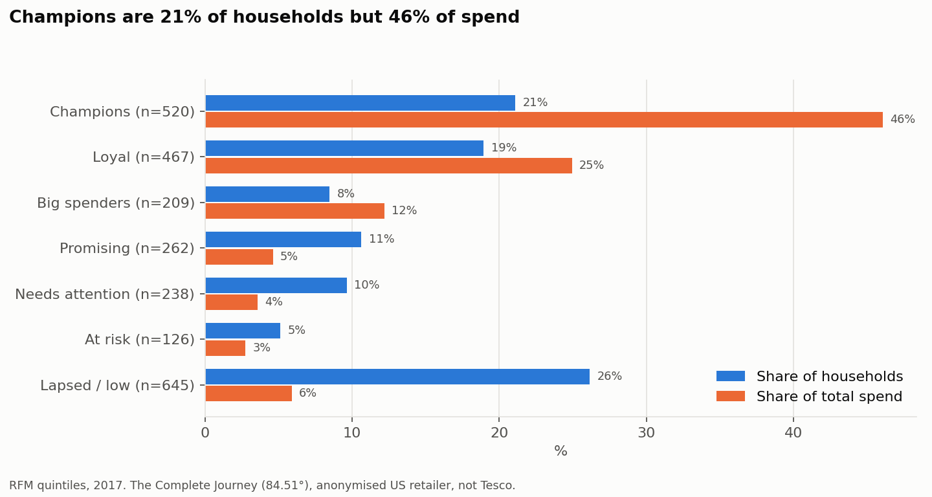
A fifth of households bring almost half of spend
21% → 46%
Champions: share of households → share of spend
40% → 71%
Champions and Loyal together
$66.51
basket value of Big spenders, who shop less often
Source: The Complete Journey (84.51° release), 2,467 households, 2017. Anonymised US grocer, not Tesco.
Notes:
RFM gives each household a 1 to 5 score for recency, frequency and spend, using quintiles. The score patterns map to seven named groups. A typical household shops every four days, with an average basket of $29.68.

Slide 8
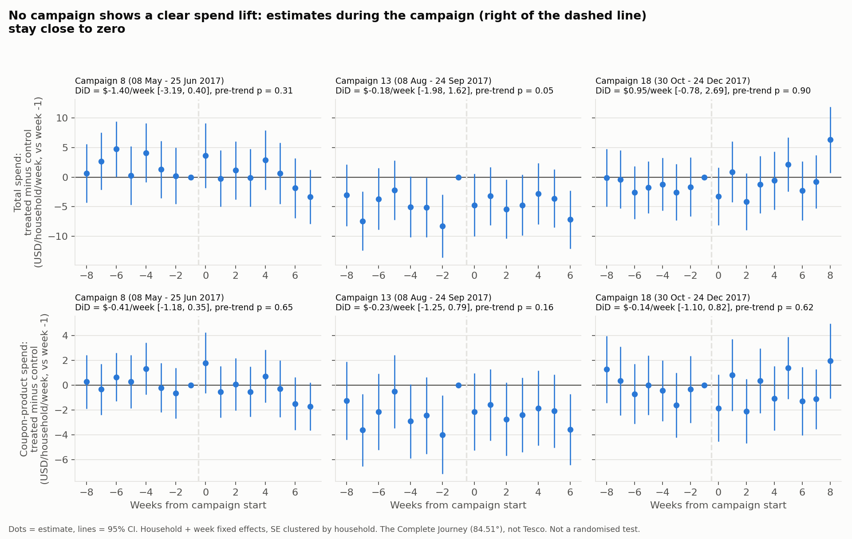
Broad campaigns did not measurably lift spend
0 of 6
estimates were significant (3 campaigns × 2 spend measures)
+$0.95
best case, per household per week (95% CI −0.78 to 2.69)
3×
targeted households already spent this much more before the campaigns
Difference-in-differences, household + week fixed effects, clustered SEs. Not randomised. The Complete Journey (84.51°), not Tesco.
Notes:
DiD compares how much the targeted group changed with how much a similar untargeted group changed. The key assumption is parallel trends. The left side of each panel checks it: it passes for campaigns 8 and 18 and is borderline for 13. A null result is still useful. It is the reason to add a random holdout group to future campaigns.

Slide 9
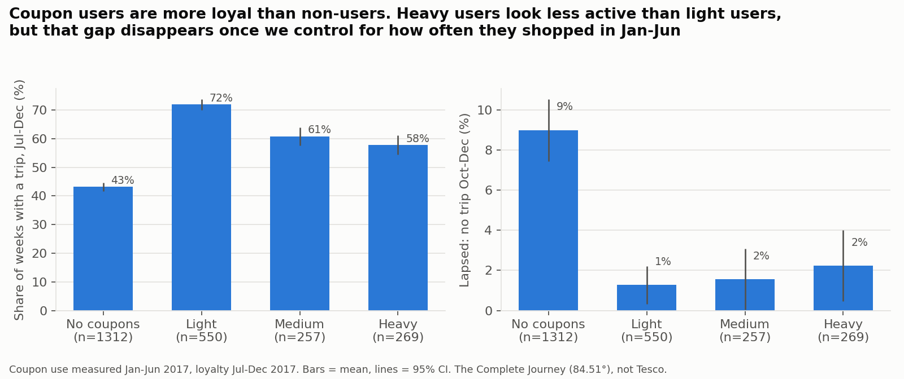
Coupon users are not less loyal
9% vs 1–2%
lapse rate: non-users vs coupon users
0.78
odds of lapsing for each +10 points of coupon use, after controls
The data changed my mind. My earlier project, on simulated data, found coupon users less loyal. On real data, that only looks true until you control for how often people shop.
Coupon use measured Jan–Jun 2017, loyalty Jul–Dec 2017. 2,388 households. The Complete Journey (84.51°). Association, not cause.
Notes:
Heavy coupon users first look less active than light users, but they also shopped less often in the first half. Coupon share is a ratio, so fewer trips push it up. Shopping frequency is the confounder. After controlling for it, more coupon use goes with slightly more loyalty.

Slide 10
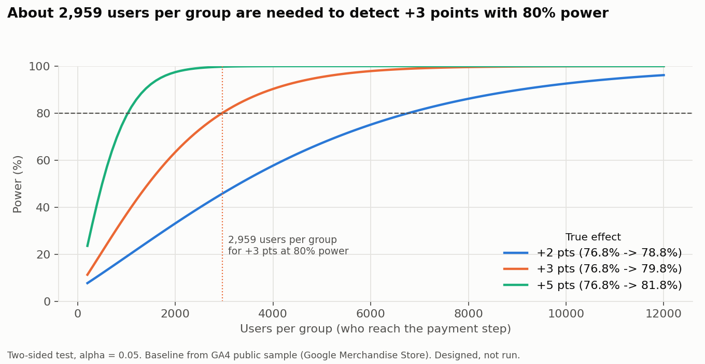
A designed test: one-tap wallet payment
Item | Plan
Change | Apple Pay / Google Pay on the payment page
Why | 11% of negative reviews; 29% drop at payment
Primary metric | Payment step → purchase (baseline 76.8%)
Unit | User, 50/50, analysed once they reach payment
Effect to detect | +3 points, alpha 0.05, power 80%
Sample size | 2,959 users per group
Guardrails | AOV, overall conversion, payment errors, speed
Designed, not run. Baseline from the GA4 public sample. Power calculation with statsmodels (Cohen’s h).
Notes:
Decision rules are set before the test: check the 50/50 split first, no peeking, ship only if the primary metric is significantly up and no guardrail is harmed. Analysing only users who reach the payment page matters: measuring all users would need about 631,000 per group instead of 2,959. A simulation of 2,000 tests with a true 3-point lift detected it 80.6% of the time, matching the plan.

Slide 11
What I would do next
# | Action | Evidence
1 | Make payment one tap | 11% of negative reviews; 29% drop at the payment step
2 | Stop forced log-outs | Login reviews average 1.65 stars; new users stall at checkout
3 | Speed up product lists and basket | App speed is the top complaint; view → cart is the biggest drop
4 | Reward top customers with service | Champions + Loyal = 71% of spend; broad campaigns showed no lift
5 | Add random holdouts to campaigns | Without them, campaign uplift cannot be measured cleanly
6 | Keep coupons, and target them | No sign that coupon use reduces loyalty
Priorities 1–3 come from reviews and the funnel; 4–6 from the transaction data. Each would be tested before a full rollout.
Notes:
The first action already has a full test plan from Module 4. Actions 2 and 3 are the other two hypotheses from Module 1, and each could get the same kind of test.

Slide 12
What this data can and cannot show
App reviews
GA4 sample
Self-selected and skewed negative. They show what kinds of problems exist, not how common they are.
Google Merchandise Store: real e-commerce data, but not grocery, obfuscated, and from a peak season.
The Complete Journey
A/B test
One anonymised US grocer in 2017 (84.51° release), not Tesco. Campaigns were not randomised.
Designed, not run. The only results shown are a labelled simulation of the analysis.
Every number in this deck comes from code that ran. Full method and code are in the project README.
Notes:
I would rather be clear about limits than overclaim. The methods, from the SQL funnel to RFM, difference-in-differences and the power calculation, would run the same way on a retailer’s own data.

