Slide 1
Driving Growth & Enterprise Value for <Client> in North America and Europe
Proposal for <Client>
March 2026

Slide 2
Case Study End Market Experience

Slide 3
Newry has broad experience across the semiconductor / electronics value chain, in a variety of topics relevant to <Client>’s business
PRIOR NEWRY EXPERIENCE ACROSS THE VALUE CHAIN
(Not Exhaustive)
Electronics Design & Architecture
Front-End Wafer Fabrication
Back-End Advanced Packaging
Board-Level Integration & Thermal Mgmt.
System-Level Integration
End Use
Co-packaged optics
Wafer carriers and handling
Organic and glass core substrates
Immersion cooling
Rack- and server-level architecture trends
Display technologies
Novel materials for capacitor design
High-purity gas for plasma etching
Glass interposers
Thermal interface materials
5G impact on consumer electronics
Advanced cooling architectures
Electronics adhesives (e.g., underfill, mold compound, etc.)
PCBs for MicroLED displays
Optical metasurfaces
Data center infrastructure and trends
Low-temp. semiconductors
Nanoimprint lithography
Advanced materials for power electronics (e.g., Si₃N₄, alumina)
… extensive experience in downstream uses
CMP equipment
MEMS sensors
Packaging for 5G mmWave (LTCC)

Slide 4
We believe there could be several vectors to drive growth for <Client>
 |  | Hypothesized Examples
Share Gain in Core Markets | Deepen relationships and expand share-of-wallet at existing customers via improved service levels, broader product forms, and spec-in support Target new accounts in high-growth end markets with favorable tailwinds (e.g., aerospace & defense, medical devices, space) Geographic expansion | Deepen penetration at existing OEM customers by expanding approved alloy specs and form factors (e.g., wire to preforms or PSPs at aerospace engine OEMs) Multi-year supply agreements / consignment inventory programs with precious metal price-pass-through to reduce friction Focused new customer acquisition in high-growth verticals (e.g., neuromodulation devices, solid-state battery cell joining) Channel management / optimization (e.g., Kay brazing seminar as demand-gen funnel) Partnerships to better serve high-growth geographies (e.g., mfg. JV or agent in India; deepen LOT-TEK partnership for EU growth)
New Product & Service Innovation | New alloy formulations or product forms to displace not-in-kind competition (e.g., active brazing alloys for ceramic-to-metal joining) Enhanced service offerings and new business models to capture value-based pricing (e.g., precious metal programs, scrap buy-back) Adjacent market expansion with existing or extended product portfolio (e.g., semicon packaging, defense electronics) | New alloy solutions to address evolving customer performance needs (e.g., Pb-free solder replacements, high-temp nickel alloys for next-gen turbines, biocompatible PGM alloys for implantable neuromodulation) Expansion of application development capability – e.g., expand engineering team, systematize co-development process, invest in brazing lab and prototyping services, leverage Kay brazing expertise as co-development platform Downstream technical support – e.g., on-site process optimization consulting, AI-enabled braze quality diagnostics
M&A and Strategic Partnerships | Targeted M&A to fill product, capability, and geographic gaps Expand into complementary engineered joining materials or precision fabricated forms Upstream or downstream integration to extend the value chain (precious metal supply, fabricated assemblies) | Geographic expansion via acquisition (e.g., European specialty brazing players; APAC precious metal fabricators in India or Japan) New technologies / capability acquisitions (e.g., thermal spray / PVD coating capabilities; advanced forming technologies) Strategic partnerships with complementary engineered materials suppliers (e.g., thermal interface, conductive adhesives, diffusion bonding) to offer bundled solutions and cross-sell to shared OEM customers; expand portfolio in similar areas Upstream precious metal supply integration or partnerships (e.g., with PGM refiner) Forward integration into precision fabricated assemblies (e.g., brazed subassemblies)
GROWTH LEVERS TO EXPLORE

Slide 5
We will work closely with <Client> to build a growth strategy and then execute to drive new revenue and enterprise value
Module 1:
Build Tactical Growth Strategy
Module 2:
Execute & Drive Growth
Approach Overview
Conduct individual interviews with <Client> leadership team followed by a project launch meeting to confirm project objectives and definition of success, review <Client>’s business, product lines, existing value creation plan, and technical capabilities, discuss existing knowledge and criteria for growth initiatives, and schedule biweekly updates
Launch an in-depth effort to build a growth strategy for <Client>:
Growth in Adjacent Markets in North America & Europe: Begin by engaging a subset of current and prospective customers to understand <Client>’s value proposition and explore potential opportunities for organic growth & innovation; then, conduct an extensive effort to identify new actionable applications where <Client> can win with existing products, slight tweaks to current formulations, or innovation & new product development; profile and prioritize opportunities based on the commercial attractiveness (TAM, growth, margins), tech fit, & <Client>’s right to win; build strategies to pursue the prioritized apps and drive sales including specific customers / partners to engage, CTQ specs, etc.
Strategic Portfolio Expansion: Based on opportunities prioritized in Part A, evaluate strategic moves in North America & Europe required to expand <Client>’s portfolio and tap new growth such as downstream integration (e.g., offering BMC, SMC, compounding), entering into new types of resins (e.g., epoxy, PUR, other thermosets), M&A (e.g., to add products, consolidate share), and others
Work with <Client> to prioritize growth initiatives for execution in Module 2
Work with <Client> to execute on the prioritized growth initiatives from Module 1:
Engage new customers, gauge their interest in <Client>’s offerings, determine requirements, provide samples, and generate sales for the top adjacent applications
Execute growth strategy, which may include finding and engaging M&A targets, working to launch a product line of SMC & BMC products, and other support
A
A
B
B
~4 months
~9 months

Slide 6
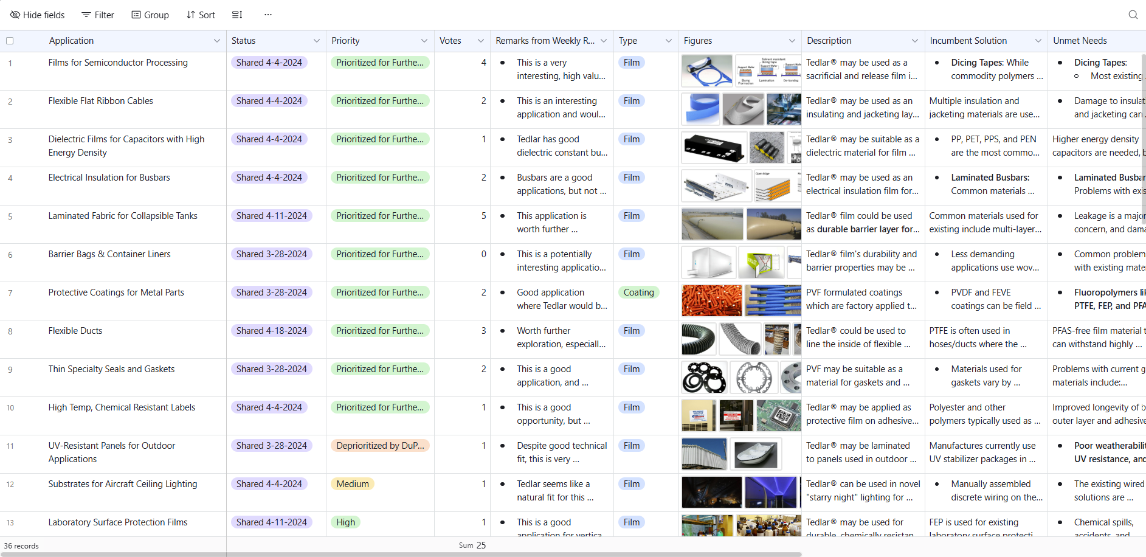
We will identify adjacent applications where <Client> has a right to win to drive profitable growth
Module 1:
Build Tactical Growth Strategy
Module 2:
Execute & Drive Growth
A
Growth in Adjacent Markets in North America & Europe
The goal is to identify new actionable applications where <Client> can win with either existing products, slight tweaks to current formulations, or innovation & new product development
We will begin by engaging a subset of current and prospective customers to understand <Client>’s value proposition and explore potential opportunities for organic growth & innovation
We will then conduct extensive secondary research and engage with additional customers and industry experts in North America & Europe to identify applications in growing areas (e.g., utility grid hardware, data centers, telecom, etc.); we will also evaluate <Client>’s existing innovation pipeline and identify additional innovation opportunities
Each application will be profiled, including:
Commercial attractiveness (TAM, growth, margins)
Incumbent solutions
Unmet customer needs
Technical fit with <Client>’s products and capabilities
<Client>’s right to win
Then, we will prioritize applications and build strategies to pursue each, including specific customers / partners to engage, CTQ specifications required by customers, and value propositions <Client> must provide to win
Example of applications profiled during Module 1 from a previous Newry project
Newry Approach to Growth in Europe
Most of Newry’s clients operate globally, and we have frequent experience working with European customers
To uncover opportunities in Europe, we will leverage our global network of chemicals & materials contacts, attend JEC and other conferences in the EU, investigate key European trends and market shifts, tap expert networks, and other sources

Slide 7
Newry will map the full application landscape, assess competing technologies, and build a bottom-up market model through 2034
Uncover the Market & Technology Landscape
Assess the Value Chain
Build the Growth Strategy
MARKET & TECHNOLOGY LANDSCAPE
Map applications, performance metrics, and qualification standards across EV, data center / AI, 5G / telecom, consumer electronics, industrial electronics, and emerging end markets
Assess competing capacitor technologies on performance, cost, scalability, and regulatory / ESG factors
Construct a 5 – 10-year technology roadmap with maturity and sector adoption probabilities, using patents, R&D disclosures, and conference intelligence
Build a bottom-up market model – device volumes × penetration × ASP – producing volume and value forecasts through 2034
Assess market potential and risks – saturation, commoditization, reduced innovation need, and enabling / limiting factors that shape long-term relevance
METHODOLOGY / EXAMPLE SOURCES
Primary Research
Expert interviews: design engineers, procurement leads, capacitor product managers, polymer chemists, etc.
Supplier conversations with technical and commercial stakeholders where accessible
Conference & trade intelligence: ICCPEA, ECTC, other passive components forums or relevant end use market conferences
Secondary Research
Patents: USPTO, EPO, J-PlatPat (R&D trajectory, technology differentiation)
Company disclosures: annual reports, investor decks, earnings transcripts
Technical literature: IEEE Xplore, Journal of Material Chemistry C, Advanced Functional Materials, Polymer Engineering & Science
Market data: IHS Markit, IDC, Paumanok Group, distributor pricing for ASP triangulation
Regulatory & standards: IPC, JEDEC, AEC-Q200; RoHS / REACH compliance

Slide 8
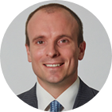
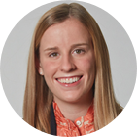
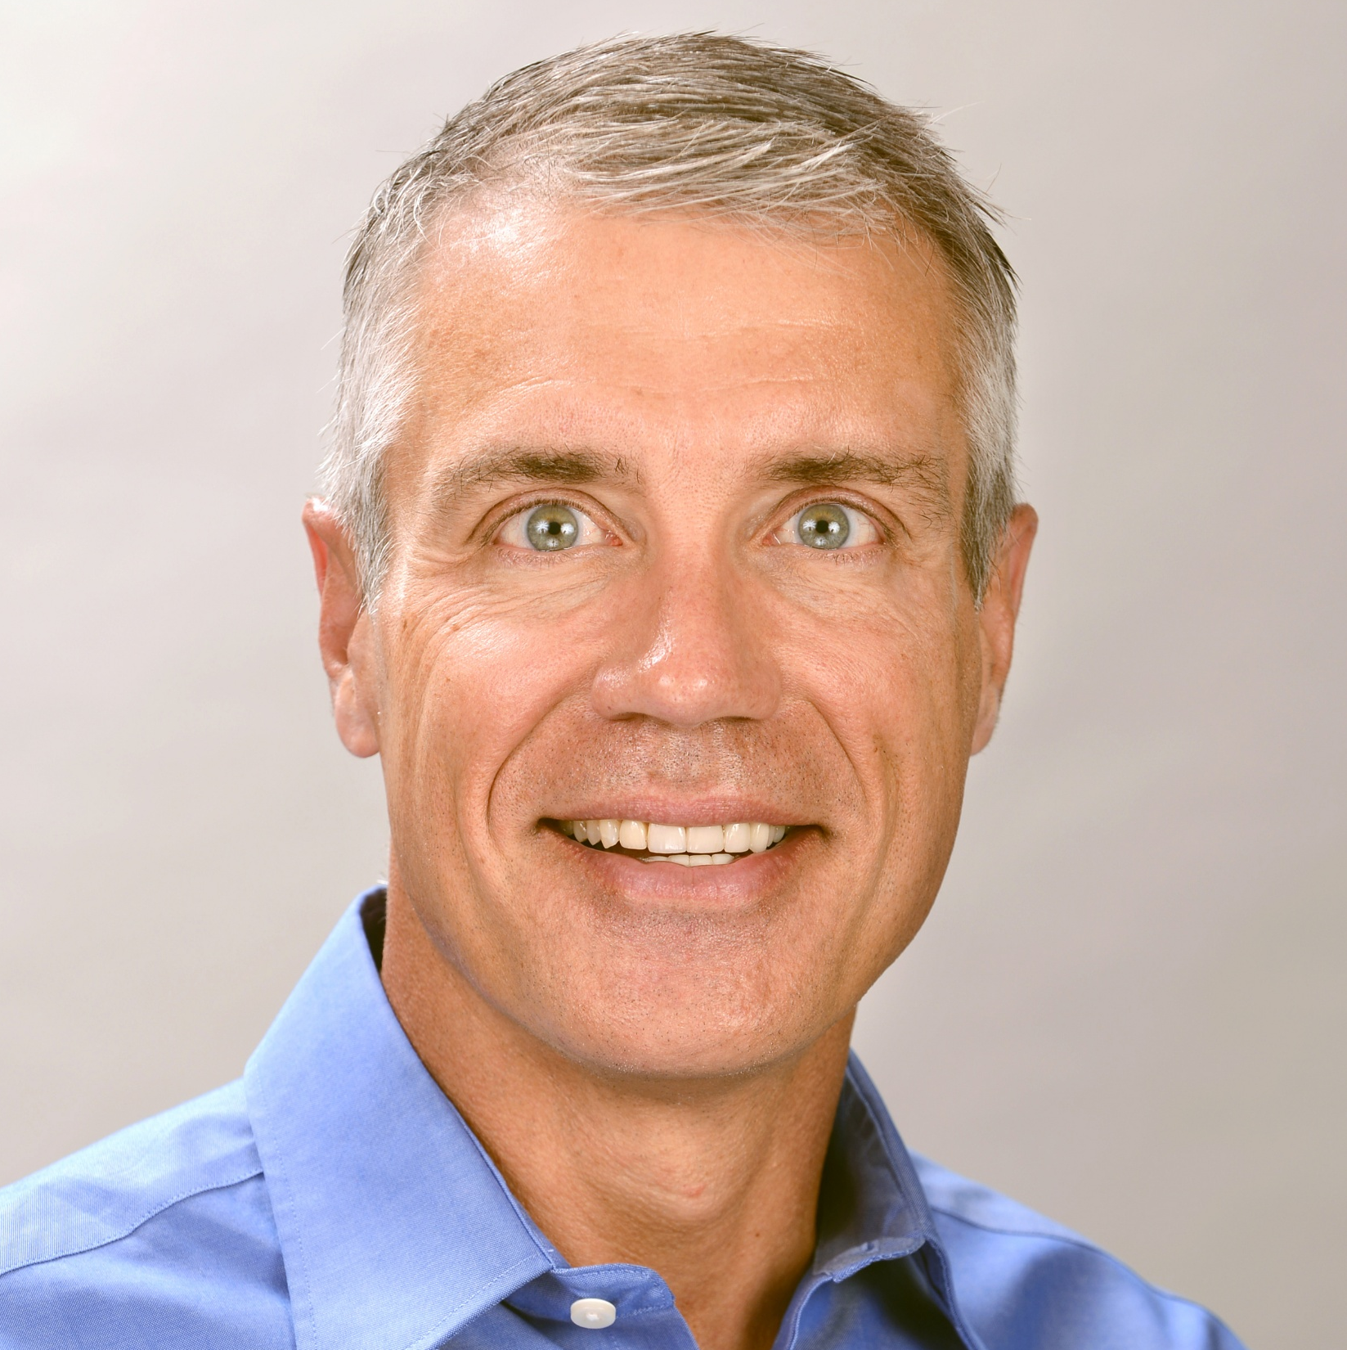
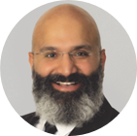

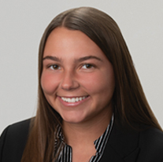
We will field a team experienced in composites that will partner closely with <Client> throughout the effort
Newry Team
Note: Project Manager & Consultant subject to change based on launch date
David Wylie
Vice President, Project Director
13 yrs at Newry driving growth for B2B material cos.
Strong expertise in composites and thermoset resins, their markets, and applications
Leads Growth Practice; led multiple growth execution efforts for PE-backed portcos
Kasey Correnti
Vice President, Project Advisor
10 yrs at Newry driving growth & innovation for B2B specialty material companies
Broad experience in many end markets including data centers, energy, building & construction, life sciences, medical, etc.
Dwight Baker
Senior Project Advisor
33-year composites industry veteran
Strong track record of diversifying composites companies into emerging end-use markets and differentiated product/service offerings
Former VP at Composites One; also held leadership roles at Owens Corning & Ashland
Krishna Nookala
Vice President, Business Development
20 yrs technical sales experience
Will support opportunity evaluation, lead generation, customer engagement, and insight development and delivery
Anna Jaffe
Project Manager
Significant experience in composites & polymers for multiple applications
Former Avient
Isabel Anness
Consultant
Strong experience in B2B marketing and analysis
Former Accenture

Slide 9

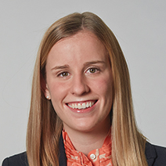
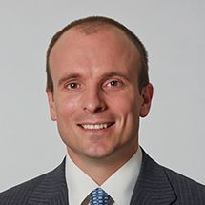
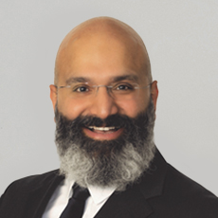
Kasey Correnti
Vice President
komalley@newrycorp.com
David Wylie
Vice President
dwylie@newrycorp.com
Krishna Nookala
Vice President, Sales
knookala@newrycorp.com
<Client> CONFIDENTIAL INFORMATION: This document may not be disclosed to anyone other than employees of <Client> Performance Materials, <Sponsor>, or Newry. If this document is found by any other party, please do not read or copy any information therein, and please call (440) 808-3839 to arrange for its return.

