Slide 1
While early-stage, precision and cultivated proteins are poised for rapid growth
Market Sizing and Segmentation
GLOBAL ALT PROTEIN MARKET SIZE, 2020 – 2030
Billions of USD
Notes
Many plant-based protein categories are well-established (e.g., nut milks) and will continue to make up the bulk of the market for the foreseeable future
Proteins from fermentation and tissue cultivation are expected to grow at a faster rate (although there is some debate about growth rates given remaining technical and regulatory challenges)
$181.9
Cultivated Protein +80%
Precision Protein +37%
+24%
Plant-based Protein +21%
$58.9
$3.9
$1.0
$21.3
$0.8
$0.1
2020
2025
2030
Source: Newry analysis (moderate growth scenario)
Notes:
CORB01 Food Sustainability Report 2022
Commentary: Nice way to include segment-specific CAGRs; the dollar signs on the chart labels are unnecessary though

Slide 2
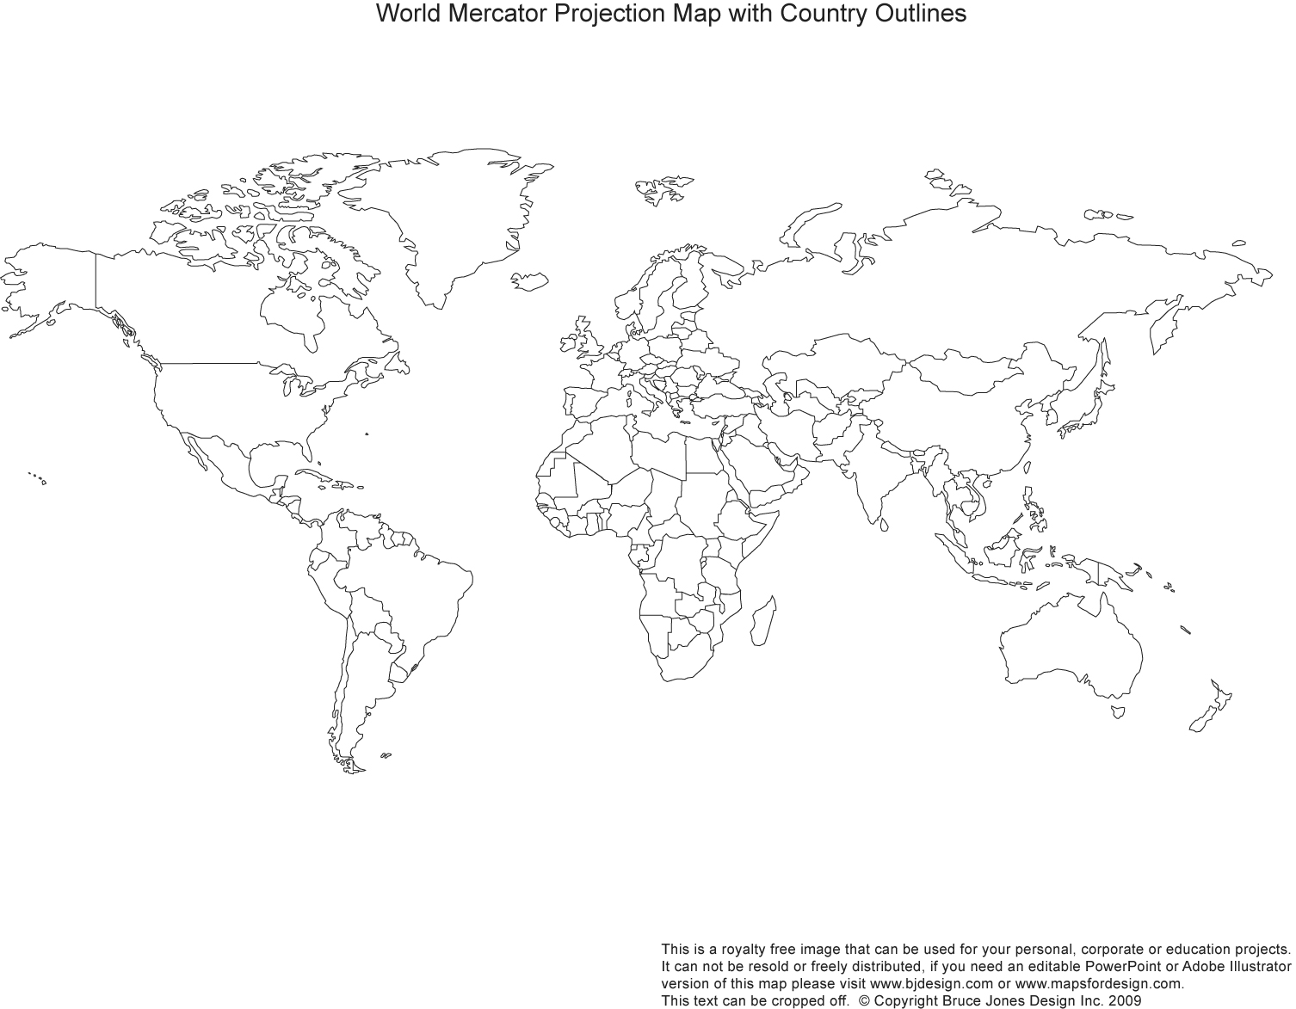
The global mkt. is ~10,000 reactors with >80% of demand from China and India
REGIONAL BATCH REACTOR MARKET SIZE ESTIMATES, 2017
Market Sizing by Geography
Growing
Europe
~550 Units
~6,000 Units
~325 Units
China
Zero Growth
North America
~2,550 Units
~850 Units
India
Rest of World
Shrinking
“Western markets have declined significantly… India may have a 7% growth rate… China growth was phenomenally high over the last 15 years but has probably tailed off a little in the last five years.”
– Andrew Wills, CEO, Pfaudler (former)
Source: <>
Notes:
COR489 AFR 2018
Commentary: Unusual and effective – if imprecise – visualization (the bubble sizes are eyeballed); the original slide included three quotes expressing that the market had stagnated in NA and EU but was growing in China, but one suffices. Missing sourcing.

Slide 3
WTMD systems are sold into a variety of market segments
Market Sizing and Segmentation
WTMD SALES BY MARKET SEGMENT
Millions of USD
Education ~23%
Other includes Hotel / Lodging and other smaller-scale public assembly buildings (museums, exhibition centers, etc.)
Public Assembly ~37%
Public Order & Safety ~21%
Government Bldgs ~5%
Airport
Large Stadium/ Facility
Train Station
Subway Station
Education
Courthouses
Police Stations
Other
Army
Gov’t Departments
Source: QY Market Research
Notes:
DUP31 Smart Wall Firearm Detection
Commentary: Not sure whether this is the most efficient way to visualize the segmentation here, but it’s definitely easier to read than one big stacked bar

Slide 4
Mask / stamp creation and pattern transfer strongly influence fabrication costs
Value Chain – Industry Commentary
FABRICATION PROCESS FLOW OVERVIEW FOR DUV AND NIL
Make Photomask or Master Stamp
Wafer Preparation
Pattern Transfer
Quality Inspection
Writing
Inspection
Inspection
Cleaning
Layering
Litho / Imprint
Etch
ALD / CVD
Metrology
Testing
Certain designs will require variations throughout the process flow to achieve the desired specifications
The cost implications of variations in wafer preparation and quality inspection are minimal relative to mask / master creation and pattern transfer
“One of the most expensive things with NIL is the master fabrication. It’s likely #1 on our BOM cost. Second is etching."
– Advanced Manufacturing, Engineering Manager, Meta
"Mask cost for DUV and NIL can vary quite dramatically depending on the feature size, pillar specs and geometry, and field size."
– Lloyd Litt, Independent Consultant
"More etching steps means more expense."
– Adam Schwartzberg, Lawrence Berkeley National Laboratory
Notes:
COR 622 Metasurface Fabrication 2022
Commentary: Nothing groundbreaking but seems like a common slide type that might come up often; title for the graphic should be more explicit about what the audience should focus on (e.g., Cost Drivers for DUV and NIL Fabrication)

Slide 5
The most promising application for Phyllo / Willow® is for Space PV
Target Market Selection
PHYLLO / WILLOW® APPLICATIONS
Pursue | Investigate Further | Deprioritize
Application | Recommendations
Space PV | Addressable market of 4 – 5k m² of Ce-doped glass and rising, potentially worth $12M – $30M Glass supply remains tight as commercial small satellite constellations scale up; customers are looking for additional glass suppliers and eager to engage with Corning
Optical Filters | Opportunity for clear, thin glass appears to be ~10,000 m²; however, additional interviews are needed to understand tradeoffs between the thickness of coatings and thinness of glass
Specialty PV | CdTe: Non-utility market leader (Toledo Solar) is interested in thinner glass, and is ready to meet with Corning to share specifics; Schott D263T 100 µm and Willow 200 µm have been tested at lab level
Spec PV: CIGS | CIGS: Industry is interested in ultra-thin glass but may have unreasonable technical needs
Spec PV: Perovs | Perovskites: Critical barrier layer performance is needed, but large-scale manufacturing is 5+ years out
Transparent Heaters | Thin glass transparent heaters will compete with commodity acrylics, polycarbs, and wire mesh products
Microscope Coverslips | Corning unable to compete on cost
Microfluidics | Majority of market is polymers; glass used is thicker (1mm); Schott D263M used for bonding
Semicon Wafer | Corning Precision Glass already active in market

