Slide 1

InclickNews
DEPARTMENT OF COMPUTER ENGINEERING AND APPLICATIONS
Institute Of Engineering and Technology
GLA University
Mathura-281406
2020
Presented By:
Siddharth Rai (I) 181500709
Mansi Verma (B) 181500372
Tanya Goyal (E) 181500754

Slide 2
CONTENT
01
02
03
04
Introduction
Working (User's Panel, Admin's Panel)
Technologies Used
Advantages

Slide 3
INTRODUCTION
The name of our website is InclickNews.
It is a News Website, Where the user can read the short version of the news.
The news will be updated approx every hour.

Slide 4
WORKING
(User's Panel)

Slide 5
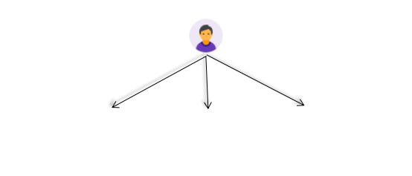
WORKING
(User's Panel)
User can read news from any category.
User can search the news.
It enables the user to send feedback.
Read News
Search
Send Feedback

Slide 6
WORKING
(Admin's Panel)

Slide 7

WORKING
(Admin's Panel)
It contains a dashboard which helps admin to know how many news they have published.
It enables the Admin to add, edit , delete categories .
It enables the Admin to publish their own news/articles.
It enables the Admin to view and delete the feedback provided by the users.
News
Categories
Feedback
Add
Edit
Delete
Add
Edit
Delete
Delete

Slide 8
Technologies Used
HTML
HTML describes the structure of a Web page.
HTML elements tell the browser how to display the content of the webpage.
Hyper Text Markup Language

Slide 9
Technologies Used
CSS
CSS is a way to style HTML, Whereas html is the content, the style sheet is the presentation of that document.
Cascading Style Sheets

Slide 10
Technologies Used
PHP
Hypertext Preprocessor
PHP can generate dynamic page content.
PHP can create, open, read, write, delete, and close files on the server.
PHP can collect form data.
PHP can add, delete, modify data in database.

Slide 11
Technologies Used
MySQL
Structured Query Language
MySQL is released under an open-source license. So we have nothing to pay to use it.
SQL is a standard language for storing, manipulating and retrieving data in databases.
MySQL works on many operating systems and with many languages including PHP, PERL, C, C++, JAVA, etc.

Slide 12
ADVANTAGES
The user does not need to do any installation to use Inclick.
Its name defines itself, user can read the news in a click.
It’s free, unlike buying newspapers which can cost.

Slide 13
THANK YOU!!

