Slide 1

Career Coaching Center
Career Coaching Center
YGN, MDY, SG,THAI
“It is not the mountain we conquer but ourselves.”

Slide 2
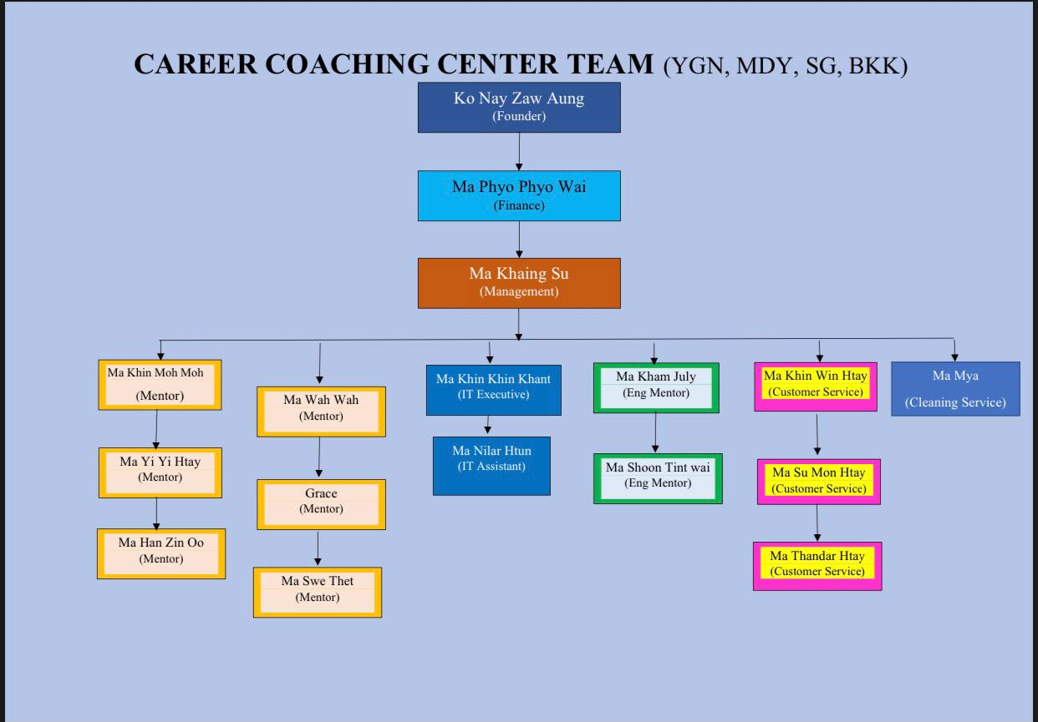

Slide 3
Agenda for 5 Days Lecture
Day 1 : Resume and Cover Letter Edition
Day 2 : Introducing Websites Platforms and
Day 3 : Job Hunting Skill
Day 4 ; How to send emails correctly, How to reply emails & which online applications are prepared
Day 5 : How to fill Application Form and S Pass Form, and SAT Check & Status Check & Sharing Knowledge about Singapore and Testing exam how much you absorb during 5 days

Slide 4
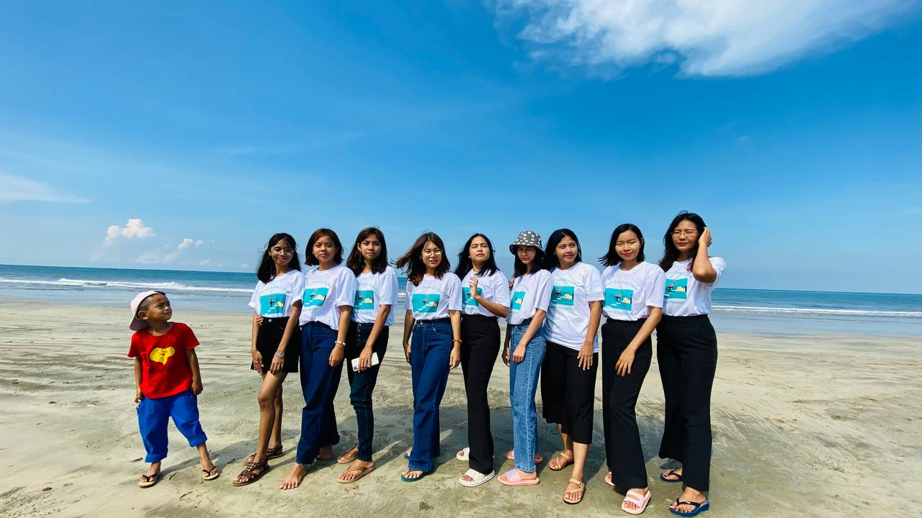
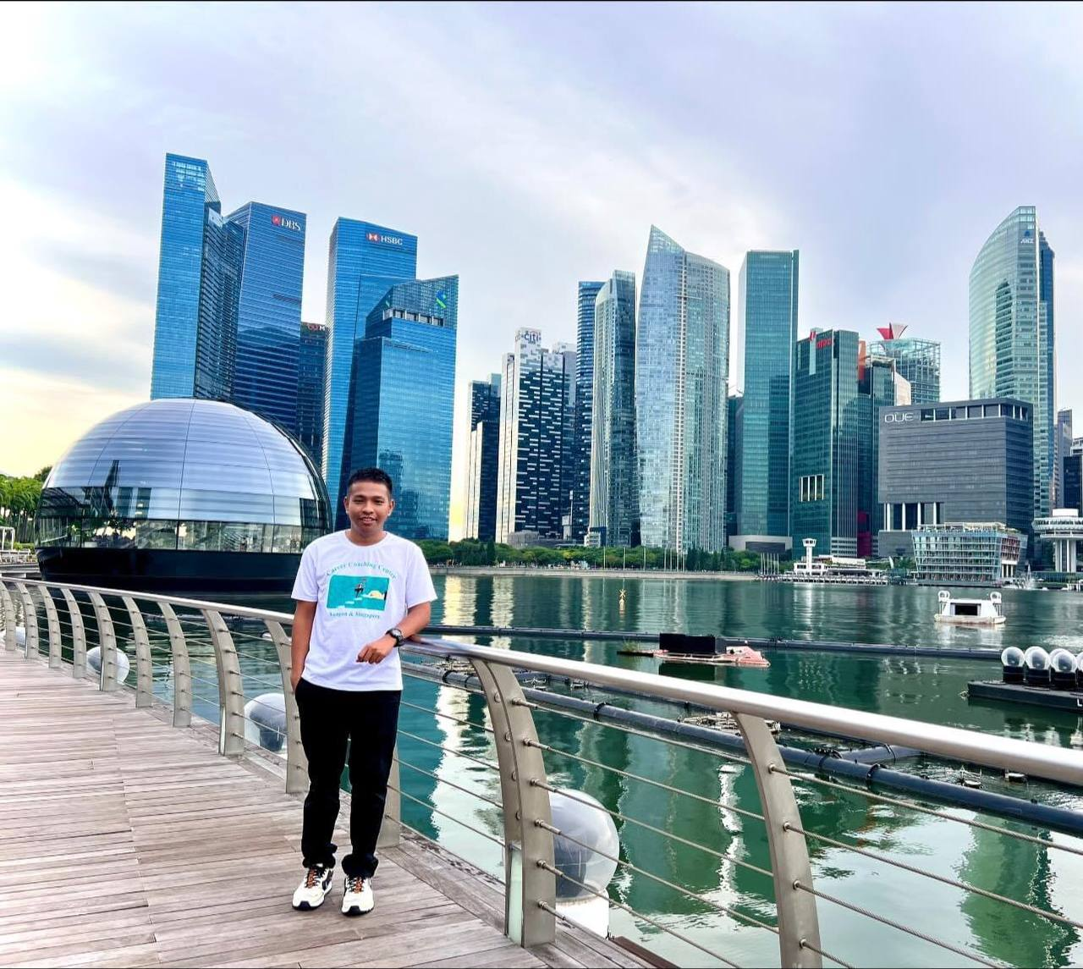
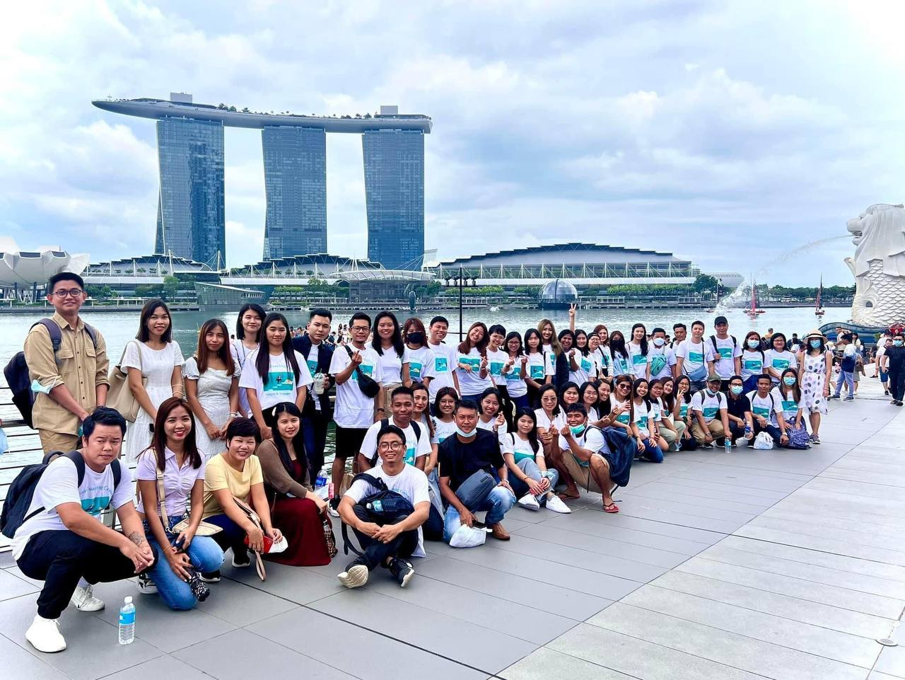
Thank you for joining with us!

