Slide 1
宏观经济学
Macroeconomics
第一章 宏观经济学的基本指标及其衡量
第3节 失业及其衡量
I (Zhiqing Yang yangzhiqing@hust.edu.cn)

Slide 2
本节要解决以下问题
如何衡量经济中的失业？
什么是“自然失业率”？
为什么总有些人是失业者？
工会和最低工资法如何影响失业？
什么是效率工资理论？它又是如何帮助我们解释失业？

Slide 3
劳动力数据
0
由美国劳工部劳工统计局调查统计
数据来自于6万个家庭的定期调查
调查家庭中的“成年人”（16岁及以上）
Notes:
Students may recall that the BLS also produces the CPI statistics.

Slide 4
劳动力数据
0
劳工统计局（ BLS ）把受调查家庭中的成年人分为三个类别：
  就业者： 包括作为得到报酬的员工而工作的人，在自己的企业里工作且得到报酬的人，以及在家族企业里工作但拿不到报酬的人
  失业者： 包括能够工作且在之前4周内努力找工作但没有找到工作的人
  非劳动力： 不属于前两个类别的人
劳动力 定义为就业者和失业者之和
Notes:
Good idea:
Tell students to take good notes on this slide and the following one, because in a moment they will have to use these definitions to solve a problem. You can tell them the problem is very similar to what they might see on their next exam – that always gets their attention!

Slide 5
劳动力数据
0
失业率：
失业者占劳动力的百分比
失业率
= 100 x
失业者人数
劳动力
劳动力参工率：
劳动力占成年人口的百分比
劳动力参工率
= 100 x
劳动力
成年人口
Notes:
Many of the following slides abbreviate “unemployment rate” as “u-rate” to reduce slide clutter and to reduce the note-taking burden on students.

Slide 6
主动学习 1
计算劳动力数据
用以下数据计算劳动力，失业率， 成年人口和劳动力参工率
美国成年人口的分类：2008.6
就业者 | 1.459 亿
失业者 | 8.5 百万
非劳动力 | 79.20 百万
Notes:
This exercise gives students immediate reinforcement and application of the concepts on the preceding slides. It prepares them for some of the kinds of questions they might see on your exam. And it gives them a sense of the actual magnitude of these statistics in the U.S. in a recent month.
Suggestion: Before lecturing on this chapter, update the numbers in this table (and in the answers that follow) using the latest available data, which you can find here:
Data source: Bureau of Labor Statistics, U.S. Department of Labor
http://www.bls.gov, look for latest “Employment Situation Survey”

Slide 7
主动学习 1
参考答案
劳动力 = 就业者 + 失业者 = 1.459 + 0.085
= 1.544 亿
失业率 = 100 x (失业者人数)/(劳动力)
= 100 x 8.5/154.4
= 5.5%
Notes:
Your students may get slightly different answers due to rounding differences.

Slide 8
主动学习 1
参考答案
成年人口 = 劳动力 + 非劳动力
= 154.4 + 79.2
= 233.6 百万
劳动力参工率 = 100 x (劳动力)/(成年人口)
= 100 x 154.4/233.6
= 66.1%
Notes:
Your students may get slightly different answers due to rounding differences.

Slide 9
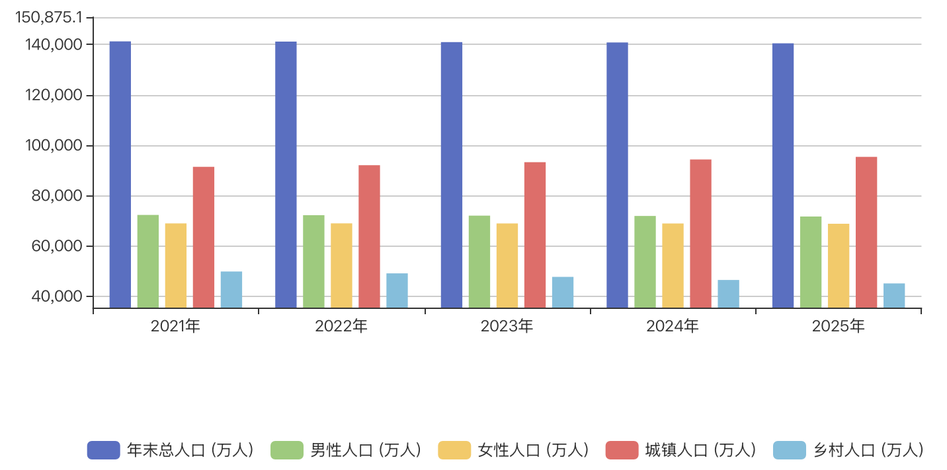
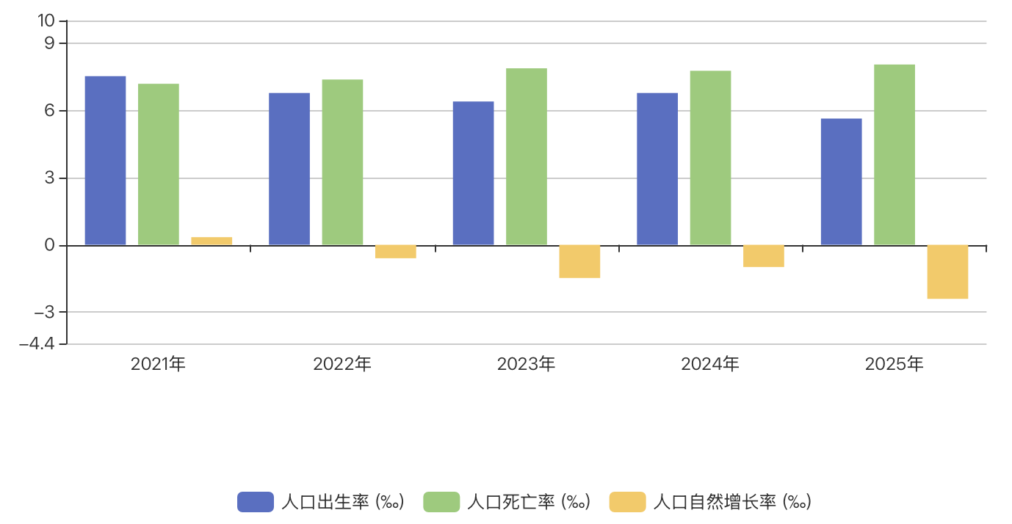
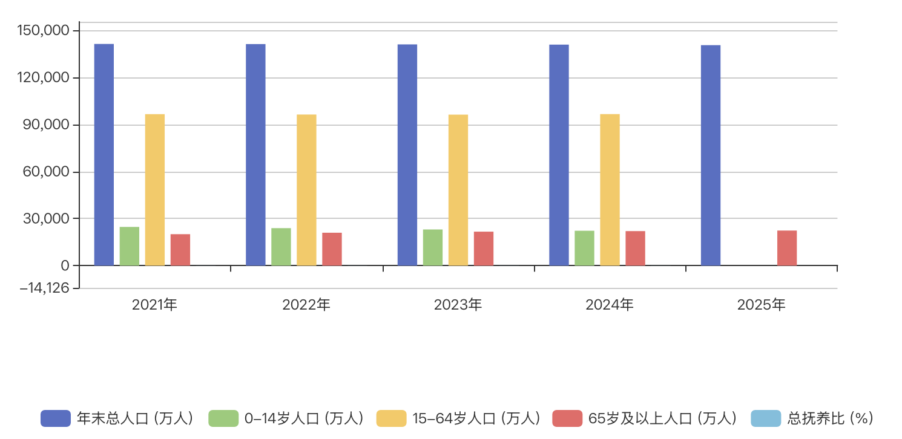
中国人口数据（ 2021-2025年）
图1 2021-2025年各年年末总人口
图2 人口出生率和自然增长率
图3 各年龄段人口情况

Slide 10
不同人口群体的劳动力市场数据
0
劳工统计局统计了这些人口群体数据
这些数据揭示了不同人口群体的劳动市场经历
Notes:
If you need to get through this chapter more quickly, you might consider omitting some of the following slides. However, I recommend that you keep the slide showing unemployment rates by education level – it is excellent motivation for students to complete their degree program!

Slide 11
白人与黑人的劳动力市场数据：2008年6月
0
成年人 (20 岁及以上)
 | 失业率 | 劳动力参工率
白人，男性 | 4.5% | 76.1%
白人，女性 | 4.2 | 60.4
黑人，男性 | 9.3 | 71.5
黑人，女性 | 7.4 | 64.3
Notes:
Within either racial group, males have higher participation rates than females.
Blacks have far higher unemployment rates than whites. This is of great concern to many economists and policymakers.
Source: Bureau of Labor Statistics, U.S. Department of Labor
www.bls.gov, look for latest “employment situation”

Slide 12
白人与黑人的劳动力市场数据：2008年6月
0
青少年 (16-19岁)
 | 失业率 | 劳动力参工率
白人 | 16.6 | 43.9
黑人 | 29.6 | 27.9
Notes:
As one would expect, teens have lower participation rates and higher unemployment rates than adults. What is striking, though, are the racial disparities: the proportion of white teens in the labor force, getting skills and experience that will help them later as adult job market participants, is far higher than the black teen participation rate. And the unemployment rate for black teens is far higher than for white teens.
Source: Bureau of Labor Statistics, U.S. Department of Labor
www.bls.gov, look for latest “employment situation”

Slide 13
其他群体的劳动力市场数据：2008年6月
0
所有年龄
 | 失业率 | 劳动力参工率
亚洲 | 4.5 | 67.4
西班牙 | 7.7 | 69.0
Notes:
Compared to the national average, unemployment is higher for Hispanics and lower for Asians. The participation rates of these groups are similar to the national average.
Note: Asian is the only demographic group for which seasonally adjusted data were not available. The figures for all other groups are seasonally adjusted. (The seasonal adjustments seem to make relatively little difference in most months.)
Source: Bureau of Labor Statistics, U.S. Department of Labor
www.bls.gov, look for latest “employment situation”

Slide 14
不同受教育程度的劳动力市场数据：2008年6月
0
成年人 (25 岁及以上)
 | 失业率 | 劳动力参工率
未上高中 | 8.7% | 45.9%
高中文凭 | 5.1 | 62.8
学士学位 | 4.2 | 71.9
高于学士学位 | 2.3 | 78.1
Notes:
These statistics, not in the textbook, are particularly interesting to college students.
It shouldn’t be surprising that educational attainment is positively related to labor force participation: for most people, the prospect of better jobs is a key reason for investing in education.
Your students may be especially happy to learn that, by getting a bachelor’s degree, they reduce their chances of becoming unemployed by more than half, compared to people with a high school diploma, and by about half compared to people who don’t finish college.
Source: Bureau of Labor Statistics, U.S. Department of Labor
www.bls.gov, look for latest “employment situation”

Slide 15
男性与女性的劳动力参工率，1950-2007年
0
男性
女性
Notes:
This chapter of the textbook contains an “In the News” with a recent New York Times article by economist Alan Krueger on the rise of the male non-worker.
The male LF participation rate is males in the labor force as a percentage of all males. Similarly for females.
I started the vertical axis at 20 rather than 0 to make the trends more apparent.
Since 1950, female participation has nearly doubled – from 34% to 60%. Male participation has declined from 86% to 73%.
If you can spare a few minutes for class discussion, ask your students two questions:
1) What factors do you think have caused these trends? The textbook offers some explanations; see the Case Study entitled “Labor Force Participation of Men and Women in the U.S. Economy.”
2) What are some of the effects or consequences of these trends?
Source: Same as textbook.

Slide 16
主动学习 2
失业率的局限
下述情形会如何影响失业率？失业率准确地描述了劳动力市场的状况吗？
A. Sue失去工作并开始寻找新工作
B. 去年Jon因钢厂倒闭失去工作，之后他丧失信心并放弃寻找新工作
C. Sam是他五口之家中唯一挣钱的人。不久前，他失去了一份年薪8万美元的研究工作。但很快他在麦当劳找到一份兼职工作，一直做到他在原先的研究领域找到另外一份工作为止
Notes:
The objective of this exercise is to lead students to discover why the unemployment rate is not a perfect indicator of joblessness.
It might be helpful to tell students to determine the impact on the u-rate – no matter how tiny. I.e., if one person becomes unemployed, the u-rate will rise – ignore the fact that, if this happened in the real world, the increase in the aggregate u-rate would be too small to matter.

Slide 17
主动学习 2
参考答案
A. Sue失去工作并开始寻找新工作
失业率上升
失业率上升使人觉得劳动力市场正在恶化。事实上，正是如此

Slide 18
主动学习 2
参考答案
B. 去年Jon因钢厂倒闭失去工作，之后他丧失信心并放弃寻找新工作
丧失信心的工人
  想工作但已放弃寻找工作的人
  属于“非劳动力”而不是“失业者”
失业率下降因为Jon不再是失业者
失业率下降使人觉得劳动力市场正在改善。但事实上，并非如此。

Slide 19
主动学习 2
参考答案
C. Sam是他五口之家中唯一挣钱的人。不久前，他失去了一份年薪8万美元的研究工作。但很快他在麦当劳找到一份兼职工作，一直做到他在原先的研究领域找到另外一份工作为止
失业率没有发生变化，因为一个人无论是做全职还是兼职工作都被视作“就业者”
事情变得越来越糟，但失业率并没有反映该状况

Slide 20
失业率真的衡量什么？
0
失业率并不是衡量失业或劳动力市场健康状况的完美指标：
  它将丧失信心的工人排除在外
  它没有区分全职工作和兼职工作，或者人们只是因为找不到全职工作才去做兼职
  在劳工统计局调查时，一些人并没有如实报告自己的工作状况
尽管存在这些问题，失业率仍然是劳动力市场和经济的一个非常有用的晴雨表
Notes:
If you choose to skip the preceding exercise, you’ll need to give students a definition of the term “discouraged worker.”
This slide recaps the lessons from the preceding exercise and mentions an additional point from the text: people may misreport their labor market status to the BLS, perhaps because they think it will help them get public assistance. This also makes the unemployment rate a bit less accurate.
You might remind students that, in earlier chapters, we learned that other macroeconomic indicators were imperfect: GDP is an imperfect indicator of society’s well-being, and the CPI tends to overstate increases in the cost of living. Yet, the unemployment rate remains highly useful. For example, when the unemployment rate rises, it is almost always true that things are getting worse in the labor market.
The BLS computes other measures of joblessness, such as (unemployed plus discouraged workers) as a percentage of (the labor force plus discouraged workers). For more details, refer your students to Table 2 in this chapter of the textbook.

Slide 21
失业的持续时间
0
大多数失业的持续时间很短：
  一般1/3失业者的失业在5周内结束，2/3失业者的失业在14周内结束
  只有20%失业者的失业超过6个月
然而，观察到的大多数失业却是长期的
  长期失业的小群体几乎没有变化，因此它在观察时间之内的失业中占了大部分比例
知道这些事实能帮助政策制定者制定更好的帮助失业者的政策
Notes:
The data under the first bullet point come from the BLS (www.bls.gov), the employment situation survey.
Some students think the two facts on this slide contradict each other. The book gives a simple example that helps students understand how these facts can both be true.
These facts imply that economists and policymakers must be careful when interpreting data on unemployment and designing policies to help the unemployed.

Slide 22
周期性失业与自然失业率
0
尽管每年的失业率一直在变化，但总是有失业存在
自然失业率
  失业率围绕它而波动的正常失业率
周期性失业
  失业率对自然失业率的背离
  这和商业周期有关，我们在接下来的章节中将学习这些内容
Notes:
Unemployment is a serious and complicated problem with a variety of causes. To most effectively address such a problem, we need to break it down and look at each cause separately.
We begin by noting that the causes of short-run fluctuations in unemployment are different than the causes of the long-run average unemployment rate, called the “natural rate of unemployment.”
The next slide shows U.S. data on both since 1960.

Slide 23
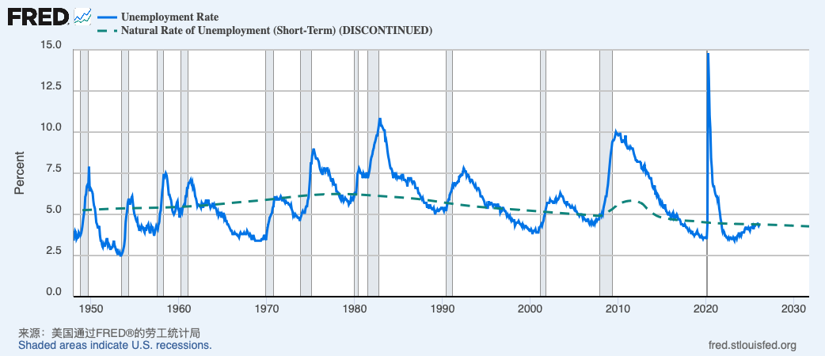
美国的失业

Slide 24
对自然失业率的解释：一个概述
0
即使经济状况很好，失业总是存在，包括：
摩擦性失业
  由于工人寻找最适合自己嗜好和技能的工作需要时间而引起的失业
  对大多数工人而言，失业持续时间较短
结构性失业
  由于某些劳动市场上可提供的工作岗位数量不足以为每个想工作的人提供工作而引起的失业
  通常持续时间较长
Notes:
In later chapters, we will study short-run economic fluctuations and learn more about the causes and possible cures of cyclical unemployment. For the rest of this chapter, our job is understanding the various causes of the natural rate of unemployment.
* * WARNING: If you are teaching with Mankiw for the first time, please note that his definition of structural unemployment may be different than the definition you’ve seen in other textbooks.
Other books commonly define structural unemployment as arising from a mismatch between the skills or locations of workers and the skill requirements or locations of jobs. Such textbooks assert that such unemployment results from sectoral shifts.
Mankiw’s position is as follows: If all wages were flexible, then they would adjust after structural changes so that all workers with any given skill set in any given location would be employed. The cause of “structural unemployment” therefore cannot be changes in the structure of demand and production; the cause must be wages that fail to adjust following these changes.

Slide 25
寻找工作
0
工人有不同的嗜好与技能，不同的工作有不同的要求
寻找工作是使工人与合适的工作相匹配的过程
部门转移是各行业或各地区之间的需求构成变动
这样的部门转移会清退一些工人，他们必须重新寻找适合他们技能与嗜好的新工作
由于经济一直在变动，摩擦性失业不可避免

Slide 26
公共政策和寻找工作
0
政府管理的就业机构
发布有关职位空缺的信息，加快工人与工作的匹配
公共培训计划
其目的是使处于衰落行业的工人学到转移到增长行业所需的技能

Slide 27
失业保险
0
失业保险：
当工人失业时为他们提供部分收入保障的政府计划
失业保险增加了摩擦性失业
想知道为什么，想想经济学的十大原理之一：
人们会对激励做出反应
当工人找到一份新工作时，失业补助停止发放。所以当还可以享受失业补助时，失业者不会努力地找工作

Slide 28
失业保险
0
失业保险补助：
减少收入的不确定性
给失业者更多的时间去寻找工作，并使他们与工作更好地匹配，进而提高生产率

Slide 29
结构性失业的解释
0
当工作岗位数量不足以为每个想工作的人提供工作时，便会产生结构性失业
失业量
W
S
实际工资
W₁
W_{E}
当工资高于均衡工资时，就会产生结构性失业
这其中有三个原因……
D
L
Notes:
On this graph, W_{E} is the equilibrium wage.

Slide 30
1. 最低工资法
0
对低技能或缺乏经验的工人而言，最低工资超过均衡工资，这会导致结构性失业
但这部分工人只是劳动力的一小部分，因此最低工资不能解释大部分的失业
Notes:
As in previous chapters, “eq’m” is short for “equilibrium.”
The textbook has an FYI box entitled “Who earns the minimum wage?” It summarizes a recent study by the Department of Labor detailing minimum wage earners.

Slide 31
2. 工会
0
工会：与雇主就工资、津贴和工作条件进行谈判的工人协会
工会用它们的市场势力来为工人争取更高的工资
参加工会的工人的工资比不属于工会的类似工人的工资要高20%，并且参加工会的工人还能得到更多的其他好处
Notes:
Information about the union wage premium differs. The textbook says that union wages are 10-20% higher. Other sources, such as the AFL-CIO and the New York Times article featured in the “In the News Box,” say the figure is closer to 20%, not including the increased benefits that union workers enjoy. The BLS (stats.bls.gov) reports that, in 2004, median weekly earnings of full-time employed workers were $781 for union members and $612 for non-union members – a difference of 28%.
So the range of estimates seems to be about 10-30%. I picked 20%, a nice round number in the middle of this range, to put on this slide in the 3rd bullet point.
In preparing these PowerPoints, I had to make judgments about which details from the textbook to omit (it would be neither possible nor desirable to include every detail from the book in these PowerPoints). I have omitted the terms “collective bargaining” and “strike” along with their definitions. I was reluctant to do so, as they are boldfaced terms with definitions in the margins. However, most students know these terms already (as well as the definition of “union”), and they aren’t necessary for the presentation of material in this section. I respect that you might disagree with me, though, and encourage you to add these terms & their definitions to your presentation if you feel it appropriate.

Slide 32
2. 工会
0
当工会把工资提高到均衡水平以上时，劳动需求量减少，引起失业
“局内人”--仍然就业的工人，他们的状况变好了
“局外人” –以前有工作而现在失业的工人，他们的状况变坏了
一些局外人会去没有工会的劳动市场，增加那些市场的劳动供给，并减少均衡工资

Slide 33
2. 工会
0
工会对经济是好还是坏？经济学家对此的看法并不一致
批评者：
工会是一种卡特尔，它们把工资提高到均衡水平以上，引起失业并降低了其他没有工会的劳动市场的工资
支持者：
工会与大企业的市场势力相抗衡，并使企业对工人的要求更积极地做出回应

Slide 34
3. 效率工资
0
效率工资理论：
企业为了提高工人生产率而自愿地支付高于均衡水平的工资
不同的效率工资理论对企业为什么想支付高工资给出了不同的解释
Notes:
In the case of unions and minimum wage laws, firms that pay above-equilibrium wages do so involuntarily. The theory of efficiency wages, however, suggests that firms may willingly pay extra-high wages in order to increase the productivity of their workers.

Slide 35
3. 效率工资
0
企业支付效率工资的四个原因：
工人健康
在一些欠发达国家，营养不良是一个很普遍的问题 。支付更高的工资可以使工人吃好，更健康，更有生产率
工人流动率
企业雇佣并培训新工人是有成本的。支付高工资可以鼓励工人留在原企业，减少流动率
Notes:
1. This is clearly not relevant in rich countries like the U.S., where equilibrium wages for nearly all workers are way more than enough to provide for the workers’ nutritional requirements. But rich countries have a fairly small proportion of the world’s population.
2. Besides the costs of placing ads, interviewing candidates, and training new hires, new workers are usually less productive in their first few months on the job – it takes time to learn how to perform their duties efficiently. For all of these reasons, turnover is costly to firms.

Slide 36
3. 效率工资
0
企业支付效率工资的四个原因：
3. 工人素质
支付高工资可以吸引更好的求职者，从而提高劳动者的素质
4. 工人努力程度
工人可以努力工作或偷懒。偷懒者如果被抓住，会被解雇。解雇偷懒者这种威胁管用吗？
这取决于找到另一个工作的难易程度。如果市场工资高于均衡工资，市场上便不会有足够的工作岗位给想要工作的工人。因此工人会更加努力工作，而不偷懒
Notes:
3. If firms responded to the surplus of labor by reducing wages, then the most competent applicants may choose not to apply as they may have better opportunities elsewhere.
4. In case you’re not familiar with efficiency wage theory, here’s the Cliff Notes version.
In many jobs, each worker can choose how hard he or she works. For simplicity, suppose there are just two choices: working hard, or “shirking” – neglecting one’s duties and responsibilities at work.
Clearly, the firm suffers when its workers shirk: output and hence revenue & profit are lower. So, the firm fires workers caught shirking. However, monitoring worker effort is costly and imperfect, and workers know there’s a good chance they won’t be caught if they shirk.
Paying workers an above-equilibrium wage gives them an incentive to work hard rather than shirk. If their firm is the only firm paying efficiency wages, then they stand to lose a particularly good job if caught shirking. If all firms are paying efficiency wages, then there will be structural unemployment due to the market wage being above its equilibrium level. In this case, the incentive to work rather than shirk is the prospect of an extended spell of unemployment. This is why Shapiro & Stiglitz titled their 1984 AER article “Equilibrium Unemployment as a Worker Discipline Device.”

Slide 37
主动学习 3
概念的应用
下面哪个最有可能减少摩擦性失业？
A. 政府取消最低工资
B. 政府增加失业保险补助
C. 颁布取缔工会的新法
D. 更多的工人将他们的简历发到巨兽（Monster.com）网站，更多的雇主通过巨兽网站寻找合适的工人
E. 部门转移更加频繁
Notes:
This would be a good exam question. Answering it correctly requires the following knowledge and skills:
Knowing the definitions of “frictional unemployment” and “sectoral shifts”
Knowing that minimum wage laws and labor unions affect structural, not frictional, unemployment
Knowing that unemployment insurance increases frictional unemployment
Being able to match policies and events to the various causes of unemployment discussed in the preceding slides and in the textbook

Slide 38
主动学习 3
参考答案
下面哪个最有可能减少摩擦性失业？
A. 政府取消最低工资
C. 颁布取缔工会的新法
这些可能减少结构性失业，
而不是摩擦性失业
Notes:
The minimum wage and labor unions are two reasons why the actual wage might be above the equilibrium wage, which causes structural unemployment (as Mankiw defines it), not frictional unemployment.

Slide 39
主动学习 3
参考答案
下面哪个最有可能减少摩擦性失业？
政府增加失业保险补助
E. 部门转移更加频繁
这些可能增加而不是减少摩擦性失业
Notes:
Unemployment insurance increases frictional unemployment by reducing the opportunity cost of being unemployed, and reducing the urgency of finding work.
Because workers have different skills and jobs have different skill requirements, it takes time for workers displaced from declining industries to get jobs in the younger, growing industries. While they are searching, these workers are frictionally unemployed. If sectoral shifts become more frequent, then we would see more of this type of unemployment.

Slide 40
主动学习 3
参考答案
下面哪个最有可能减少摩擦性失业？
D. 更多的工人将他们的简历发到巨兽（Monster.com）网站，更多的雇主通过巨兽网站寻找合适的工人
这会加快工人与工作之间的匹配过程，减少摩擦性失业

Slide 41
自然失业率的解释：一个总结
0
自然失业率由以下组成：
摩擦性失业
  寻找合适的工作需要时间
  供选择的工作足够多时，更有可能出现
结构性失业
  工资高于均衡工资，没有足够的工作
  最低工资，工会，效率工资
在接下来的章节中，我们将学习周期性失业和受商业周期影响的失业的短期波动
Notes:
The last sentence is just a reminder to students that there is more to unemployment than what we have covered in this chapter. Our goal here has been to learn about the natural rate of unemployment, the “normal” or average unemployment rate over the long run. We’ll study short-run fluctuations later.

Slide 42
本节总结
失业率是那些想要工作但没有工作的人所占的百分比
不同人口群体的失业和劳工参与状况差别很大
自然失业率是指失业率围绕它而波动的正常失业率。周期性失业是失业率对自然失业率的背离，和短期经济波动相关

Slide 43
本节总结
自然失业率包括摩擦性失业和结构性失业
当工人花时间去寻找合适的工作时，就会产生摩擦性失业
当实际工资高于均衡工资导致劳动过剩时，便会产生结构性失业
实际工资高于均衡工资的三个原因：最低工资法，工会和效率工资

Slide 44
Thanks!

