Slide 1

How much is this apartment really worth?
Predicting the asking price of apartments in Astana and Almaty from krisha.kz listings
Course project, Midterm · Machine Learning Algorithms · Direction 1 (Apartments for sale) · Regression
Rakhat Balgabekov, Aitbek Kaiyrbekuly · Group SE-2424 · October 2026
Notes:
[Rakhat · ~30 s]
Introduce the team and the one-line goal: predict the asking price of an apartment in Astana or Almaty from the fields of its ad. Say that Aitbek will take the models and results.

Slide 2



Question: can a listing's fields tell us a fair asking price?
Who uses the answer
How accurately can we predict the asking sale price (KZT) of an apartment in Astana or Almaty from its listing characteristics: total area, rooms, floor and total floors, building type, year built, district, condition and other attributes?
Buyer
Is this asking price fair before I spend an evening viewing it?
Asking prices are set by sellers and often differ from what similar apartments go for. A model gives an independent reference.
Seller
A realistic starting price so the flat does not sit unsold for months
Main metric
MAE in KZT
the error in the money the user thinks in; robust to a few luxury ads
Median absolute % error (MdAPE)
our registration goal is a median error under 10 %
RMSE and R² reported for completeness
Realtor
A quick reference estimate for every new listing
Notes:
[Rakhat · ~60 s]
Read the question once. Name the three users and what each does with the number. Explain the metric choice: MAE because the user thinks in tenge and a few luxury ads must not dominate; MdAPE because our registration goal is a relative error under 10 %. Mention the two baselines we must beat.

Slide 3



Data: 4 815 krisha.kz listings, collected with our own scraper on 4–8 Oct 2026
5 810
4 802
4 815
ad cards from the search pages, Astana and Almaty
full ad pages opened (structured fields, text, photos)
rows after cleaning: 2 503 Astana, 2 312 Almaty
Stage 1
One row = one ad, 23 fields
Search pages (20 ads each) → every ad card: id, price, title, district, preview
Target: asking price, KZT
Size: area, rooms, kitchen area, floor / total floors
Building: type, year built, ceiling height, residential complex
State: condition, bathroom, furnished, balcony, parking, mortgaged
Place: city, district, coordinates
Seller: owner / agent, photo count, urgent label
Text for the Final: seller's description, photo URLs
Stage 2
Mobile ad page → building type, year, floors, kitchen, condition, parking, coordinates, photos, description
Source check
robots.txt allows these pages, no login, objects not people: seller name and phone are not stored
Ad pages collected in two halves (4 and 8 Oct): the site's bot challenge paused new sessions in between and we waited rather than working around it; 13 ads removed meanwhile fall back to their search card (flag has_detail).
Notes:
[Rakhat · ~75 s]
Walk the three numbers left to right: cards, opened pages, clean rows. Describe the two scraper stages in one sentence each. Say the source check out loud: robots.txt allows the pages, no login, objects not people, seller names not stored. Mention that the ad pages were collected in two halves because the site's bot challenge switched on and we waited for it to lift rather than working around it; the few ads removed in between come from the search card.

Slide 4
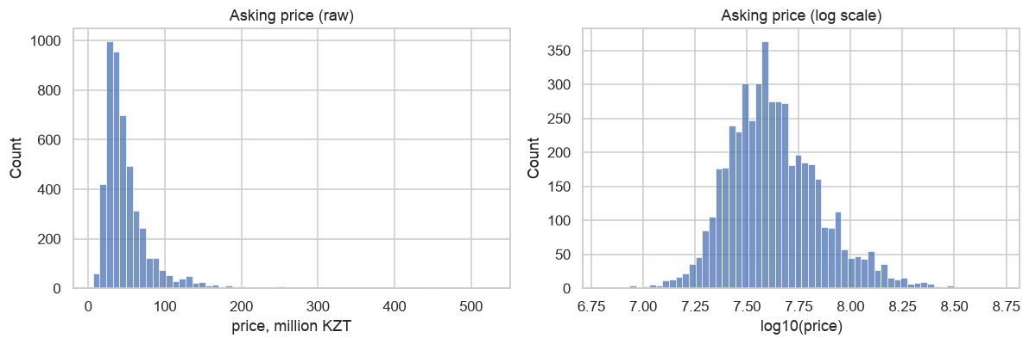
Preparation: every cleaning step has a reason and a before/after count
Step | Why | Before | After
numeric fixed price | no target: developer 'from' prices | 4,822 | 4,822
unique listing id | 'hot' block repeats ads across pages | 4,822 | 4,822
remove near-duplicate reposts | agents repost the same flat under a new id | 4,822 | 4,817
plausible ranges | typos and test ads would dominate RMSE | 4,817 | 4,815
kitchen/ceiling set to NaN | kitchen ≥ total area, ceiling outside 2.2–5 m | 4,815 | 4,815
Target modelled as log(price)
Raw prices are strongly right-skewed: the median ad is 40 M KZT, the top 5 % are above 115 M. A linear model on raw prices would spend its capacity on a few luxury ads.
Leakage check: what the model must not see
price per m² (computed from the target), price text, title and preview
description: Final-stage source, often states the price in words
ids, timestamps, promotion status: not properties of the apartment
kept: only what a seller fills in when the ad is created
imputation and scaling live inside the pipeline → fitted on the training fold only
Decision: fit on log(price), transform back to KZT, compute every metric in KZT. Area enters as log(area) too, so price ∝ area^β instead of e^area.
Notes:
[Rakhat · ~60 s]
Point at the table: every step has a reason and a before/after count; almost nothing is lost because the 'from'-price ads were filtered at collection. Then leakage: price per m² and the price text are derived from the target, the description is kept for the Final. Finish with the log target: skewed prices, so we fit log(price) and log(area) and compute every metric back in tenge.

Slide 5
Exploration: location sets the price level, area sets the scale, age bends it
District changes price per m² almost 2×; Almaty costs more at the same rank
→ city and district stay as features; the district rule becomes our baseline
Price vs area is a straight band on the log scale, but 3× wide at 60 m²
→ log target, log(area); non-linear models needed for the rest
Price per m² vs year built is U-shaped: Soviet brick cheap, 2000s middle, post-2018 dearest; panel houses cheapest
→ year as a number + building type as a category
Area, rooms and kitchen area are strongly correlated
→ Ridge and Lasso in the comparison
Notes:
[Rakhat · ~60 s]
Chart: district alone moves price per m² almost twofold, Almaty above Astana at the same rank. Then the three decisions on the right: district stays and becomes the baseline; log scale for price and area; year as a number plus building type as a category because the year effect is U-shaped. Hand over to Aitbek.

Slide 6




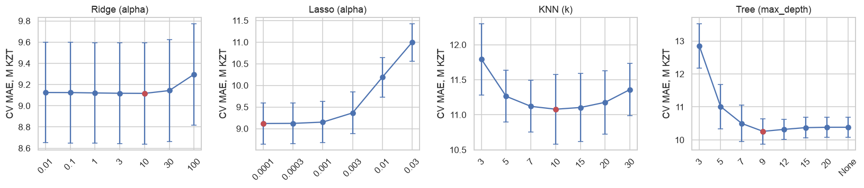
Modelling workflow: fixed split, pipeline, two baselines, five models, 5-fold CV
1 · Fixed split
2 · Pipeline
3 · Baselines
4 · Models + CV
80 / 20, random_state 42; test ids saved and reused at the Endterm and the Final
median impute + missing flag + StandardScaler; one-hot with rare levels grouped; fitted on the training fold only
dummy median, and the realtor's rule: district median price per m² × area
LinReg, Ridge, Lasso, KNN, Decision Tree; same 5 folds for all; test set touched once
Why each model is in the comparison
Main hyperparameters chosen by CV MAE, not by default
Linear Regression: simplest explainable model; plot 3 showed a log-linear relation
Ridge / Lasso: correlated features (area, rooms, kitchen); Lasso drops useless one-hot levels
KNN (distance-weighted): 'similar flats nearby cost similar money'; scaling guaranteed by the pipeline
Decision Tree: captures the U-shaped year effect and interactions without feature engineering
10
0.0001
10
9
Ridge α
Lasso α
KNN k
Tree depth
Notes:
[Aitbek · ~75 s]
Four steps: fixed split with seed 42 and saved test ids; everything inside a pipeline so imputation and scaling never see the test fold; two baselines; models compared on the same five folds. Give one reason per model. Show that alpha, k and depth were chosen by CV MAE, not left at defaults.

Slide 7
Results: a linear model on log price beats the realtor's rule by 1.3 M KZT per ad
Model | CV MAE | CV MdAPE % | Test MAE | Test MdAPE % | Test R²
Dummy (median) | 20.80 ± 0.62 | 32.2 ± 1.5 | 20.4 | 33.1 | -0.07
District median price/m² | 10.47 ± 0.53 | 14.6 ± 0.5 | 9.9 | 14.3 | 0.69
Linear Regression | 9.12 ± 0.47 | 12.1 ± 0.4 | 8.7 | 11.3 | 0.72
Ridge (alpha=10) | 9.12 ± 0.48 | 12.0 ± 0.3 | 8.7 | 11.4 | 0.71
Lasso (alpha=0.0001) | 9.12 ± 0.47 | 12.1 ± 0.4 | 8.6 | 11.3 | 0.72
KNN (k=10, distance) | 11.08 ± 0.50 | 15.8 ± 0.8 | 10.7 | 16.1 | 0.67
KNN size+location (k=10) | 10.14 ± 0.63 | 13.7 ± 0.2 | 9.7 | 13.4 | 0.72
Decision Tree (depth=9) | 10.26 ± 0.38 | 13.4 ± 0.4 | 9.3 | 12.7 | 0.75
CV = 5-fold cross-validation on the training set, mean ± std, in million KZT. Test = the held-out 20 %, touched once.
8.6 M
11.3 %
73 %
The three linear models tie. KNN on size + location only: MdAPE 13.4 % vs 16.1 % on all columns — the distance must compare the right things. The tree comes closest and wins on R², so ensembles of trees are the next step.
test MAE of the best model, KZT
median relative error (goal < 10 %)
of test ads within ±20 % of the prediction
Notes:
[Aitbek · ~75 s]
Read the table top to bottom: dummy, realtor's rule, then the models. The linear family wins on both CV and test; the gain over the realtor's rule is about 1.4 M KZT per ad. Explain why KNN on all columns loses and what the size+location KNN variant shows. Say clearly that the 10 % goal is not reached yet.

Slide 8
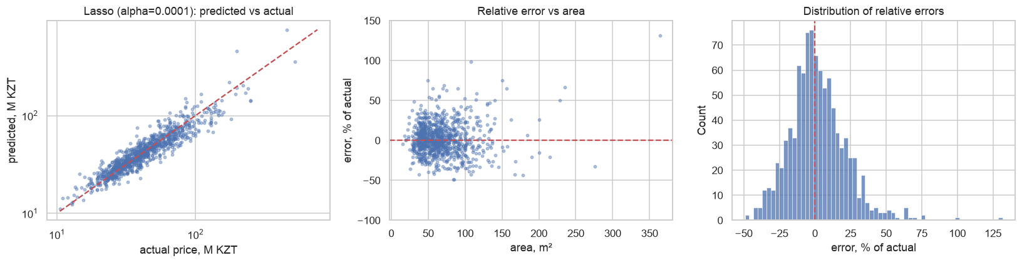

Where the model fails: expensive flats, big flats, and ads that are cheap for a reason only in the text
By price band
By size
Worst cases
MdAPE about 10 % for 20–50 M KZT, 21 % above 80 M, about 30 % above 150 M: few training ads and unobserved quality (view, finishing, the exact house)
1-room flats best (≈10 %), 4+ rooms worst; errors widen above ~120 m², where ads are rare and prices depend on finishing and view
'cash only', 'documents at the end of the year', assignment sales in 2025–26 buildings, a townhouse listed as a flat: the fields describe a normal new flat, the text explains the discount
Notes:
[Aitbek · ~60 s]
Left plot: predictions follow the diagonal over two orders of magnitude. Histogram: centred on zero with a long positive tail, so we over-estimate more often than under-estimate. Then the three cards: price band, size and source, and the worst cases where the discount is explained only in the text (cash only, no documents yet, a townhouse).

Slide 9



Conclusions and Endterm plan: every next step answers a measured weakness
Answer to the question
Ensembles + tuning
Structured fields alone give a median error of 11.3 % (MAE 8.6 M KZT), better than the realtor's rule (14.3 %), not yet under the 10 % goal. A buyer can flag any ad priced more than ~20 % above the estimate; a seller gets a defensible starting price.
Weakness: a single tree already wins on R² but is unstable across folds and fits a staircase.
Random Forest and Gradient Boosting, randomised search inside the same 5-fold CV. Target: MdAPE < 10 %.
Clustering + PCA
Limitations
asking price ≠ sale price: the seller's premium is invisible to us
a snapshot of one week (4–8 Oct 2026): prices move with rates and mortgage programmes
seller-typed fields: wrong condition, year or area in a noticeable share of ads
kitchen area is missing in most ads; the luxury tail (> 150 M) is thin
Weakness: errors grow with price; one global model treats the luxury segment like the mass market.
K-Means / DBSCAN on area, rooms, year, price per m², coordinates → segment as a feature; PCA for a compact KNN space.
Neural network
Weakness: the linear model cannot bend, the tree bends only in steps.
MLP regressor on the scaled features, compared with boosting on the same saved split.
Same saved split (data/clean/split_ids.csv) → Endterm numbers directly comparable with today's table. Description text and photos are added at the Final.
Notes:
[Aitbek + Rakhat · ~60 s]
Aitbek: the answer in one sentence with the numbers, then the limitations. Rakhat: the plan, one card each, always as weakness → method → why it should help. End with: same saved split, so the Endterm numbers are directly comparable. Total talk: about 9 minutes.

