Slide 1
Which apartments are over-priced? Ensembles, market segments and a neural network on krisha.kz ads
Endterm: the Week 5–8 methods applied to our 4,815 Astana and Almaty listings, on the same saved test split as the Midterm
Course project, Endterm (Week 9) · Machine Learning Algorithms · Direction 1 (Apartments for sale) · Regression
Rakhat Balgabekov, Aitbek Kaiyrbekuly · Group SE-2424 · November 2026

Slide 2
Question, data and what changed since the Midterm
Which apartments in Astana and Almaty are asked above or below what comparable apartments go for, and by how much?
• Same data 4,815 krisha.kz ads scraped 4–8 Oct 2026; target = asking price, KZT
• Same split 963 test ads saved at the Midterm, read from the file, used once (Section 6)
• Same metric MAE in KZT (the user's money) and MdAPE (registration goal: median error < 10 %)
• Midterm result linear model on log price, test MAE 8.65 M, MdAPE 11.3 %, goal not reached (re-run with the Endterm feature list: 8.66 M, 11.27 %)
• Users buyer flags an ad > 20 % above the estimate; seller gets a starting price; realtor a reference
• Fix 1 · question from “predict the price” to “which ads deviate from the market, by how much”
• Fix 2 · data ethics free text checked for contact data: 0 phone numbers, 7 realtor handles masked
• Fix 3 · features has_detail dropped (a scraper artefact); 10 ads with coordinates in the wrong city → missing
• Fix 4 · model choice by 5-fold CV MAE only; the Midterm had picked by test MAE
• Added forest, boosting, XGBoost, LightGBM, randomised search, blend, K-Means, DBSCAN, PCA, segment feature, PyTorch MLP
SE-2424 · Balgabekov, Kaiyrbekuly · Endterm · Machine Learning Algorithms
2

Slide 3
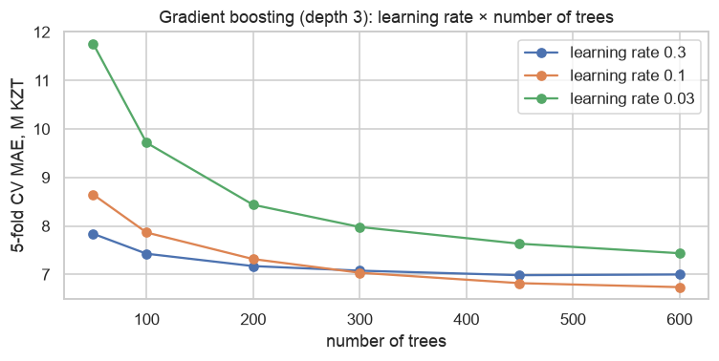
Ensembles: the forest removes the tree's variance, boosting its bias
• Fully grown tree train MAE 0.00 → CV 11.25 ± 0.73 M: memorises, high variance
• Random forest, 300 trees CV 8.00 ± 0.37 M, SD halved: averaging cancels the variance
• Gradient boosting, 100 × depth 3 CV 7.87 ± 0.33 M, smallest train→val gap (1.3 M): shallow trees, bias removed by summing
• Histogram boosting (default) CV 7.01 ± 0.38 M, 2.1 M below the linear model (9.10 ± 0.61) = 3–4 fold SDs
• Learning rate × trees 0.3 flattens at 450 trees (6.99 M), 0.1 still improving at 600 (6.74 M), 0.03 underfits (7.44 M); differences ≈ one fold SD
SE-2424 · Balgabekov, Kaiyrbekuly · Endterm · Machine Learning Algorithms
3

Slide 4
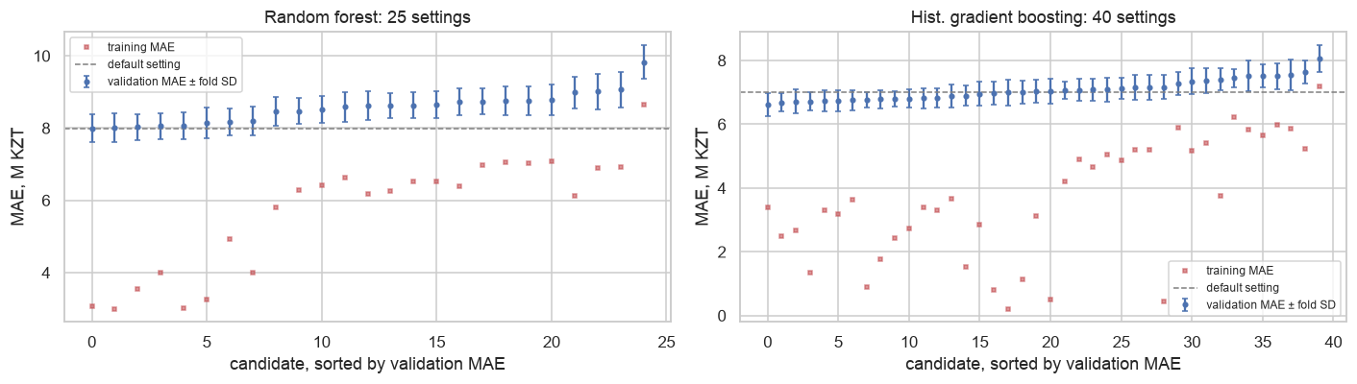
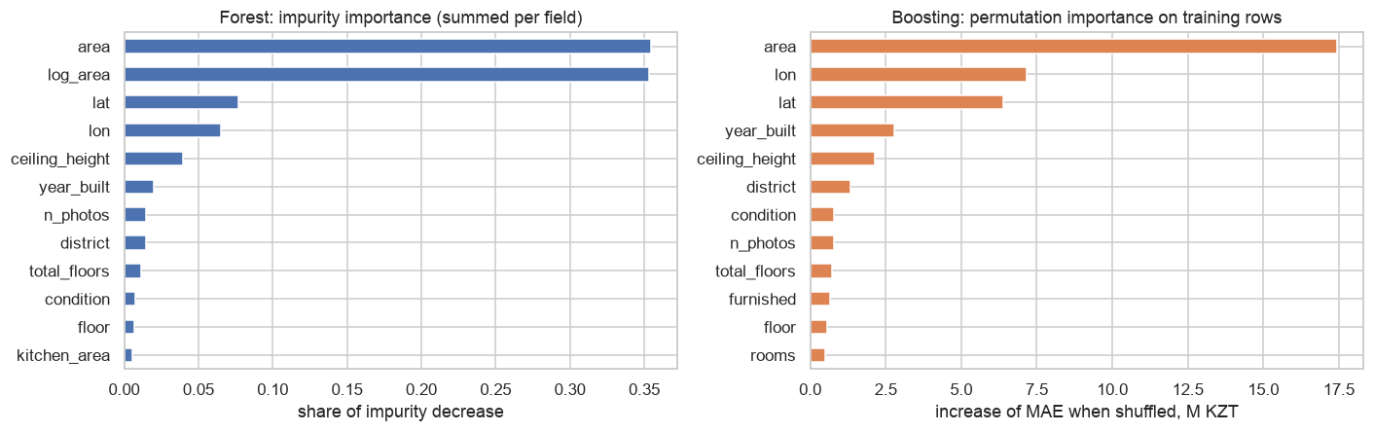
Tuning bought one fold SD for boosting and nothing for the forest; XGBoost and LightGBM confirm the score
• RandomizedSearchCV 25 forest + 40 boosting + 20 XGBoost + 20 LightGBM settings, same 5 folds, scored by MAE in KZT
• Forest best 7.99 ± 0.38 M vs default 8.00: insensitive to its settings
• Boosting best 6.62 ± 0.35 M vs default 7.01: lr 0.12, 7 leaves, 600 iterations, 5 rows/leaf; the five best within 0.11 M, all with many iterations and small leaves
• XGBoost 6.64 ± 0.32, LightGBM 6.75 ± 0.28 three libraries within a third of a fold SD; the 6.6 M floor belongs to the data, not the library
• OOB check forest OOB MAE 7.66 M vs CV 7.99 M, the two estimates agree
• Permutation importance shuffling area +17.5 M MAE, lon +7.2, lat +6.4, year +2.8, ceiling +2.1, district only +1.3: coordinates beat district names 5×
• Blend forest + boosting 6.95 M, between its parents; extra trees 8.69 M: no help
SE-2424 · Balgabekov, Kaiyrbekuly · Endterm · Machine Learning Algorithms
4

Slide 5
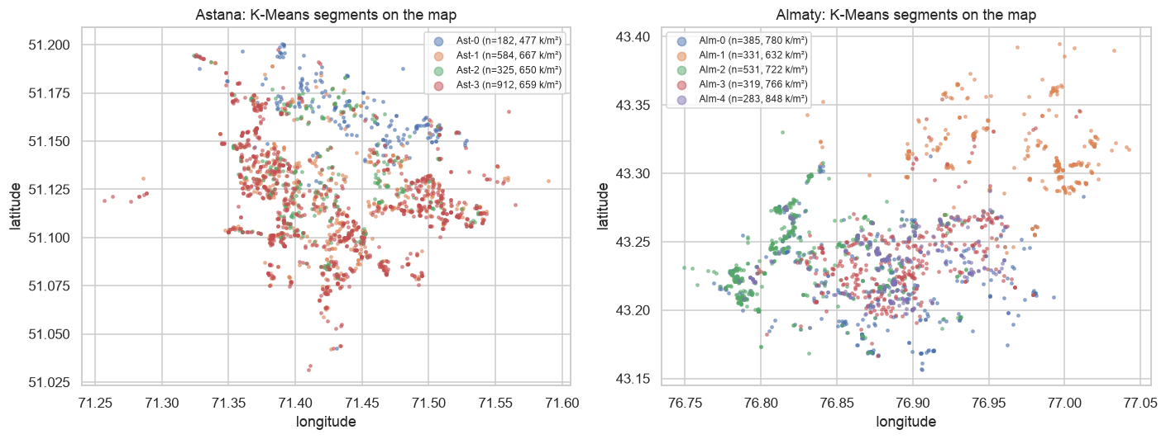
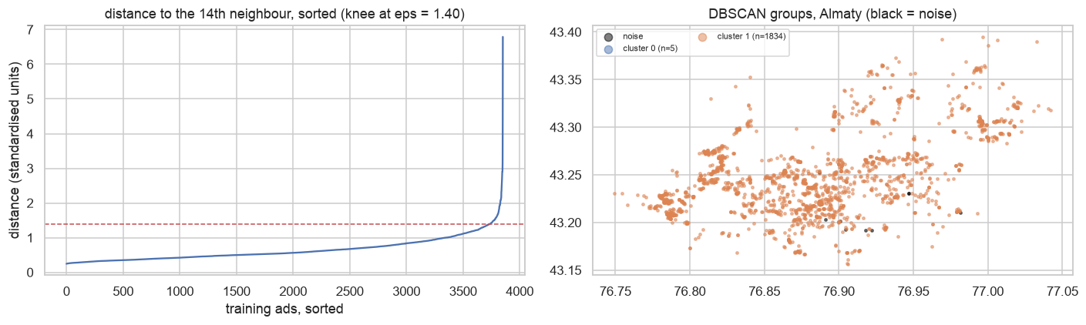
Market segments: K-Means within each city; DBSCAN finds one dense cloud per city plus 29 unusual ads
• Inputs log area, rooms, floor, floors in building, year, lat, lon; price never an input
• k chosen per city silhouette + inertia + stability (ARI on 80 % subsamples ≥ 0.9, no cluster < 30 ads) → Astana 4 segments (silhouette 0.21, ARI 0.97), Almaty 5 (0.25, 0.97)
• Segments in words Astana: mass market 45 m² new (912 ads), large family flats 92 m², tall-tower flats floor 13/18, old low-rise 2006 at 477 k/m² (cheapest). Almaty: premium high-rise 848 k/m², club-house flats 87 m², Soviet centre 1976 at 766 k/m², small new west, cheap north-east 632 k/m²
• Silhouette 0.21–0.25 cuts through a continuum, a description, not islands
• DBSCAN, eps 1.40 at the knee, min_samples 14 2 clusters = the two cities, 29 noise ads (0.8 %)
• Noise = real unusual objects 140 m² on floor 42/43, a 187 m² 6-room penthouse (listed twice), a 1-room flat on 11/34; kept, but used as a “few comparables” warning
SE-2424 · Balgabekov, Kaiyrbekuly · Endterm · Machine Learning Algorithms
5

Slide 6
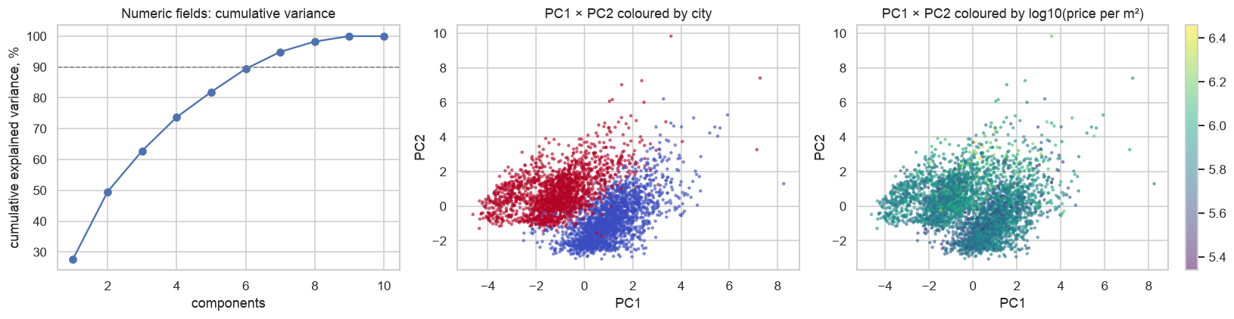
PCA describes the table but does not help the model; a segment feature adds nothing
• 10 numeric fields 5 components for 80 %, 7 for 90 % of the variance; the last one is 0 % (lat and lon anti-correlated across the two cities)
• PC1 = new high-rise in Astana vs old low-rise in Almaty total floors 0.41, lat 0.40, year 0.34, lon −0.40
• PC2 = size area 0.50, rooms 0.52, photos 0.35
• KNN on components 11.5 M (90 % var.) vs 11.1 M raw; Ridge 10.6 M vs 9.1 M raw: every reduction costs
• Midterm KNN on size + location only (10.2 M) beats both columns chosen by meaning beat directions chosen by variance
• Boosting + in-fold K-Means segment 6.65 ± 0.31 vs 6.62 ± 0.35 M: the model already carves those regions itself
SE-2424 · Balgabekov, Kaiyrbekuly · Endterm · Machine Learning Algorithms
6

Slide 7
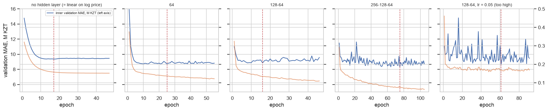
A PyTorch network ties the linear model and loses to boosting by six fold SDs
• Setup same encoded inputs (71 columns), standardised log price, L1 loss, Adam, dropout, weight decay, early stopping on 15 % of the fold, same 5 folds
• No hidden layer = linear by gradient descent 9.26 ± 0.57 M vs 9.10 for the Midterm linear model, the loop is right
• 64 / 128-64 / 256-128-64 units 8.82 / 8.90 / 8.86 M, all within 0.1 M; scikit-learn MLP 8.86 M confirms
• Curves training loss keeps falling, validation stops after 10–30 epochs: memorising; lr 0.05 jumps between 8.5 and 10.5 M
• Gradient flow (Practice 8A) first / last layer gradient ratio for 6 layers: ReLU 0.12, sigmoid 5.5e-5; the 6-layer sigmoid net never leaves the mean
• Verdict 2.2 M behind tuned boosting (6.62 M) on every fold; 3,852 tabular rows with threshold effects are tree territory, 0.3–0.7 s per fit on one CPU thread
SE-2424 · Balgabekov, Kaiyrbekuly · Endterm · Machine Learning Algorithms
7

Slide 8
One table, chosen by CV, tested once: tuned boosting reaches MdAPE 9.1 %, the 10 % goal is met
model | CV MAE (M KZT) | CV MdAPE % | Test MAE (M KZT) | Test MdAPE % | Test R² | within ±20 %
Gradient boosting (tuned) ★ | 6.62 ± 0.35 | 8.9 | 6.291 | 9.13 | 0.855 | 84%
XGBoost (tuned) | 6.64 ± 0.32 | 8.8 | 6.269 | 8.94 | 0.862 | 85%
LightGBM (tuned) | 6.75 ± 0.28 | 9.0 | 6.193 | 9.0 | 0.877 | 84%
Blend forest + boosting | 6.95 ± 0.33 | 9.0 | 6.462 | 8.68 | 0.854 | 84%
Hist. boosting (default) | 7.01 ± 0.38 | 9.2 | 6.624 | 9.06 | 0.849 | 85%
Random forest (tuned) | 7.99 ± 0.38 | 10.2 | 7.222 | 9.98 | 0.834 | 80%
PyTorch MLP, 64 units | 8.82 ± 0.60 | 11.4 | 8.327 | 10.99 | 0.735 | 75%
sklearn MLP 128-64 | 8.86 ± 0.53 | 12.2 | 8.266 | 11.85 | 0.803 | 74%
Midterm linear (log price) | 9.10 ± 0.61 | 12.1 | 8.66 | 11.27 | 0.712 | 73%
Midterm tree (depth 9) | 10.19 ± 0.50 | 13.3 | 9.421 | 13.46 | 0.751 | 67%
Realtor rule (district price/m²) | 10.45 ± 0.39 | 14.6 | 9.945 | 14.35 | 0.691 | 62%
Dummy (median) | 20.81 ± 0.75 | 32.1 | 20.402 | 33.06 | -0.067 | 32%
• Chosen by CV MAE tuned histogram boosting, 6.62 ± 0.35 M
• Test, used once MAE 6.29 M (bootstrap 5.56–7.14), MdAPE 9.13 % (8.31–9.88), R² 0.855
• vs Midterm on the same 963 ads 8.66 M, 11.27 %, R² 0.712: error in money −27 %
• Within ±10 % / ±20 % 54 % / 84 % of test ads (Midterm 45 % / 73 %)
• LightGBM, XGBoost, blend and default boosting look as good on the test column (6.2–6.6 M) we do not switch, that would be choosing on the test set; three libraries agreeing is what makes the number trustworthy
CV = 5-fold cross-validation on the 3,852 training rows (mean ± fold SD). Test = the 963 ads saved at the Midterm, used once. Model chosen by CV MAE.
SE-2424 · Balgabekov, Kaiyrbekuly · Endterm · Machine Learning Algorithms
8

Slide 9
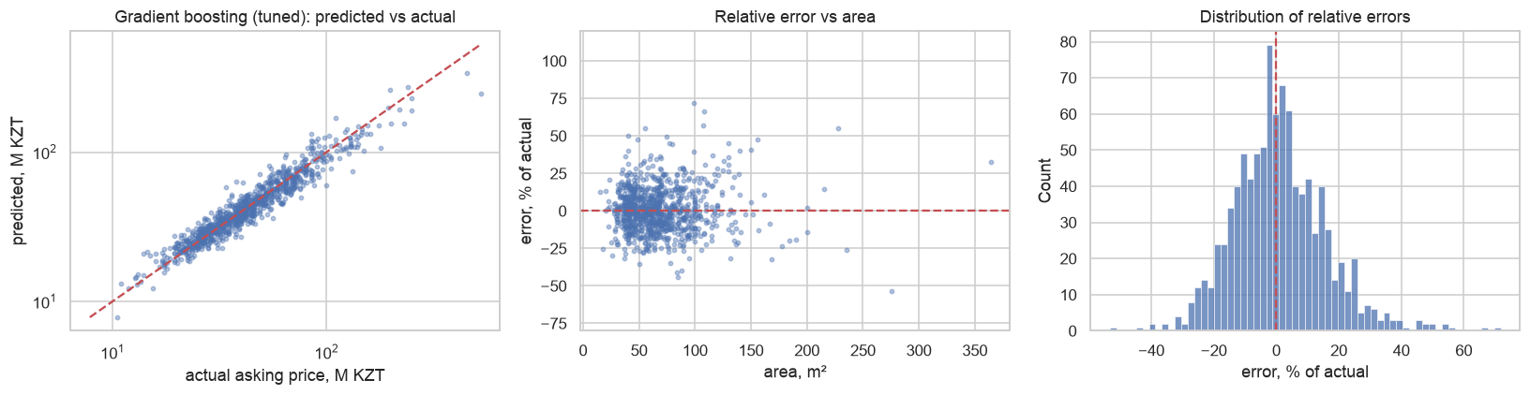
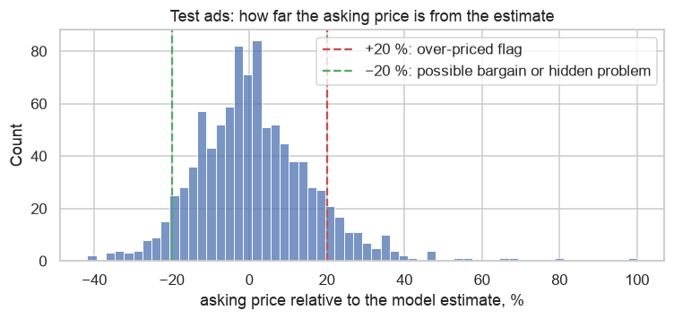
Errors: the expensive bands improved most; what is left sits in the text
• By price band (MdAPE, Endterm vs Midterm) 20–50 M 8 % vs 10 %; 80–150 M 12.9 % vs 21.9 %; > 150 M 16.6 % vs 31.8 %
• Bias cheap ads over-estimated by 9 %, luxury under-estimated by 14 % (15 ads > 150 M)
• Worst cases “cash only, assignment of rights” (13.9 M predicted 20.8), rough state, a 276 m² designer duplex at 525 M predicted 245: text-only reasons or no comparables
• Midterm's worst 8 364 m² penthouse 133 % → 33 %, Nura flat 68 % → 3 %; four of eight stay above 40 %
• Buyer's flag 93 of 963 ads (10 %) ask > 20 % above the estimate; owners and agents equally (10 %); 28 ads with no comparables get a warning (MdAPE 12.9 % vs 9.0 %)
SE-2424 · Balgabekov, Kaiyrbekuly · Endterm · Machine Learning Algorithms
9

Slide 10
Conclusions, limitations and the plan for the Final
• Answer structured fields give a 9.1 % median error; one ad in ten asks > 20 % above comparable apartments, one in twenty > 20 % below
• Ensembles −27 % error, mostly in the expensive bands; tuning worth one SD; XGBoost and LightGBM land at the same score; blend and extra trees no help
• Unsupervised one dense cloud per city; segments describe, DBSCAN flags unusual ads; PCA shows 7 real dimensions, none of them price
• Network ties linear, loses to boosting; not worth it on 3,852 tabular rows
• Importance size and coordinates carry the model; what remains is not in the fields
• Limitations asking ≠ sale price; one October snapshot, one site; 15 luxury test ads; the test set is seen at every stage; tuning on the comparison folds
• Final 1 · text TF-IDF of the sanitised description on cross-fitted residuals of the boosting model, judged on the worst cases
• Final 2 · photos pretrained-CNN embeddings of up to 3 photos per ad as a second residual correction
• Final 3 · app fields + text + photos → estimate, segment-based interval, over-pricing flag with the “few comparables” warning
• Final 4 · honest check re-scrape in November as a temporal hold-out; the saved split stays unchanged
SE-2424 · Balgabekov, Kaiyrbekuly · Endterm · Machine Learning Algorithms
10

