Slide 1
Which apartments are over-priced, and how sure are we? Location, photos, text and a trust layer on krisha.kz ads
Final: the Endterm model as the base, three new information sources fused and kept only if they beat it by the fixed 0.354 M rule, calibrated intervals for the user
Course project, Final (Week 10 defence) · Machine Learning Algorithms · Direction 1 (Apartments for sale) · Regression
Rakhat Balgabekov, Aitbek Kaiyrbekuly · Group SE-2424 · November 2026

Slide 2
Question, base and what changed since the Endterm
Which apartments in Astana and Almaty are asked above or below what comparable apartments go for, by how much, and how sure can we be?
• Same data and split 4,815 ads (Oct 2026), 3,852 training ads, the 963 saved test ads used once
• Base = Endterm model, reproduced exactly tuned HGB on log price, CV 6.616 ± 0.353 M, test MAE 6.29 M, MdAPE 9.13 %
• One rule for every model kept only if CV MAE < base − 0.354 M (Endterm fold SD, fixed) = 6.370 M on duplicate-aware folds (6.262 M random)
• New test 1,507 November ads, a month later, search-page level only
• Leakage audit duplicate ads found by photo hashes, embeddings, fields and text; grouped CV
• Location OSM distances and counts (parks, schools, shops, centre)
• Photos CLIP zero-shot, linear probes, fine-tuned EfficientNet-B0, Grad-CAM, mismatch flag
• Text TF-IDF vs transformer embeddings as residual correctors; red flags
• Trust layer conformal 80/90 % intervals, SHAP, 5 comparable ads, interval-based over-pricing flag
SE-2424 · Balgabekov, Kaiyrbekuly · Final · Machine Learning Algorithms
2

Slide 3
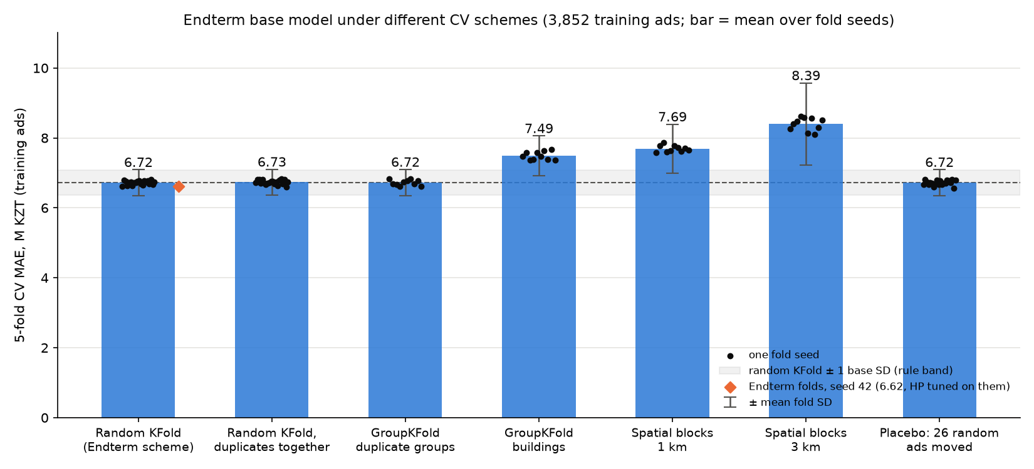
Leakage audit: duplicates exist, but too few to bend the Endterm CV
• 4 signals pHash/dHash of photos, image-embedding cosine, structured fields (area 1 %, price 5 %, 150 m), text TF-IDF; stock photos (> 5 ads) ignored
• Found 48 pairs → 43 groups, 90 ads; 18 certainly the same flat
• Test split 13 test ads (1.35 %) have a training twin
• Repaired folds Endterm folds with each duplicate group in one fold: base 6.723 ± 0.264 M vs 6.616 M random; over 20 seeds duplicates add only +0.015 M
• Decision repaired folds = primary scheme for the model choice; margin kept at 0.354 M (fold SD moves 0.26–0.50 with the seed; the earlier 6.459 threshold was wrong)
SE-2424 · Balgabekov, Kaiyrbekuly · Final · Machine Learning Algorithms
3

Slide 4
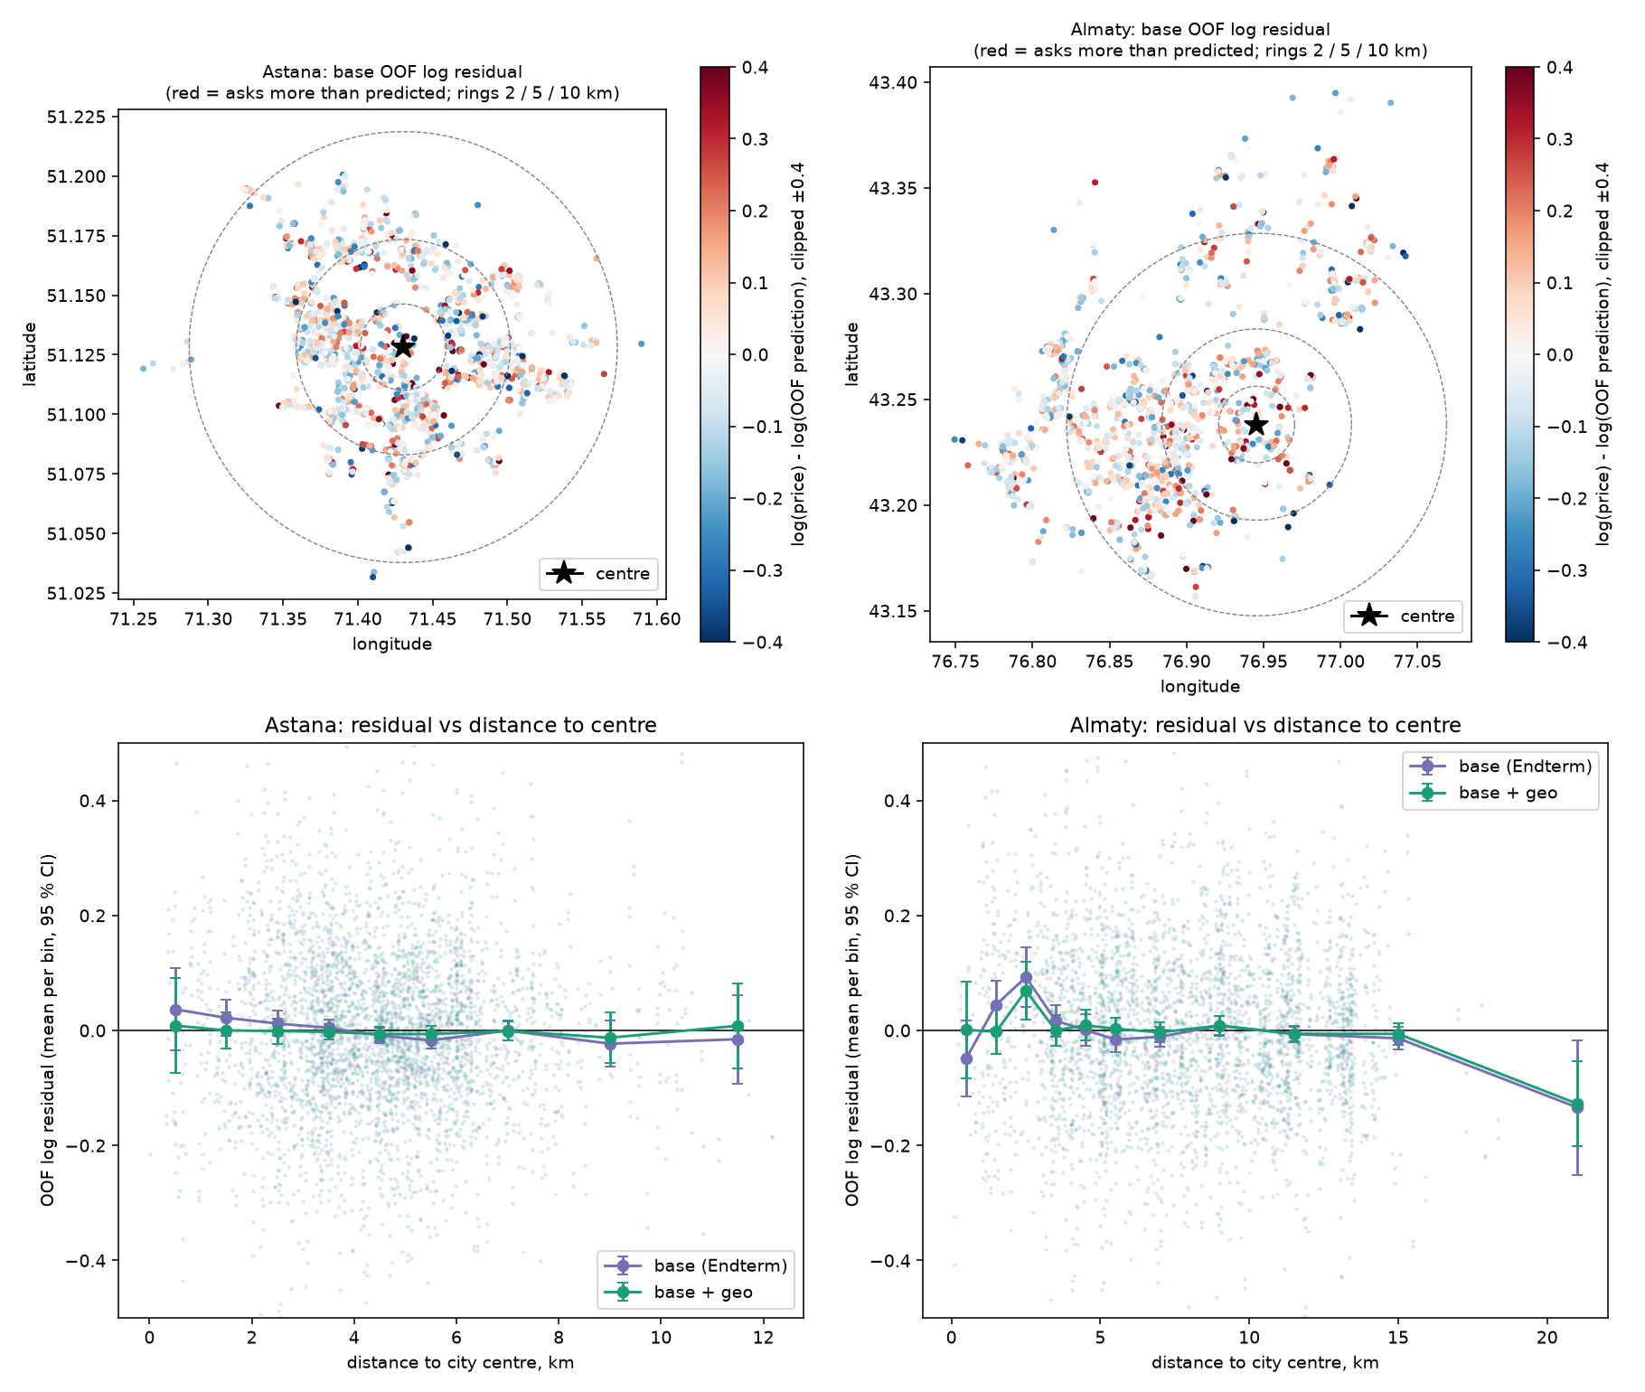
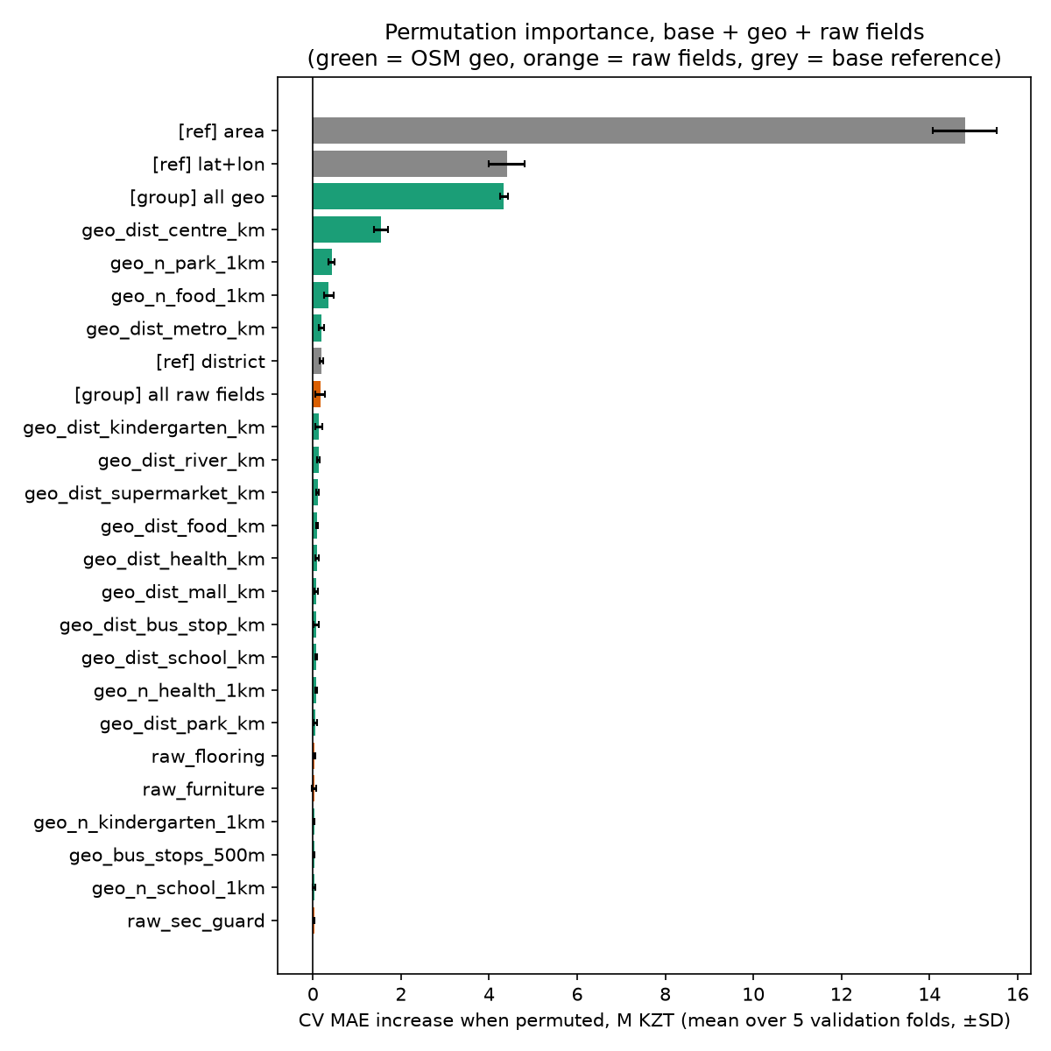
Location: a smooth distance to the centre helps; more OSM objects add little
• Features haversine distance to centre, nearest park / school / kindergarten / shop / clinic, counts within 500 m and 1 km (BallTree, OSM Overpass)
• Best variant base + geo + raw fields: 6.481 ± 0.280 M (-0.135, 4/5 folds better)
• Distance to centre alone 6.543 M, most of the OSM gain
• Raw ad-page fields alone 6.766 M: sparse columns add noise
• 1-SD rule 0 of 4 variants pass
SE-2424 · Balgabekov, Kaiyrbekuly · Final · Machine Learning Algorithms
4

Slide 5
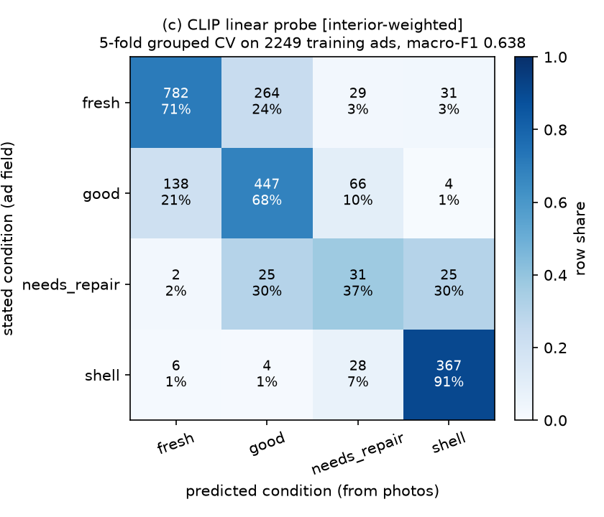
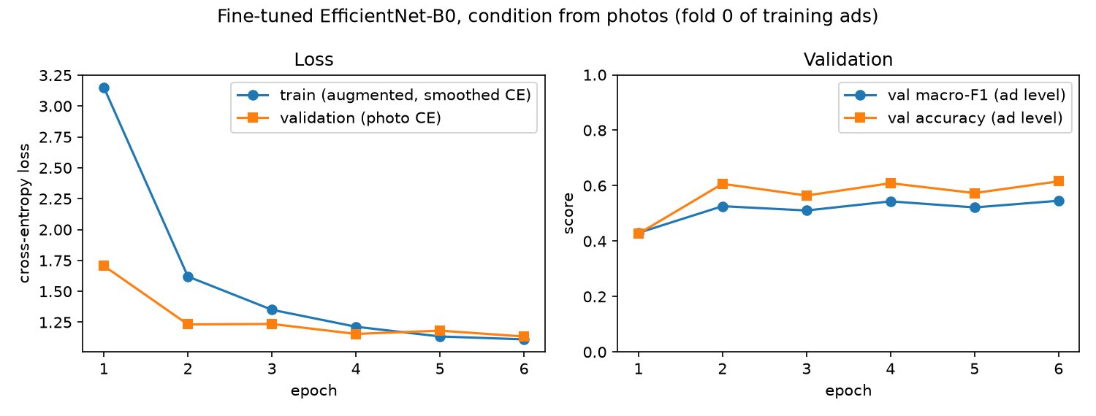
Photos: CLIP reads the renovation; the price model gains little from it
• Task the photos can see flat condition (fresh / good / needs repair / shell), grouped CV by duplicate photos
• Frozen CNN + LR MobileNetV3 F1 0.592, EfficientNet-B0 0.608
• CLIP linear probe macro-F1 0.632; fine-tuned EfficientNet-B0 0.546 (fold 0)
• Grad-CAM where the network looks; mismatch flag when photos contradict the stated condition
• In the price model best 6.426 M (-0.190); 0 of 14 pass
SE-2424 · Balgabekov, Kaiyrbekuly · Final · Machine Learning Algorithms
5

Slide 6
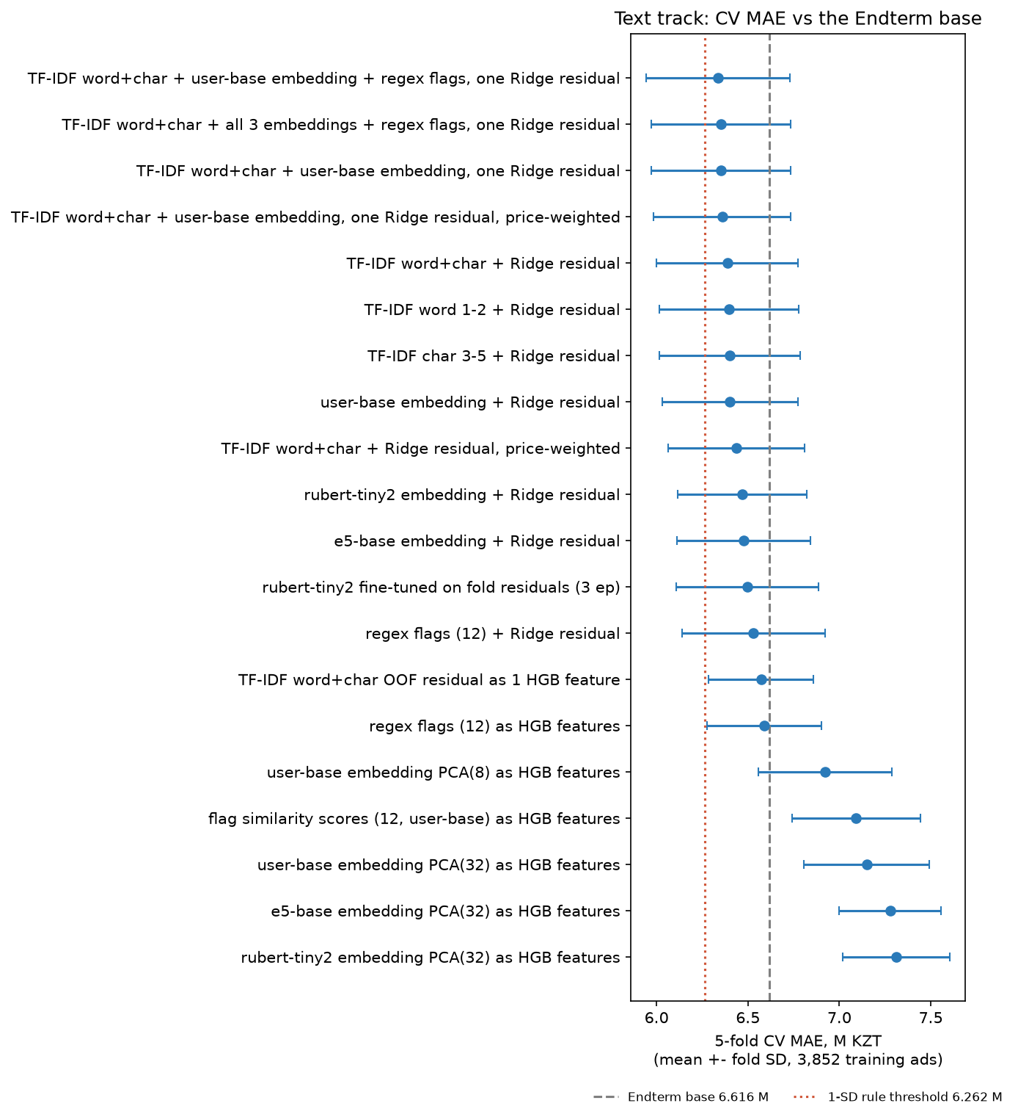
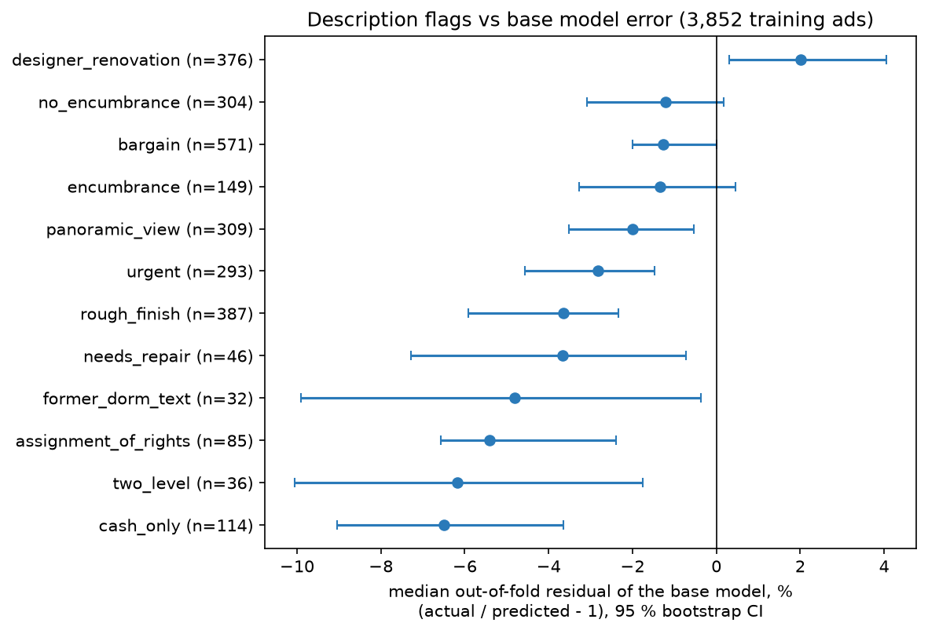
Text: a residual correction that helps on every fold, but below the bar
• Sanitised first money sentences, digits and contacts removed, so the text cannot leak the price
• As a residual corrector Ridge on the base model's inner-OOF log error, alpha by GCV per fold
• Best TF-IDF word+char + user-base embedding + regex flags, one Ridge residual: 6.336 ± 0.392 M (-0.280, 5/5 folds)
• TF-IDF vs transformer 6.388 vs 7.150 M, equal; embeddings as tree features 7.313 M, worse
• 1-SD rule 0 of 20 pass; red flags shown to the user, too rare to move the MAE
SE-2424 · Balgabekov, Kaiyrbekuly · Final · Machine Learning Algorithms
6

Slide 7
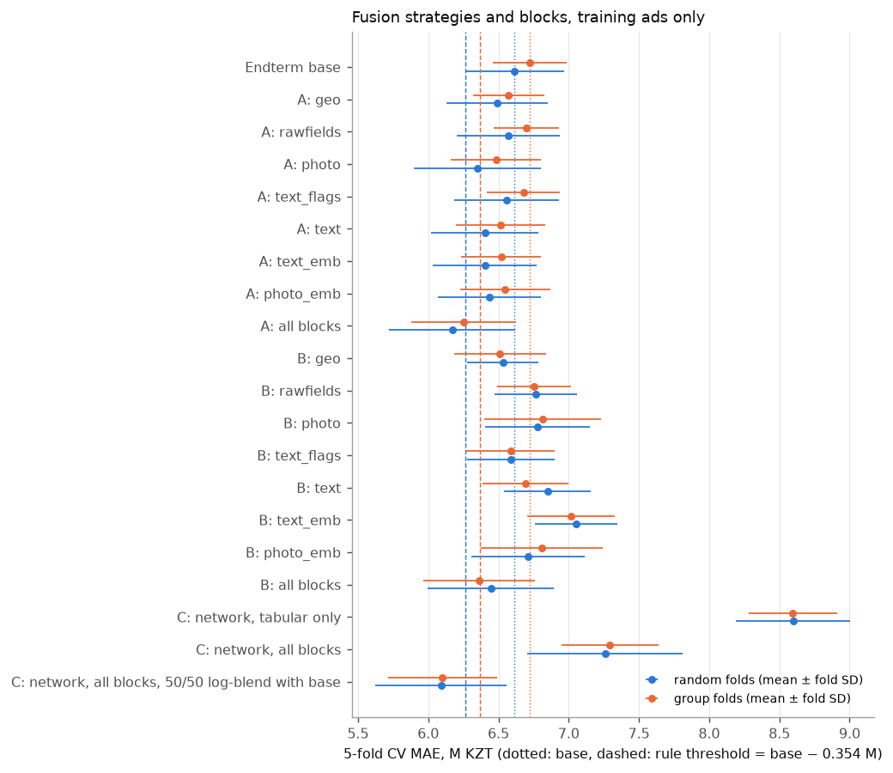
Fusion and selection: per-step vs whole model
block | best variant | CV MAE (M KZT) | Δ vs base (M) | folds better | variants kept
location (OSM + raw fields) | base + geo + raw fields | 6.481 ± 0.280 | -0.135 | 4/5 | 0/4
photos | residual: HGB on condition probs + zero-… | 6.426 ± 0.440 | -0.190 | 4/5 | 0/14
text | TF-IDF word+char + user-base embedding +… | 6.336 ± 0.392 | -0.280 | 5/5 | 0/20
fusion of kept blocks | C: network, all blocks, 50/50 log-blend … | 6.092 ± 0.468 | -0.524 | 5/5 | 5/38
• Per-step forward selection (strict) no block passes; the largest first step (photo features, −0.24 M) < 0.354 M → would keep the base
• Whole model network + base 50/50 log-blend 6.100 ± 0.388 M, −0.623 M > 0.354, 5/5 folds
• Not just ensembling blend with a tabular-only network is worse than the base
• Random folds agree 6.092 M vs 6.616: not from duplicates
• Final = the blend certified as a whole, no single block certified
CV = 5-fold CV on the 3,852 training ads (mean ± fold SD). Rule: kept only if CV MAE < base − 0.354 M (6.370 M, repaired folds).
SE-2424 · Balgabekov, Kaiyrbekuly · Final · Machine Learning Algorithms
7

Slide 8
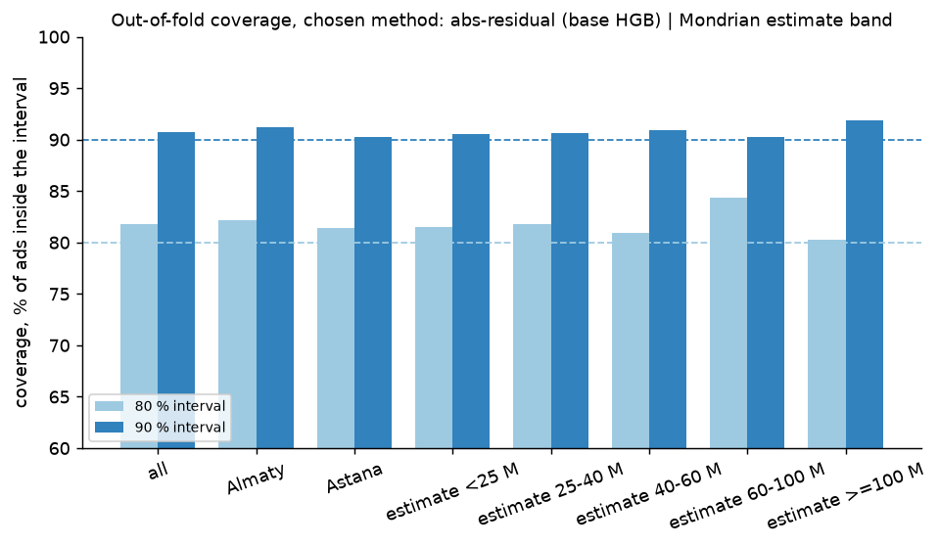
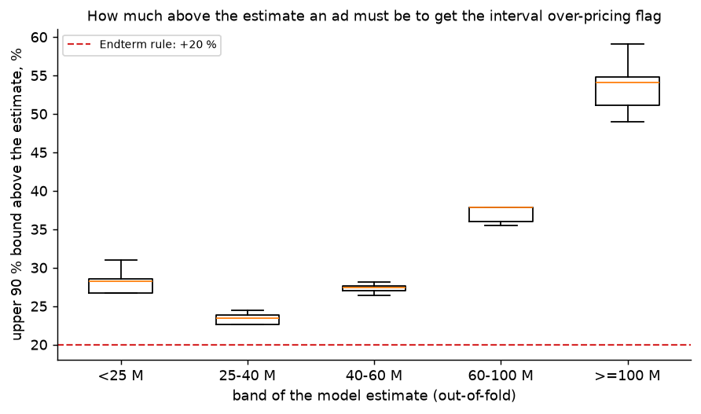
Conformal intervals replace the fixed 20 % over-pricing rule
• Conformal out-of-fold scores, quantile ⌈(n+1)(1−α)⌉/n → guaranteed average coverage
• Compared constant width on log residual vs conformalized quantile regression (CQR), per-city calibration
• Chosen abs-residual (base HGB) | Mondrian estimate band: 90 % coverage 90.7%, median width 48 % of the price
• Flag over-priced if the price is above the upper 90 % bound; overlap with the 20 % rule 0.49 (Jaccard)
• Why 20 % is too strict for standard flats, too lenient for unique ones
SE-2424 · Balgabekov, Kaiyrbekuly · Final · Machine Learning Algorithms
8

Slide 9
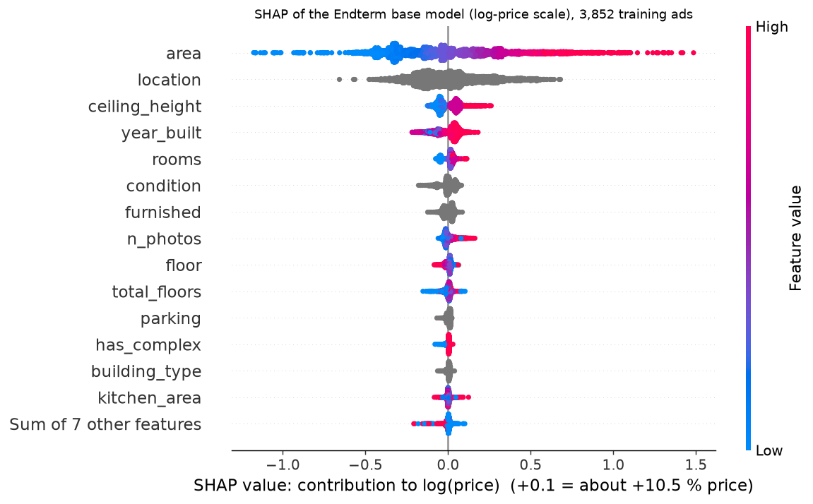
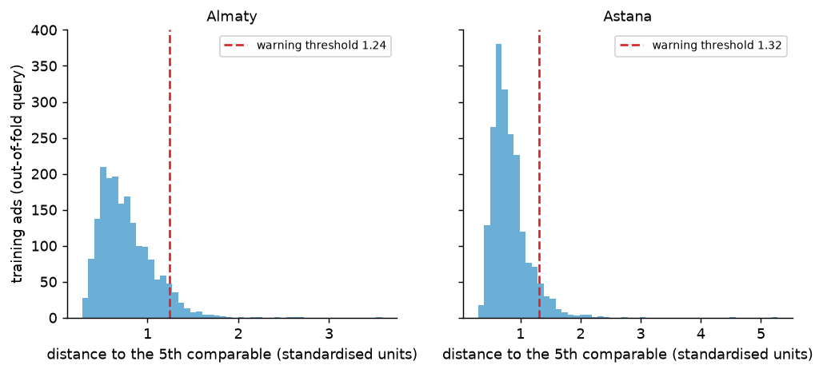
Reasons and comparables: SHAP for the model, real ads for the user
• TreeSHAP exact Shapley values, one-hot columns summed to the source feature
• Top features area, location, ceiling_height; stable vs ordinal encoding (ρ 1.00)
• Comparables 5 nearest training ads in the same city (area, rooms, year, floor, position)
• Warning 5th neighbour far → few comparables: 5.1% of ads, larger errors there
• Limit SHAP explains the model, not the market
SE-2424 · Balgabekov, Kaiyrbekuly · Final · Machine Learning Algorithms
9

Slide 10
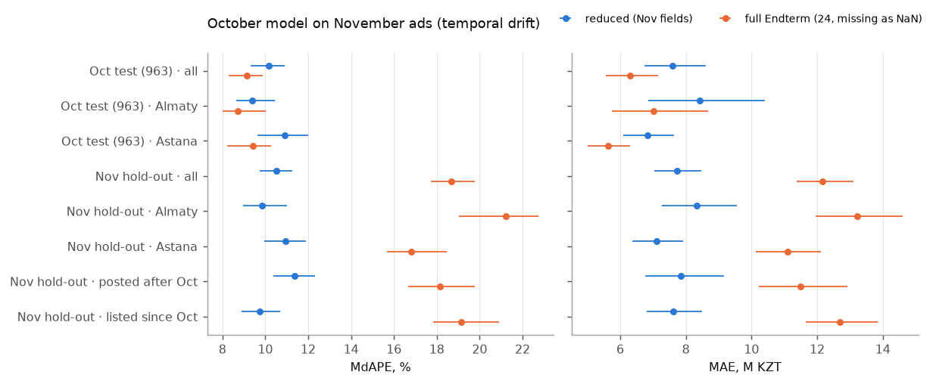
One test evaluation, and the same model a month later
model | cv_mae_M | cv_mdape | test_mae_M | test_rmse_M | test_mdape | test_r2
Endterm base | 6.616 | 8.934 | 6.2909 | 13.895 | 9.1293 | 0.8549
C network + base, 50/50 log-blend (geo+rawfields+photo+text_flags+text_emb+photo_emb) | 6.0922 |  | 5.8013 | 14.003 | 7.8241 | 0.8526
• 963 saved test ads, once MAE 5.80 M (95 % 5.09–6.67), MdAPE 7.82 %, ±20 %: 88%
• vs Endterm, paired MAE 6.29 → 5.80 M, difference -0.80 to -0.16 M; RMSE, R² unchanged (tails)
• November (1,507 ads, card fields only) reduced model MdAPE 10.16 % (Oct test) → 10.51 %: small drift
• Read with care test set reused (2nd use); Nov ad pages blocked by bot protection → fused model not testable there
SE-2424 · Balgabekov, Kaiyrbekuly · Final · Machine Learning Algorithms
10

Slide 11
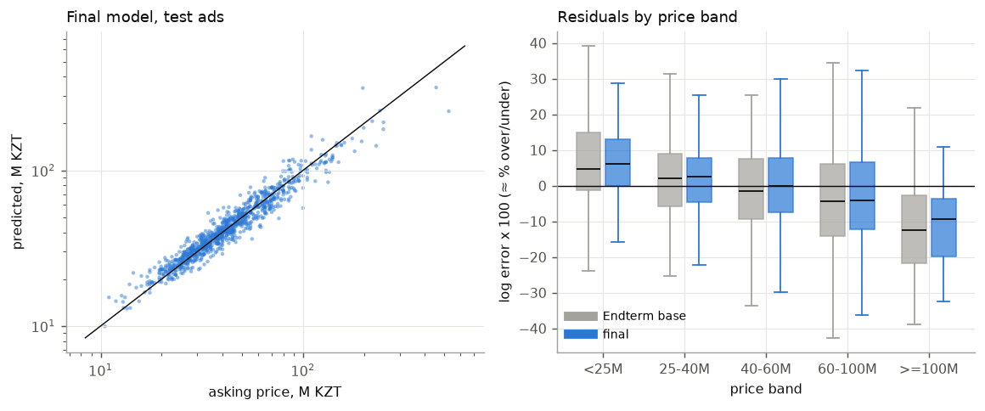
Where the final model is still wrong
• Absolute error grows with price MAE 2.1 M below 25 M, 28.9 M above 100 M
• Shrinkage to the mean top band under-predicted (−9 %), cheapest over-predicted (+6 %)
• Gain is in the bulk better in every city, band and room count except 4+ rooms (+0.84 M, CI crosses 0)
• Worst 20 errors 17 are flats above 100 M, where the intervals are widest
SE-2424 · Balgabekov, Kaiyrbekuly · Final · Machine Learning Algorithms
11

Slide 12
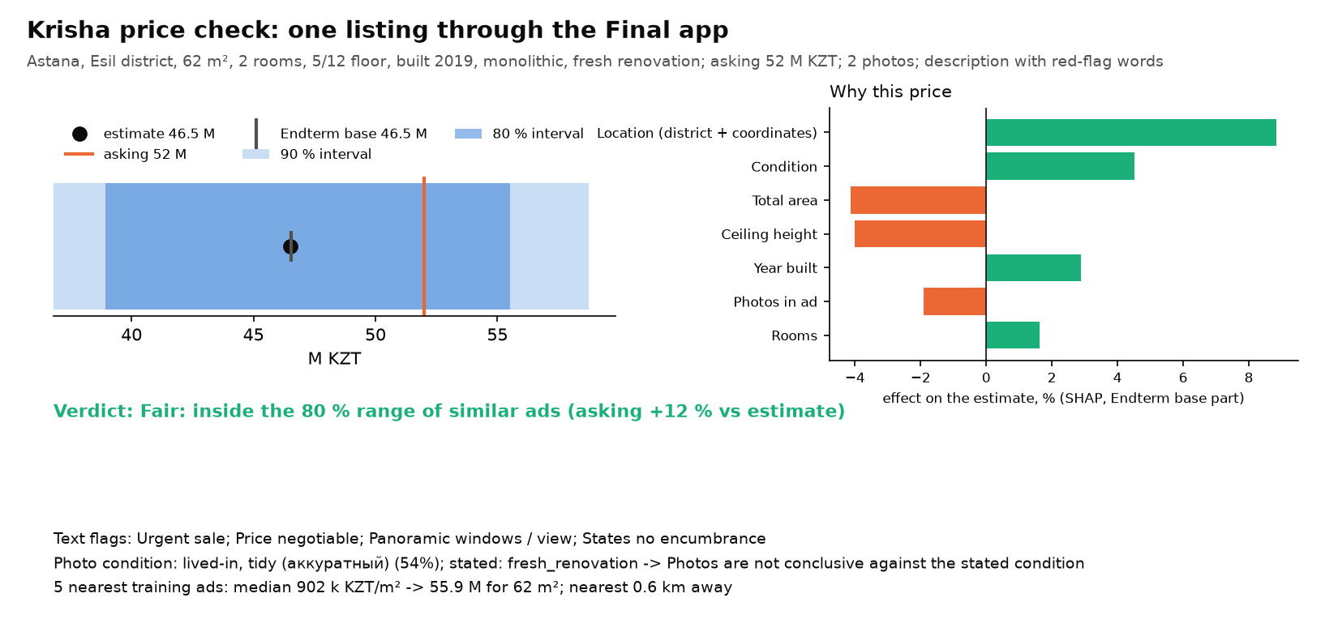
The app: one listing end to end
• Form → final model geo from coordinates, text flags + USER-base embedding from the description, CLIP embedding of up to 3 photos
• Missing by design raw ad-page fields and photo-track table features (as for training ads without them); the app says so
• Around the estimate conformal 80/90 % interval, verdict, SHAP reasons, 5 comparables, red flags, photo condition + mismatch
• Run python app/gradio_app.py
SE-2424 · Balgabekov, Kaiyrbekuly · Final · Machine Learning Algorithms
12

Slide 13
Why no deep RL, and limitations
• No deep RL RL needs actions and rewards (sold? when? at what price?); we have asking prices only, no outcome, no days-on-market, one snapshot → it would collapse into our regression with more variance
• Right tool supervised regression + calibrated uncertainty; RL only with longitudinal data
• Asking ≠ sale price 'over-priced' = above comparable asking prices
• Reused test set 963 ads scored at the Endterm and once more here
• November = listing level only ad pages blocked by bot protection; 17 of 24 fields
• Whole-model certification only no single block passes step by step; removing location costs the blend most (+0.29 M)
• Also one snapshot, seller-stated labels, OSM gaps, 5 folds a coarse ruler
SE-2424 · Balgabekov, Kaiyrbekuly · Final · Machine Learning Algorithms
13

Slide 14
Contributions and AI tools
• Rakhat Balgabekov krisha_ml foundation, Endterm reproduction, leakage audit and repaired folds, photo track, November scrape, assembly of notebook, report and slides
• Aitbek Kaiyrbekuly location track, text track, trust layer, error analysis, slides
• Both selection rule, readings, conclusions
• AI tools an AI coding assistant (Claude) helped write and debug the code of krisha_ml, the scripts and the app, review the Endterm against the rubric, draft the slides and report tables from our outputs, and check our English
• Ours every experiment run and checked by us; the methods, the selection rule, the one-time test, the readings and the conclusions are our own
SE-2424 · Balgabekov, Kaiyrbekuly · Final · Machine Learning Algorithms
14

Slide 15
Conclusions
• Endterm reproduced, CV honest duplicates few (+0.015 M), repaired folds are the primary yardstick
• New sources carry signal best single blocks −0.15 to −0.24 M, none passes 0.354 M alone
• Together they pass network + base blend, CV 6.100 M (base 6.723)
• Test, once MAE 5.80 M, MdAPE 7.82 % (Endterm 6.29 M, 9.13 %)
• Main gain for the user calibrated interval + reasons + 5 real comparables + adaptive flag, in an app
• Next follow ads over time (price cuts, removal) → time-to-sale data, then decision models
SE-2424 · Balgabekov, Kaiyrbekuly · Final · Machine Learning Algorithms
15

