Slide 1
Data Lake Overview with NYC Taxi Data
http://hpccsystems.com

Slide 2
Some important links
HPCC Systems
hpccsystems.com
HPCC Systems Github site
https://github.com/hpcc-systems
Brand new HPCC Systems/ECL tutorial
https://github.com/hpcc-systems/Solutions-ECL-Training
The tutorial HPCC Systems Data Lake cluster
http://play.hpccsystems.com:8010
The challenge Data Lake cluster (complete Taxi dataset)
http://54.227.181.228:8010

Slide 3
Agenda
Data Lake
Why the need?
What is a Data Lake? How is different from a Data Warehouse?
Components of an HPCC Systems Data Lake
NYC Trip Data Analysis using HPCC Systems Data

Slide 4
What is the Need for a Data Lake?

Slide 5
Use Case: LexisNexis Risk Analysis
Volume
Public Records
Financial Services
Decreasing Content Volume
Entity Resolution
Government
Proprietary Data
Health Care
Big Data
Insurance
News Articles
Link Analysis
Legal
Unstructured Records
Fusion
Retail
Linking
Clustering Analysis
Scientific Technical Medical
Structured Records
Increasing Content Quality
Exhibitions
Refinery
Complex Analysis
Unstructured and Structured Content
HPCC Data Lake
Over 4 petabytes of content
50 billion records
20,000 sources (DMVs, Courts, Property Records etc.)
7.5 billion unique name and address combinations
Data Science is 1% innovation and 99% data
Thank you Cloudera

Slide 6
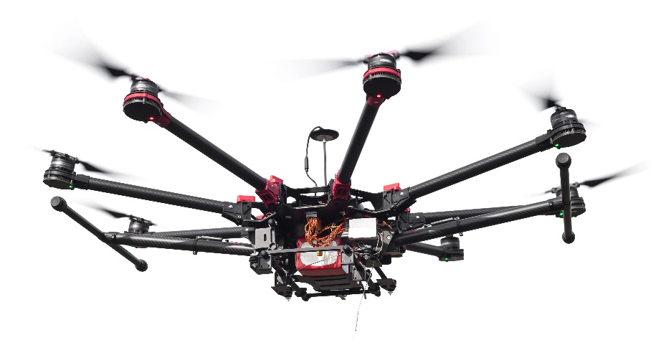









Use Case: Precision Agriculture
Velocity
Farm Management Info Systems
A wide spectrum of tools used by farmers all generating data
Satellites / Drones
Ability to identify yield and crop issues from space / drones
Farm Machinery
Every piece of equipment on the farm is now generating data and wants to be precise
Weather Data
Global current and historical weather and soil moisture data at sub-field level
Sensors(Fitbit for Cows)
Ground and animal sensors measure every- thing from animal fertility to soil moisture
Manufacturers & Distributors
Adaptris manages supply chain connectivity between MFRS and their distributors
Soil
Global soil type horizons
Agronomist
Providing farm advice, shape files and data to farmers

Slide 7
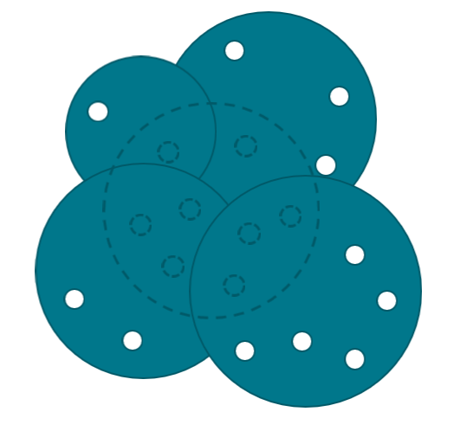
Variety
A single source of data is insufficient to overcome inaccuracies in the data
HPCC Systems is built on the premise of absorbing data from many data sources and transforming them to smart data (actionable)

Slide 8
What is a Data Lake? How is different from a Data Warehouse?

Slide 9
Key Attributes that distinguish a Data Lake
A central (logical) repository of data
Unlimited storage
Schema on read
Low cost of storage and compute
File metadata tracking
High performance processing

Slide 10
Data Lake Technology use parallel processing at its core (Apache Spark, HPCC Systems etc.)
8 Million Records
4 Partitions of 2 Million each
4 Parallel Executors
#1 ----- ------ ------
#2 ----- ------ ------
#1 ----- ------ ------
#2 ----- ------ ------
Executor 1
#3 ----- ------ ------
#4 ----- ------ ------
#3 ----- ------ ------
#4 ----- ------ ------
Executor 2
#5 ----- ------ ------
#6 ----- ------ ------
#5 ----- ------ ------
#6 ----- ------ ------
Executor 3
#7 ----- ------ ------
#8 ----- ------ ------
#7 ----- ------ ------
#8 ----- ------ ------
Executor 4
Split
Why is this efficient? 80% of data operations are inherently parallel

Slide 11
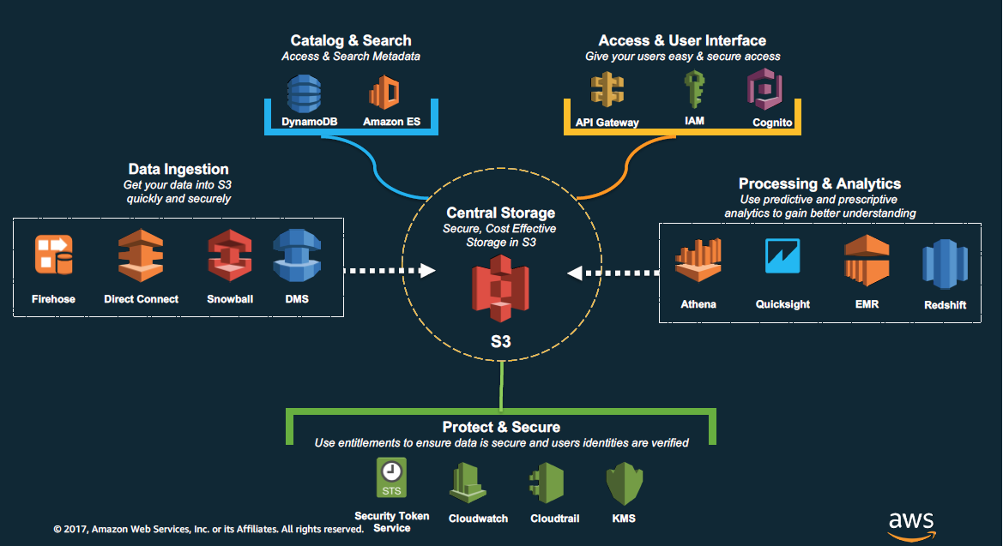
Components of an AWS Data Lake

Slide 12
Components of a HPCC Systems Data Lake
COLLECT
Batch
Real-time/Stream
Big Data
Structured
Unstructured
Semi-structured
Landing Zone (s)
Thor cluster(s)
Job Execution
ROXIE cluster (s)
Real-time API
Developer
Using VS Code ECL Plugin
Middleware Services

Slide 13
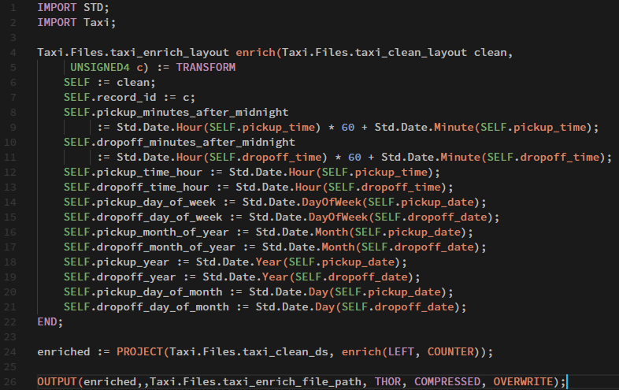
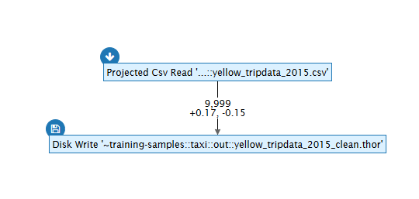
Coding (ECL) in HPCC Systems
Developer
Using VS Code ECL Plugin
Middleware Services
Compiled to a Data Flow Graph (C++ DLL)
Deployed to the Target Cluster
Execute

Slide 14



ECL Basics
Data Set
Schema on Read
Transform Activity
Transform
Action

Slide 15
ECL Transform Activities
PROJECT
ROLLUP
ITERATE
JOIN
NORMALIZE
DENORMALIZE
AGGREGATE
TABLE

Slide 16
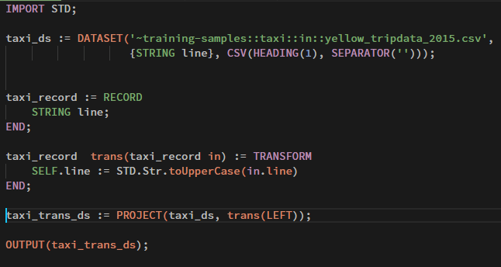
And the code

Slide 17
NYC Taxi and Uber trip data analysis

Slide 18
A Use Case – NYC Taxi Trip Data
Taxi and Uber Pickup and drop off trip information
Trips recorded between 2015 and 2016
1.3 billion records in total
Fields
Vendor id,
pickup and drop off date/time
passenger count
Lat, Long of the pickup and drop off
Payment type
Fare Amount
More…

Slide 19
The workflow
01
01 – Data Import
02 – Data Import Validate
03 – Data Profile
04 – Clean
05 – Enrich
06 – Analysis
07 - Visualize
08 – Train
09 – Model Build
10 – Export Data
Landing Zone (s)
Thor cluster
Job Execution
ROXIE cluster
Real-time API
03,04,05,06,07,08,09
10
Middleware Services

Slide 20
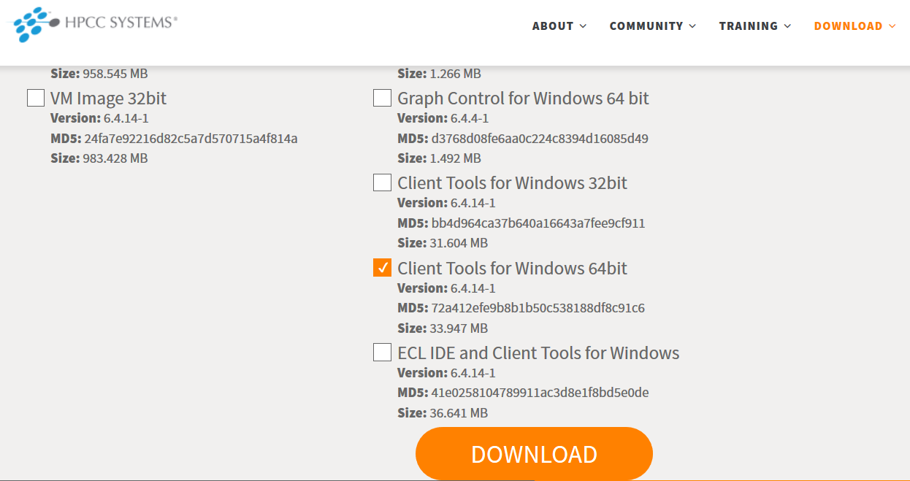
Prerequisite 1: Install HPCC Systems Client Tools

Slide 21
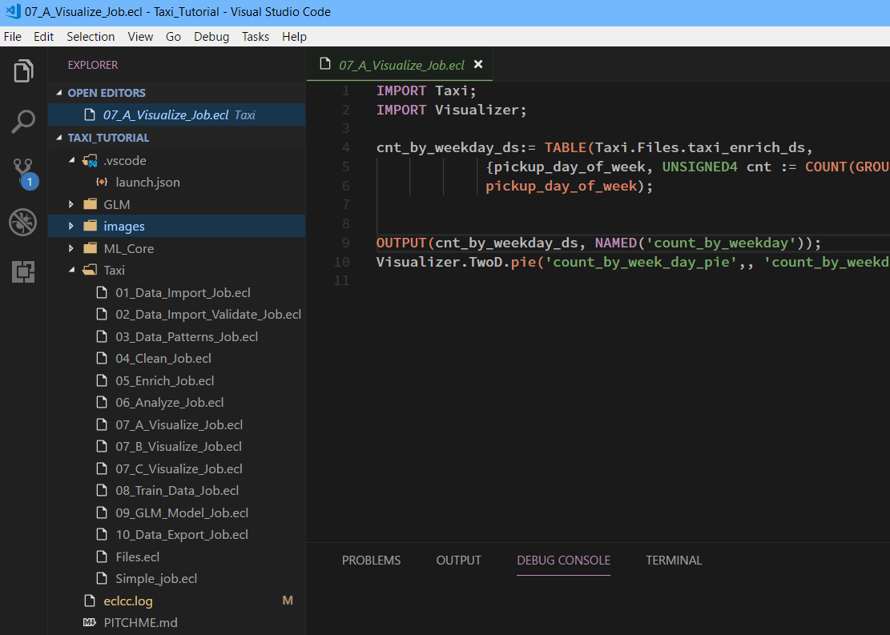
Prerequisite 2: VS Code IDE and ECL Plugin

Slide 22

Prerequisite 3: HPCC Systems Cluster
Landing Zone (s)
Thor cluster
Job Execution
ROXIE cluster
Real-time API
http://play.hpccsystems.com:8010
1 instance of C4.2xLarge
Middleware Services
http://54.227.181.228:8010
5 instance of R3.xLarge

Slide 23
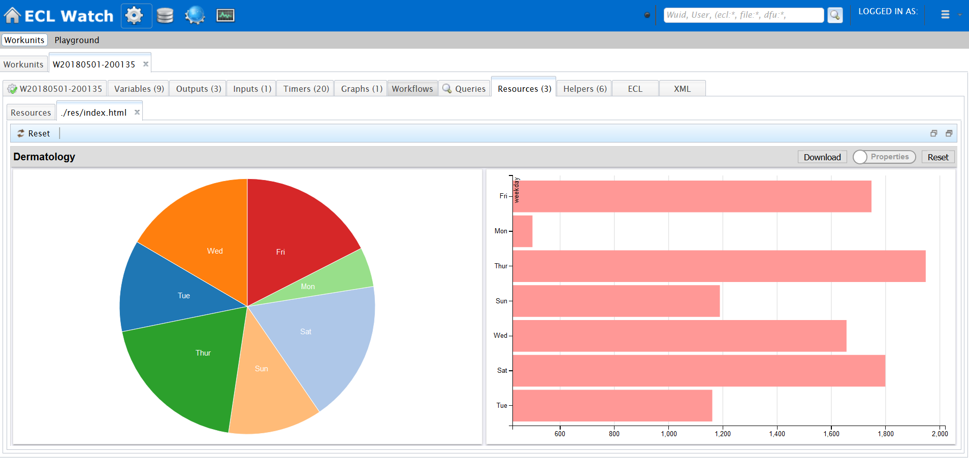
Prerequisite 4: Basic Knowledge of ECL Watch (management console)
ECL Jobs Execution Output
Landing Zone Files and Logical Files
Persisted/Materialized Output
Visualization

