Slide 1

Comprehensive Data Analysis
Data Science Career Track
Egor Petrov

Slide 2
Agenda
Welcome Message
About
Team
Introduction to a project
Final Thoughts

Slide 3

Defining a Project
Main Course Project for Developing Data Science Skills

Slide 4
The problem
Predicting a Sale Price
Problem statement
My project is focused on challenges to predict the final price of each home.
This is too hard or impossible to calculate the final price. Each house is different and built from so many different structures. Each house has a different zone classification and many more differences. In my project I will show how this can be solved with a Data Scientist expertise.

Slide 5
Solution
Use of new technologies.
New Python + AI
Very new approach!
Let the computer do the service for you!
Train your ML model!

Slide 6
Implementation

Slide 7
Dataset Wrangling and Cleaning
Dataset Analysis
Exploratory Data Analysis
Statistical Data Analysis

Slide 8
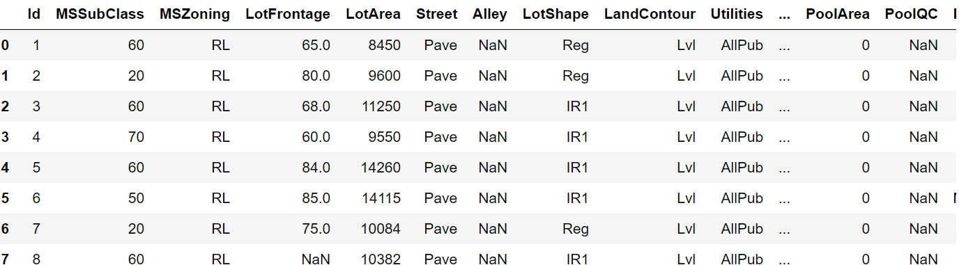
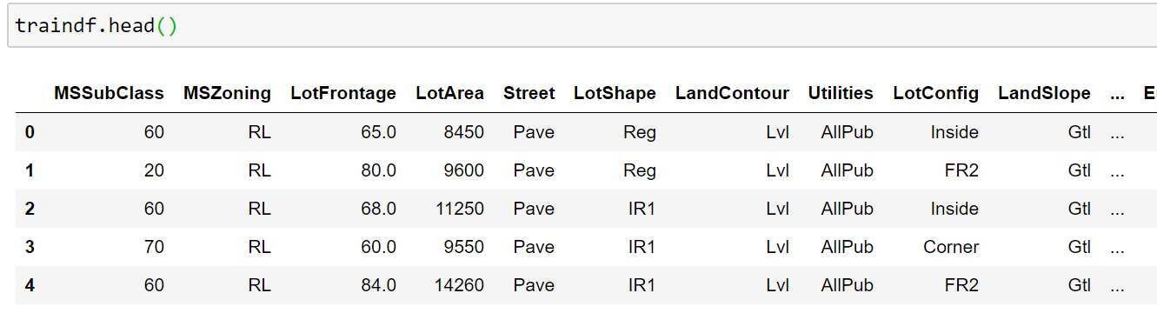
Data Wrangling Results
Initially Data comes as a mess. It can have a lot of missing values in it.
Data Wrangling techniques used by a data scientist will update the same dataset as a complete DataFrame

Slide 9
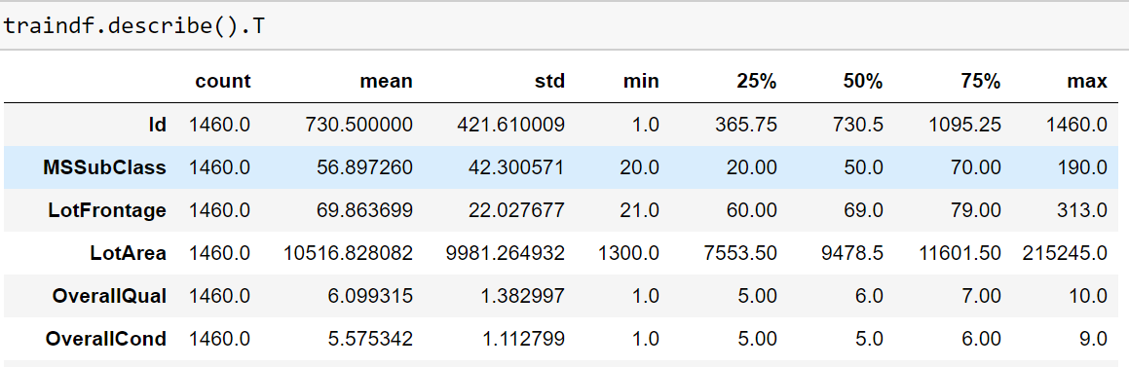
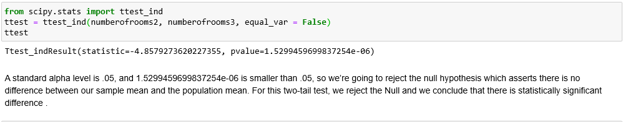
Statistical Analysis Results
Hypothesis testing

Slide 10
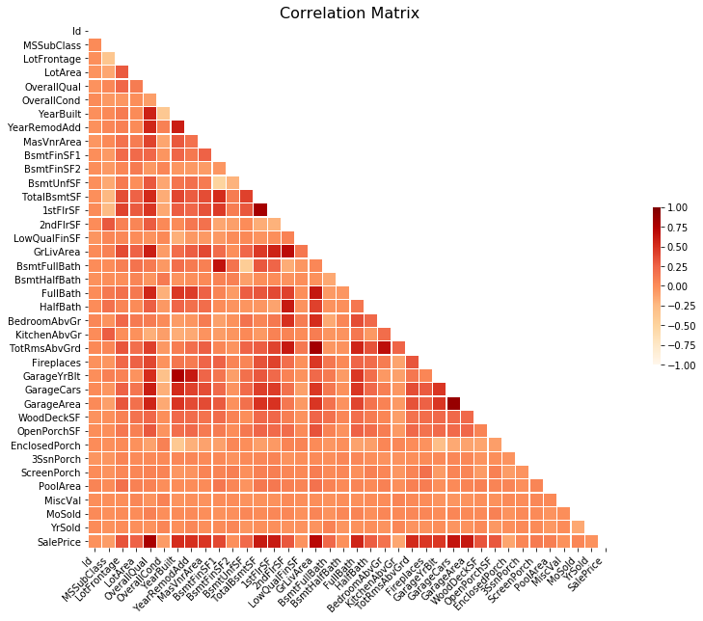
Visualizations

Slide 11
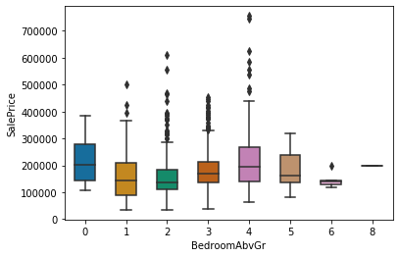
Visualizations

Slide 12
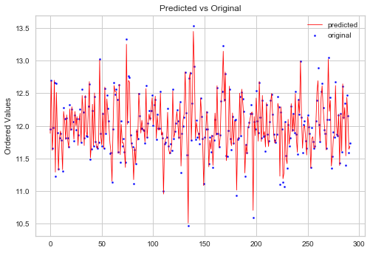
Training a model

Slide 13
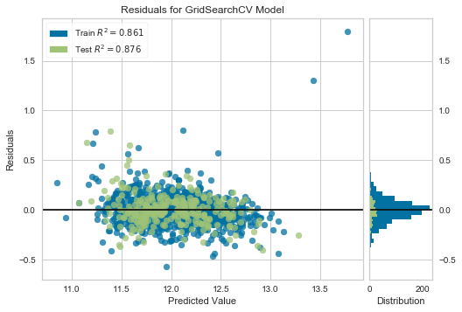
Visualizations

Slide 14
Metrics
Ridge: RMSE scores mean: 0.143
Ridge after removing not correlated features: RMSE scores mean: 0.143
Pipeline Ridge: RMSE scores mean: 0.141
Random Forest: RMSE scores mean: 0.144
Random Forest after removing NOT correlated features: RMSE scores mean: 0.144
XGBoost : RMSE scores mean: 0.130
XGBoost after removing NOT correlated features: RMSE scores mean: 0.130

Slide 15
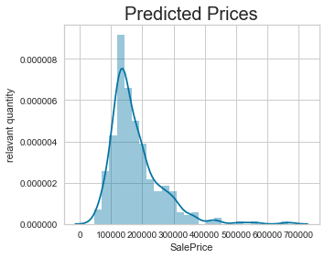
Target
ma growth
Predicted Prices

Slide 16
Final Thoughts
A ML model is fun, fast and accurate.
Dataset preprocessing takes 80% of work.
Advice: Know your data, visualize data
Statistics matter

