Slide 1

Diabetes Classification
Weekly Assignment 2
By: Newton AI Team

Slide 2
Bussiness and Data Understanding
1
Basic Information about Diabetes

Slide 3
Reason of This Project
Definition
Diabetes is a chronic, metabolic disease characterized by elevated levels of blood glucose (or blood sugar), which leads over time to serious damage to the heart, blood vessels, eyes, kidneys and nerves. The most common is type 2 diabetes, usually in adults, which occurs when the body becomes resistant to insulin or doesn't make enough insulin.
Diabetes Risk
In the past 3 decades the prevalence of type 2 diabetes has risen dramatically in countries of all income levels. Type 1 diabetes, once known as juvenile diabetes or insulin-dependent diabetes, is a chronic condition in which the pancreas produces little or no insulin by itself. For people living with diabetes, access to affordable treatment, including insulin, is critical to their survival. There is a globally agreed target to halt the rise in diabetes and obesity by 2025.)
Key Point: An AI system to speed up the diagnosing process of diabetes as well as for prevention methodfrom getting diabetes

Slide 4
EDA
2

Slide 5
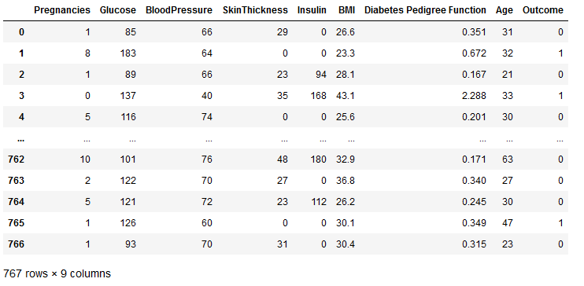
Exploring Datasets
Our Datasets has 767 data with total of 8 feature and 1 target.

Slide 6
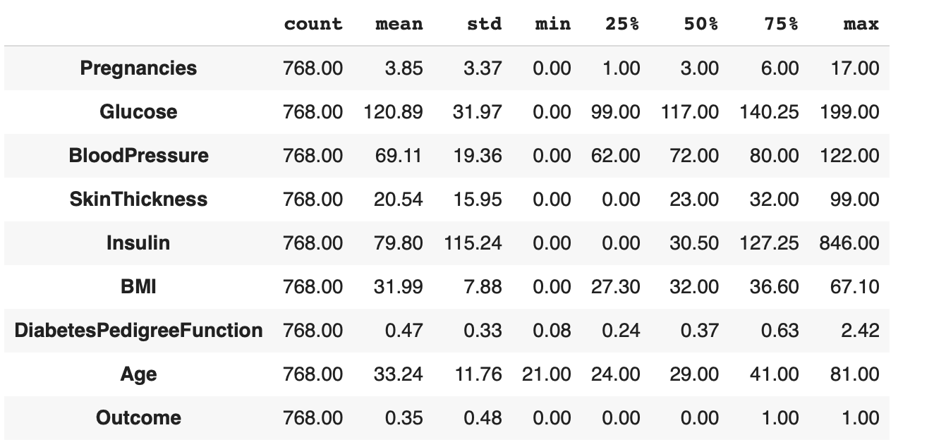
Exploring Datasets
Statistical component from the datasets.

Slide 7
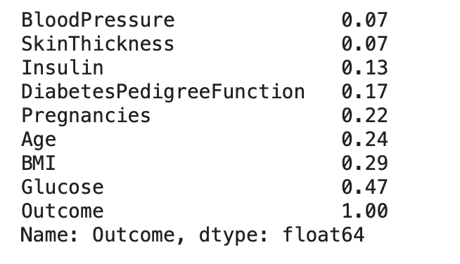
Exploring Datasets
Insight from Correlation:
We can assume that high glucose in their body has high risk getting diabetes
We can assume that person with high BMI also has high risk getting diabetes

Slide 8
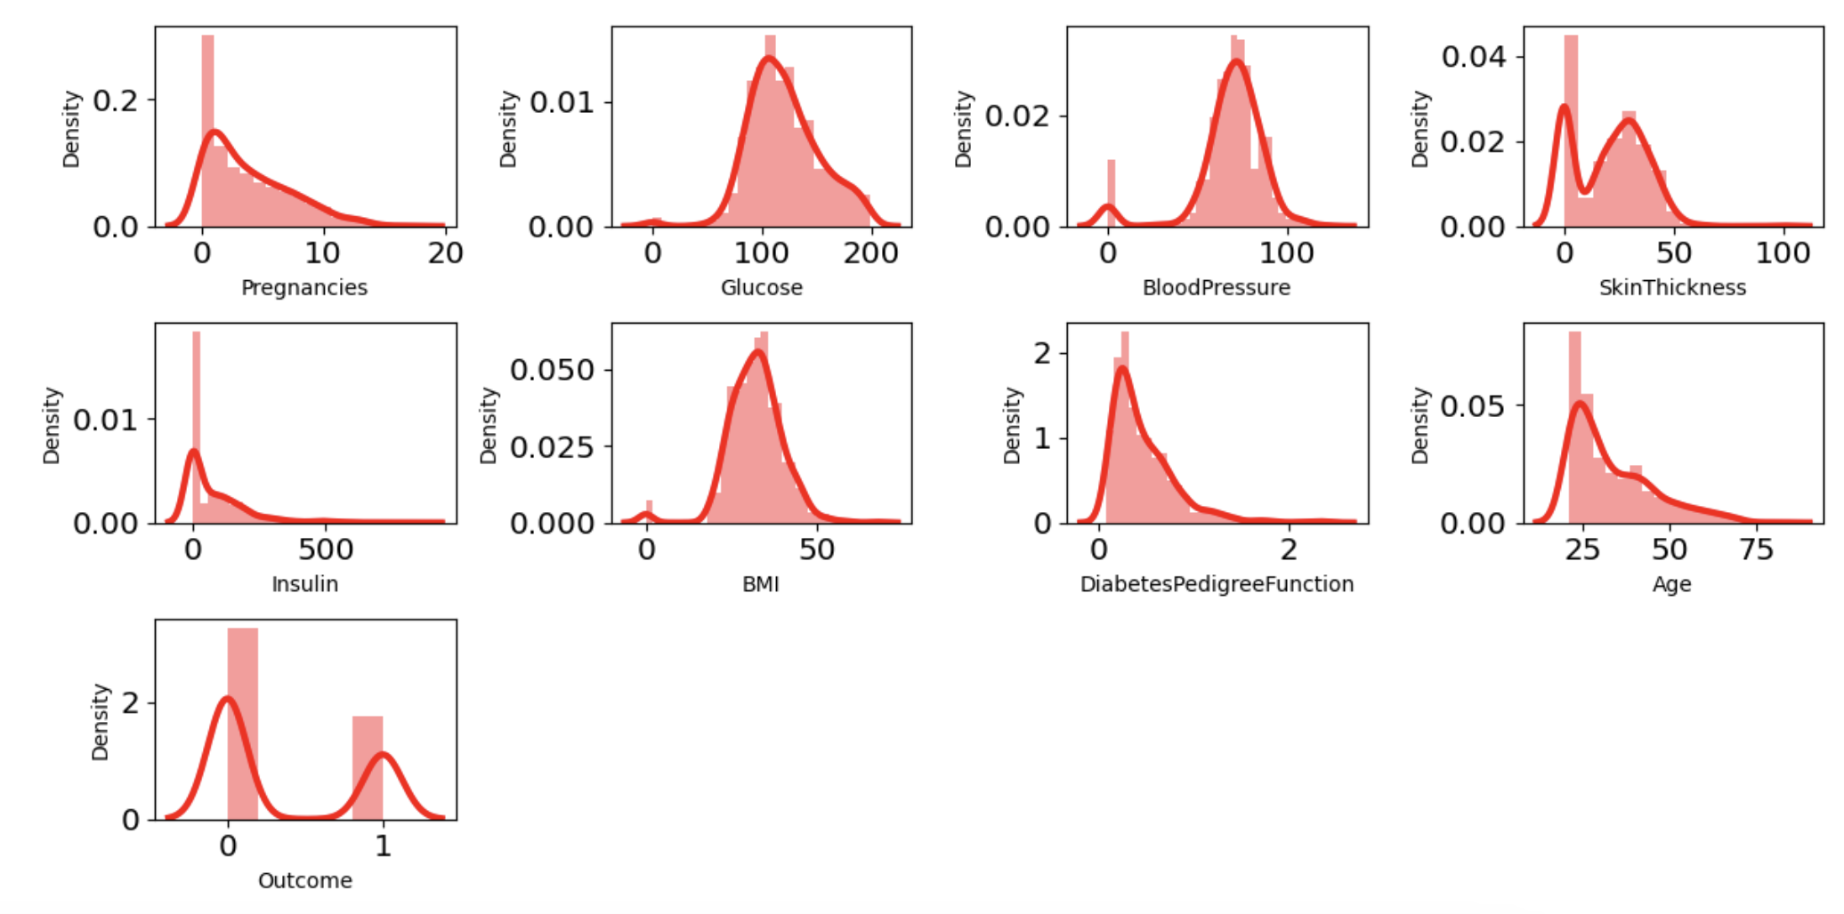
Exploring Datasets
Cenderung memiliki skewed distribution

Slide 9
Data Cleaning and Preparation
3
Removing Outlier, Normalization, and so on

Slide 10
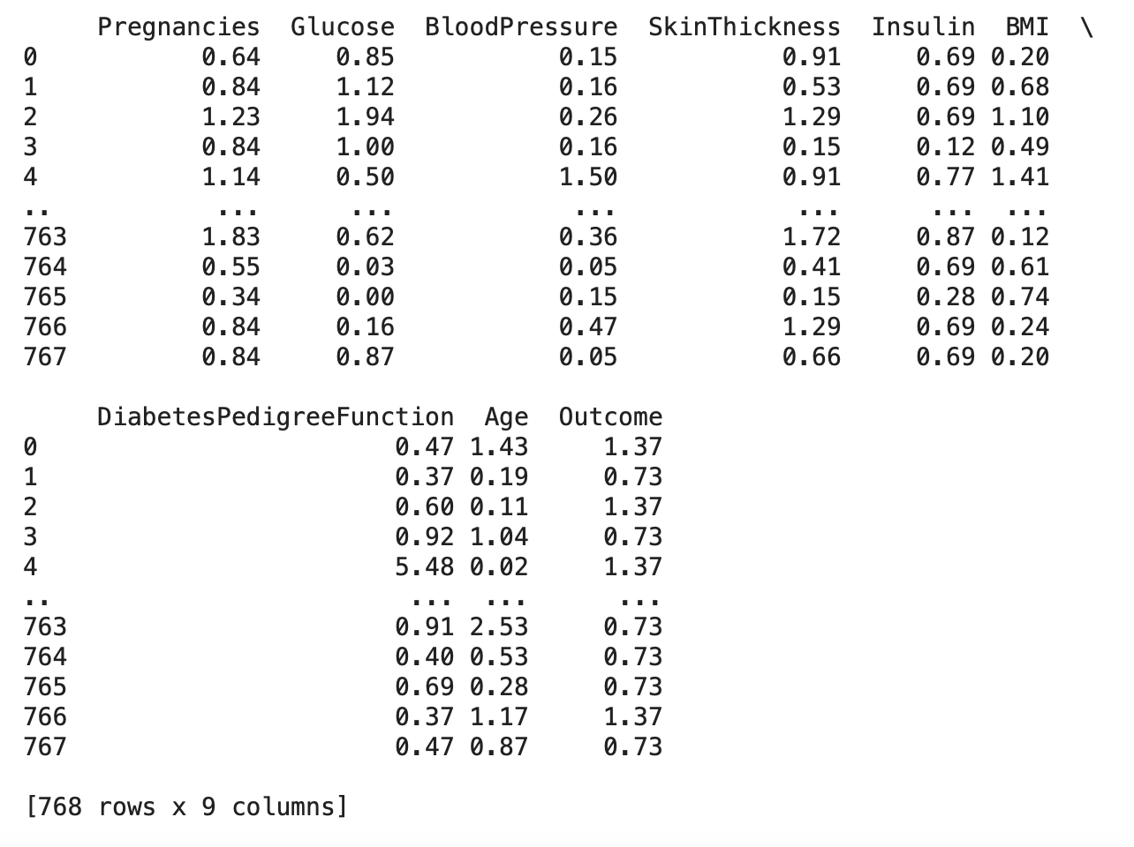
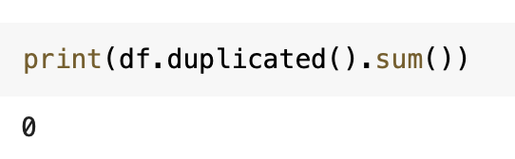
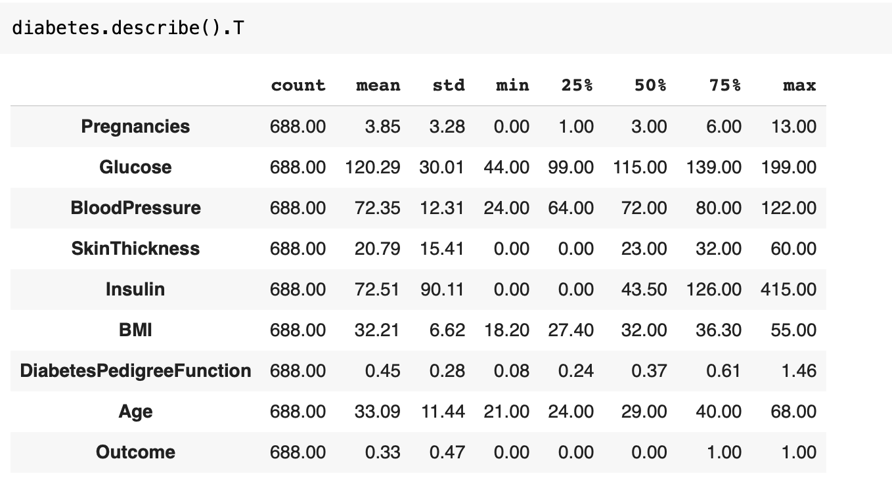
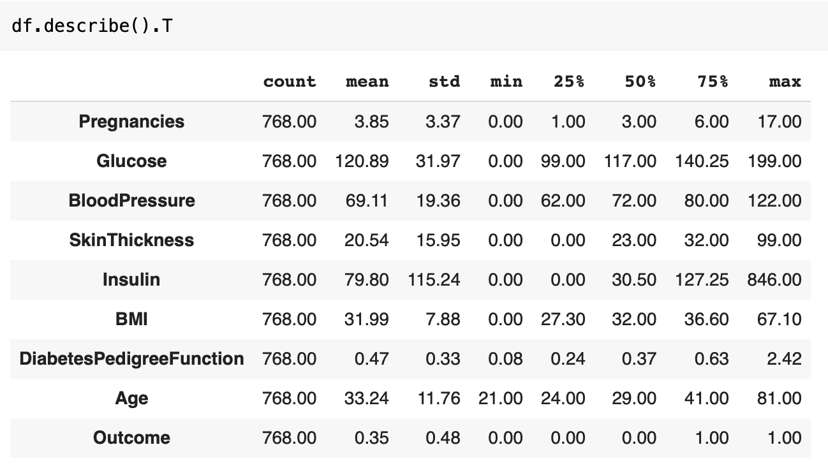
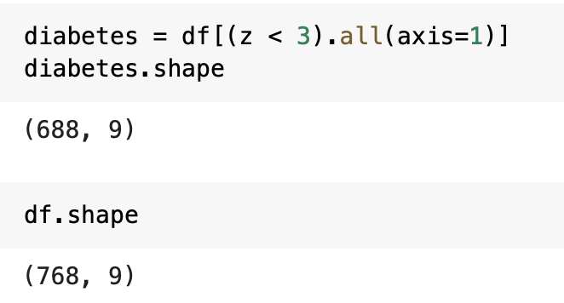
Removing Outliers
Checking Duplication
Method: Z-Score

Slide 11
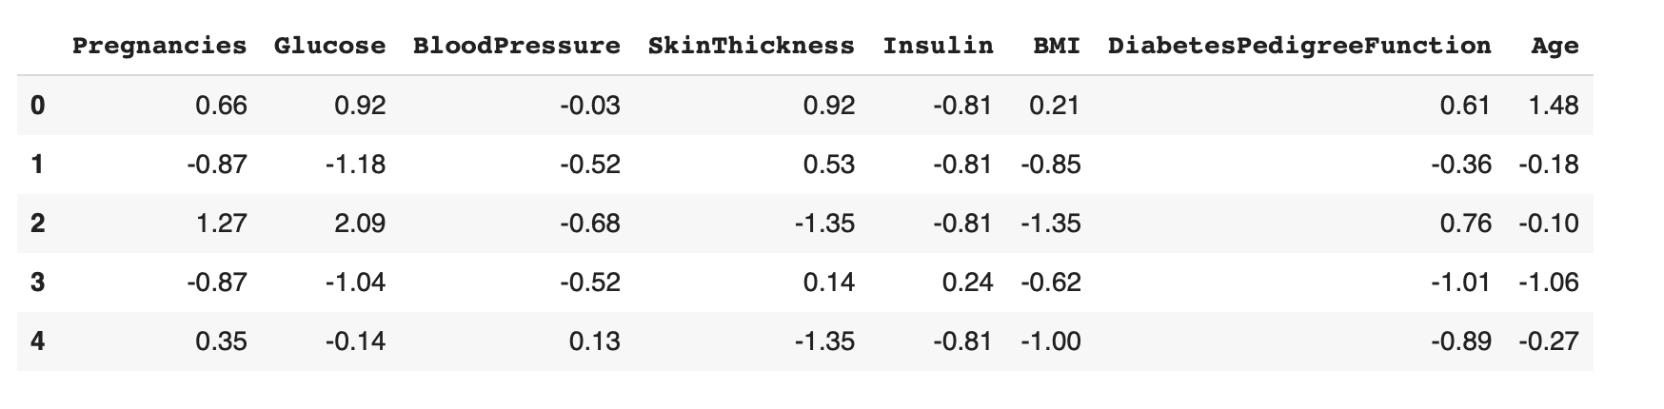
Scaling
Method: MinMax Scaler

Slide 12
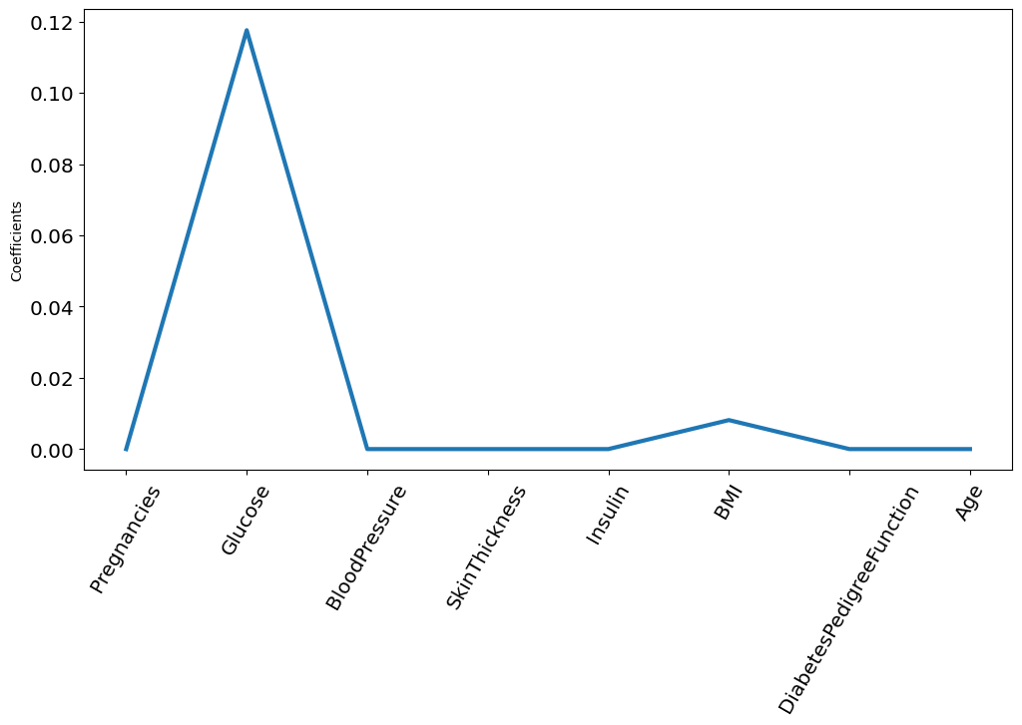
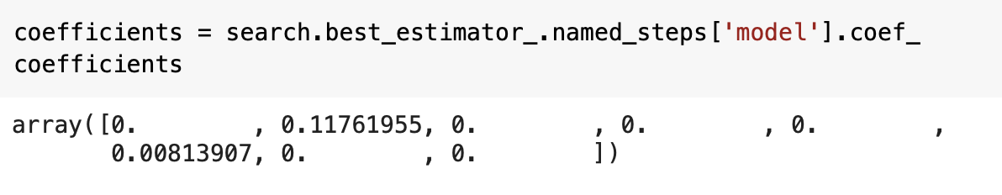
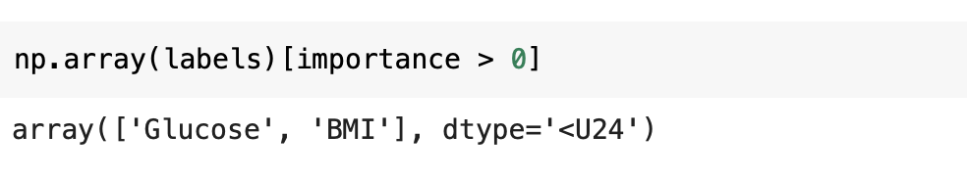
Feature Selection
Method: LASSO

Slide 13
Data Modeling
3
Lazy Regressor, MLP

Slide 14
Lazy Classifier
Features | Algorithm | Accuracy
Glucose, BMI (LASSO) | GaussianNB | 83%
Glucose, BMI, Insulin | SGDClassifier | 80%
Glucose, BMI, Age, Insulin, BloodPressure | NuSVC | 80%
Glucose, BMI, Blood Pressure | AdaBoostClassifier | 79%
Glucose, BMI, Age | NuSVC | 79%
Glucose, BMI, Insulin, Blood Pressure | BernoulliNB | 79%
Glucose, BMI, Age, Blood Pressure | ExtraTreesClassifier | 78%
All Features | SGDClassifier | 78%
Glucose, BMI, Age, Insulin | KNeighborsClassifier | 77%

Slide 15
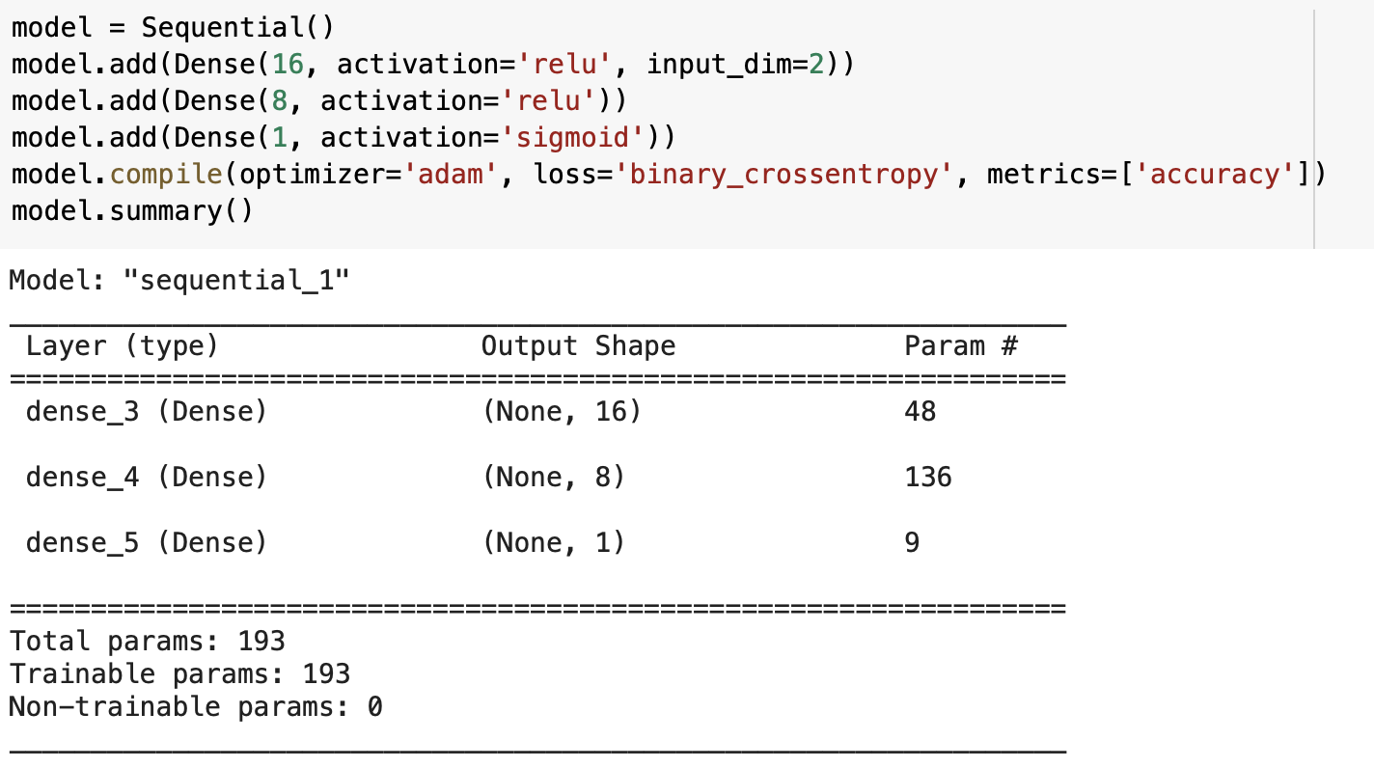
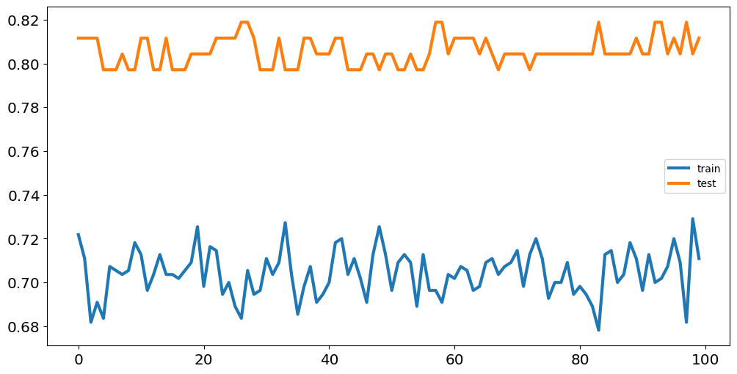
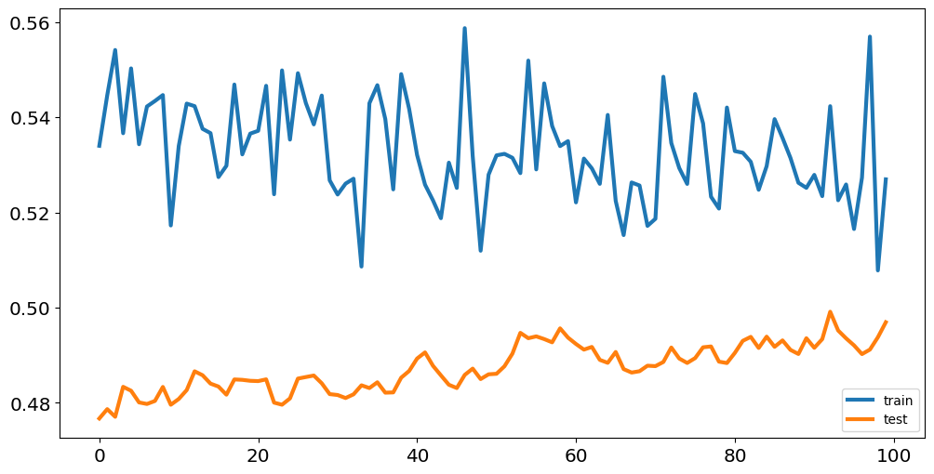
MLP (LASSO : Glucose, BMI)
Accuracy
Loss
Training Accuracy | 76%
Val Accuracy | 82.6%

Slide 16
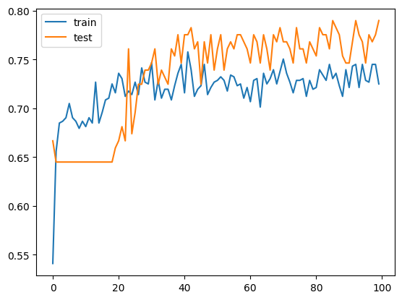
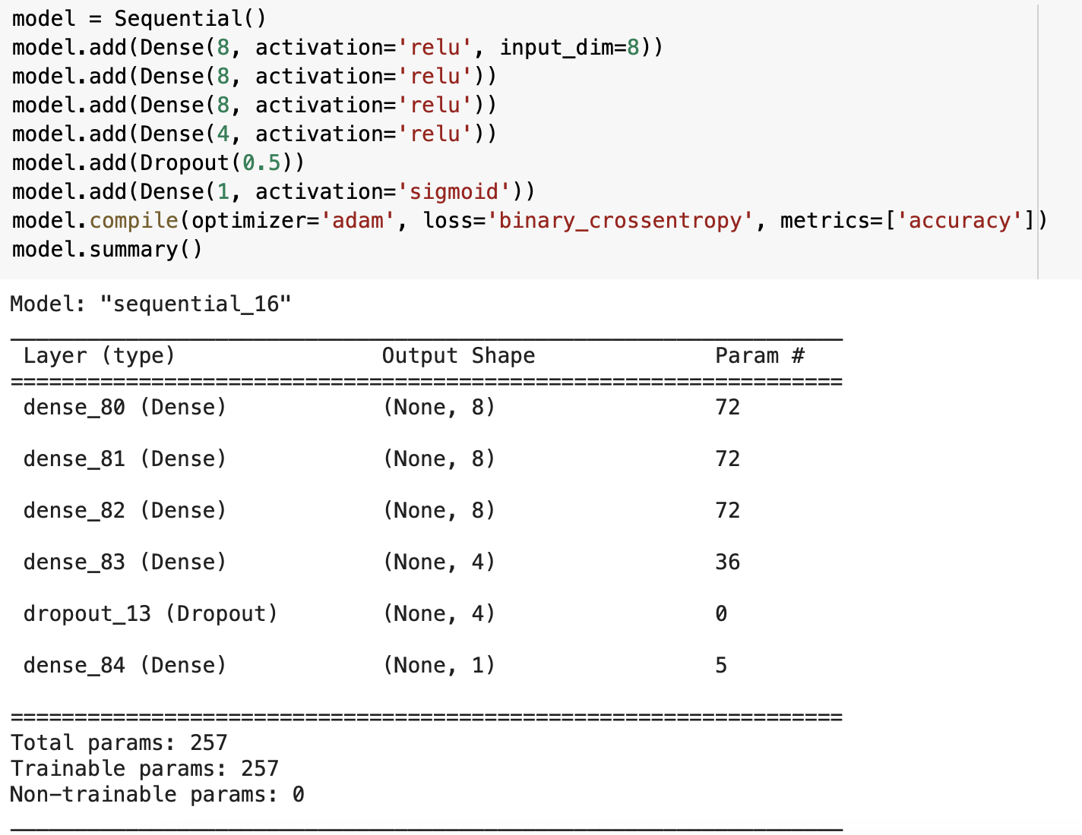
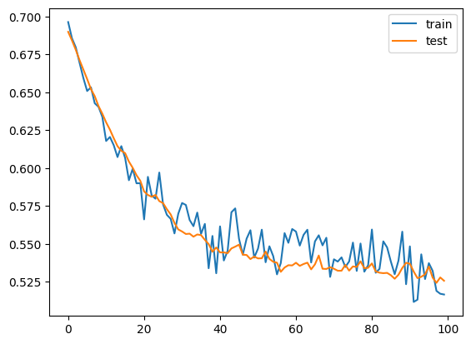
MLP (All Features)
Accuracy
Loss
Training Accuracy | 73%
Val Accuracy | 79%

Slide 17
Model Evaluation
4
Confusion Matrix Result

Slide 18
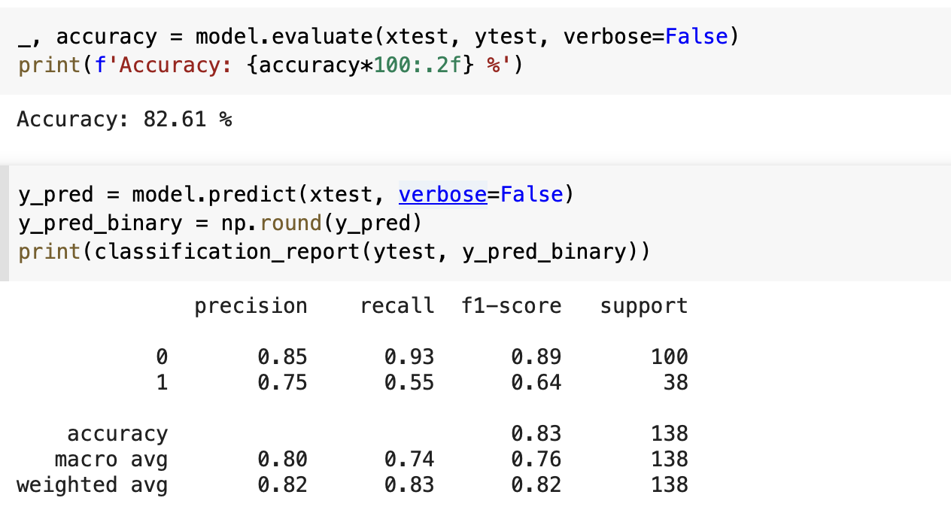
Classification Report (MLP -LASSO)

Slide 19
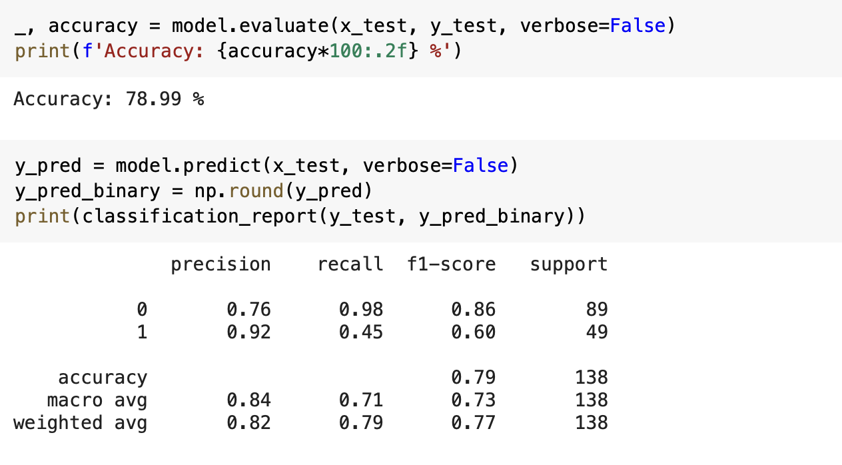
Classification Report (MLP - ALL Features)

Slide 20
Future Improvements
5

Slide 21
Things we can add in the future
Oversampling method. Because of Imbalanced Dataset. Especially on people who have diabetes, is only half of those who don’t have.
Hyperparameter Tuning. Using Bayesian Optimization.

Slide 22
Things we can add in the future
Add more parameters and tune learning rate or batch size for more stable learning curve.
Try cross validation to measure model’s performance on different folds of data.

Slide 23
Model Deployment
6
https://newtonai-diabetes-diagnosis.streamlit.app/

