Slide 1
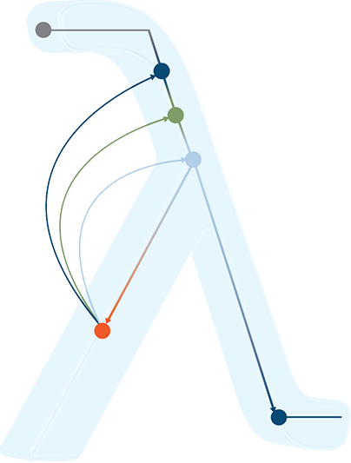
Proposal: Using absorbing Markov chains to model patient flow
Horizon Eye Care
November 10, 2017

Slide 2
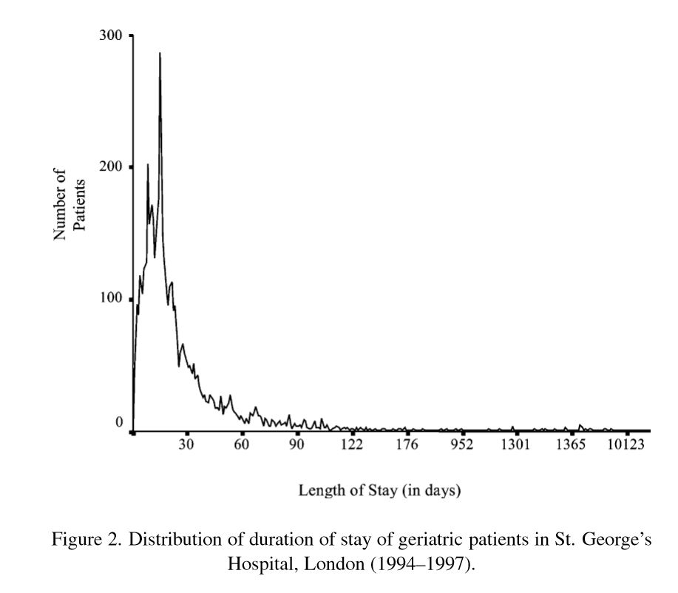
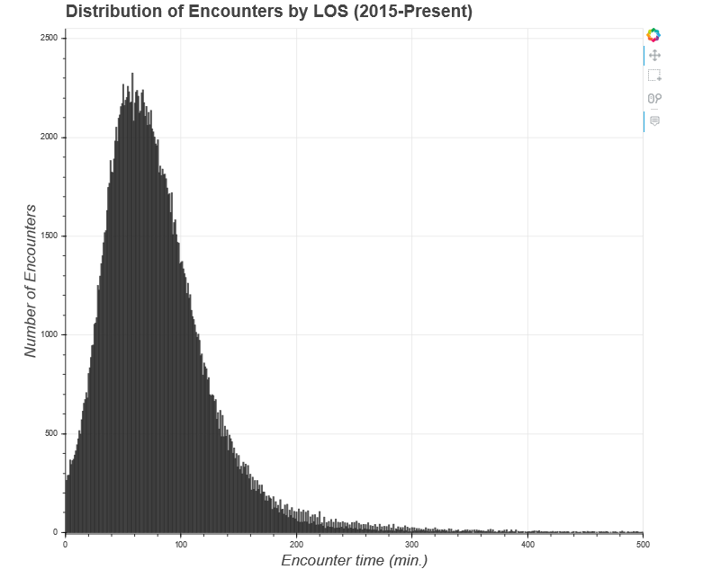
Literature Review
Figures: Distribution of patient visits by length-of-stay for Horizon’s data (bottom) aligns well with distributions seen in literature (above) [2], despite the different time scales. Note the long tail and right-skewedness.
Other teams have found success using state-based models to predict length of stay via patient movement through phases of care. One article mentioned several options: Markov models, phase-type distributions, mixed exponential distributions, and simulation [2].
After reviewing phase-type distributions [1,3], their limitations and complexity seemed a poor fit, but the notion of an absorbing state that all processes eventually enter was analogous to a patient checking out.
Absorbing Markov chains incorporate an absorbing state without over-complexity and limitations.

Slide 3
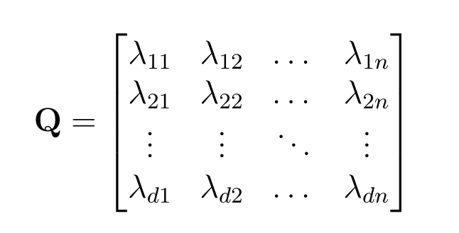
Absorbing Markov Chains
Figures: An example Markov chain for Horizon’s patient flow is pictured above. Below is the matrix of transition probabilities.
Provider
Check-in
ABSORB
Arrival
Tech
Checkout
Wait
Testing
Model transition to an absorption state, which is a state that cannot be left once entered.
Any transient state (non-absorbing state) can transition either to another transient state or the absorbing state.
Transition events are represented by the probability of the specific transition from state i to state j.
Expected value for number of occurrences of transient states can be found via the matrix equation N = inv(I – Q), then expected value of time spent in these states is calculated by multiplying this value by the average length of time spent in that state [4].

Slide 4
Requirements
Future Trials
Build model for each Visit Type and Location
Data set:
{Id, VisitType, Location, PatientFlowState,
NextFlowState, AvgLengthOfState}
Build bootstrapped datasets for cross-validation and testing set
Construct matrix T with all transition probabilities to transient states and absorption states – Derive matrix Q from it.
Solve equation from previous slide to find expected length of time for each flow state and total predicted time
Test set: bootstrapped sample of appointments with total E-time and E-time for each flow state.
Incorporate other predictive variables: Diagnosis, Doctor, Age Bin, etc., Time of Appointment, Date of Appointment
Fit a true phase-type distribution with an expectation maximization algorithm
Incorporate deterministic bottleneck detection
Integrate with a No-Show Model for complete sight into expected outcomes.

Slide 5
References
Asmussen, S. et. al. (1996). Fitting Phase-type Distributions via the EM Algorithm. Scandinavian Journal of Statistics, 23, 419-441
Marshall, A., Vasilakis, C., El-Darzi, E. (2005, August). Length of stay-based patient flow models: recent developments and future directions. Health Care Management Science, 8 (3), 213- 220
Marshall, A., McClean, S. (2004). Using Coxian phase-type distributions to identify patient characteristics for duration of stay in hospital. Health Care Management Science, 7, 285- 289
Montgomery, J. (2009, February). Absorbing Markov Chains. Retrieved from https://www.ssc.wisc.edu/~jmontgom/absorbingchains.pdf

