Slide 1
THIAGARAJAR COLLEGE OF ENGINEERING,MADURAI
DEPARTMENT OF ECE
22EC690 – PROJECT-II
Emotion detection from a speech signal using ViT
[Vision Transformer]
Guided By,
DR.M.N.SURESH ,
ASSOCIATE PROFESSOR,
ELECTRONICS AND COMMUNICATION ENGINEERING,
TCE.
Team Members
2302917710621091 - NISHAANTH R
2303917710621032 -HARI HARA SUDHAN C
2303917710621317- PREM KUMAR P

Slide 2
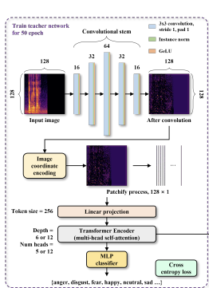
ViT [Vision Transformer]
Here We Use ViT Which Is A Deep Learning Model To Split Speech signal Or Image Into Patches Process Them Like A Sequence Of Tokens
Collection of dataset form CREMAD dataset.

Slide 3
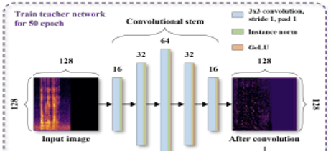
Brief Explanation About The Architecture
Title:
CNN + Transformer architecture
Overall Architecture:
Speech Spectrogram CNN Transformer Emotion
Convolutional stem:
  Uses 3x3 Kernels
  Extracts local features
  Filters: 16 32 64 32 16
  Increase in filters helps to learn complex features
  Decrease in filters compresses the important information

Slide 4
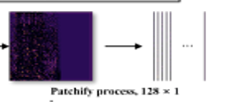
Why CNN?
it captures or extracts local features like
Pitch
Energy
Frequency patterns. Depending upon the number of filters used
Patchify process:
The output we get after the convolution is a feature map which contains local features now in this process the feature map got split into vertical patches.
Each patch = time segment of speech
128x128 is converted into 128x1

Slide 5
Token embedding:
Each patch is converted into vectors
Vectors are the 1D flattened values of each patch
Vectors are converted to tokens and these numerical tokens are given as input to the transformer
Vector = [x1,x2,x3,….,x128]
Tokens are taken in the size of 256
Positional encoding:
Adds position information to the tokens
It is very important because speech is sequential
It helps the model to understand the time order
Transformer encoder:
It is the core part of the model
It learns relationship between the patches and it understand the long term speech behaviour to understand the patterns which is very important for emotion detection
CNN is for local features and transformer captures the global dependencies

Slide 6
MLP classifier:
The Multi Layer Perceptron (MLP) is a fully connected neural network which is used at the Final stage
It takes the features from the transformer and converts them into emotion probabilities
In simple words , it is to classify the extracted features into emotion classes

Slide 7
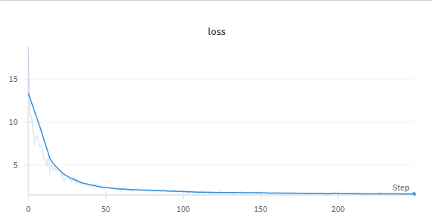
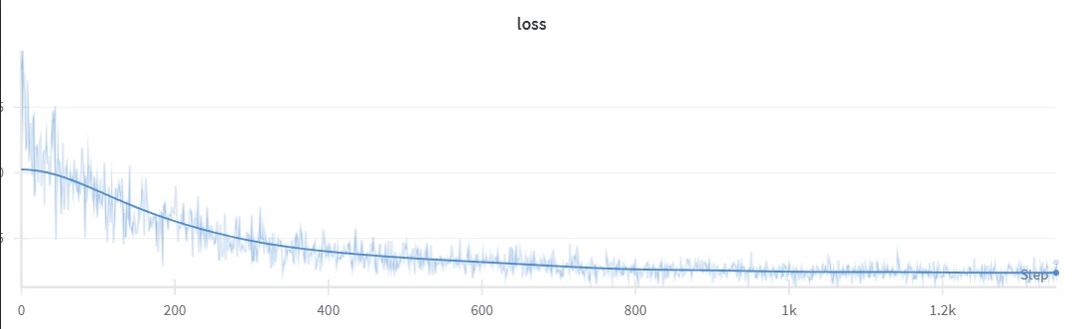
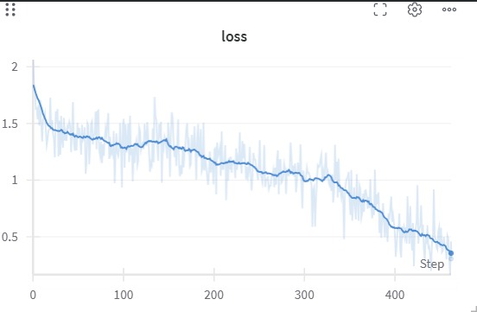
MODEL - 1
MODEL - 2
MODEL - 3
Architecture: Vertically Patched VIT
Epochs: 50
Lr rate : 1e-3
Accuracy: 25% on test set. (Higher level of Underfit).
Architecture: Vertically Patched VIT
Epochs: 50
Lr rate : 1e-4
Accuracy: 27% on test set. (Higher level of Underfit)
Architecture: Vertically Patched VIT
Epochs: 25
Lr rate : 1e-4
Accuracy: 87% on train set and 30% test set. (Higher level of Overfit).

Slide 8
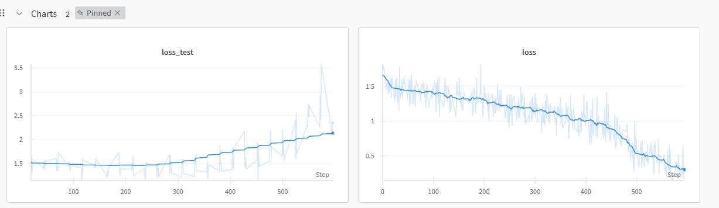
FINDING OPTIMAL EPOCH
Since at a certain point of step the training loss tends to decrease further while the testing loss increases.
We found that at step=313 the gradient starts to take other direction we found the corresponding epoch as 13.
313/23.84 ~ 13 which is the optimal epoch
Steps per epoch = dataset size/(batchsize * 10) = 23.84

Slide 9
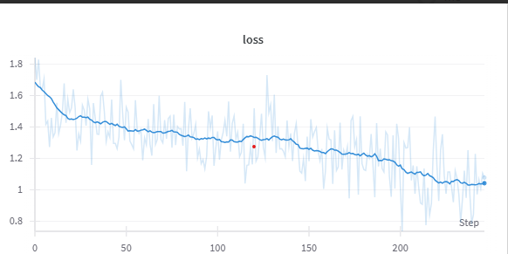
PROCESS & INTERPRETATION OF MODEL - 4
Architecture: Vertically Patched VIT
Batch Size: 32
Epochs: 13
Lr rate : 1e-4
Optimizer: Adam
Train test split: 80 – 20 split
Accuracy: 61% on train set and 53% test set. (Generalized).
Size: 11.1 MB

Slide 10
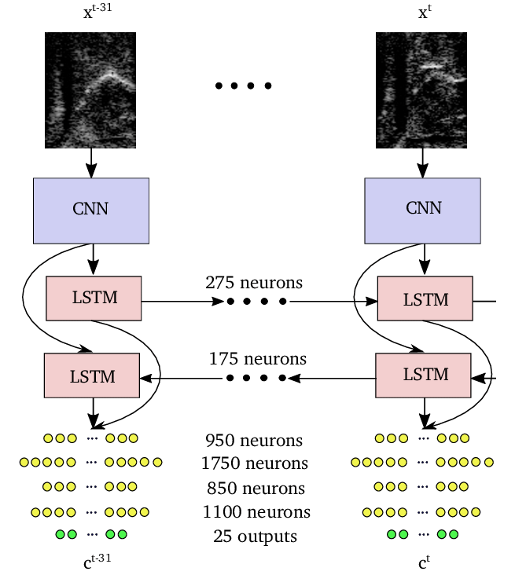
Process & Interpretation of Model-5
Architecture: CNN BiLSTM
Architecture: CNN BiLSTM
Batch Size: 32
Epochs: 44 (Early Stopped)
Lr rate : 1e-3
Optimizer: Adam
LR Scheduler: LRPlateueScheduler
Size: 65.8 MB
Accuracy: 64% on train set and 63% test set. (Generalized).

Slide 11
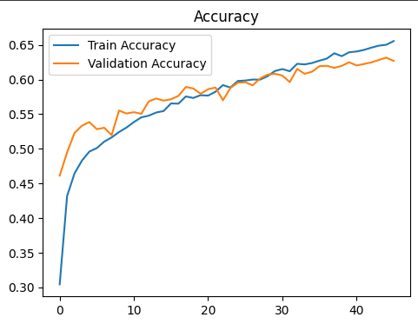
Process & Interpretation of Model-5

Slide 12
Process & Interpretation of Model-6
Architecture: CNN BiLSTM (Ravedess + CREMAD + TESS)
Architecture: CNN BiLSTM
Batch Size: 32
Epochs: 45 (Early Stopped)
Lr rate : 1e-3
Optimizer: Adam
LR Scheduler : LRPlateueScheduler
Size: 65.8 MB
Accuracy: 88% on train set and 87% test set. (Generalized).

Slide 13
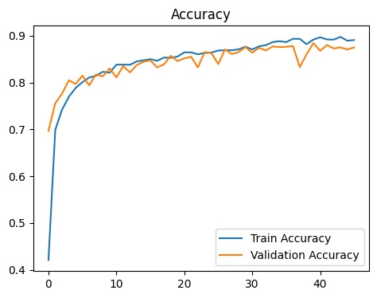
Process & Interpretation of Model-6

Slide 14
FEATURES TO BE ADDED
Wanted to explore alternative feature extraction methods like Gamma tone filter bank, LPC, WFC.
Want to make a comparative study with each of these feature extraction techniques and want to try multi feature fusion for paper works.
Want to explore Real-time speech acquisition using ADC with USART-based transmission for live emotion detection

Slide 15
SDG Relevance
SDG 3 – Good Health and Well-being
• Early detection of stress, depression, or burnout from voice signals.
• Support mental health interventions and remote patient monitoring.
SDG 9 – Industry, Innovation, and Infrastructure
• Driving innovation in AI, speech technology, and human-computer interaction.
SDG 17 – Partnerships for the Goals
• Collaboration between academia, healthcare, and tech companies to responsibly advance SER technology.

Slide 16
THANK YOU

