Slide 1
THIAGARAJAR COLLEGE OF ENGINEERING,MADURAI
DEPARTMENT OF ECE
22EC690 – PROJECT-II
Review-I
Emotion detection from a speech signal using ViT
[Vision Transformer]
Guided By,
DR.M.N.SURESH ,
ASSOCIATE PROFESSOR,
ELECTRONIC AND COMMUNICATION ENGINEERING,
TCE.
Team Members
2302917710621091 - NISHAANTH R
2303917710621032 -HARI HARA SUDHAN C
2303917710621317- PREM KUMAR P

Slide 2
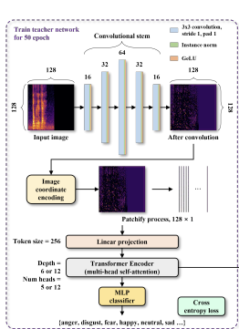
ViT [Vision Transformer]
Here We Use ViT Which Is A Deep Learning Model To Split Audio Or Image Into Patches Process Them Like A Sequence Of Tokens
Collection of dataset form CREMAD dataset.

Slide 3
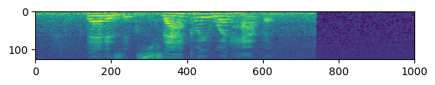
PREPROCESSING
Sampled every audio file at 16KHz with a 4 sec time window.
Samples are then padded or trimmed accordingly.
Converting to frequency domain using STFT algorithm.
Converting to Spectrogram to analyze pitches.
Converting to log mel spectrogram as they are in human hearing range.
Dataset Size: 7442 samples Train: 5,953 Test: 1489

Slide 4
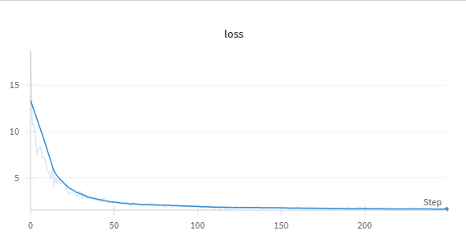
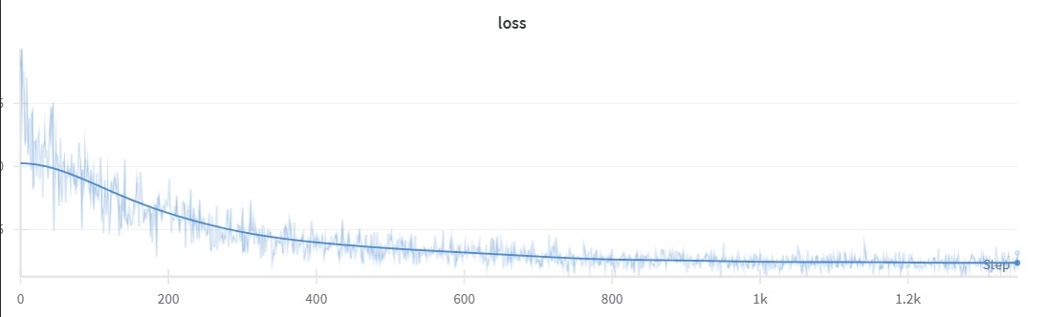
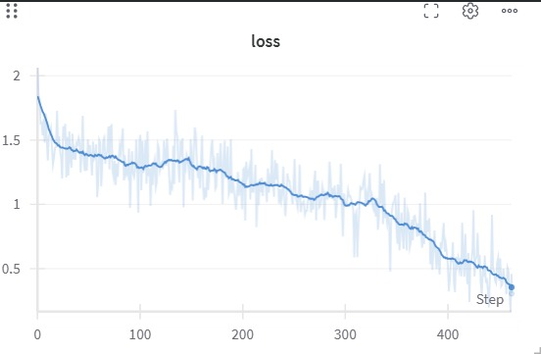
MODEL - 1
MODEL - 2
MODEL - 3
Architecture: Vertically Patched VIT
Epochs: 50
Lr rate : 1e-3
Accuracy: 25% on test set. (Higher level of Underfit).
Architecture: Vertically Patched VIT
Epochs: 50
Lr rate : 1e-4
Accuracy: 27% on test set. (Higher level of Underfit)
Architecture: Vertically Patched VIT
Epochs: 25
Lr rate : 1e-4
Accuracy: 87% on train set and 30% test set. (Higher level of Overfit).

Slide 5
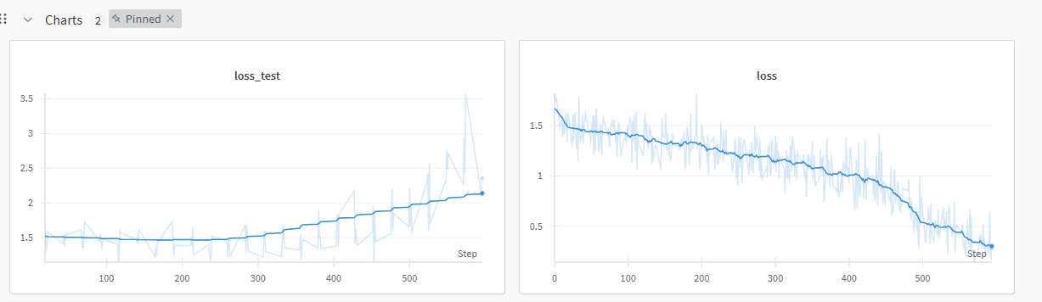
FINDING OPTIMAL EPOCH
Since at a certain point of step the training loss tends to decrease further while the testing loss increases.
We found that at step=313 the gradient starts to take other direction we found the corresponding epoch as 13.
313/23.84 ~ 13 which is the optimal epoch
Steps per epoch = dataset size/(batchsize * 10) = 23.84

Slide 6
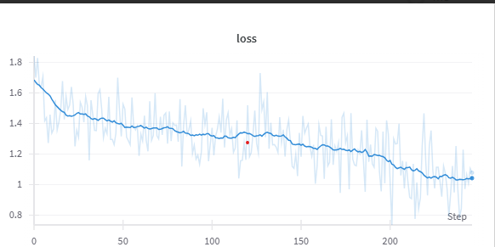
PROCESS & INTERPRETATION OF MODEL - 4
Architecture: Vertically Patched VIT
Batch Size: 32
Epochs: 13
Lr rate : 1e-4
Optimizer: Adam
Train test split: 80 – 20 split
Accuracy: 61% on train set and 53% test set. (Generalized).
Size: 11.1 MB

Slide 7
FEATURES TO BE ADDED
Since, it is highly important to run the model on low end (edge) devices with reduced or optimal latency we want to proceed with Quantization.
Want to train models in various architectures to improve the accuracy which includes, CNN BiLSTM architecture and also wanted to explore alternative feature extraction methods like Gamma tone filter bank, LPC, WFC.
Want to make a comparative study with each of these feature extraction techniques and want to try multi feature fusion for paper works.

Slide 8
THANK YOU

