Slide 1
CS401 - Communications
Benjamin Newton, Aaron Nguyen, Jagjot Nijjar, Kosta Nikolaou

Slide 2
Requirement 01
The system should consist of a single multi-threaded server application and multiple client applications

Slide 3
Requirement 02
The server and client applications should communicate over TCP/IP

Slide 4
Requirement 03
The server should allow multiple users/clients to log in at the same time

Slide 5
Requirement 04
The server should be able to route multiple client-to-client messages simultaneously (users should not have to wait for their messages to be sent)

Slide 6
Requirement 05
The client should indicate if a message was sent successfully or failed to send

Slide 7
Requirement 06
Users should be able to send and receive messages synchronously and asynchronously

Slide 8
Requirement 07
Users should be able to message each other in groups, publicly or privately

Slide 9
Requirement 08
All user messages should be logged

Slide 10
Requirement 09
Message logs should include who sent the message, at what time, and the message contents

Slide 11
Requirement 10
IT users and only IT users should be able to view message logs

Slide 12
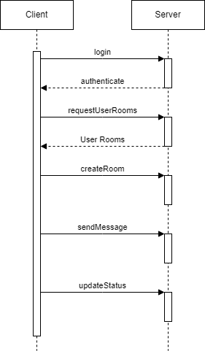
Sequence diagram

Slide 13
Server
Logging in
Receiving messages
Sending messages
Storing logs/history
Populating user lists
Rooms

Slide 14
Client
Rooms
User

Slide 15
Request
Type (message sending, room creation)
Payload

Slide 16
User
Id
Password
Status
Permissions

Slide 17
Message
Sender
Receiver (group/user)
Contents
Status (sending, success, fail)
Timestamp

Slide 18
Room
Name
Participants
Creation Date
History

Slide 19
History
Messages
Search/Filter functionality
Used for logging and to display messages for users

