Slide 1

AITAM is a collaborative tool to help associates to manage and track their action items to completion.

Slide 2

Introduction
AITAM can be used to Create, Assign, Track, Review and Manage the Action Items of a team. AITAM is developed in an effort to learn/refresh the concepts of Java and Web development.
The Concepts and features of AITAM are given in the attached Excel file with the following Worksheets.
Features of AITAM: A report of all the features that are available and will be available.
Learn as you Develop: A report of all the concepts used in AITAM, their theoretical reference and the files they are applied.
The current version of AITAM is v1.0
AITAM

Slide 3
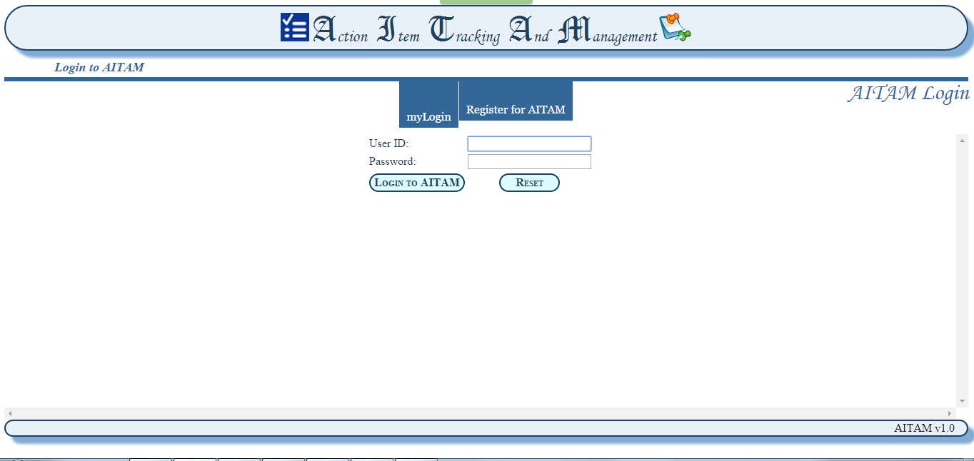
myLogin:
Login to AITAM using Employee ID and Password
AITAM

Slide 4
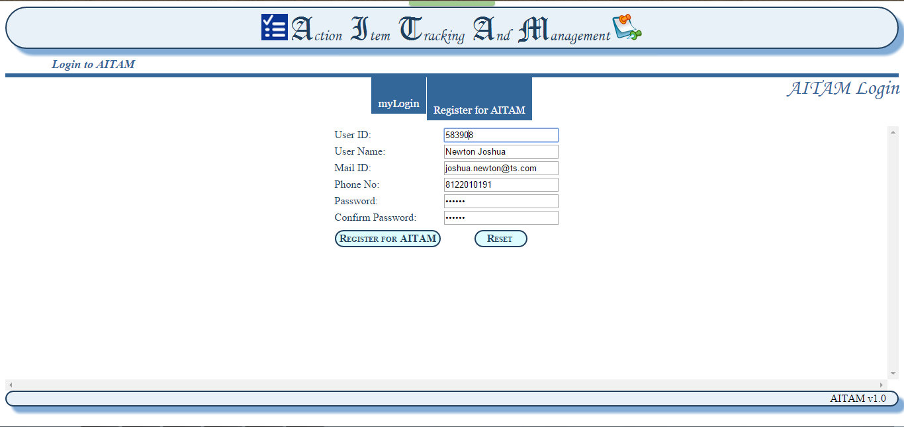
Register for AITAM:
Register as a new User to AITAM. Admin needs to approve your request and map you with your manager.
AITAM

Slide 5
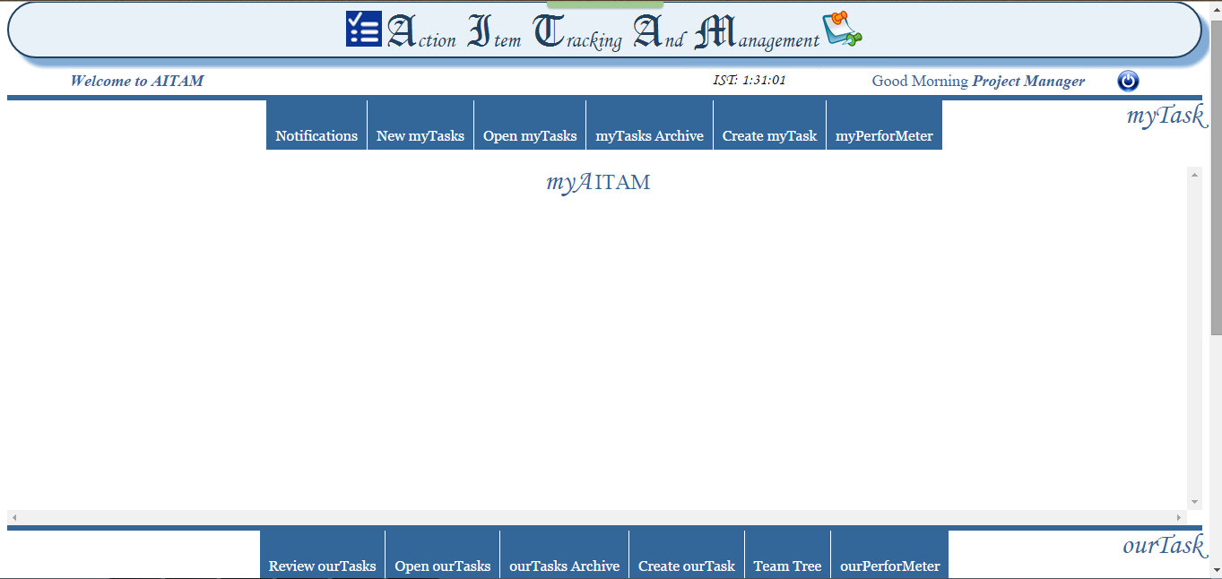
myAITAM:
Welcome to the AITAM homepage. Summary of Action Items will be displayed here. (* under construction).
Glossary: myTask= Individual member’s task, ourTask= Team task (Available only for Managers)
AITAM

Slide 6
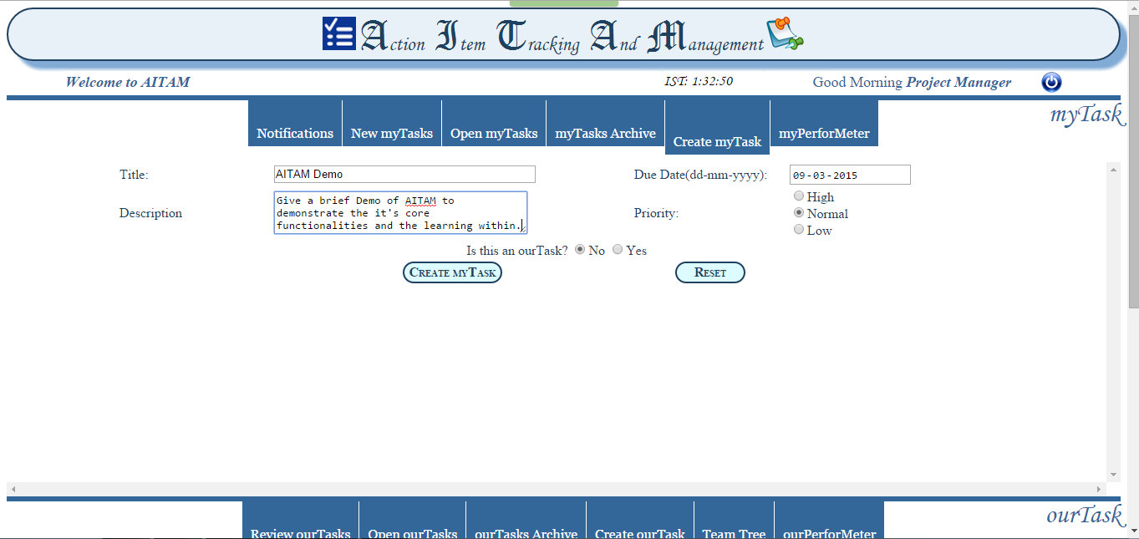
Create myTask:
Create an action item for yourself to keep track of the activity.
Note: These action items will not be considered for performance analysis. Only action items assigned or approved by managers will be considered.
AITAM

Slide 7
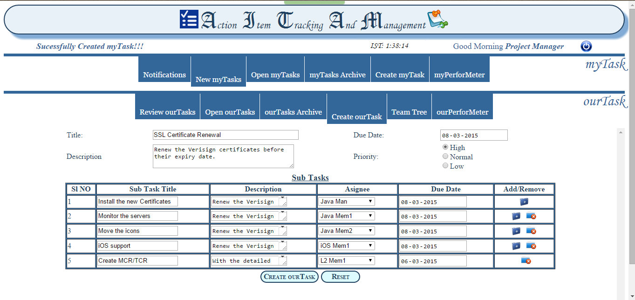
Create ourTask:
Create a Task and assign action items to team members.
Set Due date, Priority for the task.
AITAM

Slide 8
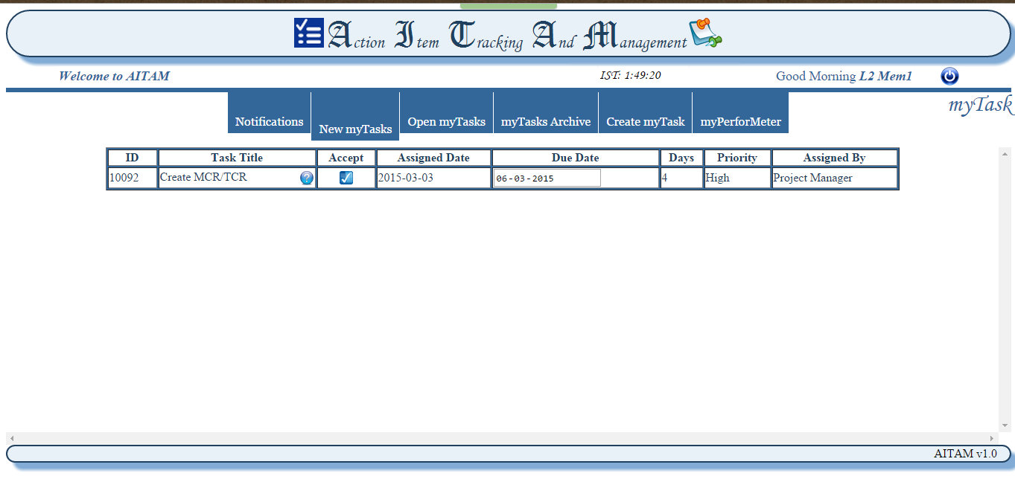
New myTasks:
Tasks assigned to you will be displayed here.
You can accept the task or Appeal against the due date.
Note: Accepted task will be moved to ‘Open myTasks’ pane.
AITAM

Slide 9
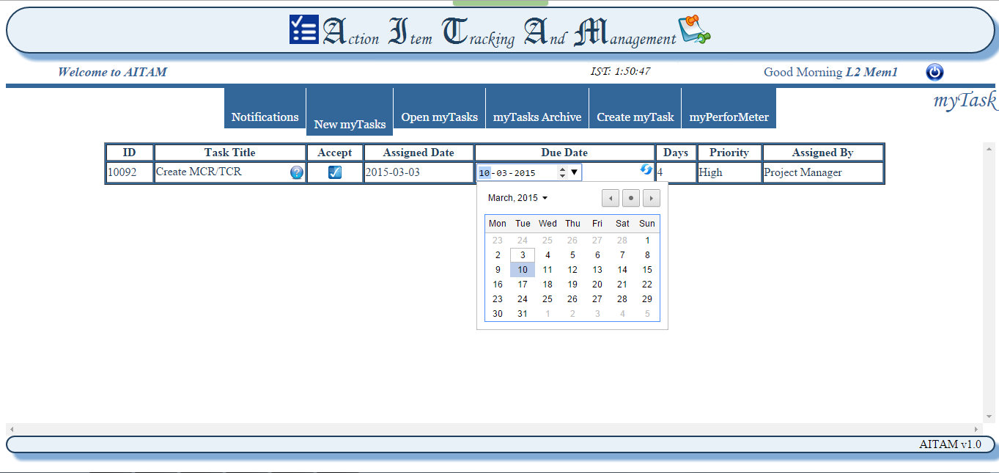
New myTasks:
Edit the Due Date and update it to Appeal against due date. It’ll be sent for Assigner’s approval.
Note: Performance analysis will be based on assigned date, due date, and completed date. Due date will be changed to the Appealed date if approved by the assigner. Else the original due date will remain.
AITAM

Slide 10
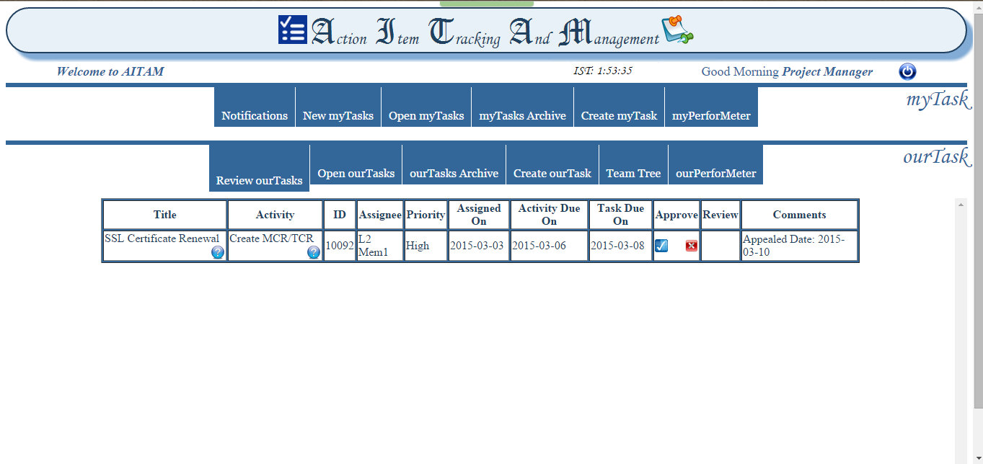
Review ourTasks:
When a task assigned by you is Appealed against it’s due date, it’ll appear in this pane.
You can either approve the proposed new Due Date or cancel the appeal.
Note: If either the appeal is cancelled or ignored the original due date will remain.
AITAM

Slide 11
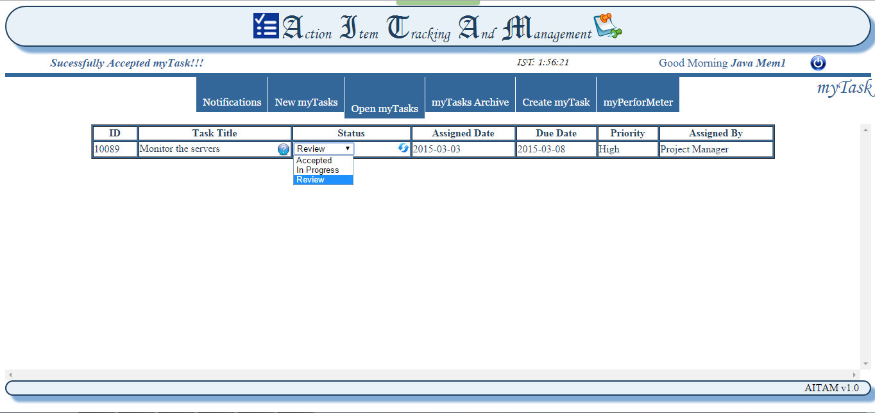
Open myTasks:
All the open tasks assigned to you will be listed here. You can update the status of the action item as In Progress, Review or Completed.
Note: For self assigned action item you can mark the status as ‘Completed’. But for action items assigned to you, you can only mark the status as ‘Review’. Then it’ll be sent for the Assigner’s review.
AITAM

Slide 12
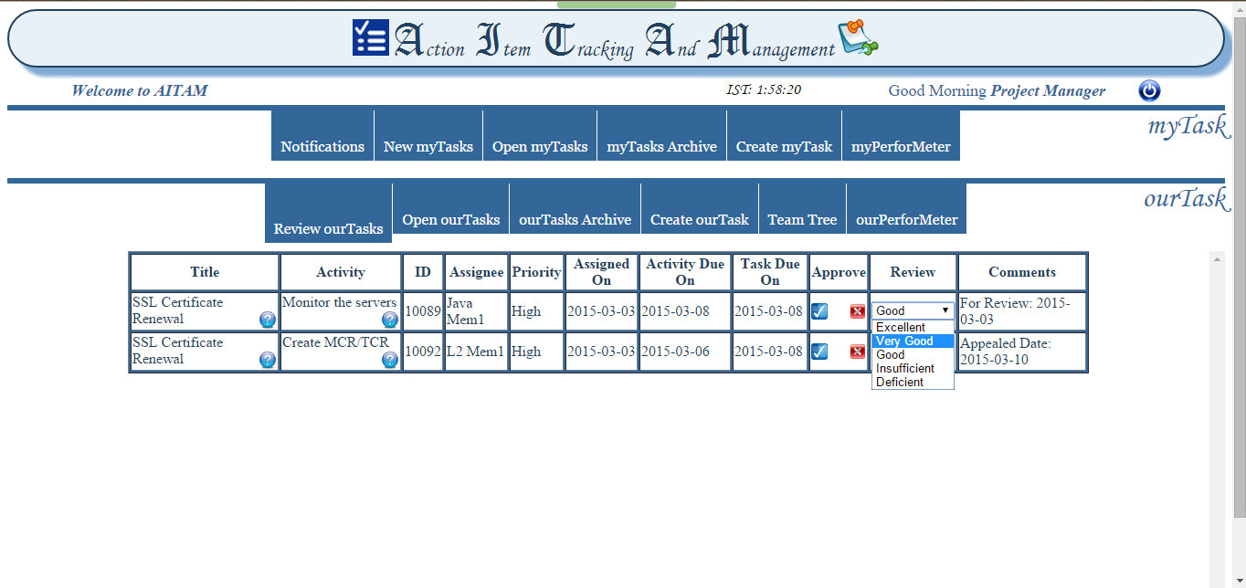
Review ourTasks:
When an action Item assigned by you is marked as ‘Review’ it’ll be displayed in this pane. You can Approve the task and provide your Review comments via drop down box. Or you can cancel the Review request and send it for ‘ReWork’
Note: The Review comments given will be considered for the Performance analysis.
AITAM

Slide 13
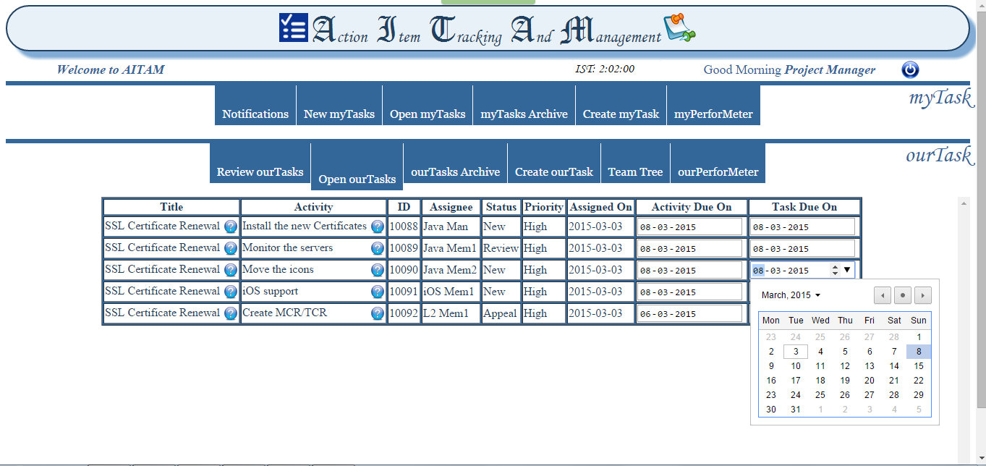
Open ourTasks:
All the open tasks assigned by you will be listed here. You can update the due date of the task or the action item.
AITAM

Slide 14
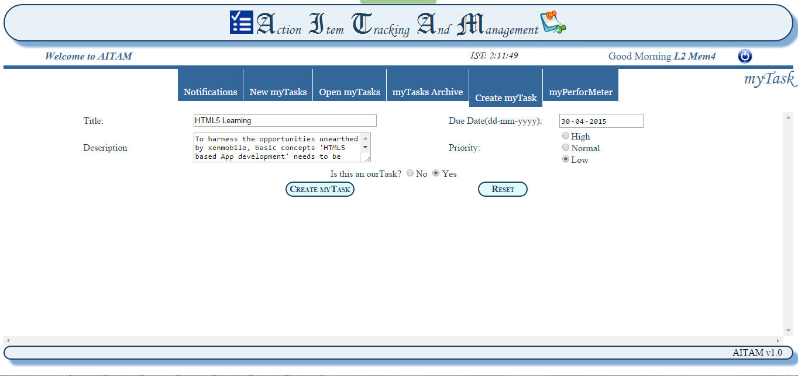
Create myTask:
You can create a myTask for yourself and get it approved by your manager to make it ourTask. To do this select ‘Yes’ for ‘Is this ourTask?’.
Note: If Approved by the manager this action item will be considered for Performance analysis. Else it’ll remain as a self assigned myTask and will not be considered.
AITAM

Slide 15
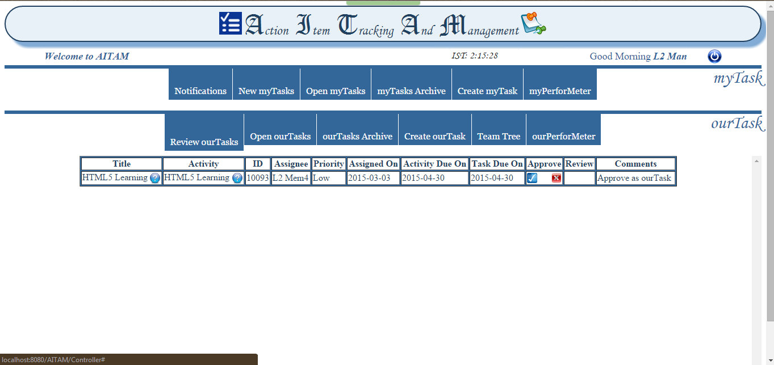
Review ourTasks:
If your team member has requested his myTask to become ourTask, it’ll be displayed in this pane.
You can approve this request or reject it.
AITAM

Slide 16
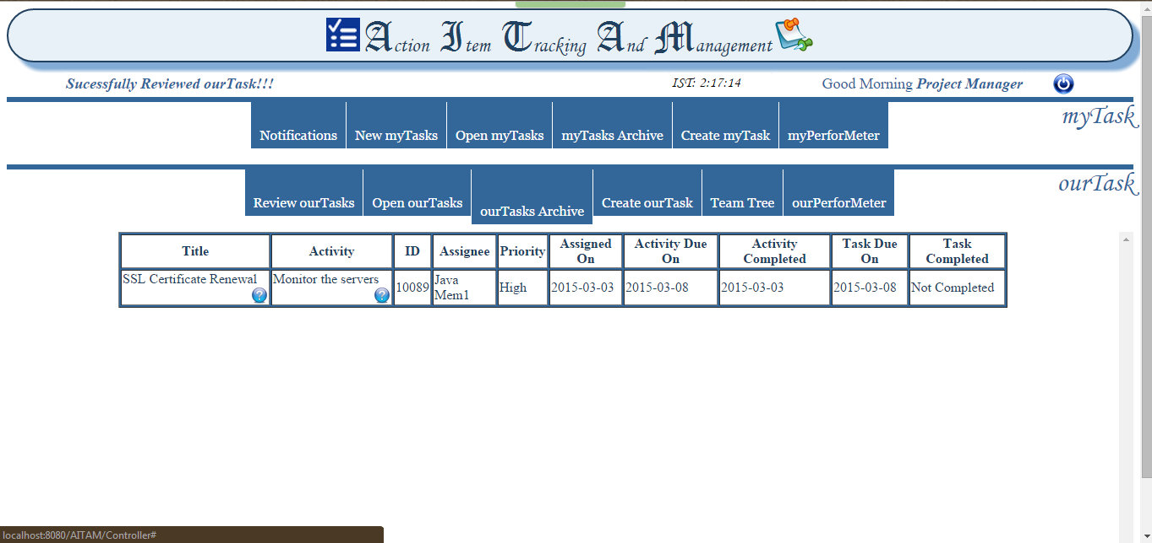
ourTasks Archive:
All the completed tasks assigned by you to your members and have passed your review will be displayed in this pane.
Note: The task will be considered as completed only when all it’s underlying action items are completed.
AITAM

Slide 17
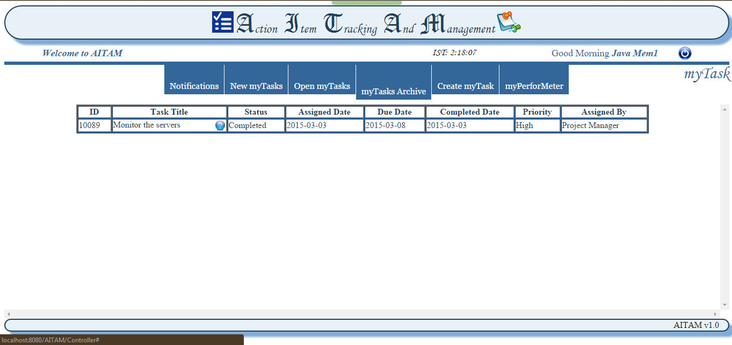
myTasks Archive:
All the completed tasks assigned to you by yourself or by managers will be displayed in this pane.
AITAM

Slide 18
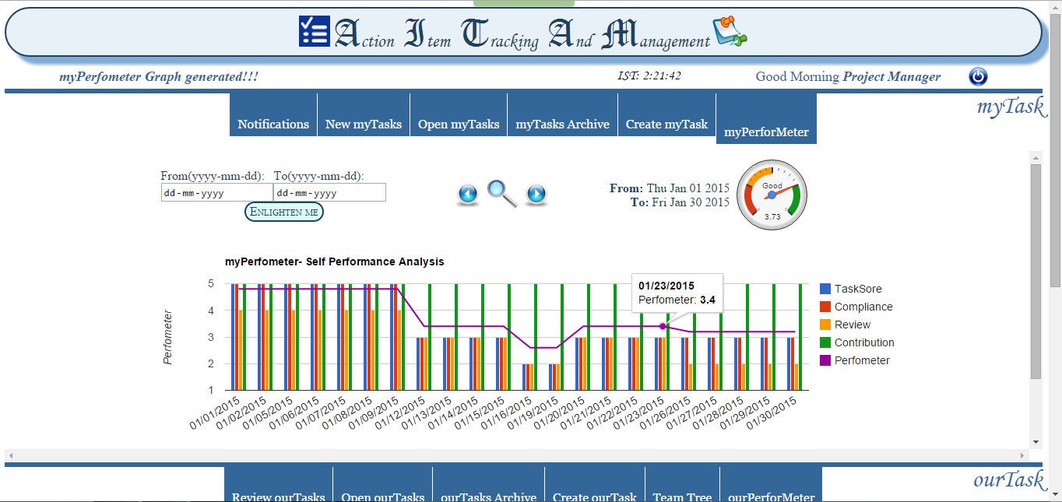
myPerforMeter:
Your performance during the selected period will be displayed in a chart on a day wise manner.
The average consolidated Performeter value will be displayed in a gauge.
Note: The chart will be loaded on submitting the duration. The chart will be displayed after clicking on the chart icon. The loaded chart will be available till the session expires
AITAM

Slide 19
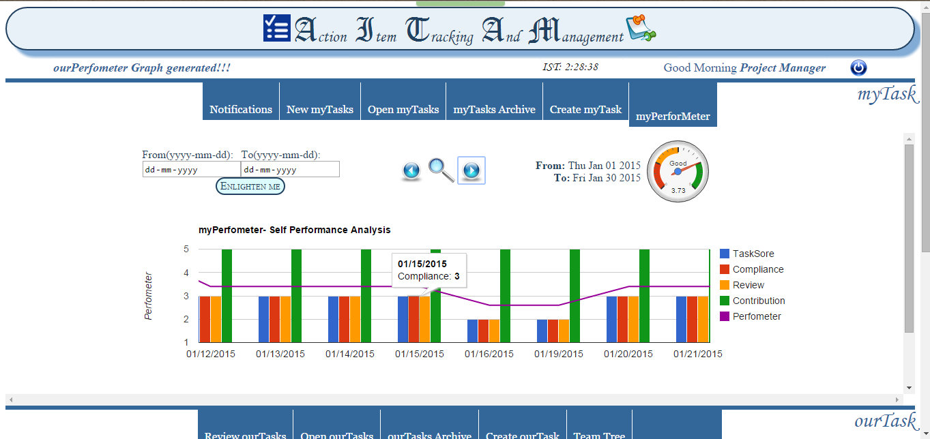
myPerforMeter:
You can zoom in and out of the chart. Once zoomed in you can navigate to and fro.
Note: clicking on any area of the chart will display the details of the clicked value.
AITAM

Slide 20
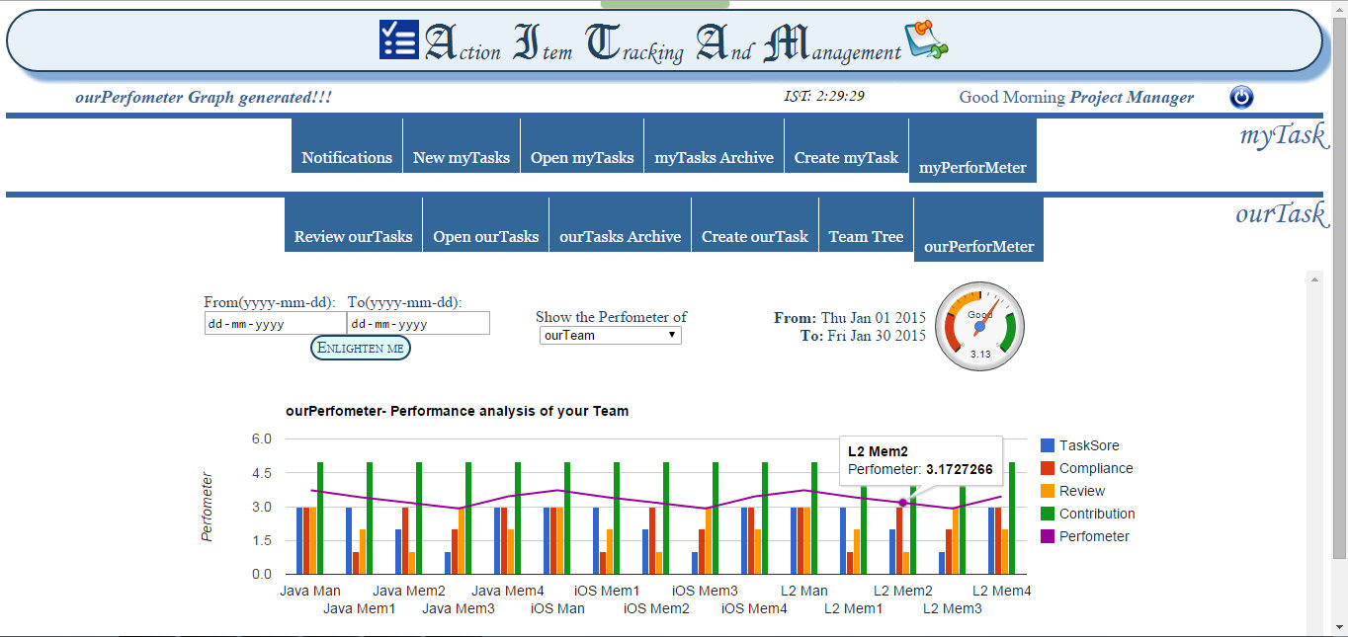
ourPerforMeter:
Your team’s performance during the selected period will be displayed in a chart on a team member wise manner.
AITAM

Slide 21
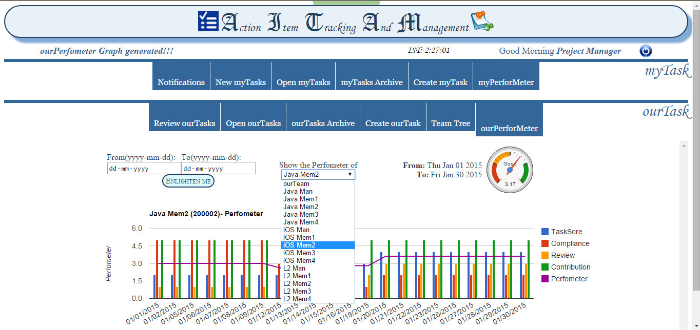
ourPerforMeter:
You can view the detailed day wise Performeter chart of all your team members by selecting them via dropdown..
AITAM

Slide 22
Appendix- PerforMeter concepts myPerforMeter
The PerforMeter calculation is based on the below logic
Find Working days between the selected period
  For each working day
    Find Contribution of the associate
    Find the tasks performed by the associate
      For each task find
        Task Score
        Time Compliance
        Review
      Find the average of Task Score, Time Compliance and Review for the day
    PerforMeter= (2* Task Score) + Time Compliance + Review + Contribution
  Consolidated PerforMeter= Average of Day wise Performeter
AITAM

Slide 23
Appendix- PerforMeter concepts myPerforMeter
Contribution:
Find all the Associates of the same team
  For each associate
    Find the number of action items engaged on that day
    Find the associate who engaged in the highest no of action items.
    Mark his/her Contribution as ‘5’.
Based on the conversion ratio, find the Contribution of the particular associate from the no of tasks he has performed on that day.
Task Score
Task score of a task= ((Review * Priority)+ Time Compliance) * 5 / 20
Priority:
Priority | High | Normal | Low
Priority Score | 3 | 2 | 1
AITAM

Slide 24
Appendix- PerforMeter concepts myPerforMeter
Time Compliance:
Compliance % = Actual Days taken for an action Item / Expected Days
Review:
The Review comments given by the Assigner of the action item on completion
Compliance % | < 75 | 75 – 90 | 90 – 110 | 110 – 125 | > 125
Time Compliance Score | 5 | 4 | 3 | 2 | 1
Review Comment | Excellent | Very Good | Good | Insufficient | Deficient
Review Score | 5 | 4 | 3 | 2 | 1
AITAM

Slide 25
Appendix- PerforMeter concepts ourPerforMeter
ourPerforMeter is calculated based on the below logic.
Find all the associates in the team
  For Each Associate
    Find myPerfometer for the given period
    Find the consolidated PerforMeter for the same period
  Consolidated ourPerforMeter = Average of myPerforMeter of all associates
AITAM

Slide 26
AITAM v2.0
The following features are planned to be incorporated into AITAM in the second version.
Password Encryption
Notifications
myAITAM- Summary
Team Tree
Admin Pane
Load Balancing
Session Management
Date Limitation
Store data in Google Cloud sql Database
Deploy in Google App Engine
AITAM

Slide 27
Development Effort
The Effort to develop the Web Project from the scratch is 20 Personal Days (160 hours)
The development activity has been carried out using personal devices and during non working hours.
During weekdays the activity will start at 11:30 pm and during weekends at 2:00 pm
Date | 1-Feb | 2-Feb | 3-Feb | 4-Feb | 5-Feb | 6-Feb | 7-Feb | 8-Feb | 9-Feb | 10-Feb | 11-Feb | 12-Feb | 13-Feb | 14-Feb | 15-Feb
Effort (hrs) | 6 | 3 | 3 | 3 | 3 | 3 | 6 | 10 | 3 | 3 | 3 | 3 | 3 | 6 | 10
16-Feb | 17-Feb | 18-Feb | 19-Feb | 20-Feb | 21-Feb | 22-Feb | 23-Feb | 24-Feb | 25-Feb | 26-Feb | 27-Feb | 28-Feb | 1-Mar | 2-Mar | 3-Mar
5 | 5 | 5 | 5 | 5 | 6 | 10 | 5 | 5 | 5 | 5 | 5 | 6 | 10 | 5 | 5
AITAM

