Slide 1
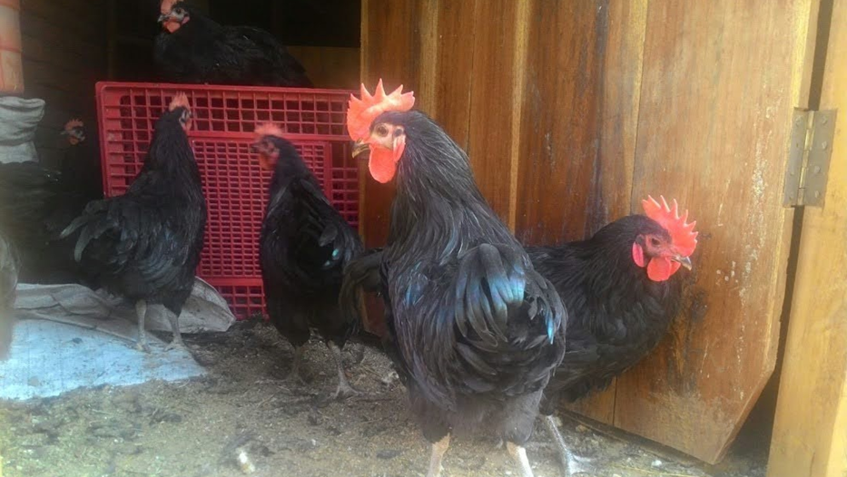
Computer Applications
Mikolongwe college of veterinary sciences

Slide 2
Course content
Introduction to microcomputers and operation systems
Introduction to computer applications, which include
Microsoft Word
Microsoft PowerPoint
Microsoft Excel
Internet and email

Slide 3
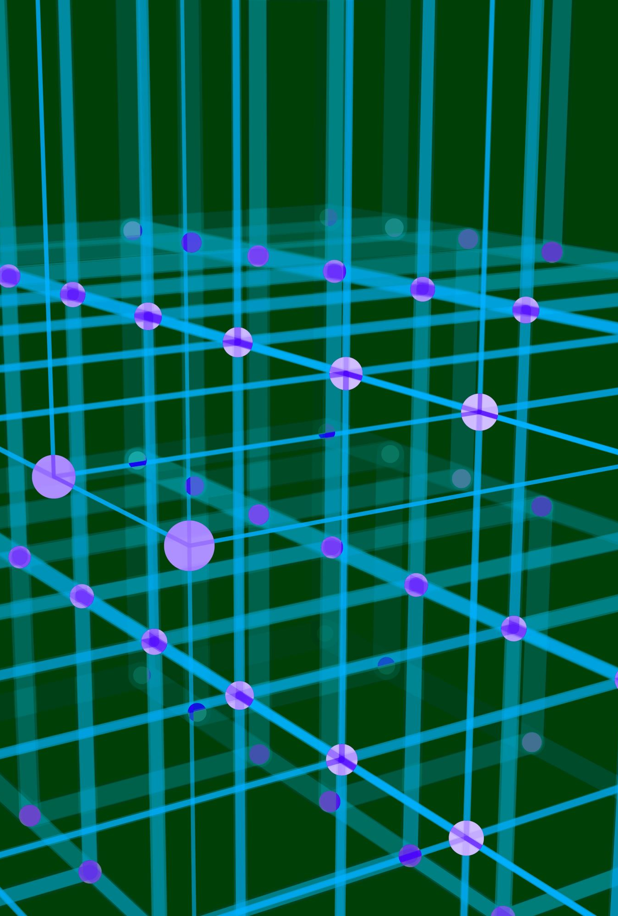
Introduction

Slide 4
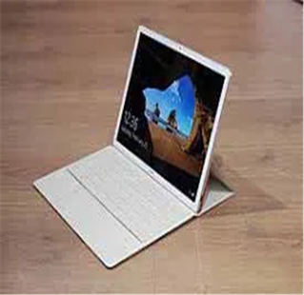
Terms and definitions
Computer: is an electronic device that executes the instructions in a program
Hardware: these are the physical parts of the computer that are visible to the eye and can be touched.
Software: these are program/instructions that tell the computer what to do.
ROM: Read-Only- Memory, in which information is saved once and can never be altered, e.g. CD-ROM drives read information saved on compact diskS (CDs)

Slide 5

Terms and definitions…
RAM: Random Access Memory, which is the computer’s short term memory used whenever an action is performed by a program.
DATA: these are individual facts such as name, quantity or price of goods that can be entered in a computer or be taken out from the computer.
INFORMATION: refers to data that has been processed into useful form like a graph.

Slide 6
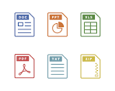
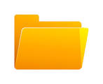
Terms and definitions
FILE/DOCUMENT:
refers to any single item created with an application.
This can be anything saved in your computer such as a research paper, a spreadsheet, pictures, music, and downloaded programs (although usually documents refer only to items with text).
FOLDER:
this is a virtual container within a computer memory in which groups of files and other categories can be kept and organize

Slide 7
Terms and definitions
Window: is a visual area containing some user interface.
Menu: refers to a list of commands presented to an operator by a computer. They are said to be shortcuts to frequently used commands.
Icons: Are pictures that are shortcuts to programs or files. By clicking an icon you start the program or open the file.
Default: original settings i.e. what will happen if you do not change anything.

Slide 8
Terms and definitions
Server: is a computer that runs a network of computers. It handles the sharing of equipment like printers and communication between computers on a network.
Peripherals: These are devices connected to computers which are not part of the main machine. Examples are
A mouse A keyboard
Speakers Printers Scanners e.t.c

Slide 9
Common Windows items
The following are just some of the terms used to describe the Windows desktop you are likely to run into. Most are indicated in the diagram below the list:
Desktop refers to the background of your screen on which the various programs run. Think of your computer screen as your electronic desktop.
Icons are those small pictures on the desktop and inside folders that represent various programs, specialized folders, etc.
Folders are virtual containers that can contain icons, programs, data or other folders (sub-folders).

Slide 10
Common Window items
Title bar refers to the bar at the top of an open window. The folder's title will tell you what the folder is used for. It contains the minimize, maximize and close buttons. You can use the title bar to move a window around.
Cursor is the graphic pointer which indicates where the mouse is and what sort of action it is performing. The cursor will change from the default arrow to various shapes according to the purpose it is serving at the time. For instance, it may form an I-beam shape when you are selecting text in a document or a double-arrow when you are resizing a window.

Slide 11
Common Window Items
Task bar refers to the bar usually at the bottom of your Windows screen (it is movable) containing the Start Button on the left and the clock and grouped icons on the right.
A Scroll Bar appears when there is more information in the window than can be displayed. This is usually a vertical scroll bar, but a horizontal scroll bar may appear if the width of the window is too narrow. Windows 10 often hides scroll bars until you hover over them.
The Address Bar tells you your location and provides the tools to navigate around your computer. These settings vary by Windows version and can be modified.

Slide 12
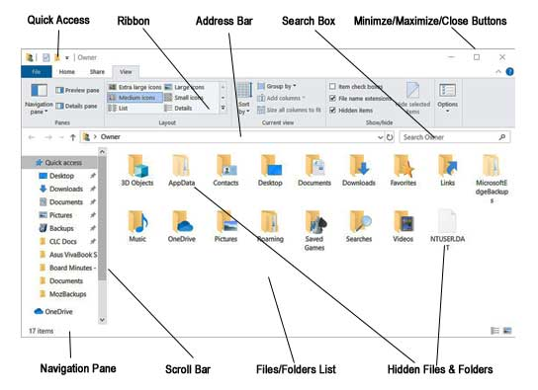

Slide 13
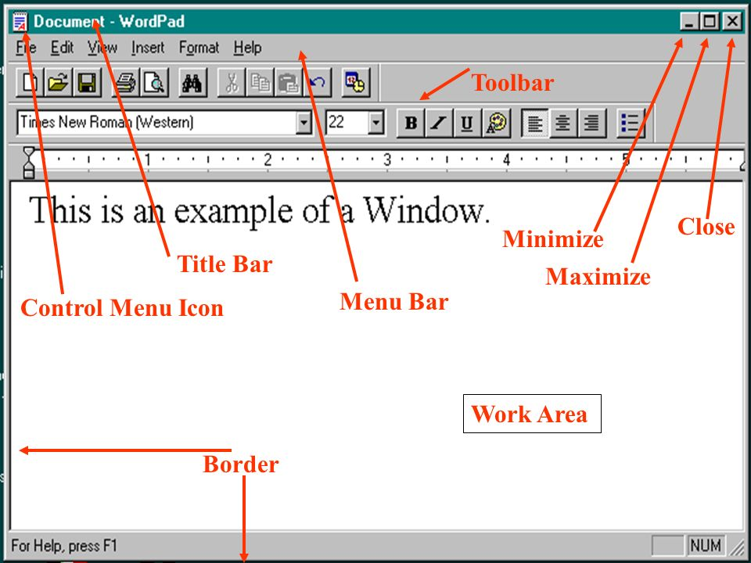

Slide 15
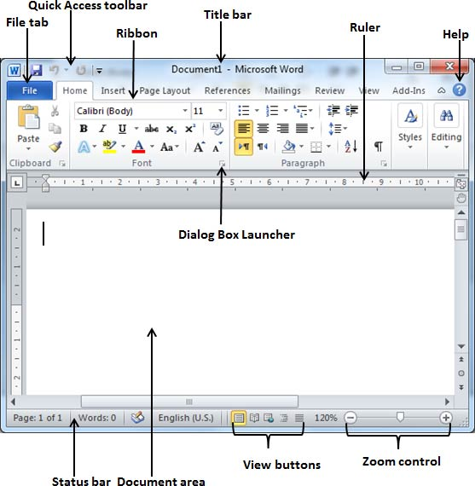

Slide 16
Mouse Clicks
A basic computer mouse
You'll see at least two buttons on your mouse (most current mice have a middle button and may have others). The type of click means the button you push when you click. Left-handed users will have to reverse these instructions.
The left-click selects items and will be used most often. If no button is specified, this will be the one you use.
If you right-click on an item you will get a context-sensitive menu with a list of the things that you can do with the item you clicked on.
When you right-click to obtain a menu, you will select the menu with the left button (generally just referred to as selecting or clicking — the left mouse button click is assumed).

Slide 17
Context Sensitivity
When you right-click on various locations on the screen the results vary (known as context sensitive):
Right-clicking an icon on your desktop will include the option to open it.
Right-clicking on the background (desktop) will give you options to arrange icons or refresh the desktop.
When you right-click on various locations on the screen the resulting list of options vary (known as context sensitive).
A very useful selection is Properties option when you right-click on an object. This will give you information about the icon or object you are selecting. The menu options differ between various versions of Windows.

Slide 18
Types of computers
Based on operational principle, there are three types, namely:
Analogue
Digital
Hybrid

Slide 19
Analogue computers
These are almost extinct today.
These are different from a digital computer because analogue ones can perform several mathematical operations simultaneously.
It uses continuous variables for mathematical operations & utilizes mechanical or electrical energy

Slide 20
Examples of Analogue computers
Thermometer. An analogue thermometer makes use of a graduated scale and properties of mercury to fulfil its operation. ...
Speedometer. The speedometer is a device that detects the speed of a moving vehicle. ...
Analogue Clock. ...
Seismometer. ...
Voltmeter. ...
VCR (video cassette recorder) players and tapes.
Any clock without a digital display.
Polaroid or film cameras.
Traditional laser photocopiers.

Slide 21
Digital computers
any of a class of devices capable of solving problems by processing information in discrete form.
It operates on data, including magnitudes, letters, and symbols,

Slide 22
Examples of Digital computers
Calculator. A digital calculator is an electronic gadget designed to perform calculations including simple mathematics, complex algebra, logical analysis, etc. ...
Digital Clock. ...
Weighing Machine. ...
Consumer Electronic Equipments. ...
Automobiles. ...
Smart Phones. ...
Laptop/Personal Computer. ...
ATM.

Slide 23
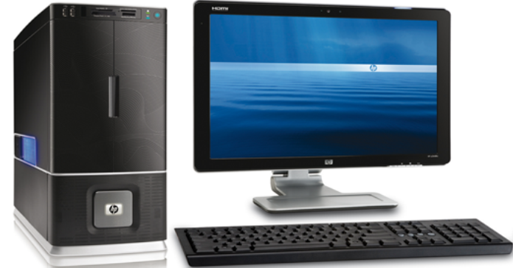
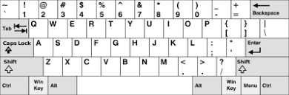
Hybrid computers
Are a combination of both digital and analogue computers
In these computers the digital segments perform, process & control by conversion of analogue signals to digital signals
QWERTY

Slide 24
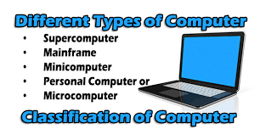

Slide 25
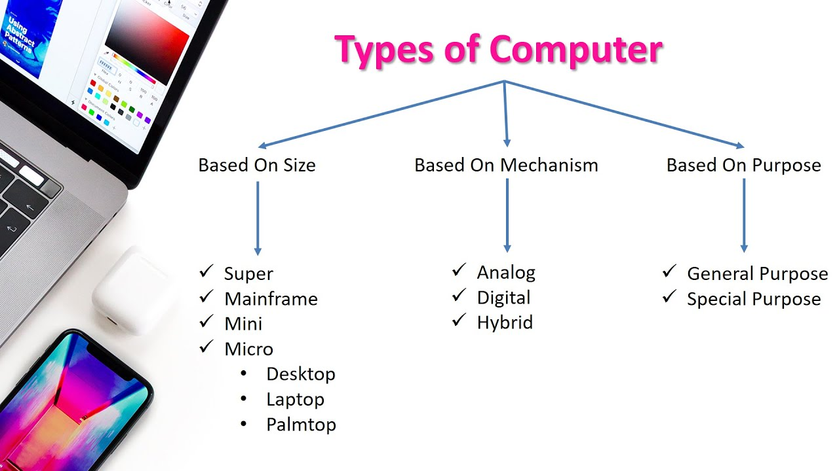

Slide 26
COMPUTER COMPONENTS
1. Hardware Components
2. Software Components

Slide 27
Hardware Components
is a collection of electric, electronic, and mechanical components.
divided into five categories, namely:
1. Input devices
2. Output devices
3. Storage devices
4. Communication devices
5. Systems Unit

Slide 28
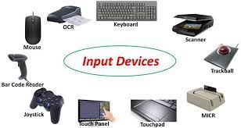
INPUT DEVICES
any hardware component that allows you to enter data and instructions into a computer.
5 widely used input devices are the
keyboard,
mouse,
microphone,
scanner, and
Web cam.

Slide 29
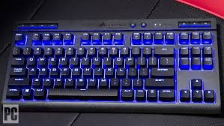
Key Board
A computer keyboard contains keys you press to enter data into the computer.
For security purposes, some keyboards include a fingerprint reader, which allows you to work with the computer only if your fingerprint is recognized.

Slide 30
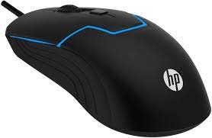
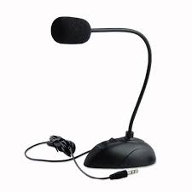
Mouse & Microphone
A mouse is a small handheld device. With the mouse, you control movement of a small symbol on the screen, called the pointer, and you make selections from the screen.
A microphone allows you to speak into the computer.

Slide 31
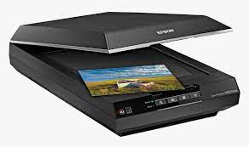
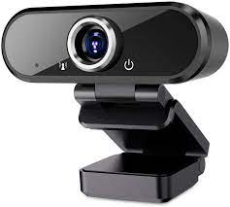
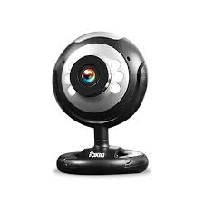
Scanner & Webcam
A scanner convert printed material (such as text and pictures) into a form the computer can use.
A Web cam is a digital video camera that allows you to create movies or take pictures and store them on the computer instead of on tape or film.

Slide 32
Scanner & Webcam
A scanner convert printed material (such as text and pictures) into a form the computer can use.
A Web cam is a digital video camera that allows you to create movies or take pictures and store them on the computer instead of on tape or film.

Slide 33
Word processing
Word processing is the production, storage, and manipulation of text on a computer.
To perform word processing, you need a computer, a special program called a word processor, and a printer.
A word processor enables you to create a document, store it electronically on a disk, display it on a screen, modify it by entering commands and characters from the keyboard, and print it on a printer.
The most commonly used word processor is Microsoft word.

Slide 34
Word processer
Word processors vary considerably, but all word processors support the following basic features

Slide 35
Insert text: Allows you to insert text anywhere in the document.
2. Delete text: Allows you to erase characters, words, lines, or pages as easily as you can cross them out on paper.
3. Cut and paste : Allows you to remove (cut) a section of text from one place in a document and insert (paste) it somewhere else.
4. Copy : Allows you to duplicate a section of text.

Slide 36
Practical
Create a word document and do edits
Insert table
Customize it into a scientific format
Save all the work in a file with file name “ MCVS 2023”
Store your work in a folder “COMPUTER APPLICATIONS”

Slide 37
COMPUTER SOFTWARE COMPONENTS
Computer software is s a collection of related instructions organized for a common purpose.
A computer software tells a computer what task to perform and how to perform it.
Software components of a computer system have no physical presence, they are stored in digital form within computer memory

Slide 38
COMPUTER SOFTWARE TYPES
Computer software are classified into groups, namely:
a. Systems Software
b. Application Software

Slide 39
SYTEMS SOFTWARE
System software consists of the programs that control or maintain the operations of the computer and its devices.
System software serves as the interface between the user, the application software, and the computer’s hardware.
There two mostly used Systems Software, they include:
1. Operating Systems
2. Utility Software

Slide 40
Operating Systems
It is a set of programs that coordinates all the activities among computer hardware devices.
It provides a means for users to communicate with the computer and other software
Examples of well-known operating systems include, Microsoft windows, Mac OS, Linux Operating System, Android OS, Symbian OS, and BlackBerry.

Slide 41
Application Software
Application software consists of programs designed to make users more productive and/ or assist them with personal tasks.
Application software is also called end-user programs
A widely used type of application software related to communications is a Web browser, which allows users with an Internet connection to access and view Web pages or access programs.

Slide 42
Application Software….
Other popular application software includes word processing software, spreadsheet software, database software, and presentation software.
Examples of word processing application software include Microsoft word, Office writer, Zaho writer and Google Docs.
Examples of spreadsheet software include Microsoft Excel, Google sheets, iWork Numbers, Libre Office, Open Office, etc.

Slide 43
PRESENTATION
Presentation software refers computer programs that are used to display information in a slide show format.
Presentation software enables computer users to create a sequence of text and images that tells a story.
The most commonly used presentation software is Microsoft PowerPoint, others include Apple keynote, Open office Impress, Flowboard, Adobe Persuation, etc.

Slide 44
STORAGE DEVICES
Storage devices holds data, instructions, and information for future use.
For example, computers can store hundreds or millions of customer names and addresses. Storage holds these items permanently.
d/or retrieves (reads) items to and from storage media.

Slide 45
Computer Memory cont’d….
The difference between Computer memory and Storage is that computer memory is volatile i.e it losses all the information when power goes off while storage stores information permanently.
Examples of storage media are USB flash drives, hard disks, optical discs, and memory cards.

Slide 46
COMPUTER NETWORKS AND THE INTERNET
A computer network refer to collection of computers that are connected together.
This connection can be either through, Data cables, Bluetooth, wireless network and infrared.
Computers in a network are able to communicate with each other.
Computers in a network are able to share resources, data and instructions

Slide 47
COMPUTER NETWORKS AND THE INTERNET cont’d….
In a network one computer must work as a server.
A server controls access of resources in a network

Slide 48
IMPORTANCE OF COMPUTER NETWORKS
Networks allow sharing of resources between connected computers.
Computer network offer a cheaper means of communication.
Computer networks allows easy and cheap sharing of information and data

Slide 49
THE INTERNET
Internet is the worldwide collection of networks.
People connect to the internet to share resources.
The world wide web, www, is the most popular service on the internet.
A web is a global library of information available to anyone connected to the internet.

Slide 50
WEBSITE
A web contains billions of documents called web pages.
A collection of related web pages is called a website.
Web pages of a website are kept in a server.
A web server can be accessed by everyone connected to the internet.

Slide 51
Internet and Emails
Internet refers to the global collection of all networks.
World Wide Web is one of the famous internet services.
World Wide Web allows as to access a library of web pages.

Slide 52
EMAIL
Short form for “electronic mail”
Email is the exchange of computer stored messages by telecommunication.
Email messages are sent and accessed through web pages.
As a result, send and receiving emails depends on the availability of internet.

Slide 53
INTERNET
Internet is the backbone of information technology
Without the internet, all server web pages cannot be accessed.
Internet is provided by internet service providers.
In Malawi, our internet providers include TNM, Airtel, MTL, Global Internet, Sky Band, and many more.

