Slide 1
STRATUM UI
Observations and Changes

Slide 2
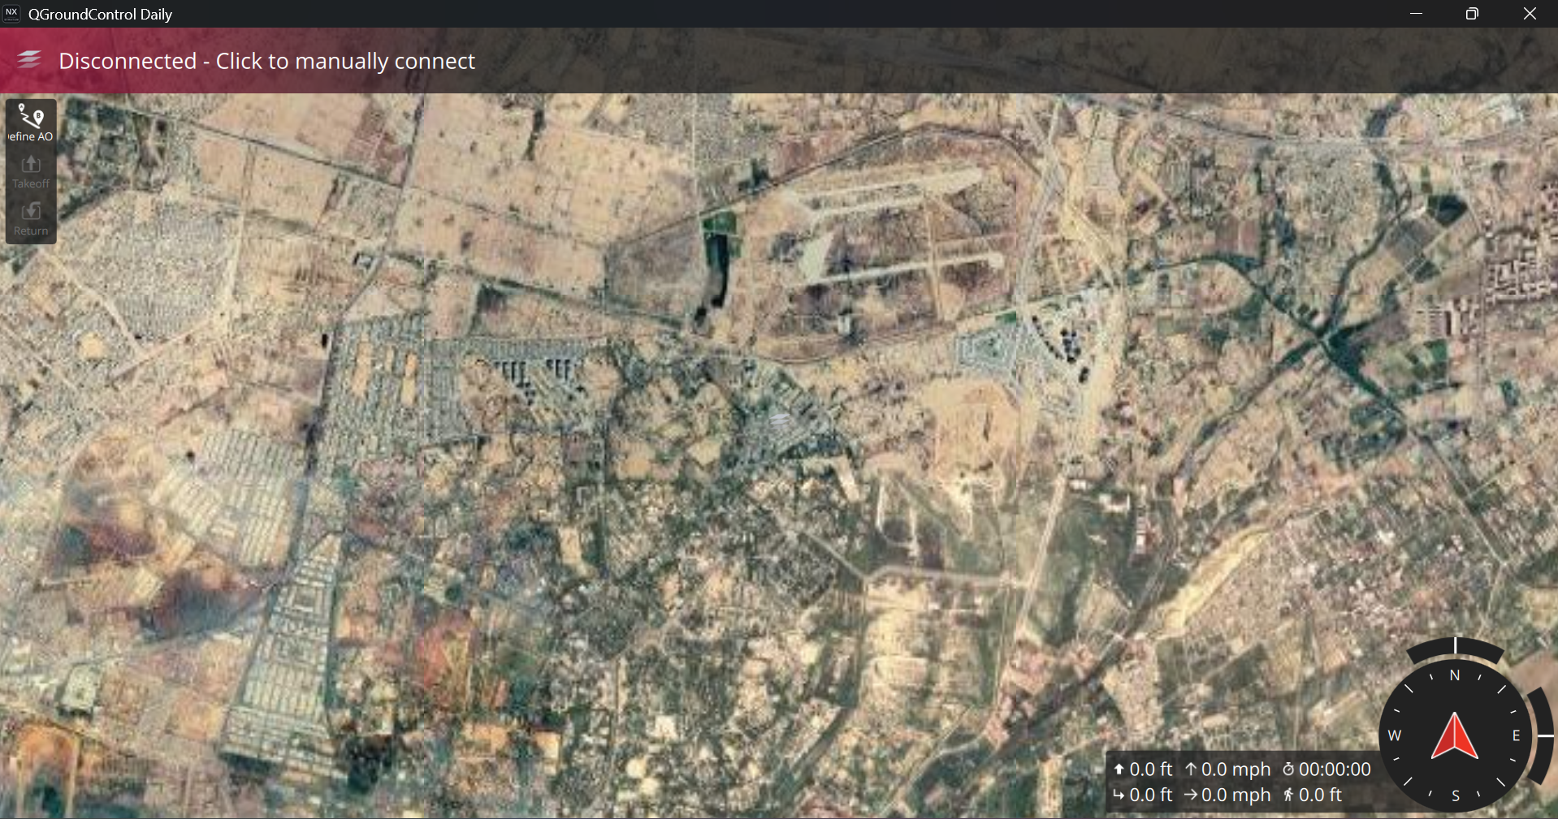
The greenbox title “QGroundControl Daily” should be “STRATUM with version number.

Slide 3
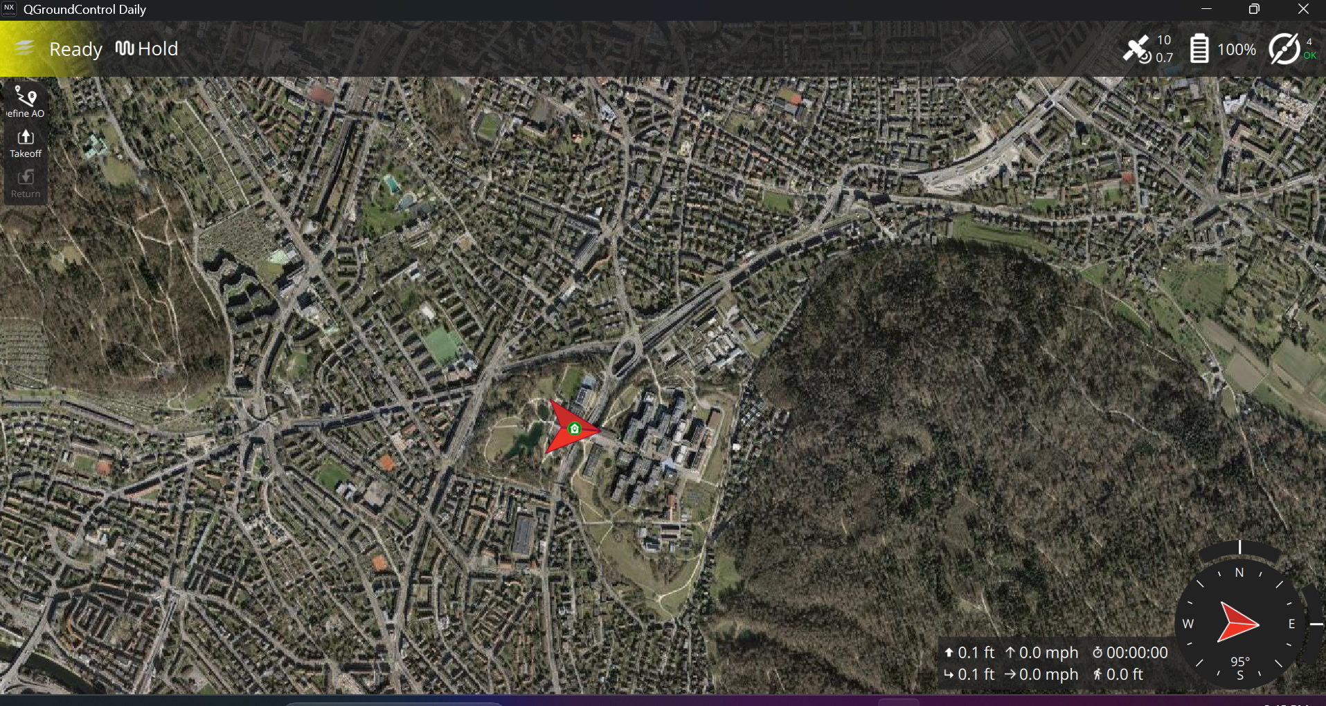
Define AOP
Takeoff
Return to Base
Land

Slide 4
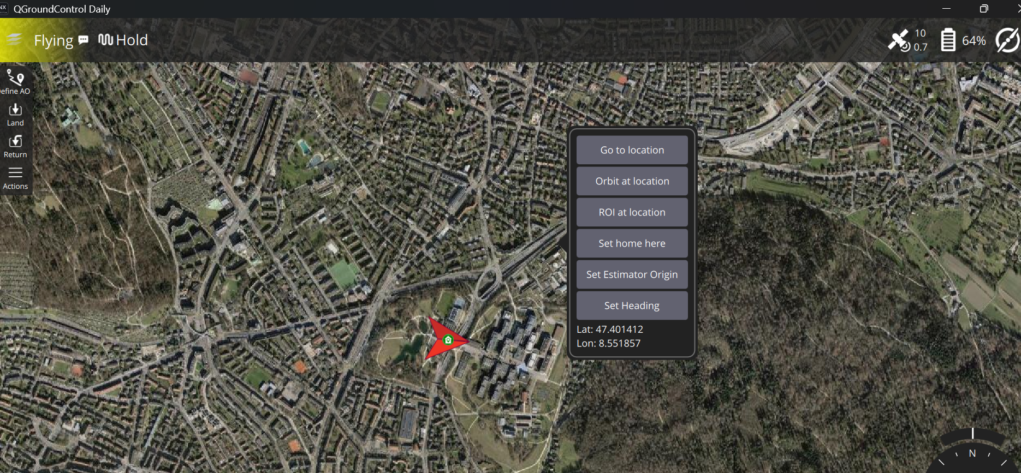

Slide 5
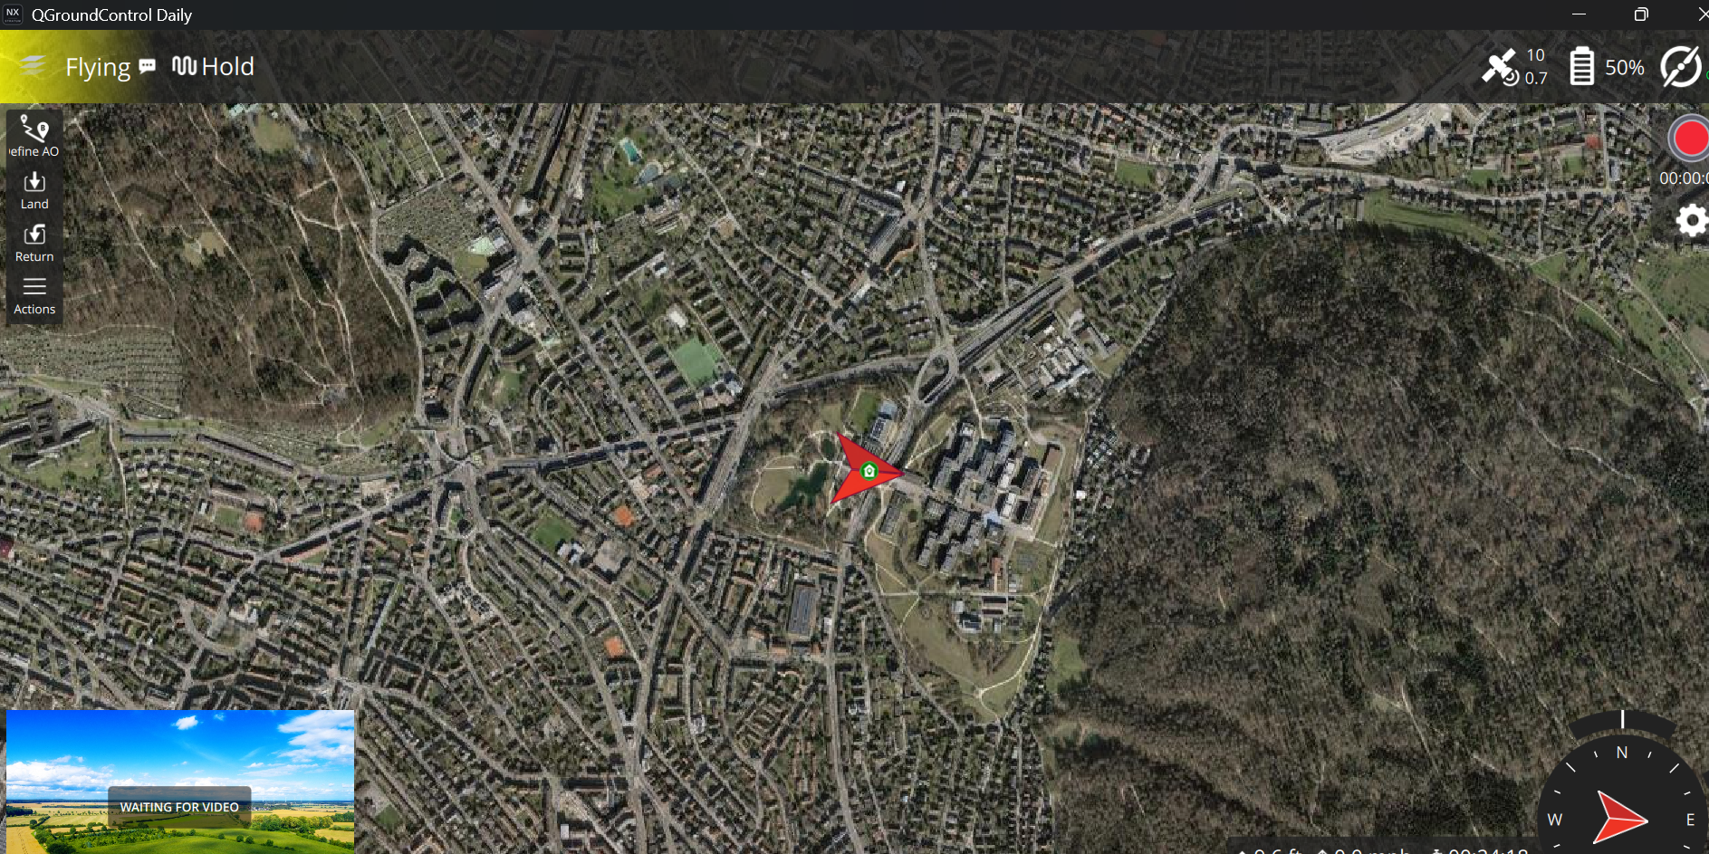
Land

