Slide 1


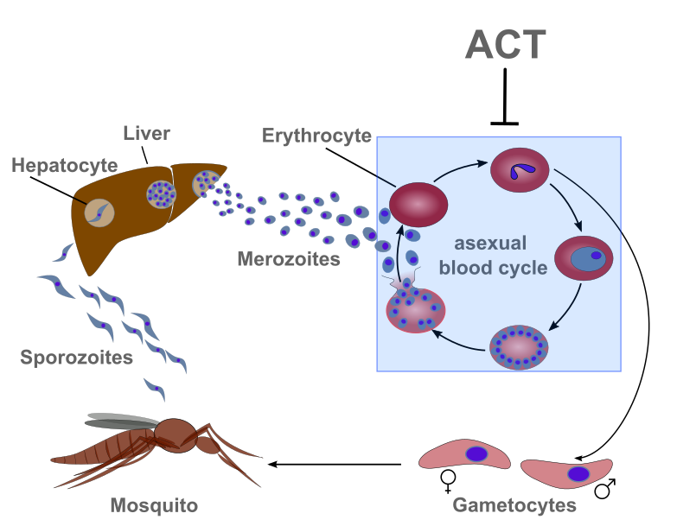
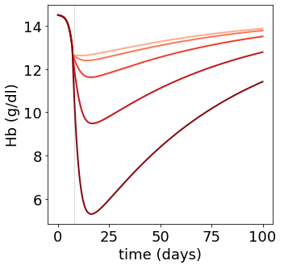
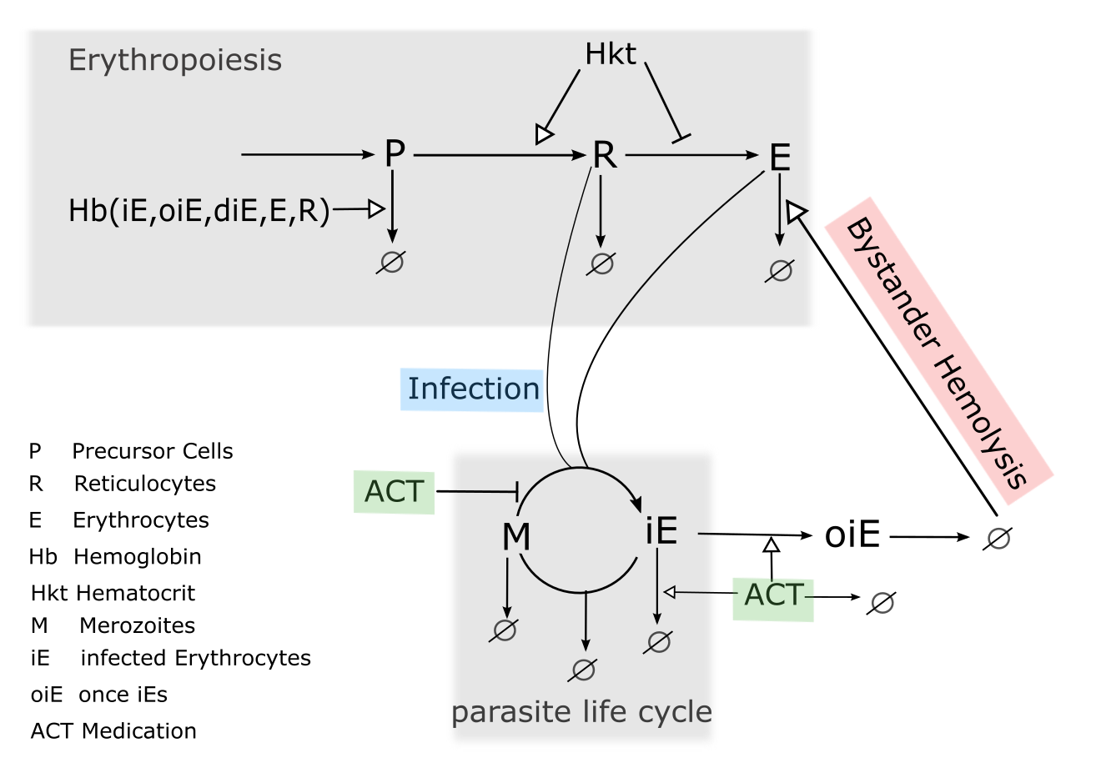
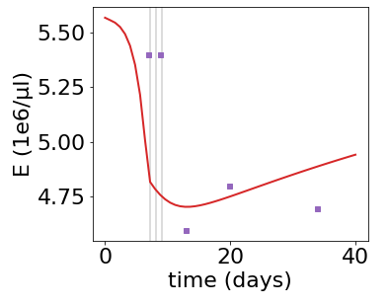
Investigating Post-Treatment Hemolysis in Malaria Treatment
Rebecca Beyer ¹, Jorin Diemer ¹, Pinkus Tober-Lau², Florian Kurth ², Edda Klipp¹
¹ Theoretical Biophysics, Humboldt-Universität zu Berlin, Germany
² Department of Infectious Diseases and Respiratory Medicine, Charité - Universitätsmedizin Berlin, Germany

