Slide 1
Information Screen
Different options to realize

Slide 2
Idea one – You want this if:
It should be easy to provide information
Even for non-technical advanced users
The Editor options should provide:
A small amount of text
Images, videos and sound
You want multiple «Sheets»
As well as different transitions (side feature)

Slide 3



Idea one – Use in practice (upload)
You will have a simply share
In This share you can find folders:
The first one is where you go
The second one is optional for advanced settings
The third one is used by the program itself
In the first one make folders with date and time like this:
Place any Power Point inside each one:

Slide 4
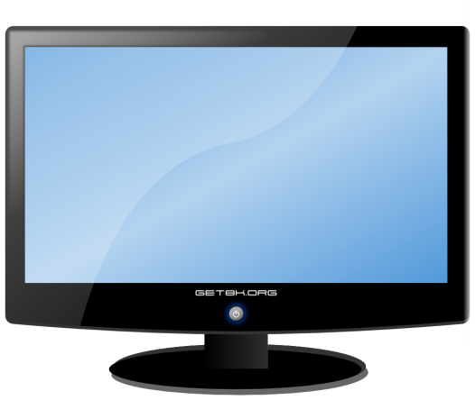

Idea one – Use in practice (display)
An automated program will take the files
Assuming today is the 06.10.2015
It will read the ppt/pptx file inside “05.10.2015_1830”
Beause now is after 28.09.2015_1200 and before 10.10.2015_0920
It will display the placed PP Presentation

Slide 5
Idea one – Technically
A simple Python script or Java / C# program
It will choose the files
It will open them with PowerPoint
In full screen
It will do automated inputs
To switch the sheets
It will make a temporary copy of the file shown
To prevent access blocking
To allow editing the PP currently shown
It will take care of custom settings if exist
There is a template (but all optional – it runs standalone)

Slide 6
Idea one - Requirements
Depending on the choose programming language:
If Python
Any Linux or Windows server/machine where Python can be installed on
If Java
Any server/machine where the JVM can be installed on
If C#
Any server with an updated .NET Framework
Other software required
Power Point installed on the server
Open Presenter “could” work too
Network access required

