Slide 1
It works!
PPInfoScreen Server is now running and will
display your deployed presentations
Some instructions will follow…

Slide 2
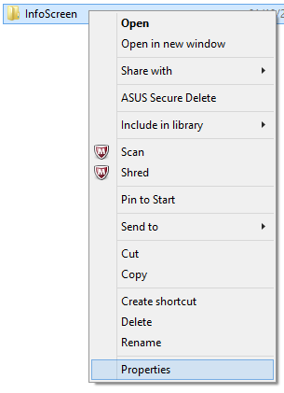
1.0 Share a folder
You need to share a folder
You must do that on any computer in the same network as the server
Create a folder and
Go to Properites

Slide 3
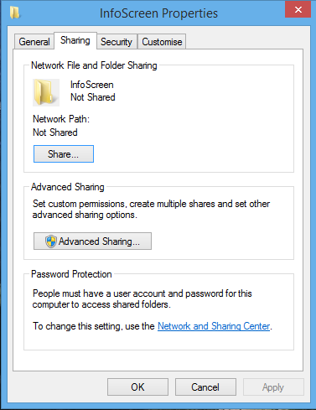
1.1 Share a folder
Go to the tab «Sharing»
Click «Share…»

Slide 4
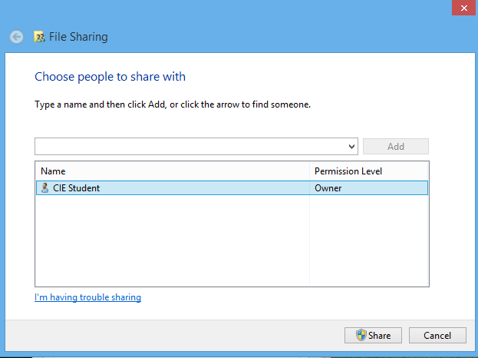
1.2 Share a folder
Add more users if you want
You don’t have to
Click «Share»

Slide 5

1.3 Share a folder
The folder is shared now
You will get something like this:
This is the network path
Do a note you will need it

Slide 6
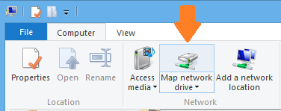
2.0 Map network drive
Do this on the Server
Go to My Computer
Expand the «Computer» tab
Click «Map network drive»

Slide 7
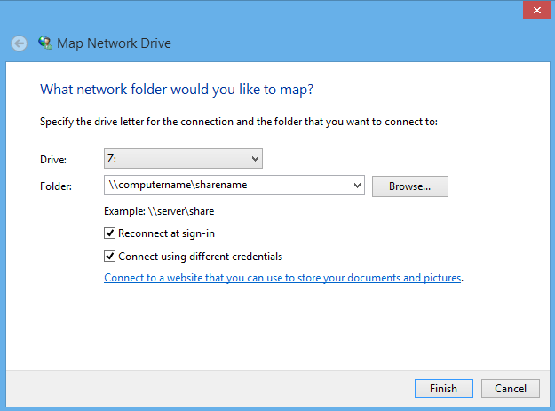
2.1 Map network drive
Select drive Z:
Enter the network path
You’ve made a note before
Check both boxes
Click “Finish”

Slide 8
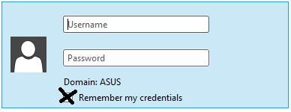
2.2 Map network drive
Enter the username from the other computer as well as password
Check the box below

Slide 9

2.3 Map network drive
You should be done if drive Z appears in «My Computer»

Slide 10
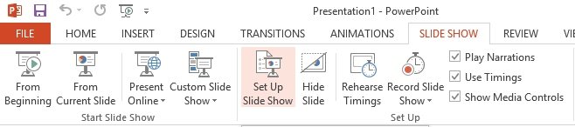
3.0 Prepare presentation
Go to «SLIDE SHOW»
Click «Set Up Slide Show»

Slide 11
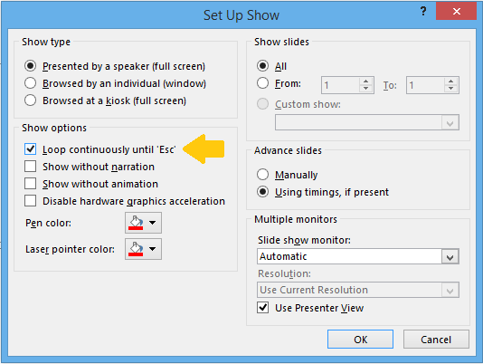
3.1 Prepare presentation
Check the «Loop» box
That’s all

Slide 12
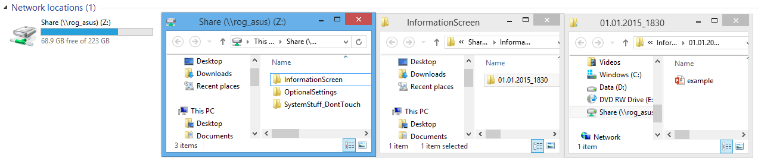
4.0 Deploy presentations
You got this structure:
Place a folder with date and time into the “InformationScreen” folder
Syntax is mm.dd.yyyy_hhmm
Place any presentation into it

Slide 13
4.1 Deploy presentations
The lastest before now will be displayed
Assuming you have
01.01.2015_1200
15.04.2015_1130
04.07.2015_1300
Assuming today is the 17.05.2015
It will display the second one because:
We don’t have 04.07.2015_1300 yet
The date 15.04.2015_1130 is passed already

