Slide 1

Effect Of Network Topology On The Performance Of ADMM-based SVMs
22MAT220 Mathematics for Computing 3
Team 12 (AIE-C):
A. Charan Kumar Reddy (CB.SC.UAIE24207)
Naveen K (CB.SC.U4AIE24235)
B Sai Kushal (CB.SC.U4AIE24252)
Subash B (CB.SC.U4AIE24254)

Slide 2
Problem Statement
Large-scale machine learning requires efficient distributed optimization.
Serial methods are no longer capable of solving today’s large problems due to the lack of scalability.
centralized parallel optimization methods may perform poorly due to communication overheads.
Need to identify which topologies accelerate convergence while maintaining scalability.

Slide 3
Objective
Develop and evaluate ADMM-SVM training over different network topologies.
Use d-regular random graphs to represent communication networks.
Measure impact on number of iterations, training time, and classification accuracy.
Comparison of SVM and ADMM-SVM that demonstrates the justification of ADMM usage in this project.

Slide 4
workflow
Build a Distributed Consensus-ADMM SVM
Design the Network Topology (d-regular Graphs)
Dataset Preparation
Normalize and Preprocess the Data
Train the Model on Each Dataset & Topology
Plot and Analyze the Results

Slide 5
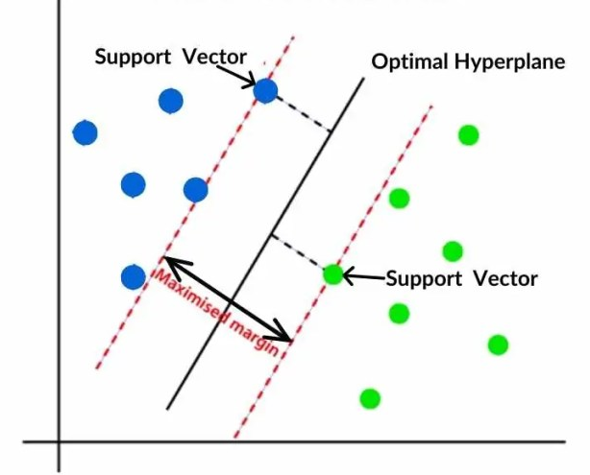
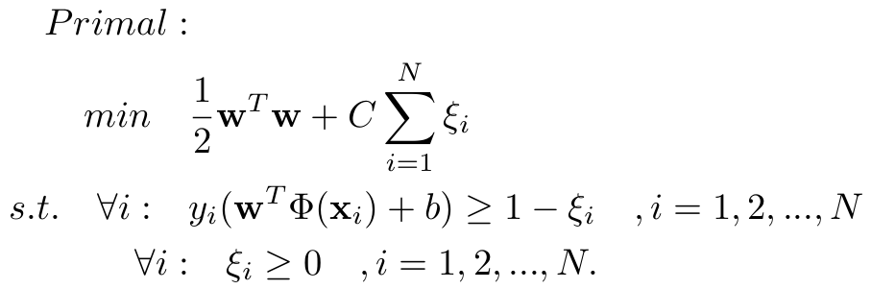
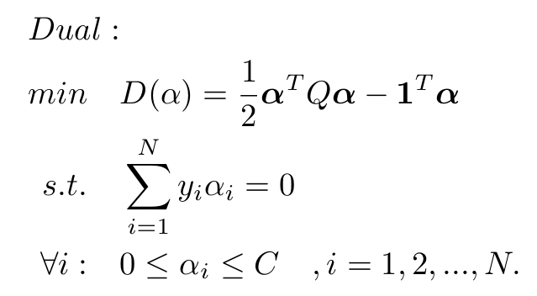
Support Vector Machines (SVM) - Overview
Supervised learning technique for classification.
Finds hyperplane maximizing margin between two classes.

Slide 6

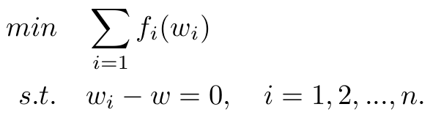
Alternating Direction Method of Multipliers (ADMM) - Overview
Decomposes optimization into subproblems for distributed solving
The optimization problems of the following form can be solved using ADMM.
Distributed consensus-based optimization can be formalized as
Each node solves local subproblem, communicates only with neighbors
Iteratively enforces consensus with convergence guarantees for convex problems

Slide 7
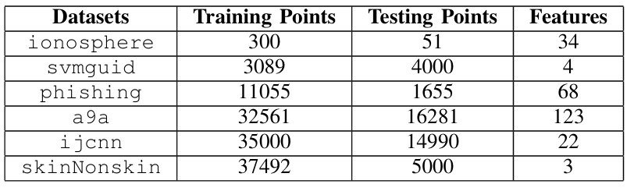
datasets
G1
G2
Ionosphere → contains radar signals as "good" or "bad" , (good, bad)=(+1,-1)
Svmguide → Contains benchmark feature vectors with two class labels: +1 and -1
Phishing → distinguishes between "phishing" and "legitimate" websites, (phishing, legitimate)=(+1,-1)
A9a (Adult) → predicts whether income is "≤50K" or ">50K". (>50K, ≤ -50K)=(+1,-1)
IJCNN → Competition dataset with two classes: +1 and -1
Skin/Non-skin → Contains RGB (Red, Green, Blue) taken from images, (skin, Nonskin)=(+1,-1)

Slide 8
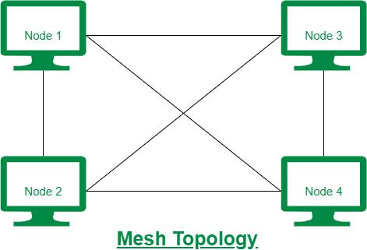


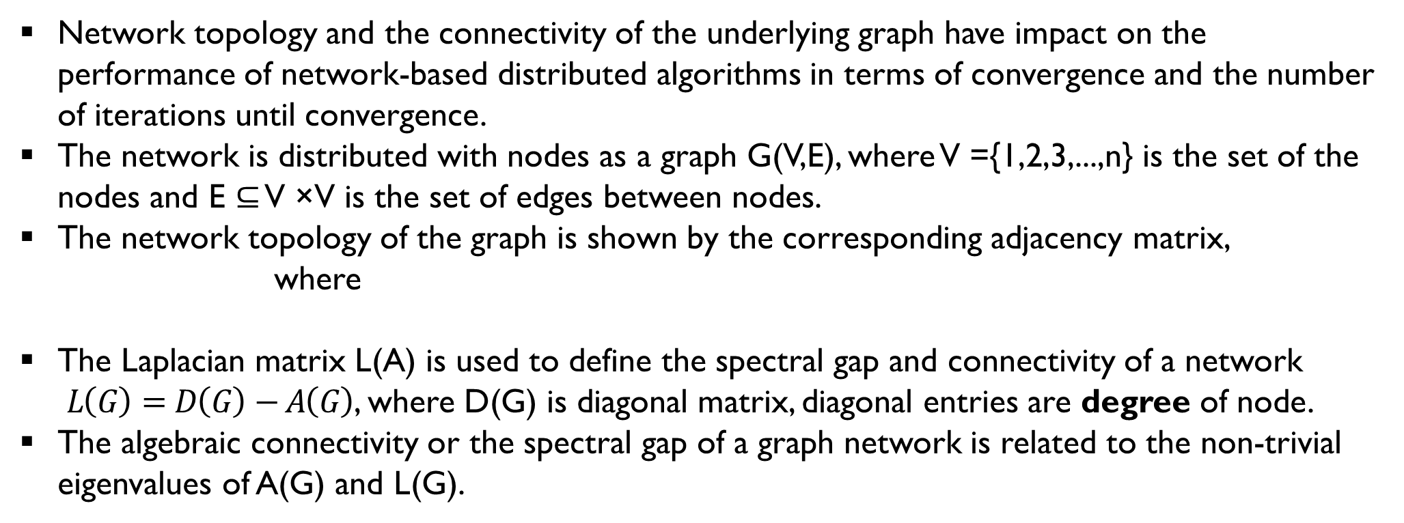
Network Topology
Introduction
Network topology and the connectivity of the underlying graph have impact on the performance of network-based distributed algorithms in terms of convergence and the number of iterations until convergence.
The network is distributed with nodes as a graph G(V,E), where V ={1,2,3,...,n} is the set of the nodes and E ⊆ V ×V is the set of edges between nodes.
The network topology of the graph is shown by the corresponding adjacency matrix,
where
The Laplacian matrix L(A) is used to define the spectral gap and connectivity of a network
$L\left(G\right)=D\left(G\right)−A\left(G\right)$, where D(G) is diagonal matrix, diagonal entries are degree of node.
The algebraic connectivity or the spectral gap of a graph network is related to the non-trivial eigenvalues of A(G) and L(G).

Slide 9
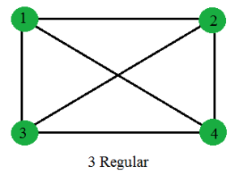
d- regular random graphs
A d-regular graph is one where each node is connected to exactly d neighbors.
In random d-regular graphs, connections are assigned randomly while
maintaining equal degree for all nodes.
They are widely used as models for expander graphs due to their strong connectivity properties.
Such graphs ensure uniform communication load across nodes in distributed networks.
Larger spectral gaps in d-regular random graphs lead to faster convergence in
ADMM-based SVMs.

Slide 10
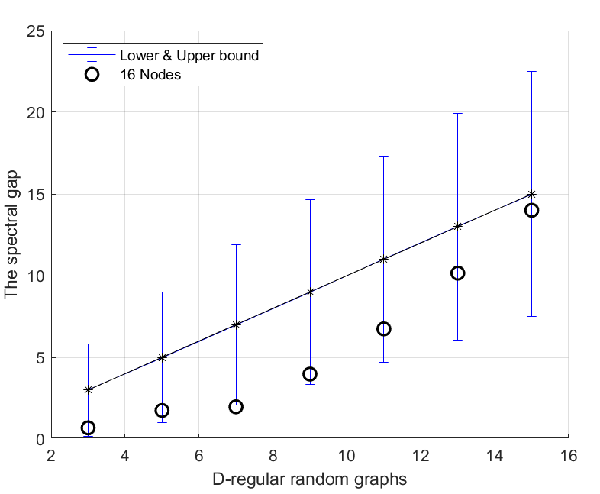
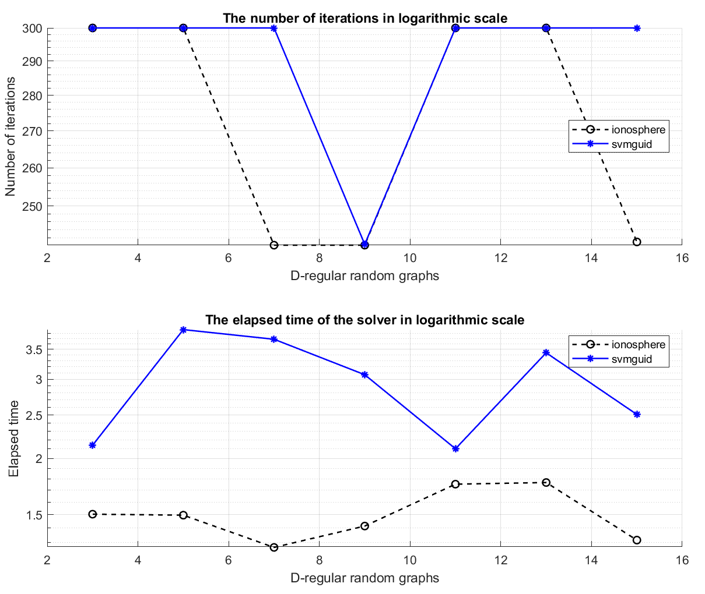
Results
G1 Datasets

Slide 11
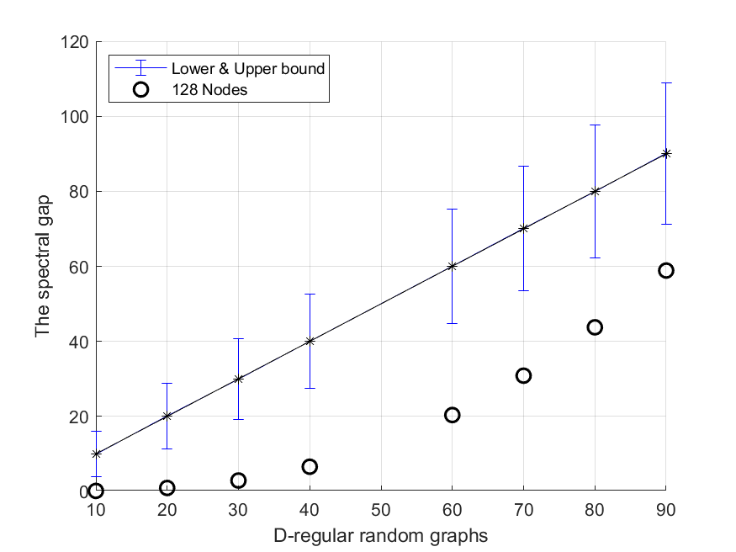
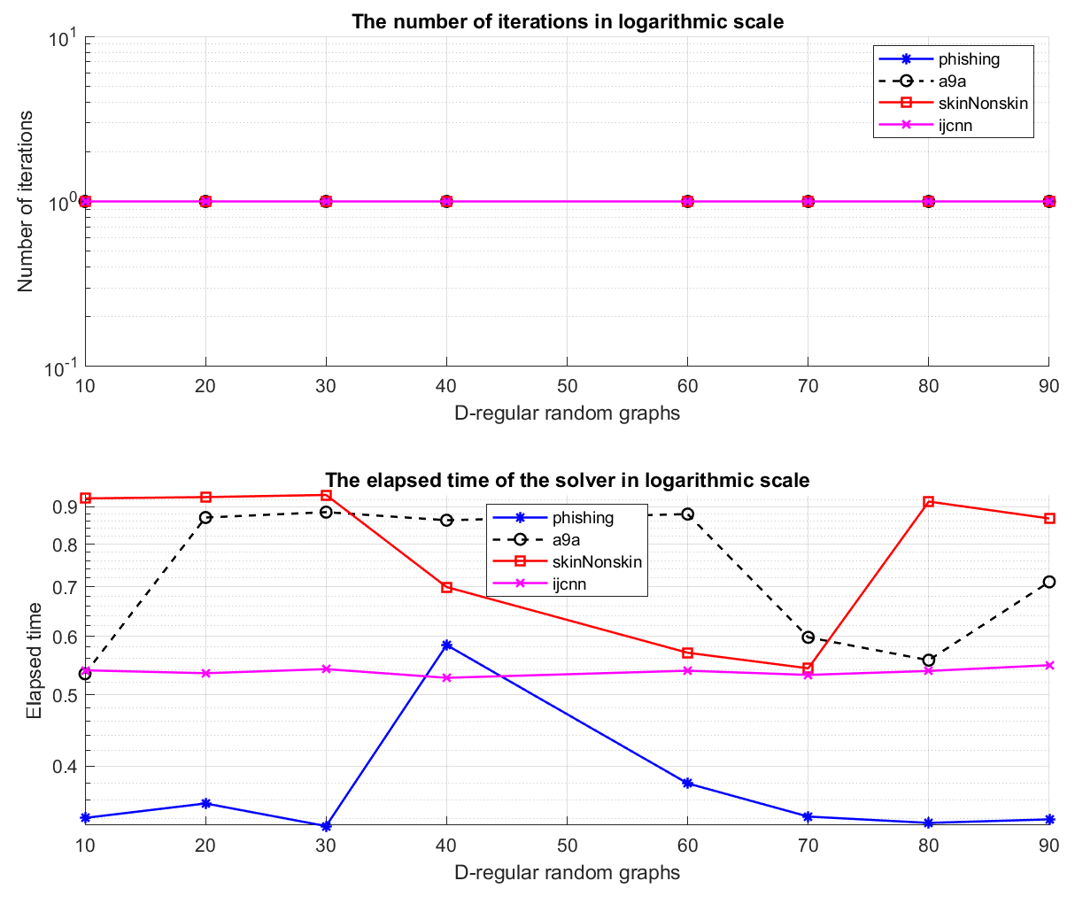
G2 Datasets

Slide 12
Future work
Implement few more topologies namely Ring, Bus, Mesh
Classification plots of ADMM based SVM model for each dataset
Comparison of SVM and Implemented ADMM based SVM

Slide 13
Thank You

