Slide 1

CO2 emission prediction using machine and deep learning techniques
SUBJECT NAME:
Mathematics for computing 2 and
Elements of computing -2
SUBJECT CODE:
22MAT122, 22AIE113
Group 24:
Cibikumar (CB.SC.UAIE24212)
Naveen K (CB.SC.U4AIE24235)
Subash B (CB.SC.U4AIE24254)
T Manas (CB.SC.U4AIE24257)

Slide 2
ABSTRACT
The rapid growth of computational technologies has led to increased energy consumption and carbon emissions, raising concerns about environmental sustainability. This project explores Green Computing by leveraging Deep Learning and Machine Learning techniques to predict CO₂ emissions across various sectors. Using a cleaned monthly sector-wise dataset, we implemented multiple predictive models, including Long Short Term Memory (LSTM), Ridge Regression, XGBoost, and LightGBM. The dataset was preprocessed through feature engineering, normalization, and lag feature generation, ensuring robust time-series forecasting. LSTM, a recurrent neural network, was used to capture temporal dependencies, while traditional regression, XGBoost, and LightGBM provided efficient and interpretable alternatives. The models were evaluated using performance metrics such as Root Mean Squared Error (RMSE), Mean Absolute Error (MAE), Mean Squared Error (MSE), and R² Score.Our results demonstrate the effectiveness of machine learning in forecasting CO₂ emissions, enabling policymakers and industries to make informed decisions for sustainable energy usage. This project highlights the role of AI-driven solutions in reducing environmental impact and promoting energy-efficient computing practices.

Slide 3

DATASET OVERVIEW
The dataset contains 523 rows and 10 columns.
The data spans from January 1973 onward.
It records monthly CO₂ emissions from different energy sources in the electric power sector.
Columns
Date,
Coal Electric Power Sector CO₂ Emissions,
Oil Electric Power Sector CO₂ Emissions,
Geothermal Energy Electric Power Sector CO₂ Emissions,
Natural Gas Electric Power Sector CO₂ Emissions,
Non-Biomass Waste Electric Power Sector CO₂ Emissions,
Petroleum Coke Electric Power Sector CO₂ Emissions,
Petroleum Electric Power Sector CO₂ Emissions,
Residual Fuel Oil Electric Power Sector CO₂ Emissions
Total Energy Electric Power Sector CO₂ Emissions
Source
Kaggle

Slide 4
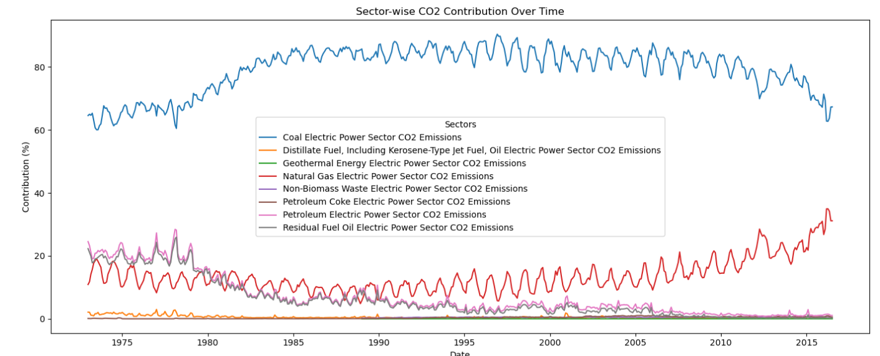
OBJECTIVE
The primary objective of this project is to analyze and forecast monthly CO₂ emissions based on fuel-specific emissions data using advanced machine learning techniques. This includes:
Identifying key fuel contributors to total CO₂ emissions.
Predicting total CO₂ emissions from individual sectoral emissions (e.g., natural gas, coal, petroleum).
Forecasting future emissions trends using temporal patterns in historical monthly data.
Comparing model performances (MAE, RMSE, R²) across multiple regression and time-series models such as Linear Regression, LSTM, XGBoost, LightGBM, and SVM.
Recommending optimal models for accurate emission forecasting to aid in environmental planning and policy-making.

Slide 5
METHODOLOGY
Step 1: Data Collection
Use monthly sectoral CO₂ emissions dataset from trusted sources (e.g., government or environmental databases).
Step 2: Data Preprocessing
Handle missing values, outliers, and data inconsistencies.
Normalize or scale the features for better model performance.
Convert time-series date fields into usable formats (e.g., month, year index).
Step 3: Exploratory Data Analysis (EDA)
Analyze trends, patterns, and seasonality in CO₂ emissions.
Visualize correlations between fuel-specific emissions and total emissions.
Step 4: Feature Engineering
Create lag features to capture temporal dependencies.
Generate new features such as rolling averages or monthly year-on-year changes.
Step 5: Data Splitting
Divide the dataset into training and testing sets (e.g., 85/15 or use TimeS eries Split).

Slide 6
Step 6: Model Selection & Training
Apply multiple models:
Ridge Regression
Support Vector Regression (SVR)
XGBoost Regressor
LightGBM Regressor
LSTM (for deep learning time-series forecasting)
Tune hyperparameters for each model.
Step 7: Model Evaluation
Use performance metrics:
MAE (Mean Absolute Error)
RMSE (Root Mean Squared Error)
R² Score (Coefficient of Determination)
Step 8: Forecasting
Use the best-performing model to predict future CO₂ emissions.
Visualize actual vs. predicted emissions.
Step 9: Model Comparison
Compare models based on accuracy, complexity, training time, and interpretability.
Step 10: Conclusion & Recommendations
Summarize findings.
Suggest suitable models for real-time emission monitoring and policy implications.

Slide 7
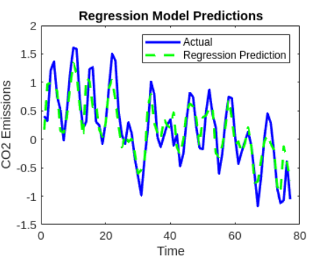
RIDGE REGRESSION
A type of linear regression that includes L2 regularization.
Helps prevent overfitting by penalizing large coefficients.
Useful when features are correlated or the dataset has multicollinearity.
Balances bias-variance trade-off using a regularization parameter (λ).
Works best with simple, linear relationships in the data.
Faster and interpretable but less effective on non-linear patterns.

Slide 8
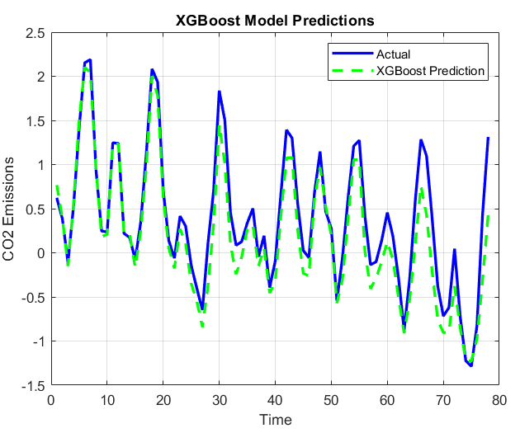
XG BOOST
An ensemble learning algorithm based on decision trees.
Boosts accuracy by combining multiple weak learners.
Uses gradient descent to minimize errors over iterations.
Includes built-in regularization, preventing overfitting.
Handles missing values and noisy data effectively.
Works well for tabular and structured data, including emissions datasets.
Requires feature scaling, but is highly efficient and scalable.

Slide 9
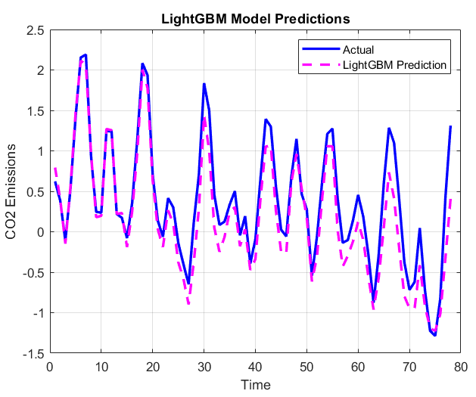
LIGHT GBM
A faster and more efficient alternative to XGBoost.
Uses leaf-wise tree growth for better accuracy.
Optimized for speed and low memory usage.
Supports categorical features natively.
Best suited for large-scale datasets with many features.
Can handle complex, non-linear relationships in CO₂ emissions data.
May overfit on small datasets, so needs tuning.

Slide 10
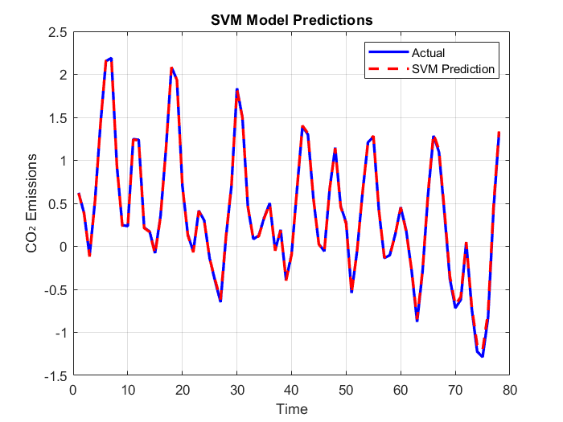
SVM(SUPPORT VECTOR MACHINE)
A powerful supervised learning algorithm for classification and regression.
Finds the optimal hyperplane that separates data points.
Can be extended to non-linear problems using kernel trick (e.g., RBF).
Effective in high-dimensional spaces, especially with fewer samples.
Robust to outliers, especially with a good kernel choice.
Requires feature scaling and parameter tuning (C, gamma).
In emissions forecasting, SVM captures non-linear temporal trends.

Slide 11
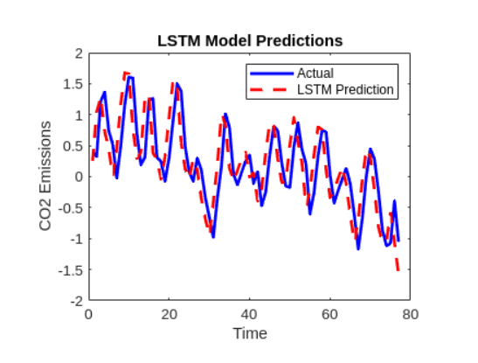
LSTM MODEL
A special type of Recurrent Neural Network (RNN) designed to handle sequential/time series data.
Excels at learning temporal dependencies — trends and patterns over time.
Uses memory cells to remember information for long periods.
Solves the vanishing gradient problem found in traditional RNNs.
Has three gates:
Input gate – controls what new information is stored.
Forget gate – decides what information to discard.
Output gate – selects what information to output.
Performs well in modeling non-linear, complex temporal relationships.

Slide 12
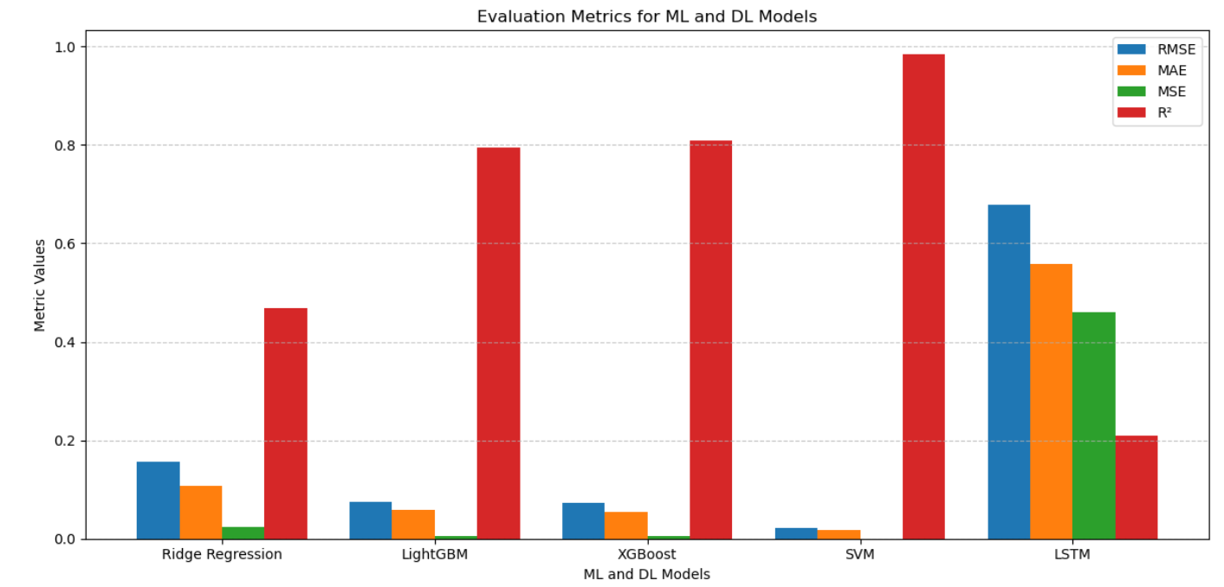

Slide 13
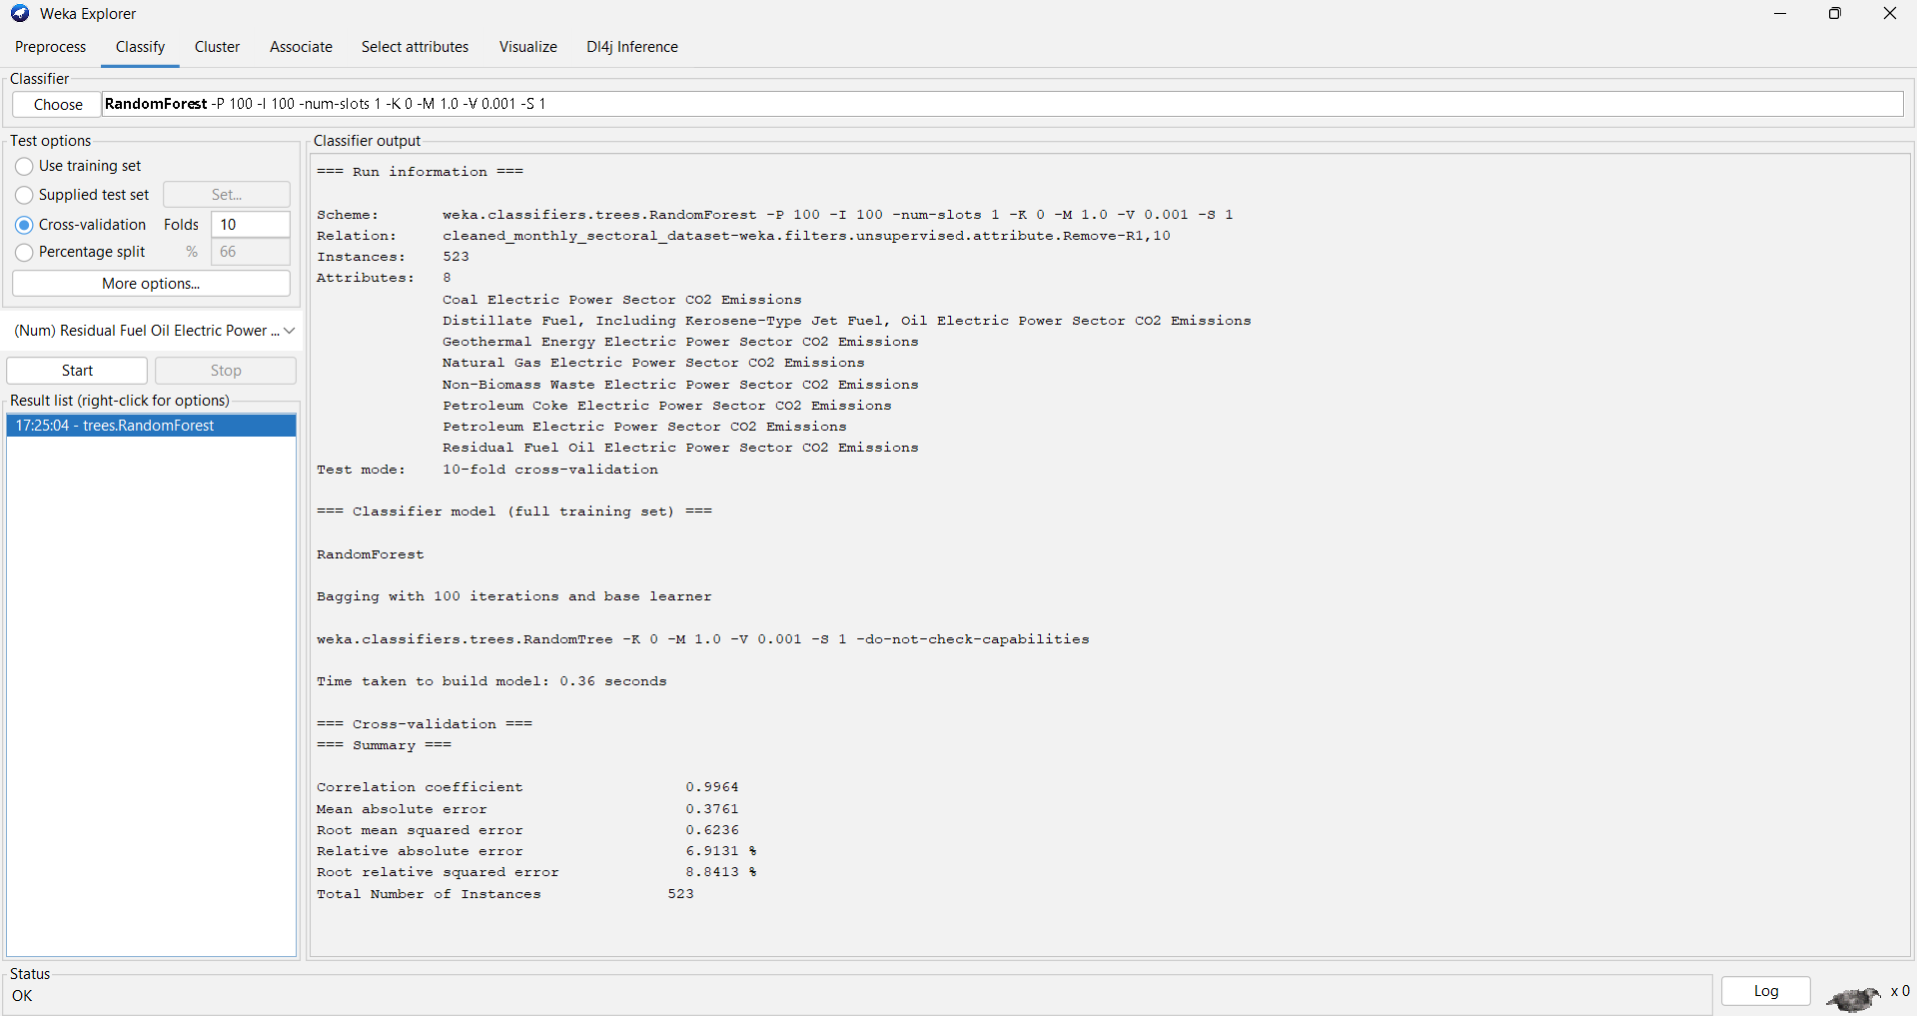

Slide 14
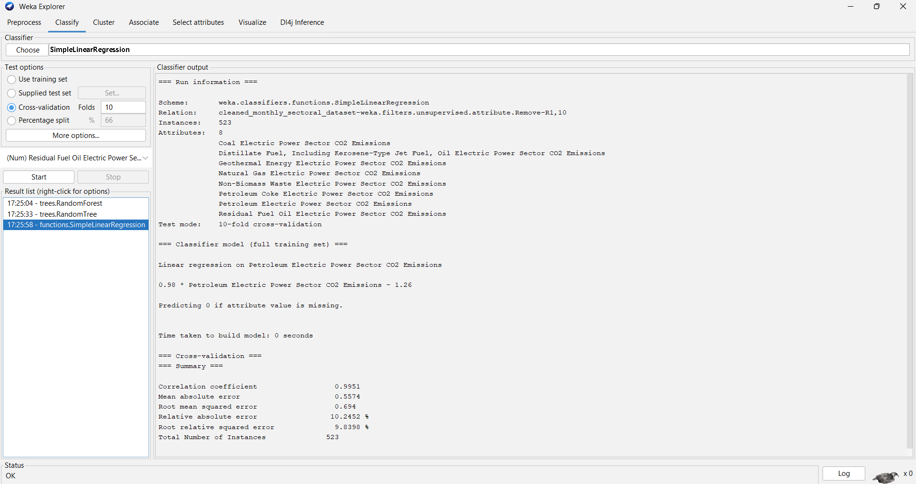

Slide 15
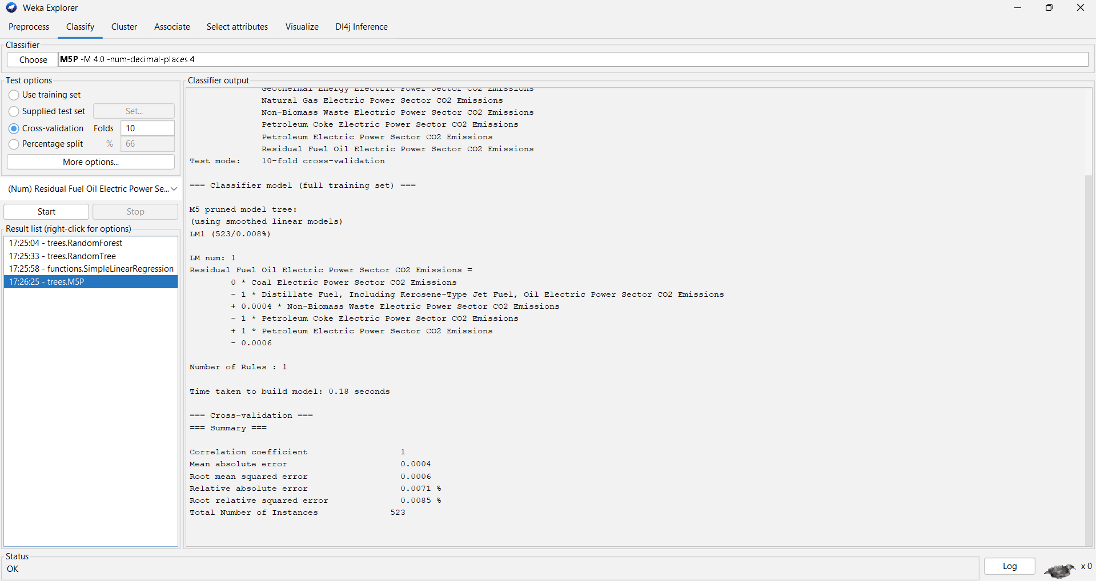

Slide 16
REFERENCES
Ajala AA, Adeoye OL, Salami OM, Jimoh AY An examination of daily CO₂ emissions prediction through a comparative analysis of machine learning, deep learning, and statistical models
Kumar M, Thakur S, Singh S Machine learning-based time series models for effective CO₂ emission prediction in India
Ullah I, Qureshi AS, Kim D Predicting CO₂ Emission Footprint Using AI through Machine Learning
Xing Liu CO₂ emissions prediction based on regression, neural network and SVM
Zhao B, Li J, Zhang Y Machine learning approaches for predictions of CO₂ emissions in the building sector

Slide 17
CONCLUSION
This project focused on forecasting CO₂ emissions from the electric power sector using both machine learning and deep learning techniques.
We trained and evaluated several models, including:
Machine Learning Models: Ridge Regression, Support Vector Machine (SVM), XGBoost, and LightGBM
Deep Learning Model: Long Short-Term Memory (LSTM)
Each model was assessed using key evaluation metrics: RMSE, R² Score, and MAE.
While deep learning showed promising results, particularly with LSTM capturing temporal dependencies, the Support Vector Machine (SVM) model outperformed others with the highest accuracy and lowest error.
The results indicate that SVM is well-suited for handling complex, nonlinear relationships in emission data.
These findings contribute to developing more accurate predictive tools for climate analysis and energy policy planning.

