Slide 1

Camper Ghillie
Thomas “SiletzSpey” Gilg
2015 F350 / 2018 NL 9’6”
Dec 1, 2019

Slide 2
Camper Ghillie Features
Legend
Not yet in-scope
Not yet done
Not yet designed
--tg Dec 1, 2019
Temperature & Atmospheric Sensors
Outside – temp, humidity, solar _{DS18B20 Waterproof case}
Cabin – temp @ ceiling/floor/bed, humidity, baro, VOC air quality _{BME680}
Basement – temp @ black/gray/fresh/sink vaults and more _{DS18B20}
Tanks – temp @ black _{DS18B20}
Furnace – temp @ output port, mostly to detect furnace on/off
Wet Levels
Water – black/gray/fresh… to see usage by event and over time
Power – solar output, charger output, battery levels, battery charge rate, battery draw rate, power draw rate. Four shunt setup provides more details
Propane – with just-filled reset button (still need to validate novel approach)
Freeze Guard
Small PC fans (12V, 75ma, 26CFS) and mini heaters (bulb or heater elements) to keep crawl space plumping and tanks from freezing while parked at home during mild winter conditions (say to 15F / -10C), Get temp grid online first so that the needs and approaches can be explored
Shower Miser
Body-perfect hot water – no hot/cold mixing/wasting on inside and outside faucets _{DS18B20 High temp case x1}
Other
Atmospheric gas monitors – above and beyond VOC air quality
G forces, spill monitors, security alarm, other
Generic Attributes
Data-log and store locally, uplift telemetry to cloud via WiFi for analysis
E-mail alerts (e.g. water vaults approaching outside freezing temps)
In-cabin audible and LCD-display alerts
Trending and prediction to empty/full where appropriate
Use ESP8266 with WiFi to start, turn on extreme power conservation features
Consider ESP32 to gain Bluetooth and more GPIO. Needs more power ☹
Avoid Raspberry PI due to power draw

Slide 3
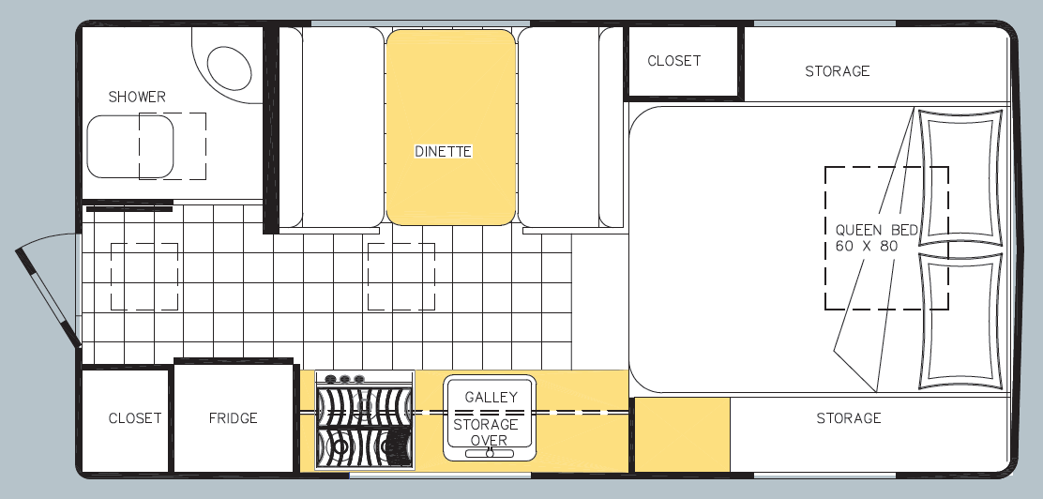
Sensor Positions and Wiring
1) Black vault down-low air
2) Black tank surface at 1/4 full position *
3) Gray vault down-low air
4) Fiberglass inner surface near gray vault **
5) Fresh vault down-low air
6) Sink vault air
7) Heater vent output (using 1 of 2 two-inch basement vents) ***
8) Bedroom head-high air TO BE WIRED
9) Cabin head-high air
10) Cabin ankle-high air TO BE WIRED
11) Outside air circa propane vent ****
* See water thermal-mass aspects
** See surface v free air diffs, consequences for water line mounts
*** Mostly to see propane furnace on/off
**** Minor concern about propane tank cooling effects
Sensors equalized to +/- 0.1F of each other, about 0.1F steps, about +/- 1.0F accuracy over well below freezing to near boiling temp
1
2
7
Ard
3
4
5
10
8
9
6
11

Slide 4
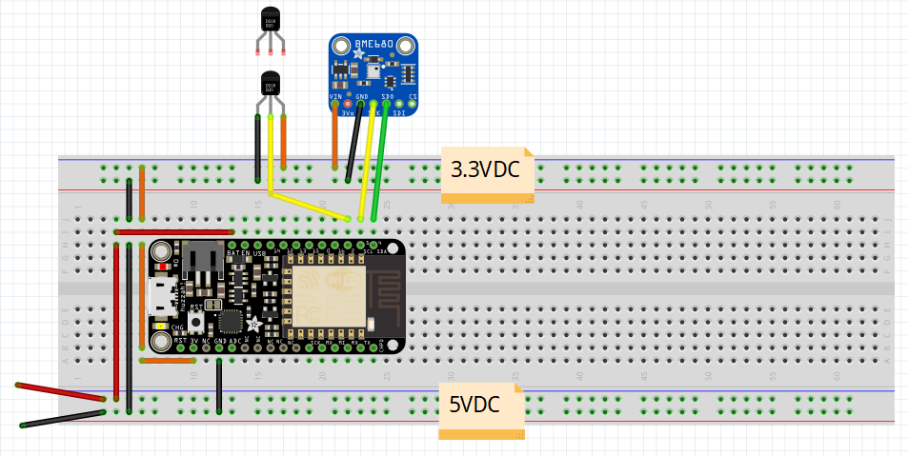
ESP8266 Arduino Fritzing Diagram (Copy)
Sensors
DS18B20 temp sensors x11
BME680 for humidity, barometric, altitude and VOC-gas sensing x1
Simple low-voltage 24ga wires around camper
ESP8266 Arduino
Wi-Fi to home LAN
Sensor data streamed to Adafruit MQTT Service every 15 seconds
Live MQTT dashboards
Data download to MS-Excel for better analysis and graphing
Adafruit has a free/paid MQTT service. I’m trying to stay at the free feed count and data quantity level, in part by cramming all sensor data into a CSV string and treating it as a single feed bound for MS-Excel --tg

Slide 5
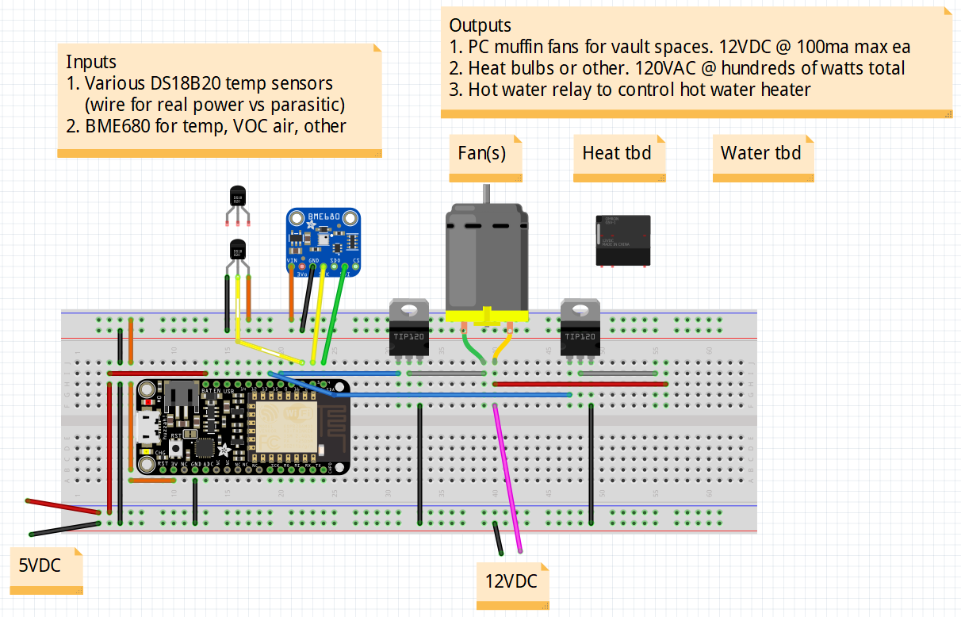
ESP8266 Arduino Fritzing Diagram 2 (Copy)
Future intentions…
Add micro PC fan(s) to aid heating in the basement/vault spaces during below freezing weather
Add water heater sensing and control for Shower Miser feature

Slide 6
Helper Diagrams

Slide 7
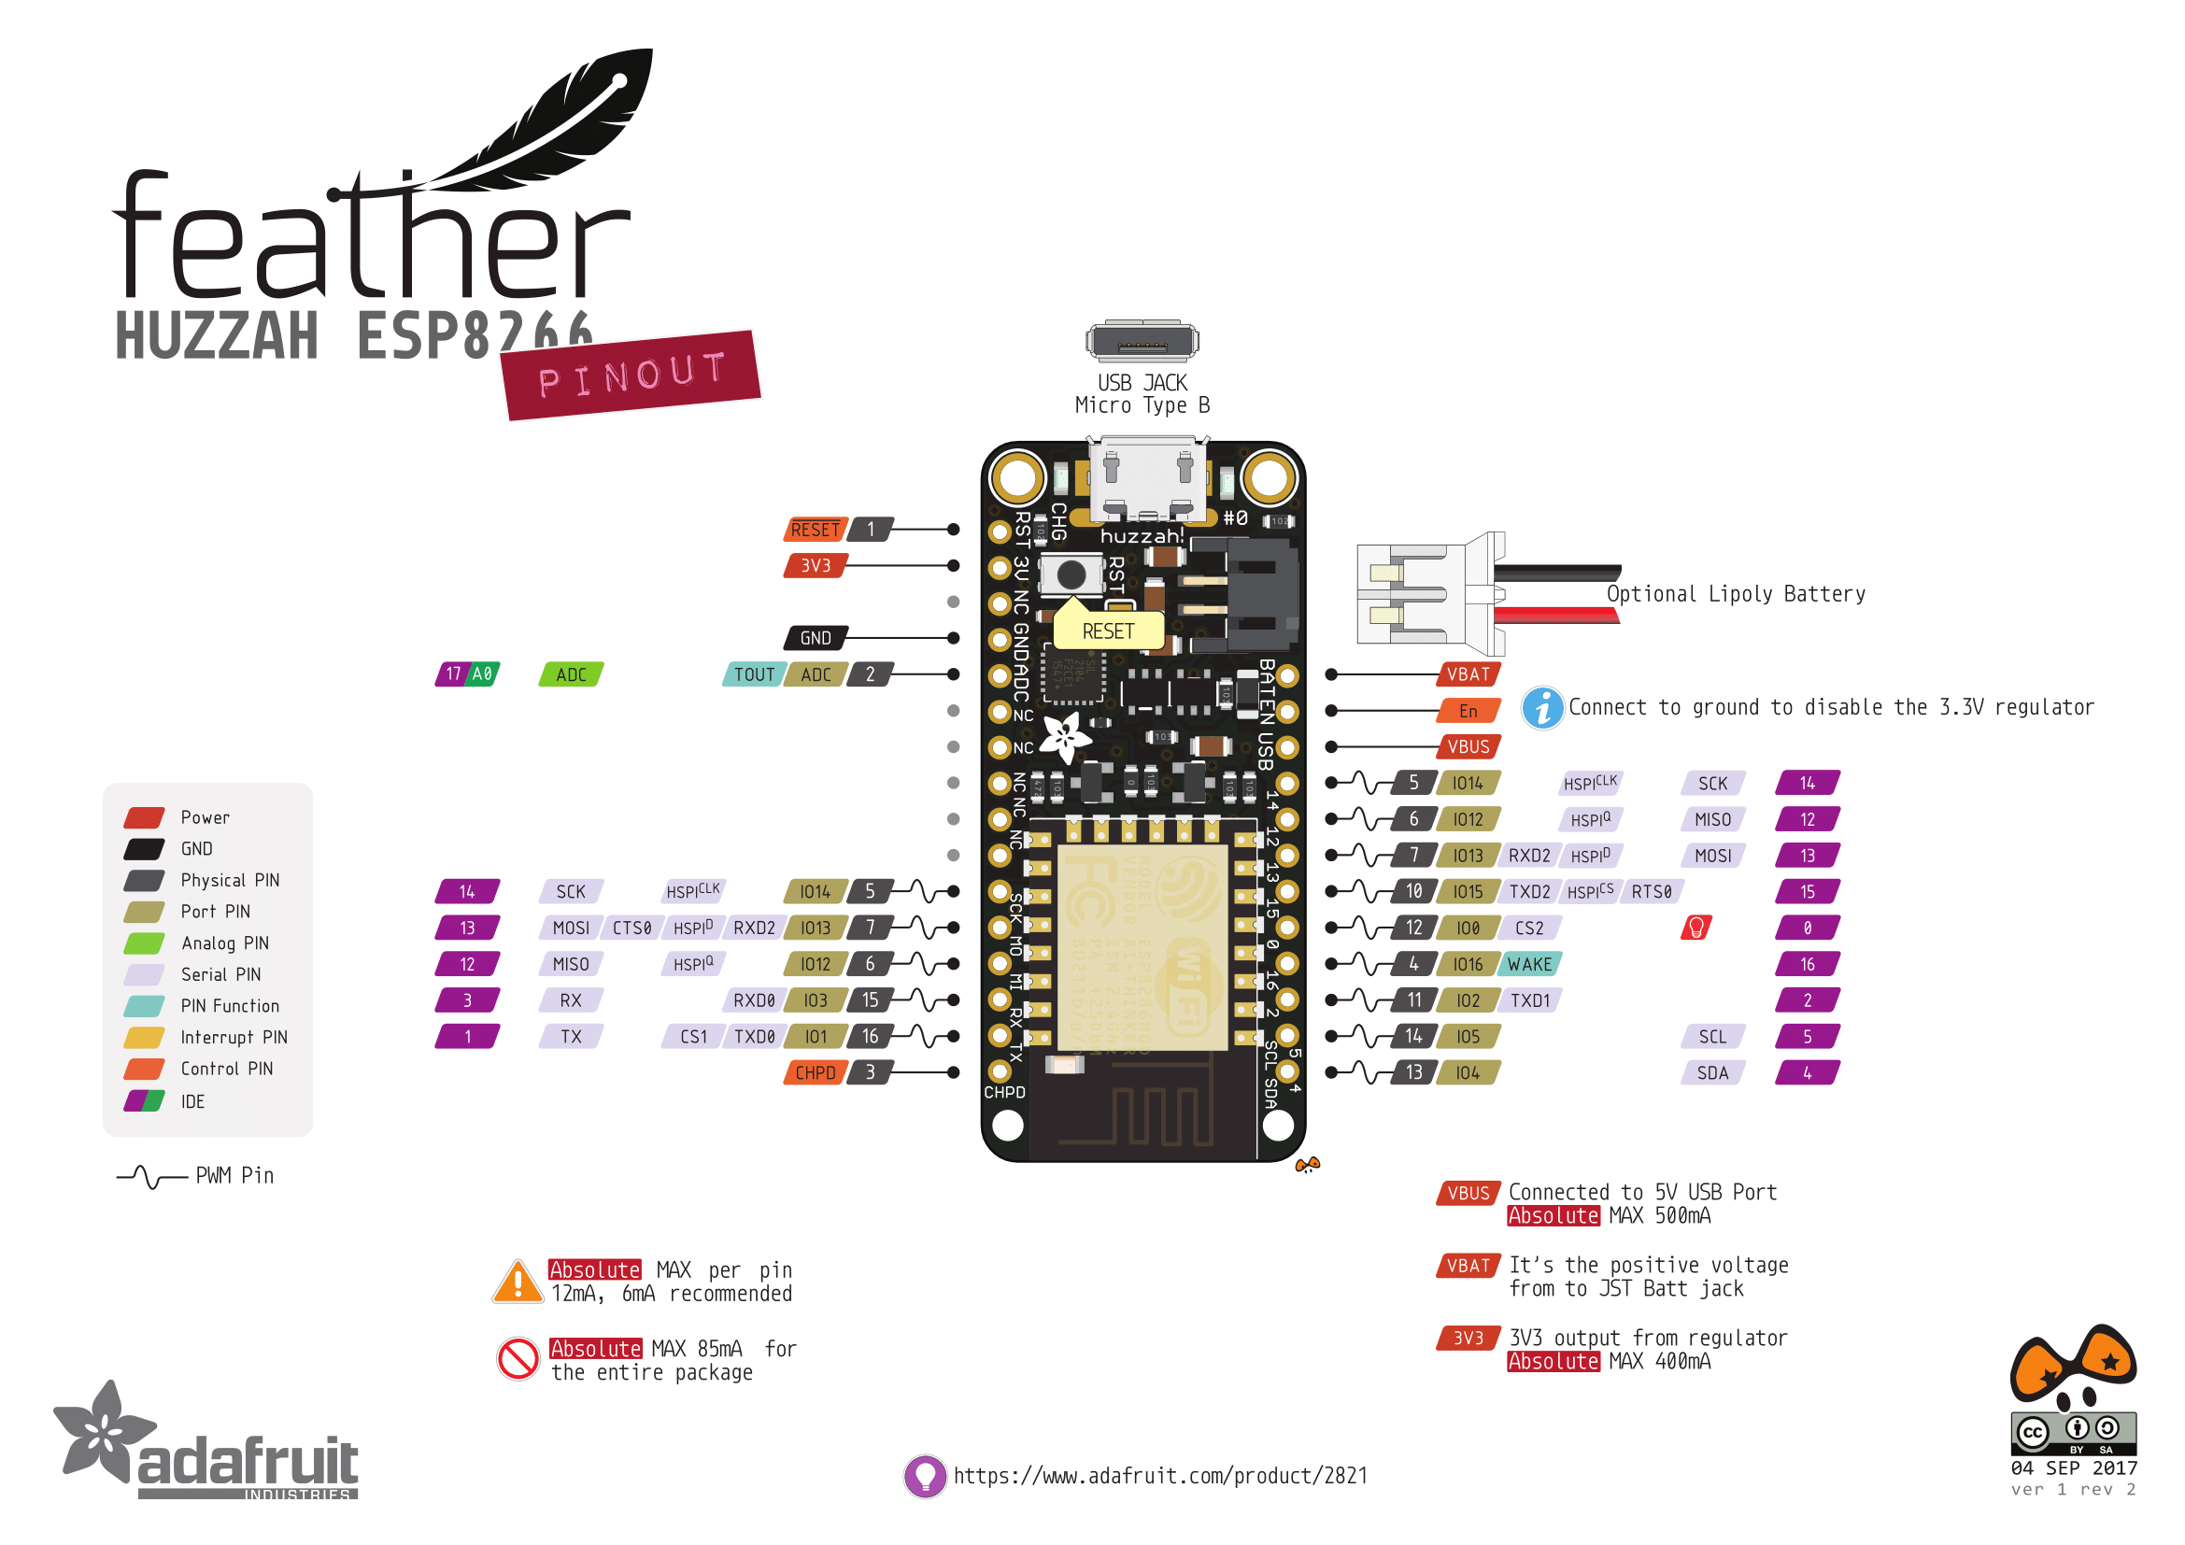
0 Boot on Low + Red LED
1 Serial TX
2 Boot on Low + Blue LED + Pull-Up
3 Serial RX
4 I2C SDA
5 I2C SCL
6-11 Flash
12 SPI MISO
13 SPI MOSI
14 SPI SCK
15 SPI SS / Boot on High + Pull-Down
16 Connect to RESET for Deep Sleep Wake + Pull-Down
17 ADC

Slide 8
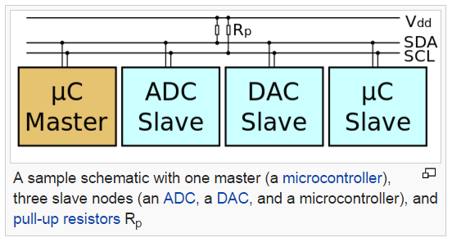
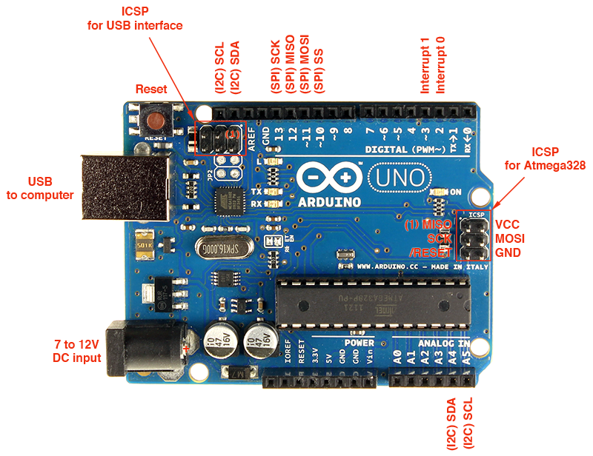
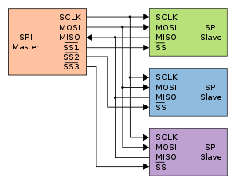
I2C | SPI | UART | Dallas OneWire
Slow Fewer lines Addressable devices Interrupt line More complicated to use Master/slave “bus” Falling / rising edge differences between parts ☹ | Fastest More lines Easier to use Point to point More robust HW/SW | Slow/Slowest | Slowest Simple but robust Very long wire runs possible compared to I2C and SPI In theory GND + Signal with parasitic powering off Signal, but adding V+ makes things more robust

Slide 9
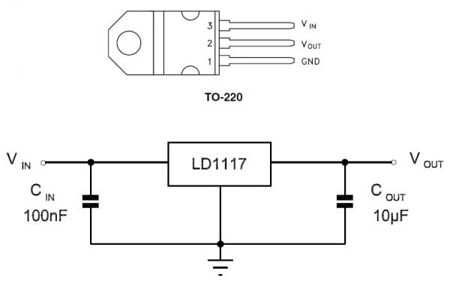
120Ω on LD1117v1.2 out to maintain min load. No need on v3.3
100nf = 0.1uf

