Slide 1

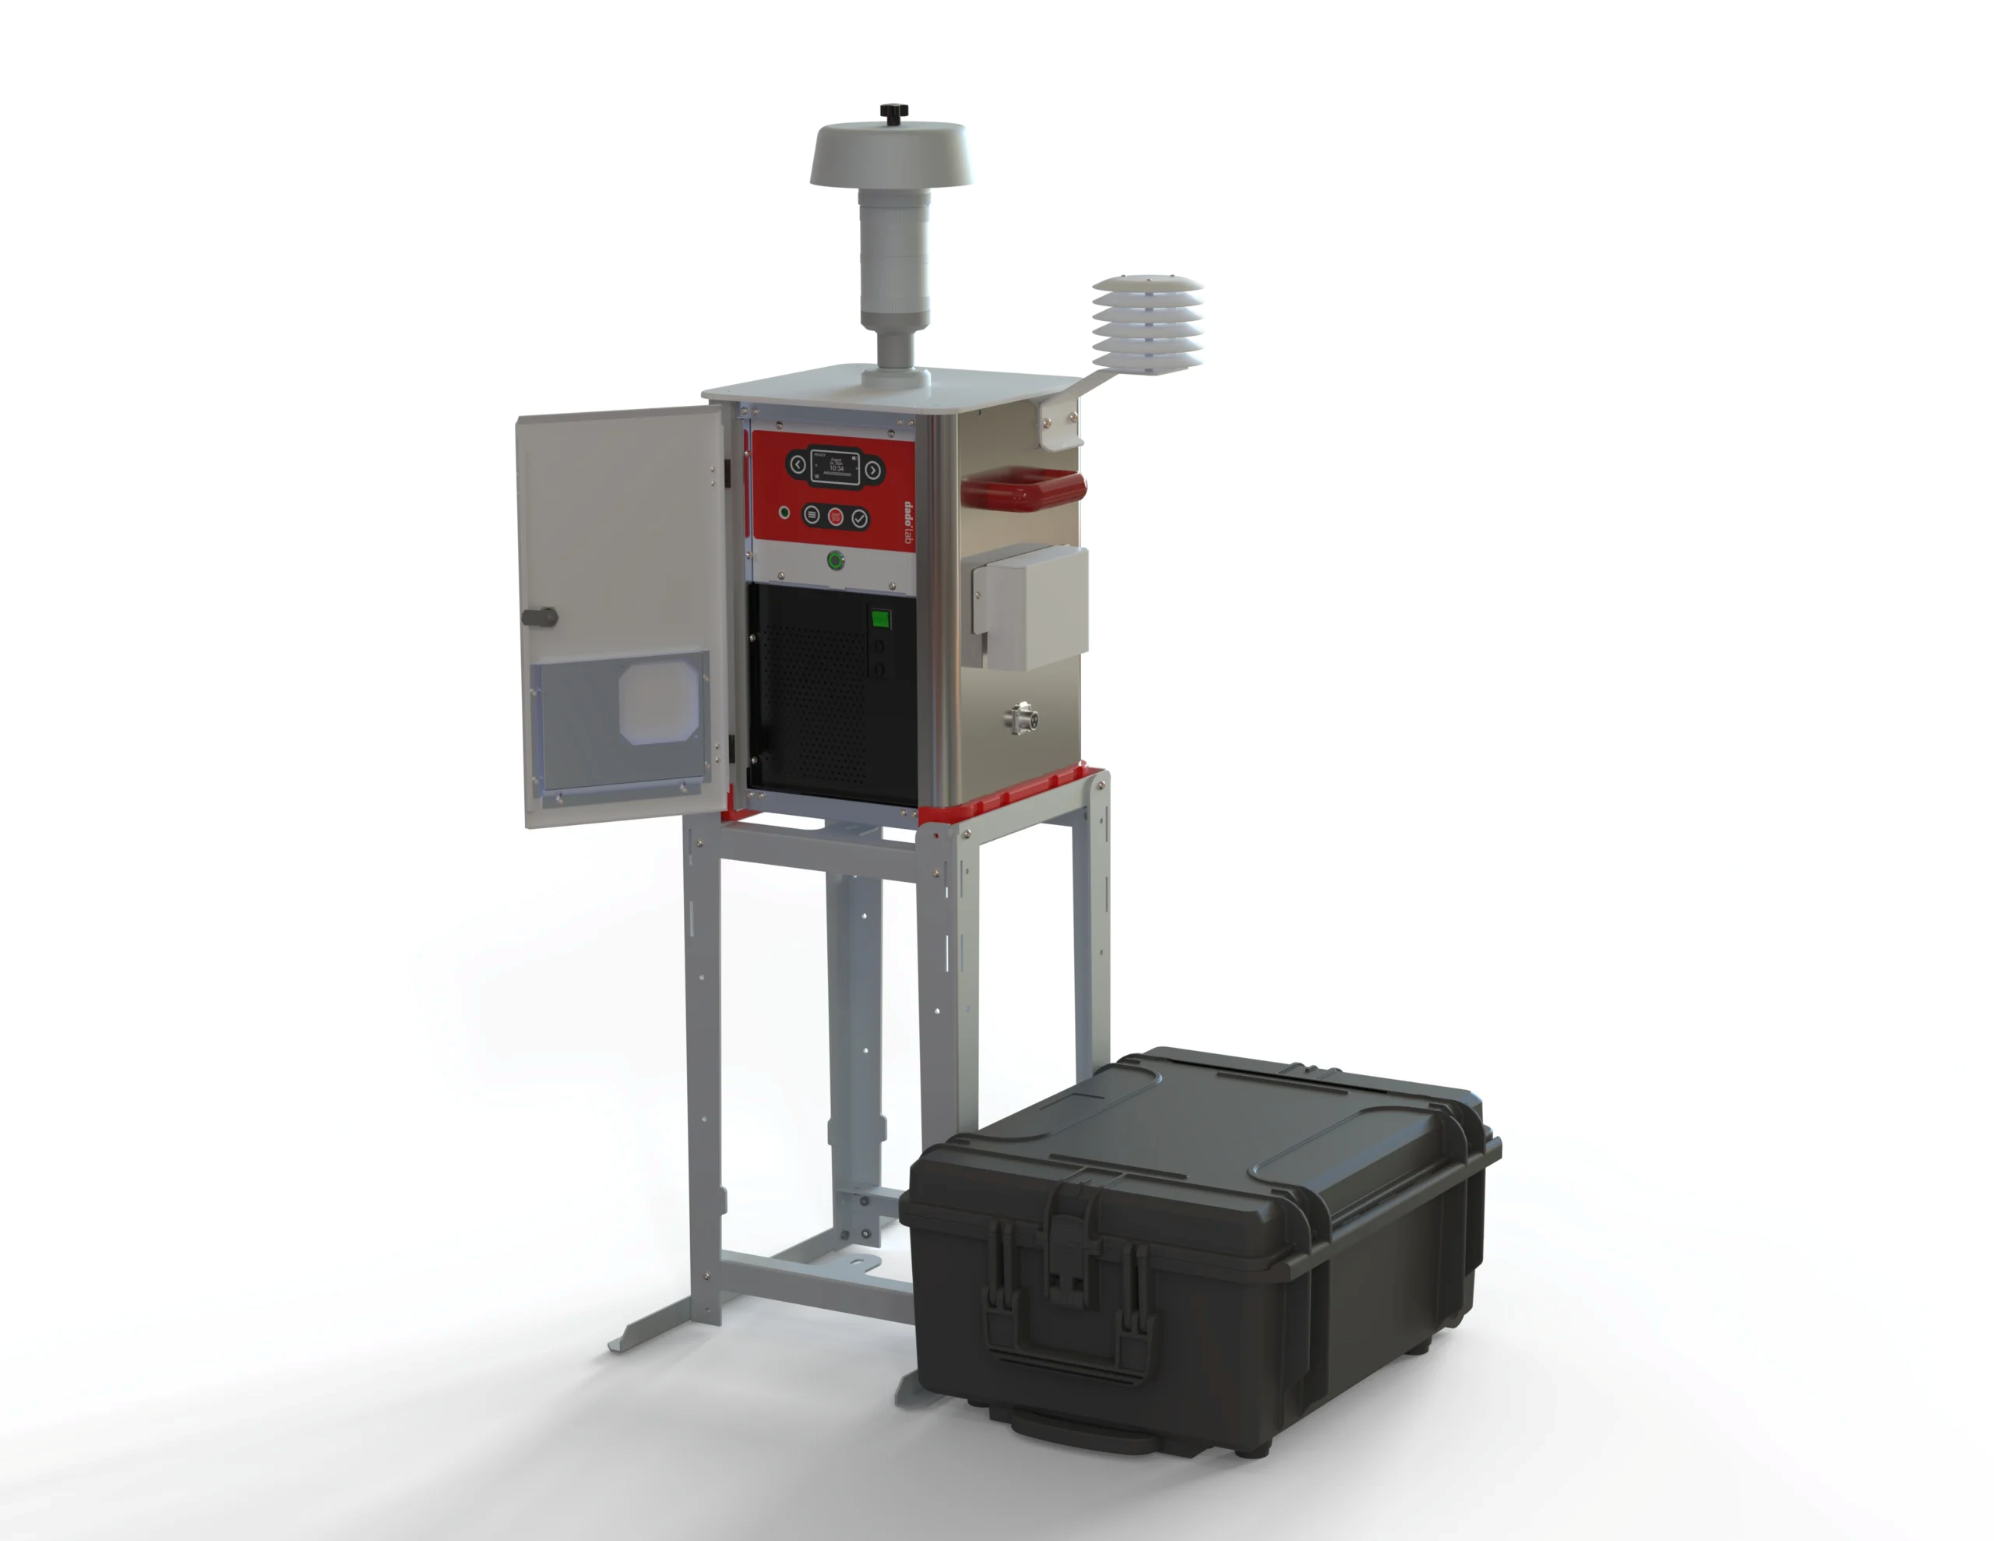
Sampling, analysis and interpretation of atmospheric aerosol particles
Summer school lecture
Online instruments, offline samples, and source interpretation
01

Slide 2
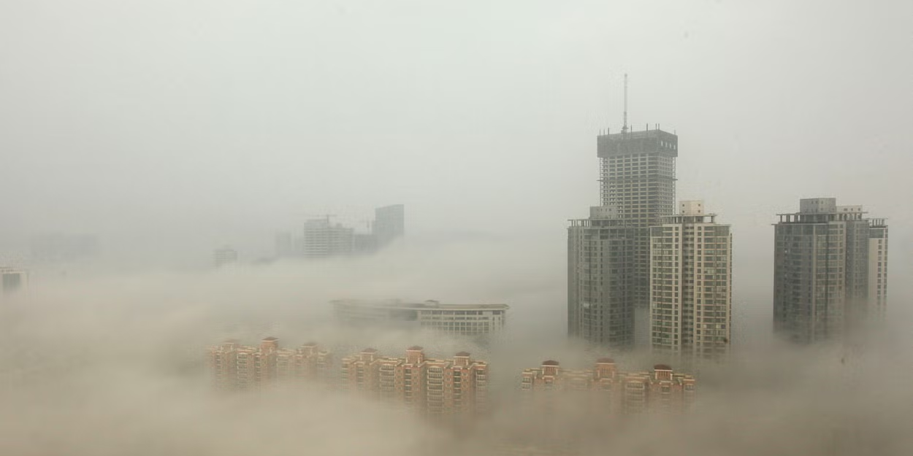
Air as the first exposure
Aerosol measurements matter because people breathe continuously
Without | Typical survival time
Food | Weeks
Water | Days
Air | Minutes
Air quality begins with the particles people inhale.
02

Slide 3
Aerosol particles in the atmosphere
Small abundance can still have large atmospheric effects
- Particles scatter and absorb radiation
- Particles act as cloud condensation nuclei
- Particle surfaces carry chemistry and biological exposure
- Size and composition control the effect
The same mass can mean very different particle numbers.
03

Slide 4
The measurement chain
Sampling decisions shape every result that follows
Step | Question
Sampling | What reaches the instrument or filter?
Analysis | Which property do we measure?
Quality checks | Can we trust the number?
Interpretation | What source or process explains it?
Bad sampling cannot be repaired by good statistics.
04

Slide 5
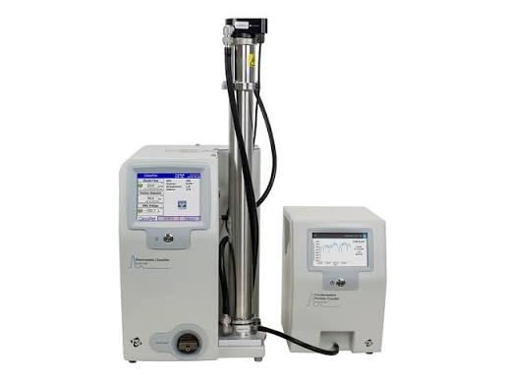
Online and offline measurements
Real-time dynamics and laboratory detail answer different questions
Approach | Strength | Typical limitation
Online | Minutes to seconds | Usually fewer chemical targets
Offline | Detailed chemistry | Time-integrated sample
05

Slide 6
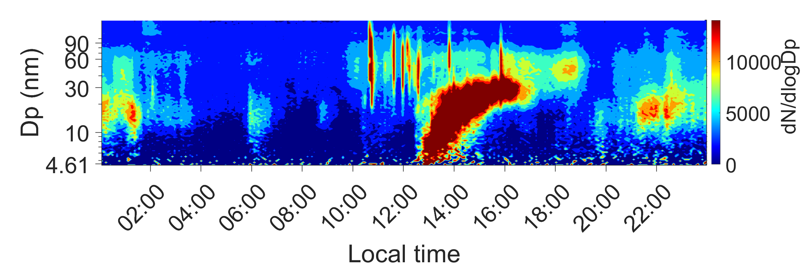
SMPS
A real-time view of particle number size distributions
The output is concentration by mobility diameter and time.
06

Slide 7
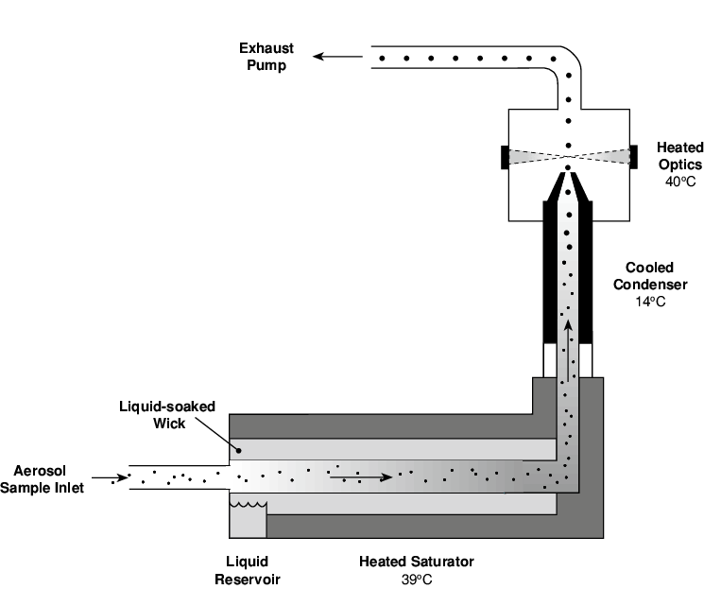
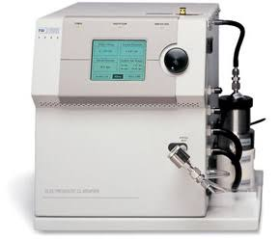
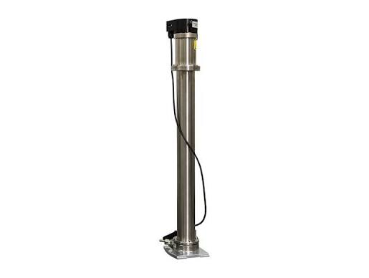
Inside an SMPS
Charge, classify, count
Neutralizer
DMA
CPC
07

Slide 8
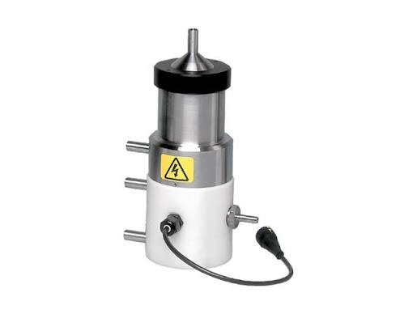
DMA choice
The selected classifier sets the useful size window
Classifier | Use
Nano DMA | Small particles and nucleation mode
Long DMA | Wider or larger submicron range
08

Slide 9
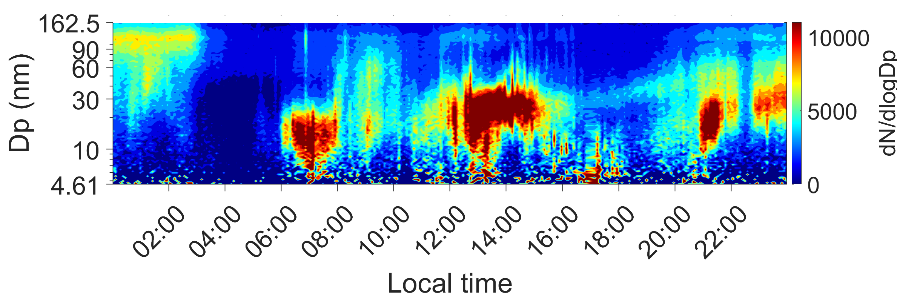
Reading SMPS contours
Growth appears as a rising size band over time
- Time on the x-axis
- Particle diameter on the y-axis
- Color shows number concentration
09

Slide 10
Aethalometer
Optical absorption gives near-real-time carbonaceous aerosol information
Signal | Interpretation
880 nm absorption | Common equivalent black carbon channel
370 to 950 nm range | Wavelength dependence of absorption
AAE | Clue for source and brown-carbon influence
AE31 and AE33 instruments use seven wavelengths.
10

Slide 11
Black and brown carbon
Seven wavelengths help separate soot-like and organic light absorption
Material | Typical optical behavior
Black carbon | Strong absorption across visible wavelengths
Brown carbon | Stronger absorption toward UV and blue light
Separation | Model-based estimate using wavelength dependence
Do not call the split purely mechanical. It depends on assumptions.
11

Slide 12
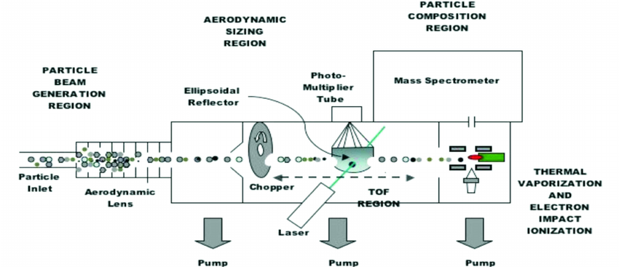
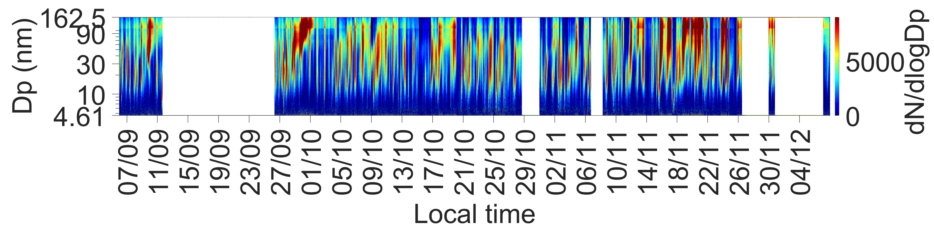
Aerosol mass spectrometry
Online chemistry joins size information with composition
What AMS adds | Why it matters
Non-refractory chemistry | Sulfate, nitrate, ammonium, organics
Fast time resolution | Events and changing sources
Mass spectra | Chemical fingerprints
12

Slide 13
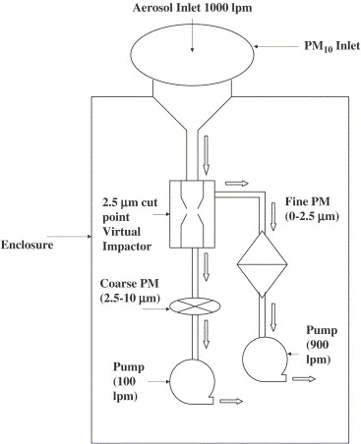
Offline sampling
Filters turn air into a preserved analytical sample
- Known flow rate
- Known sampling time
- Known inlet cut point
- Filter selected for later analysis
13

Slide 14
Gravimetric analysis
Mass concentration comes from a controlled weighing difference
Quantity | Meaning
Pre-weight | Clean conditioned filter
Post-weight | Loaded conditioned filter
Air volume | Flow multiplied by time
PM mass concentration | Mass difference divided by air volume
Temperature and humidity control are part of the measurement.
14

Slide 15
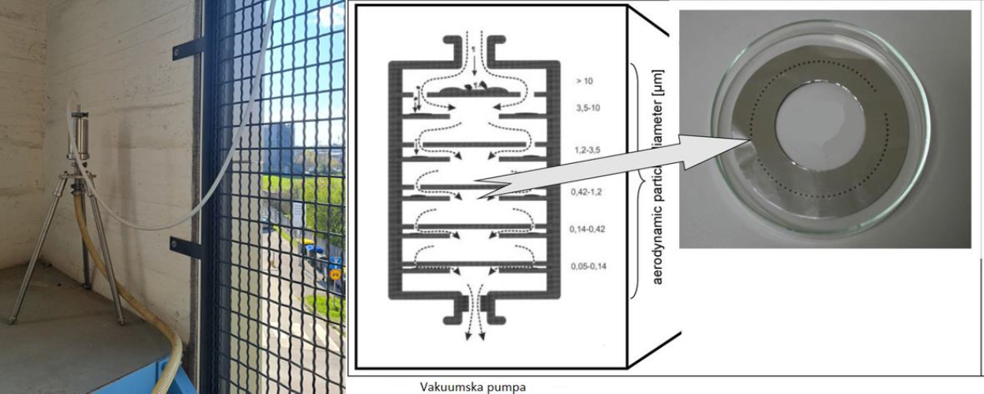
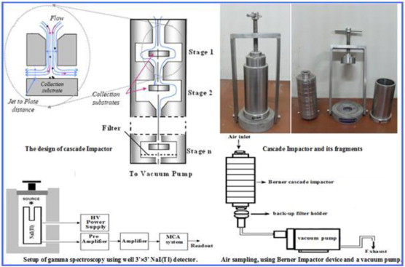
Size-resolved offline sampling
Cascade impactors separate particles by aerodynamic diameter
- Large particles impact first
- Smaller particles reach later stages
- Each stage can be analyzed chemically
15

Slide 16
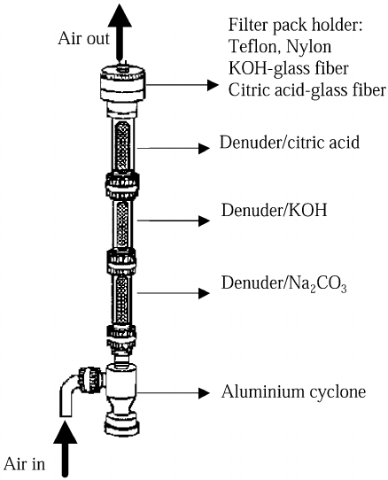
Denuders and sampling artefacts
The sampler can change the sample
Artefact | What happens
Positive | Gas adsorbs on the filter
Negative | Collected material evaporates
Denuder | Removes selected gases before collection
16

Slide 17
Storage and blanks
A filter remains chemically active after sampling
- Use field blanks and laboratory blanks
- Avoid contamination during transport
- Control light, temperature, and humidity
- Freeze or cool samples when the target compounds require it
- Document the chain of custody
The archive is useful only when the history is known.
17

Slide 18
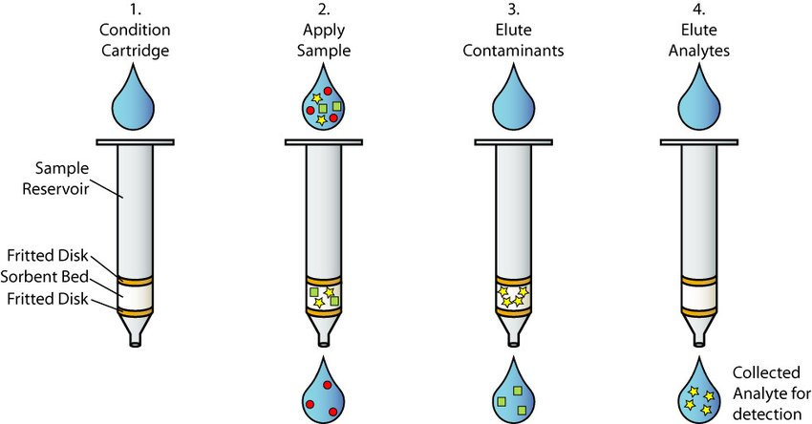
Extraction strategy
The solvent follows the compound class
Target | Common strategy
Ions and WSOC | Water extraction
WIOC and organics | Organic solvent extraction
Metals | Acid digestion or direct elemental analysis
Volatile organics | SPME or thermal desorption
18

Slide 19
Carbon fractions
OC, EC, WSOC, and WIOC depend on operational definitions
Fraction | How to explain it
OC | Carbon that evolves in the organic-carbon part of the method
EC | Refractory light-absorbing carbon by thermal-optical split
WSOC | Organic carbon extracted into water
WIOC | Organic carbon remaining outside the water-soluble fraction
Protocol choice can affect the OC and EC split.
19

Slide 20
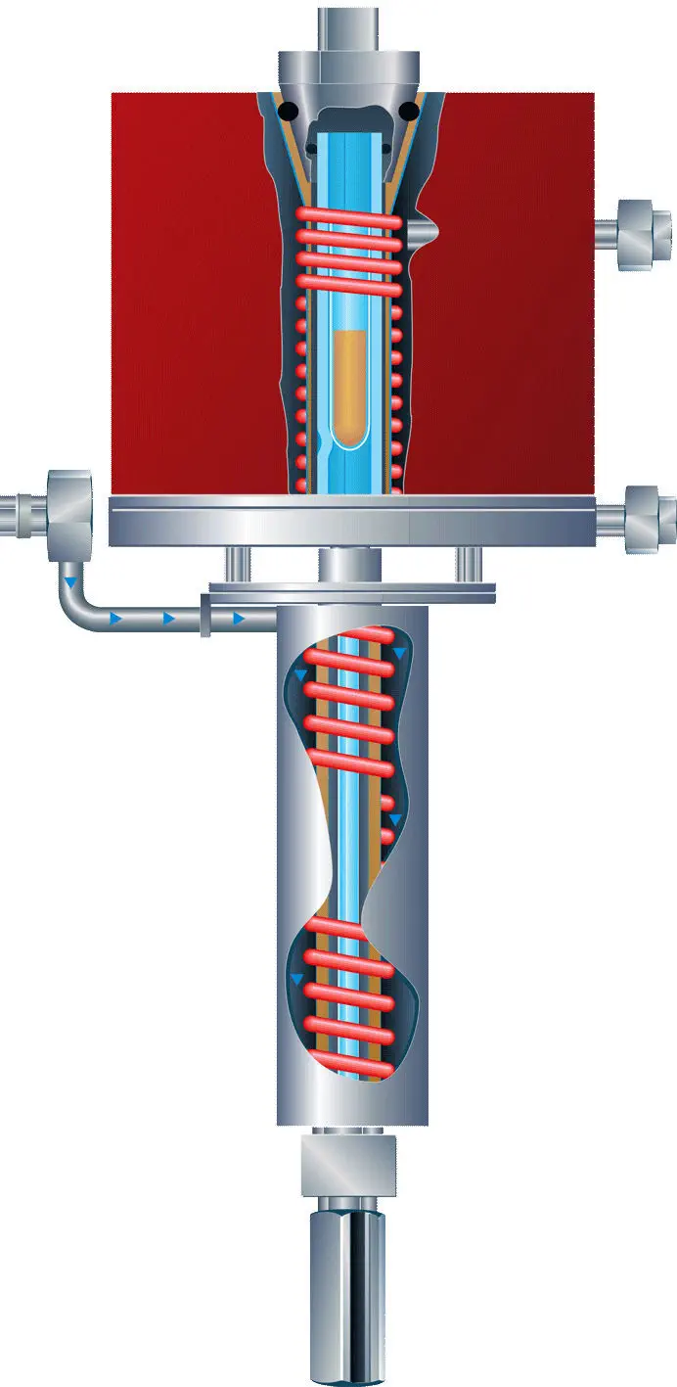
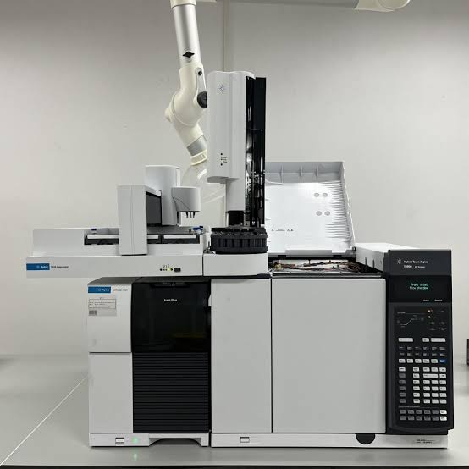
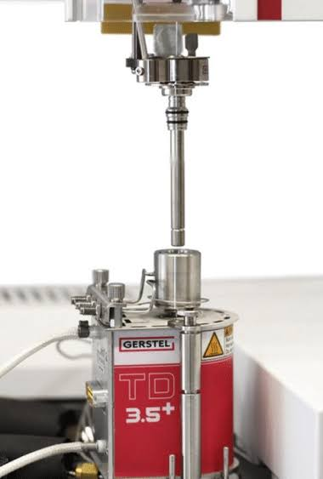
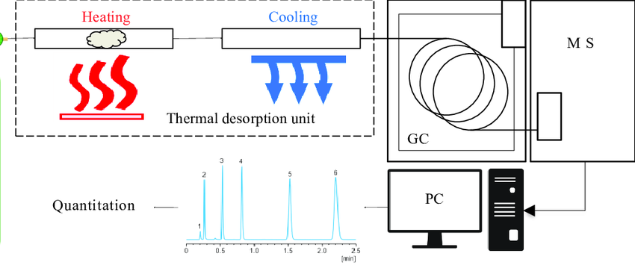
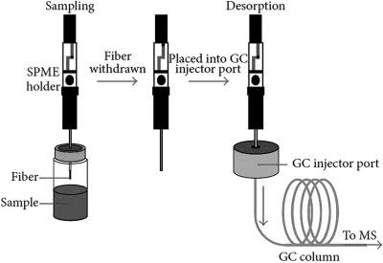
GC-MS and thermal desorption
Volatile and semi-volatile compounds need gentle transfer
Trap, desorb, separate, detect.
20

Slide 21
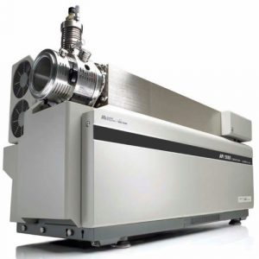
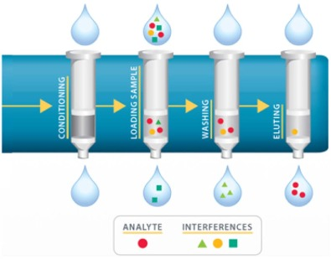
LC-MS
Polar and soluble organics often require liquid chromatography
- Extract into a compatible solvent
- Clean or concentrate with SPE when needed
- Separate by LC before mass spectrometry
- Quantify target compounds by calibration
21

Slide 22
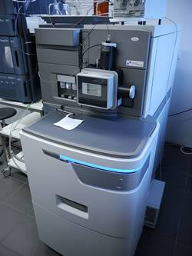
HRMS and triple quadrupole MS
Discovery and quantification use different strengths
Instrument | Best teaching role
HRMS | Molecular formula clues and non-target screening
Triple quadrupole | Sensitive targeted quantification
22

Slide 23
Elements and metals
Inorganic tracers connect particles to sources and processes
Tracer group | Possible interpretation
Crustal elements | Dust and resuspension
Sea salt ions | Marine influence
V, Ni | Oil combustion or shipping influence
K | Biomass burning influence
Pb, Zn, Cu | Industry, traffic, or brake and tire wear
Tracers suggest sources. They rarely prove a source alone.
23

Slide 24
Interpretation goals
The same data can serve monitoring, mechanism, or source analysis
Goal | What the data must support
Monitoring | Comparable measurements over time
Science | New compounds and mechanisms
Episodes | Timing and meteorology
Source apportionment | Patterns that separate source influence
Choose the method after choosing the question.
24

Slide 25
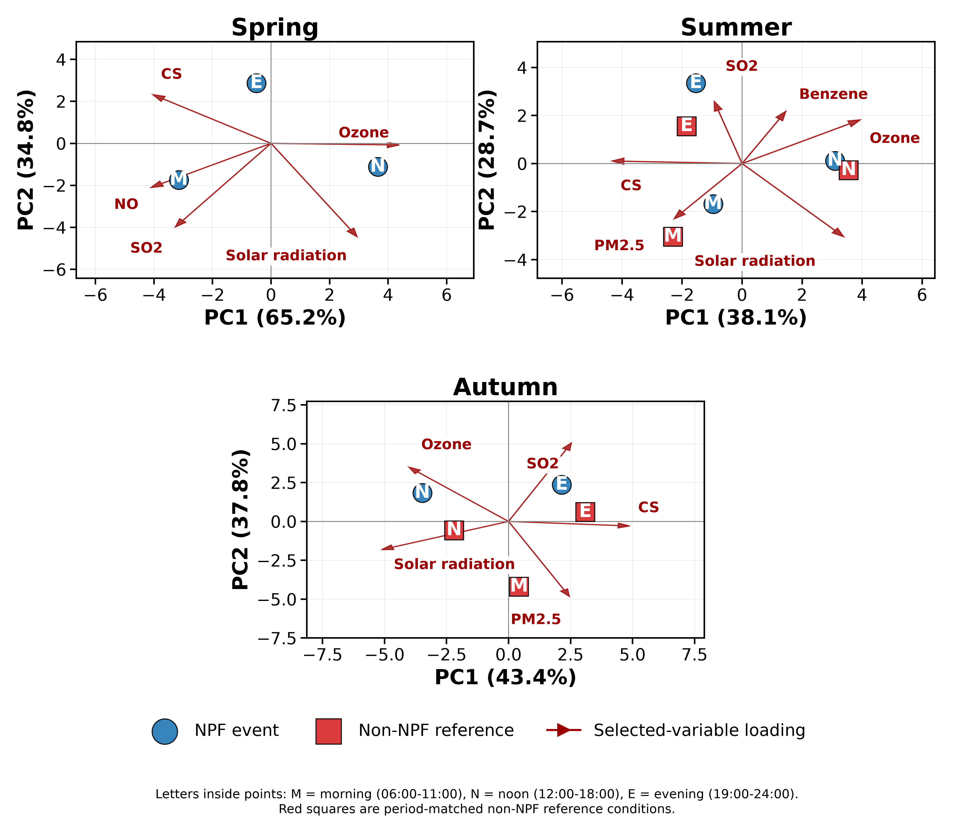
PCA
Principal components summarize covariance patterns
PCA output | How to read it
Loadings | Which variables move together
Scores | When each pattern is strong
Components | Mathematical patterns, not sources by themselves
PCA is a starting point for interpretation.
25

Slide 26
Source apportionment workflow
Interpretation combines chemistry, time, and air-mass context
Input | Role
Chemical species | Source fingerprints
Size fractions | Formation and removal processes
Time patterns | Emissions and photochemistry
Meteorology | Transport and dilution
Model output | Hypotheses to test
The best interpretation explains more than one line of evidence.
26

Slide 27
Take-home messages
Good aerosol interpretation starts before the sample exists
- Online instruments reveal fast atmospheric dynamics
- Offline samples provide richer laboratory chemistry
- Sampling artefacts can change carbon and semi-volatile results
- Extraction and instrument choice must follow the target compounds
- Source interpretation needs chemistry plus atmospheric context
27

Slide 28
Questions
Sampling, analysis, interpretation
From air to data to explanation
28

