Slide 1
FROM SENSORS TO ENVIRONMENTAL INTELLIGENCE

Slide 2
Talk Overview
Six stops from raw sensor data to environmental intelligence
01
MOTIVATION
The environmental data challenge: why collection alone is not enough
02
ARCHITECTURE
The end-to-end data lifecycle, from sensing to intelligence
03
DATA QUALITY
Automated QA/QC, calibration and environmental compensation
04
DATA FUSION
Harmonisation and the raw-to-intelligence data architecture
05
AI & ANALYTICS
From trusted data to prediction, forecasting and decision support
06
IN PRACTICE
Platform integration and applications: AirSensis & FROSTDEFEND
A single reusable platform underlies every application above.
From Sensors to Environmental Intelligence
2

Slide 3
The Environmental Data Challenge
Why collection alone is not enough
Heterogeneous inputs
Data quality risks
Operational requirements
Multiple manufacturers
Different pollutants & units
Different sampling rates
External weather and reference data
Missing data & communication gaps
Noise, spikes & flat-lines
Drift and cross-sensitivity
Temperature / humidity effects
Near-real-time processing
Historical analytics
Traceability & provenance
Integration with external systems
The goal: convert distributed raw measurements into consistent, trustworthy and reusable environmental information.
From Sensors to Environmental Intelligence
3

Slide 4









The End-to-End Environmental Data Lifecycle
A single pipeline from observation to decision
1
2
3
4
5
SENSE
CONNECT
COLLECT
VALIDATE
PROCESS
Environmental
observations
IoT & Edge
Streaming &
batch ingestion
QA/QC &
quality flags
Calibration &
harmonisation
9
8
7
6
ACT
INTEGRATE
ANALYSE
STORE
Alerts &
decisions
APIs &
services
AI &
analytics
Time-series &
metadata
Data provenance and traceability are maintained across every transformation.
From Sensors to Environmental Intelligence
4

Slide 5

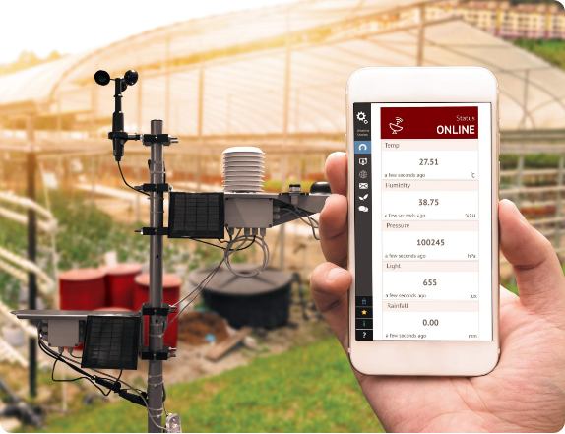
Data Gathering: Multi-Source by Design
Sensor-agnostic acquisition for environmental monitoring
Air Quality
Reference & Lab
PM₁ • PM₂.₅ • PM₁₀
NO₂ • O₃ • CO • SO₂
VOC/TVOC • CO₂
Reference instruments
Co-location datasets
Laboratory calibration
ENVIRONMENTAL
OBSERVATION LAYER
Meteorology
External Sources
Temperature • RH • Pressure
Wind • Rainfall • Solar
Weather APIs
Earth observation
Existing monitoring networks
From Sensors to Environmental Intelligence
5

Slide 6
IoT Connectivity & Edge Acquisition
Reliable field-to-cloud data transfer
FIELD
CONNECTIVITY
PROTOCOLS
CLOUD INGESTION
EDGE
Wi-Fi
Ethernet
4G / 5G
NB-IoT
LoRaWAN
Authentication
Buffering
Validation
Routing
Time
Local buffer
Store & forward
Retries
Sensors
Stations
Gateways
MQTT
HTTP(S)
REST API
Resilience principle: temporary connectivity loss should not automatically become permanent data loss.
From Sensors to Environmental Intelligence
6

Slide 7
Scalable Data Ingestion
A common entry point for heterogeneous environmental data
Real-time streams
Continuous sensor and station observations
COMMON OBSERVATION MODEL
INGESTION
LAYER
Device
Sensor / Parameter
Value + Unit
Timestamp
Location
Quality / Metadata
Batch ingestion
Authentication
Schema validation
Normalization
Routing
Monitoring
Historical files, laboratory datasets, backfills
External APIs
Meteorology, public datasets, third-party services
From Sensors to Environmental Intelligence
7

Slide 8
From Raw Measurements to Trusted Data
Separate data maturity levels instead of overwriting observations
L0
RAW
Original observations
L1
VALIDATED
Structural checks + QA/QC
L2
CORRECTED
Cleaning + calibration
L3
HARMONISED
Units + timestamps + formats
L4
DERIVED
Aggregates + indicators
L5
INTELLIGENCE
Forecasts + alerts + decisions
Reprocessing is reproducible because the original measurement and processing history are preserved.
From Sensors to Environmental Intelligence
8

Slide 9
Automated Data Quality Assurance
Quality control is a platform service, not a manual afterthought
Range / physical limits
Missing values
Spikes & outliers
Flat-line detection
Rate-of-change
Duplicate data
Timestamp consistency
Communication gaps
Cross-sensor consistency
Sensor drift
Environmental interference
Sensor health
QUALITY FLAGS
VALID
SUSPECT
INVALID
MISSING
CALIBRATED
ESTIMATED
Flag questionable data — do not silently destroy provenance.
From Sensors to Environmental Intelligence
9

Slide 10
Calibration & Environmental Compensation
Transform sensor response into a traceable corrected measurement
INPUTS
OUTPUT
• Raw sensor response y
• Temperature T
• Relative humidity RH
• Context / co-pollutants x
CALIBRATION
MODEL
• Corrected value ŷ
• Uncertainty / confidence
• Calibration version
• Quality information
ŷ = f(yraw, T, RH, x)
Supported approaches: laboratory calibration • field co-location • multivariate models • ML • drift correction
From Sensors to Environmental Intelligence
10

Slide 11




Harmonisation, Processing & Data Fusion
Move from device-specific measurements to a common environmental information model
Temporal processing
Harmonisation
Sensor processing
Data fusion
Resampling
Synchronisation
Interpolation
Rolling statistics
Unit conversion
Naming conventions
Common timestamps
Metadata mapping
Calibration
Drift correction
Outlier handling
Missing-data handling
Multi-sensor consensus
Reference integration
Spatial combination
Uncertainty
DERIVED PRODUCTS
AQ indicators
Exceedances
Exposure metrics
Statistics
Spatial layers
From Sensors to Environmental Intelligence
11

Slide 12
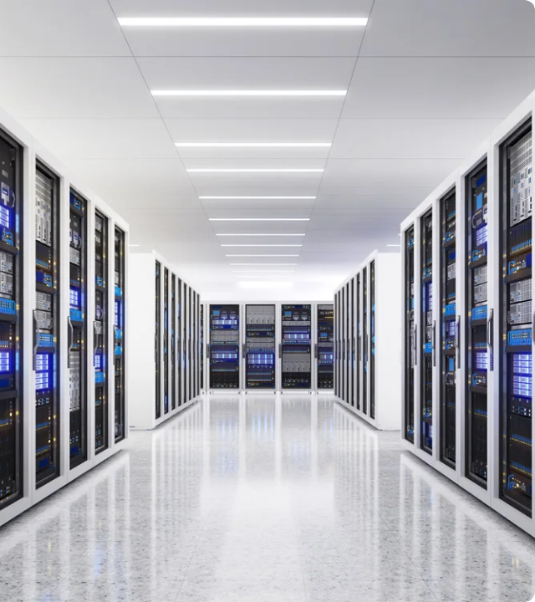
Environmental Data Architecture
Raw, trusted and derived information coexist
INTELLIGENCE
AI • forecasts • risk • alerts
CONTEXT & PROVENANCE
DERIVED
AQI • statistics • exposure
• Device & sensor metadata
• Location & deployment
• Configuration history
• Calibration models & versions
• Quality flags
• Processing lineage
• User / tenant ownership
CALIBRATED
Corrected values • uncertainty
VALIDATED
QA/QC • quality flags
RAW
Original immutable observations
Architecture principle: never lose the path from the original observation to the final information product.
From Sensors to Environmental Intelligence
12

Slide 13
AI & Advanced Environmental Analytics
Trusted data becomes the foundation for prediction and decision support
Sensor Intelligence -
Hardware Level
Data Intelligence -
Data Level
Environmental Intelligence -
Domain Level
• Automated calibration
• Drift detection
• Sensor-health monitoring
• Anomaly detection
• Missing-data imputation
• Denoising
• Data fusion
• Uncertainty estimation
• Air-quality forecasting
• Pollution-event detection
• Spatial estimation
• Exposure / risk analysis
MEASURE
VALIDATE
UNDERSTAND
PREDICT
ACT
From Sensors to Environmental Intelligence
13

Slide 14












Platform Integration: Data In, Intelligence Out
The platform can be the user-facing solution or the environmental data backbone
Sensors
Field air-quality sensors
Dashboards
Stations
ENVIRONMENTAL
DATA PLATFORM
Customer Apps
Reference monitoring stations
Ingestion
GIS / BI
Weather
Meteorology & external feeds
QA / QC
Processing
Research
External APIs
Storage
Third-party & public datasets
AI / Analytics
Authorities
From Sensors to Environmental Intelligence
14

Slide 15
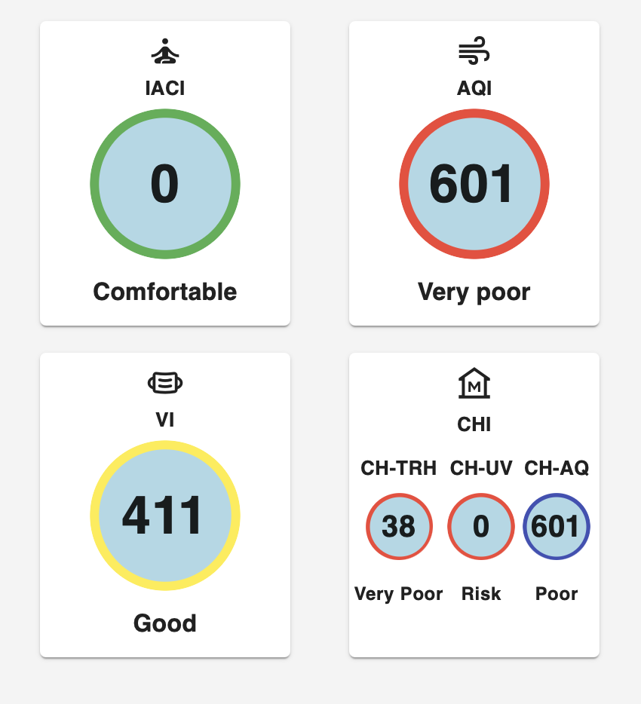
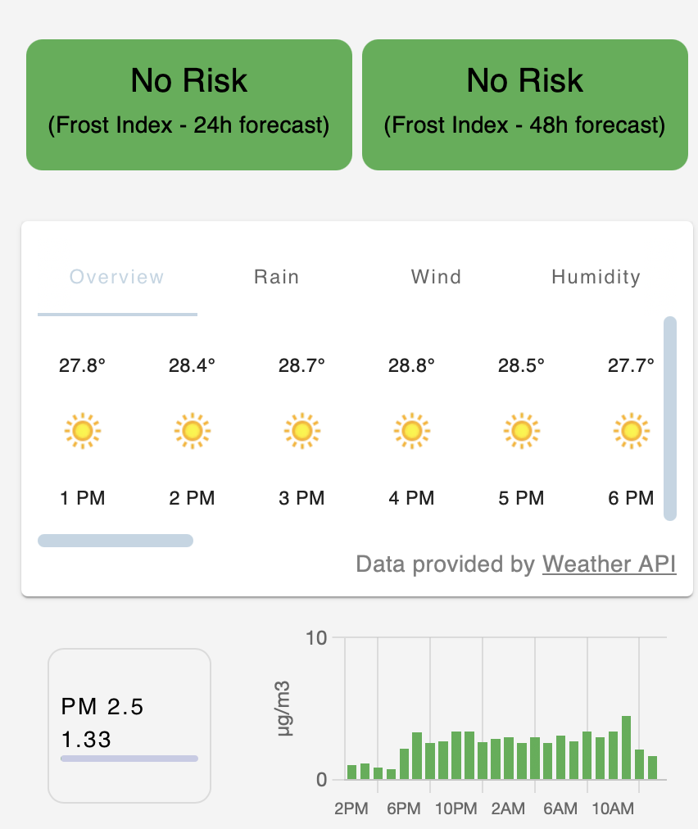
One Core Platform, Multiple Environmental Applications
Reuse the same data and intelligence services across domains
ENVIRONMENTAL INTELLIGENCE PLATFORM
AirSensis
FROSTDEFEND
Air-quality monitoring
analytics & visualisation
Dashboards & Applications
Microclimate
forecasting & warning
Alerts & Decision Support
AI & Analytics
Data Processing / QA/QC
Data Management & Storage
IoT / API Integration
Device & Sensor Management
The strategic asset is the reusable platform underneath the applications.
From Sensors to Environmental Intelligence
15

Slide 16



The Environmental Data Value Chain
Increasing value at every stage
6
ACTION
5
PREDICTION
4
KNOWLEDGE
3
INFORMATION
2
What should we do?
TRUSTED DATA
1
What happens next?
RAW DATA
Alerts • decisions
Action
Why is it happening?
What does it mean?
Forecasts • risk
Prediction
Can we trust it?
Patterns • analytics
Knowledge
What happened?
Indicators • context
Information
QA/QC • calibration
Trusted Data
Sensor measurements
Raw Data
The platform transforms measurements into decisions while preserving traceability across the complete lifecycle.
From Sensors to Environmental Intelligence
16

Slide 17
From Monitoring to Environmental Intelligence
The evolution of an environmental platform
TRADITIONAL MONITORING
Sensors
Database
Dashboard
ENVIRONMENTAL INTELLIGENCE
Sensors
Trusted Data
Integrated Platform
AI / Prediction
Decision Support
Action
We do not simply collect environmental data.
We build the infrastructure that turns sensor observations into trusted, interoperable and actionable environmental intelligence.
From Sensors to Environmental Intelligence
17

Slide 18
THANK YOU — QUESTIONS & DISCUSSION

