Slide 1

Horizon Europe Project NextAIRE
HORIZON-WIDERA-2024-TALENTS-03-01
NextAIRE Summer School 2026
University of Sarajevo – Faculty of Science
Sarajevo, Bosnia and Herzegovina
Hosted by the Department of Chemistry

Slide 2
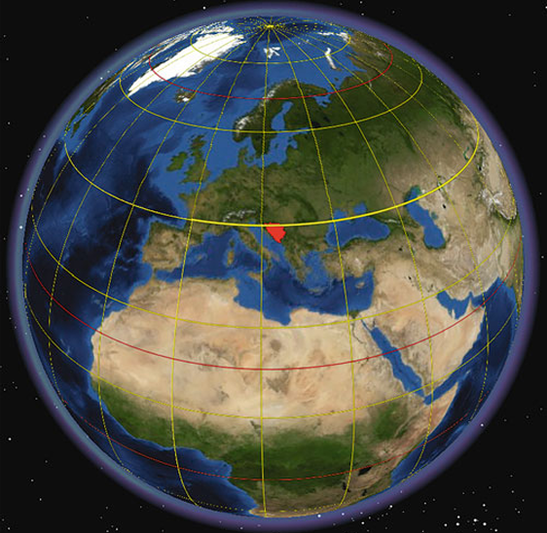
Bosnia and Herzegovina
Southeast European country situated in the western part of the Balkan Peninsula
Capital: Sarajevo
51,209.2 km²
Diverse landscapes dominated by the Dinaric Alps
Continental, mountain and Mediterranean climatic influences
Rich natural and cultural diversity

Slide 3
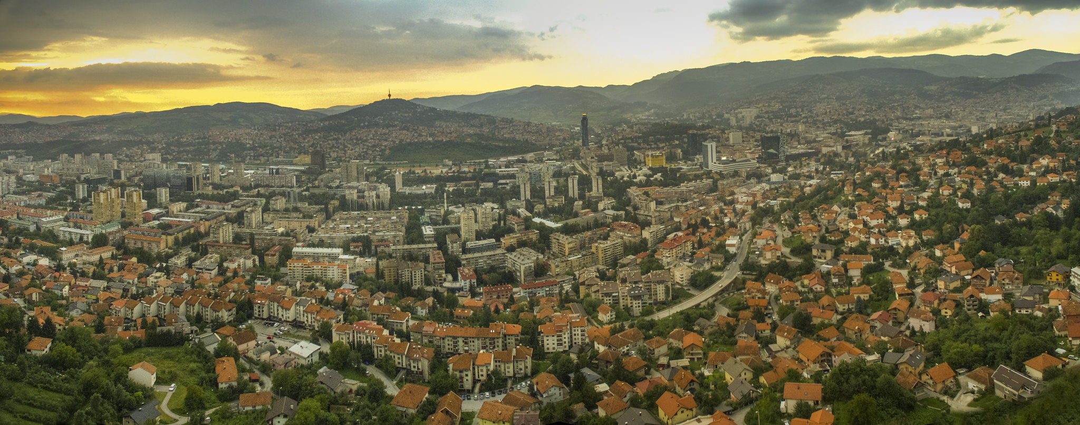
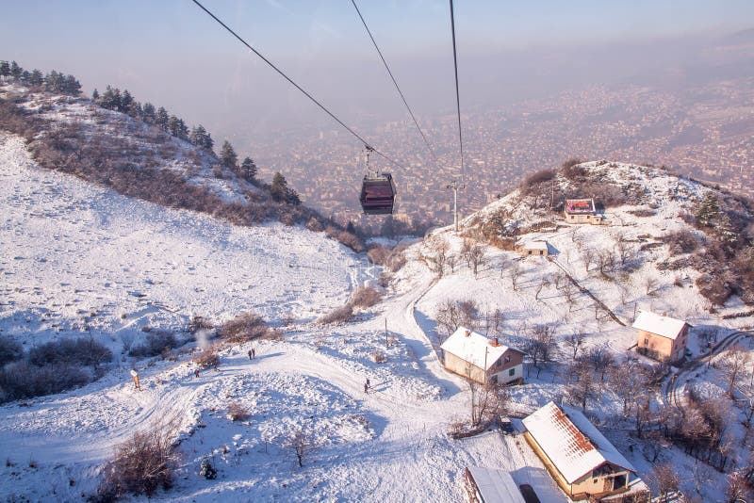
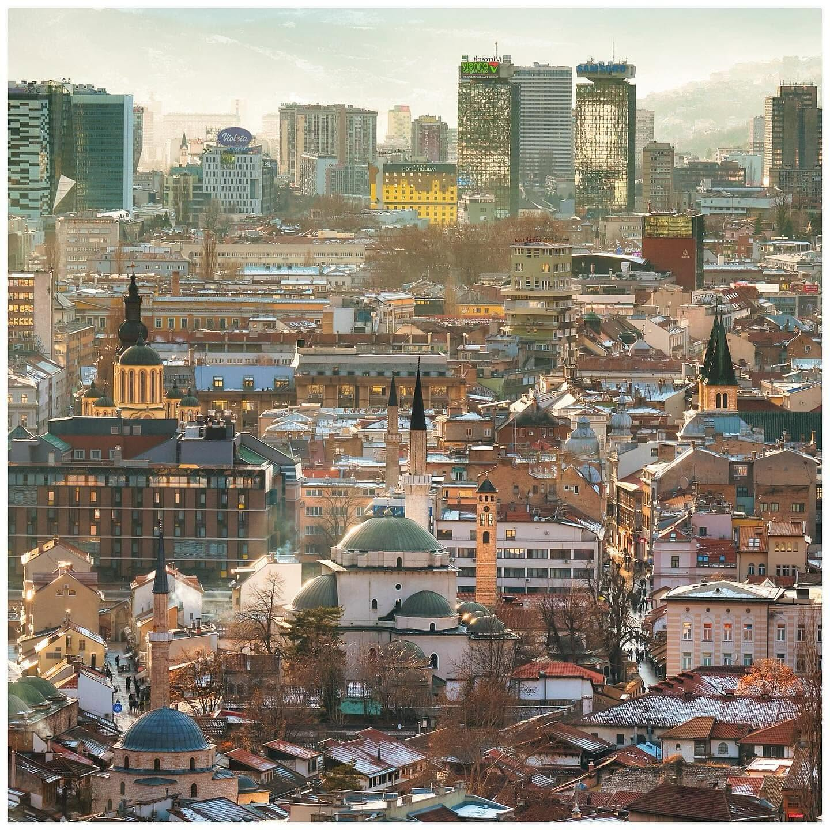
Sarajevo: A City Shaped by Geography
Capital of Bosnia and Herzegovina
Located in the Sarajevo Valley
Surrounded by the Dinaric Mountains
A meeting point of cultures and traditions
Geography strongly influences local air quality
Population (2013 Census)
City of Sarajevo: 275,524
Sarajevo Canton: 413,593

Slide 4
More than 65 Years of Science
1888
1950
1960
1962-1964
Today
Beginnings of modern natural sciences in BiH
Natural and mathematical sciences at the University of Sarajevo
Faculty of Science established as an independent faculty
Institute of Chemistry and Physics constructed
5 departments & multidisciplinary research

Slide 5

From Chemistry and Physics to a Multidisciplinary Faculty
Institute of Chemistry and Physics
Designed by architect Juraj Neidhardt
Built 1962–1964
Modern laboratories and teaching facilities

Slide 6
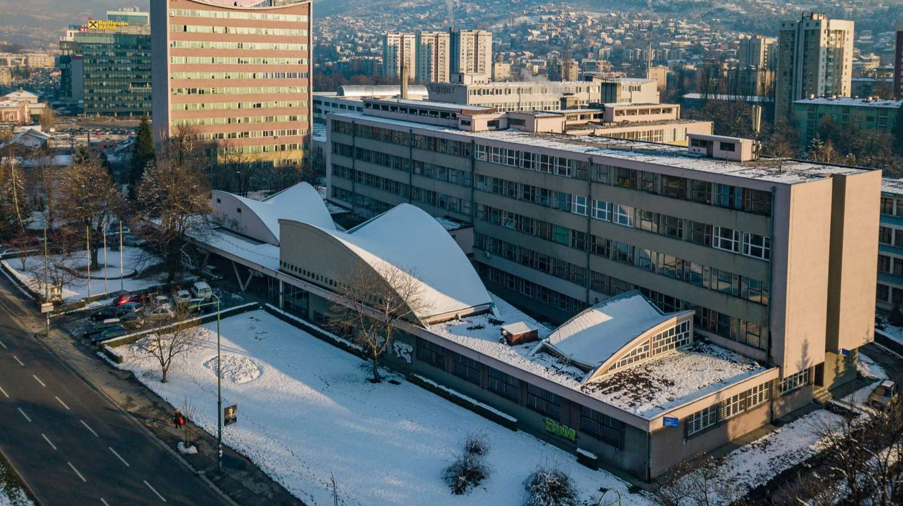
Faculty of Science, University of Sarajevo
Five departments:
Biology
Chemistry
Geography
Mathematics & Computer Science
Physics
Education • Research • International Cooperation

Slide 7

Welcome to Next AIRE Summer School!
We wish you an inspiring and productive Summer School and a wonderful stay in Sarajevo.

