Slide 1



MegaSense Oy
NextAIRE Secondments & Research Update
Consortium update • 9 September 2026

Slide 2
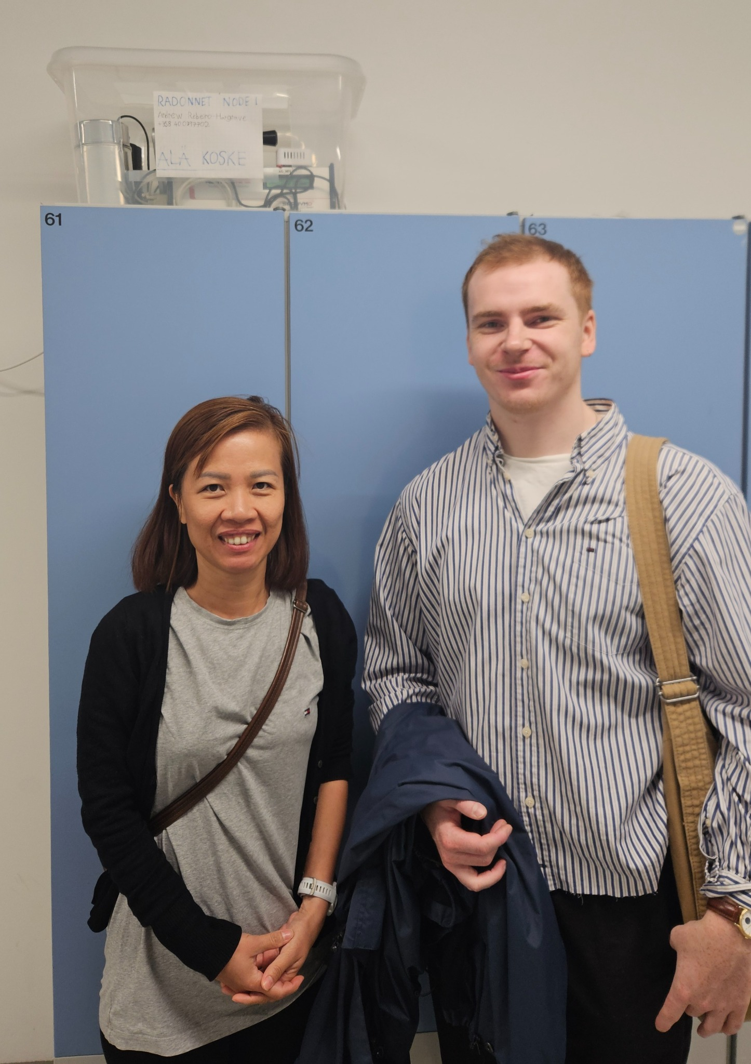
Current secondment — Han Tran
KNOW Center, Austria → Helsinki • 8 September–4 December 2026
Confirmed status
Started successfully on 8 September. KNOW Center confirmed
and welcomed the extension through 4 December.
• Hosted with MegaSense / University of Helsinki at Kumpula and NODEs Lab.
• Co-research with Ilari, Alan and the wider Helsinki team.
• Main focus: MegaSense sensing, RadonNET validation, indoor-air-quality and people-flow datasets.
• Goal: reproducible analysis that develops directly into scientific outputs.
Han Tran and Ilari Ranin with a RadonNET node at Kumpula.

Slide 3
Research agenda
Four connected workstreams using existing Helsinki research infrastructure
1 RadonNET
2 MegaSense sensing
Low-cost radon sensors versus reference instrumentation: QA/QC, calibration, stability and reproducibility under real building conditions.
Sensor connectivity, data access, environmental-data
QA/QC and reproducible analysis pipelines.
3 Exactum indoor environment
4 Untangling People Flow
People count together with noise / TVOC and related
signals to investigate occupancy–environment relationships.
Selected campus and airport datasets: occupancy,
demand and operational prediction linked to environmental sensing.

Slide 4
Expected outputs by 4 December
Mobility should leave reusable science, not only exchanged experience
SEP
OCT
NOV
4 DEC
Set-up & access
Sensors • datasets
• workflows
Core analysis
QA/QC • validation
• multimodal models
Scientific synthesis
Figures • tables
• cross-dataset results
Handover
Reproducible package
• manuscript inputs
• Documented datasets and reproducible workflows.
• Sensor-validation and modelling results with publication-quality figures and tables.
• Contributions to joint manuscripts and follow-on KNOW Center–MegaSense–Helsinki research.

Slide 5
Next mobility actions
Current plans — confirmed activity is separated from mobility still being finalised
Abdullah Khan — incoming
NCSR Demokritos — planned
Rescheduled toward Oct–Dec 2026. Proposed scope:
MegaSense sensing devices and analysis of generated environmental data.
Discussions include two technician secondments.
Timing, hosting and practical scope still need
final confirmation.
Mobility principle
Helsinki hosting
Each visit: defined dataset/device → reproducible method → measurable research result → clear knowledge-transfer handover.
Use Kumpula / NODEs Lab and existing testbeds where
appropriate, connecting mobility directly to ongoing research.
MegaSense: sensing platforms • environmental datasets • AI/data science
• field testbeds • mobility-driven knowledge exchange

