Slide 1
Soft Skills: Product Development Life Cycle
Zvonimir Anić, Assistant Director of R&D
Smart Sense

Slide 2
What is PDLC?
Framework outlining the stages a product passes
Why PDLC? Because humans love frameworks
2

Slide 3
Six phases of the PDLC
Discovery & Ideation
Definition & Scoping
Design & Prototyping
Development & Testing
Launch & Commercialization
Iteration & Maintenance
New evidence can change earlier decisions.
3
Notes:
SLIDE 3 | Six phases of the PDLC
TIME 2:30–3:30 (1 minutes)
SPEAKING CUES
• Read the six phases without explaining every activity.
• Emphasise feedback loops and decisions.
• Feasibility and user learning continue across phases.
TRANSITION
We begin by deciding whether the problem deserves a solution.
STUDY SCRIPT
We will use six phases: discovery and ideation, definition and scoping, design and prototyping, development and testing, launch and commercialization, and iteration and maintenance.
These labels organise the work. They do not imply that every project follows a neat one-way sequence. A prototype can reveal that we misunderstood the user. A field test can change the requirements. Support requests after launch can expose a new opportunity.
At each stage, ask what we currently believe, what evidence we need, and which decision the evidence will support. We may proceed, revise the idea, pause, or stop. Feasibility, economics, and user learning continue throughout the process. For a scientific audience, this should feel familiar: assumptions lead to experiments, and results inform the next step.
SOURCES

Slide 4
1. Discovery & Ideation
Core Goal
Identify a meaningful problem and explore possible solutions.
Key Activities
User interviews, observation, market and competitor research, brainstorming.
Main Question
What is worth solving, and how might we solve it?
Output
An evidence-supported problem and promising solution concepts.
4
Notes:
SLIDE 4 | 1. Discovery & Ideation
TIME 3:30–6:00 (2.5 minutes)
SPEAKING CUES
• Ask about the last real experience, not whether people like an idea.
• Distinguish user, buyer, and decision-maker.
• Explore alternative solutions before choosing technology.
TRANSITION
The Fire Phone shows why building a distinctive product does not guarantee adoption.
STUDY SCRIPT
Discovery begins with understanding what people are trying to accomplish. We need to establish whether a problem occurs often enough, matters enough, and remains poorly addressed by current alternatives. An interview should focus on an actual experience. Ask someone to describe the last time the problem occurred, what they did, and what it cost in time, effort, or money.
If we ask whether they like our proposed idea, we may receive encouragement without useful evidence. People are often polite. Their existing behaviour and willingness to change a workflow tell us more.
Consider researchers who spend hours moving data between instruments and analysis tools. The first assumption might be that they need a faster analysis algorithm. Observation could reveal that file preparation, naming, and manual transfer cause the main difficulty. That opens several possible solutions: automated import, direct instrument integration, a shared data platform, or a service that handles the preparation.
Ideation keeps those possibilities open long enough to compare them. A multidisciplinary group is valuable because a scientist, engineer, designer, and support colleague may see different parts of the problem.
In air-quality monitoring, we also need to distinguish the person looking at measurements from the person approving the purchase and the person responsible for responding. A facilities manager, researcher, and procurement team may value different things.
The output is evidence for a specific problem and a set of plausible solutions. We have enough understanding to define the opportunity more carefully, while keeping our assumptions visible. The most important soft skill here is listening closely enough to allow the evidence to change our original idea.
SOURCES

Slide 5
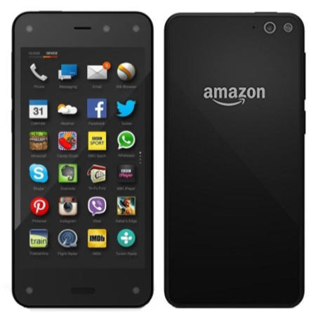
Amazon Fire Phone
“If you build it, they will come”
They built it. Adoption fell short.
2014 launch with distinctive features
~$170 million
Inventory and supplier-commitment charges
Amazon Fire Phone
5
Notes:
SLIDE 5 | Amazon Fire Phone
TIME 6:00–8:00 (2 minutes)
SPEAKING CUES
• 2014 launch with Dynamic Perspective and Firefly.
• About $170m in inventory and supplier-commitment charges, not development cost.
• Distinguish documented outcome from interpretation of causes.
TRANSITION
The next phase translates a worthwhile opportunity into specific requirements.
STUDY SCRIPT
Amazon introduced the Fire Phone in 2014 with distinctive features. Dynamic Perspective responded to how the user held and viewed the device. Firefly could recognise products and media. The product existed, it worked, and it had the backing of a major company.
Commercial results nevertheless fell short. Amazon later reported approximately 170 million dollars in charges, primarily associated with Fire Phone inventory valuation and supplier commitments. That number describes those charges. It is not a measure of the total development cost or the entire lifetime loss.
This is a useful counterexample to the assumption, 'If you build it, they will come.' The evidence establishes disappointing commercial results despite distinctive technology. It does not establish that the company did no user research, or that one feature alone caused the outcome.
The question for us is whether customers have a sufficiently strong reason to choose a new product over what they already use. Adoption can require spending money, learning new habits, accepting different integrations, and giving up familiar alternatives.
The parallel for scientific products is straightforward. An additional capability may be exciting to the development team. We still need evidence that intended users value it enough to adopt the complete solution. Ask the audience to consider: what would make your next customer change their current workflow?
SOURCES
https://www.sec.gov/Archives/edgar/data/1018724/000101872416000172/amzn-20151231x10k.htm
https://press.aboutamazon.com/2014/6/introducing-fire-the-first-smartphone-designed-by-amazon
https://www.laptopsdirect.co.uk/grade-a1-as-new-but-box-opened-amazon-fire-phone-black-32gb-unlocked-77229634-1-amzfire32gbbl/version.asp

Slide 6
2. Definition & Scoping
Core Goal
Define the product, its boundaries, and measurable success.
Key Activities
Requirements, functional specifications, priorities, feasibility, objectives and key results.
Main Question
What will we build, for whom, and what counts as success?
Output
Agreed scope, requirements, constraints, and acceptance criteria.
6
Notes:
SLIDE 6 | 2. Definition & Scoping
TIME 8:00–11:00 (3 minutes)
SPEAKING CUES
• Separate desired outcomes from feature lists.
• Define operating conditions and acceptance criteria.
• Explain OKRs with clearly illustrative targets.
• Prius: the target increased from 1.5 times to twice conventional fuel efficiency.
TRANSITION
Once the scope is clear enough, prototypes help us test the design.
STUDY SCRIPT
Definition and scoping turn the opportunity into a clear commitment. We specify the intended user, the use case, the benefit, the boundaries of the first version, and how we will judge success.
A requirement such as 'the product should be reliable' is too broad to guide a test. We need to identify the operating conditions, the expected behaviour, and the threshold that would be acceptable. For a monitoring product, this could include data availability over a defined deployment period, measurement performance across specified conditions, and the maintenance effort expected from the operator.
Objectives and key results, often called OKRs, help connect development activity to outcomes. The objective states what we want to accomplish. Key results describe measurable evidence of progress. For example, an illustrative objective could be to make installation easier for facilities teams. Possible key results might include successful unaided installation by a stated proportion of pilot users and a reduction in median setup time. The numerical thresholds should come from user needs and pilot evidence. They are not universal requirements.
Toyota's Prius provides a useful historical example of a measurable ambition guiding concept selection. The G21 project initially considered fuel efficiency 1.5 times that of a comparable conventional car. The ambition increased to twice the fuel efficiency, alongside leadership's push towards a hybrid. That strengthened the case for a different powertrain approach.
The lesson is that requirements influence engineering choices. They also expose trade-offs. Adding range, accuracy, durability, or features can affect cost, size, and development effort. Scoping requires negotiation between disciplines, with a shared understanding of what the first version must achieve and what can wait. It should end with criteria that both the team and relevant stakeholders can use to assess the result.
SOURCES
https://global.toyota/en/prius20th/challenge/birth/01/

Slide 7
3. Design & Prototyping
Core Goal
Explore the design and test important assumptions early.
Key Activities
Sketches, user flows, wireframes, physical mock-ups, functional experiments.
Main Question
What can we learn before committing to the complete product?
Output
A tested design direction and evidence for the next investment.
7
Notes:
SLIDE 7 | 3. Design & Prototyping
TIME 11:00–13:30 (2.5 minutes)
SPEAKING CUES
• Choose prototype fidelity according to the question.
• Proof of concept, prototype, and MVP have different purposes.
• Use air-monitor enclosure versus sensing bench example.
TRANSITION
Physical models make this principle easy to see.
STUDY SCRIPT
A prototype is a way to ask a focused question about the proposed product. It should contain enough detail to answer that question without demanding the effort of a finished system.
A sketch can help compare ideas. A clickable interface can test whether users understand the sequence of actions. A bench setup can investigate technical behaviour. A physical mock-up can reveal whether someone can reach a connector or mount the product in the intended location.
It helps to distinguish three terms. A proof of concept demonstrates that a technical principle can work. A prototype explores some aspect of the design or interaction. A minimum viable product, or MVP, is a limited usable solution that allows learning from actual use. An MVP still needs the quality appropriate to its intended purpose.
For an air-quality monitor, we might examine enclosure size and mounting with a simple model while evaluating sensing behaviour on a separate bench setup. Later we must test the integrated system because packaging and electronics can influence the measurement environment. The early separation simply helps us learn about individual questions efficiently.
We should decide in advance what observation would make us revise the design. If every result is interpreted as positive, the prototype is providing reassurance rather than useful evidence.
This phase benefits from open criticism. A colleague finding a difficult interaction or a technical weakness has helped the project. The earlier we identify it, the more options we have for changing the design. Teams need enough psychological safety to report weak results and challenge an attractive concept.
SOURCES

Slide 8
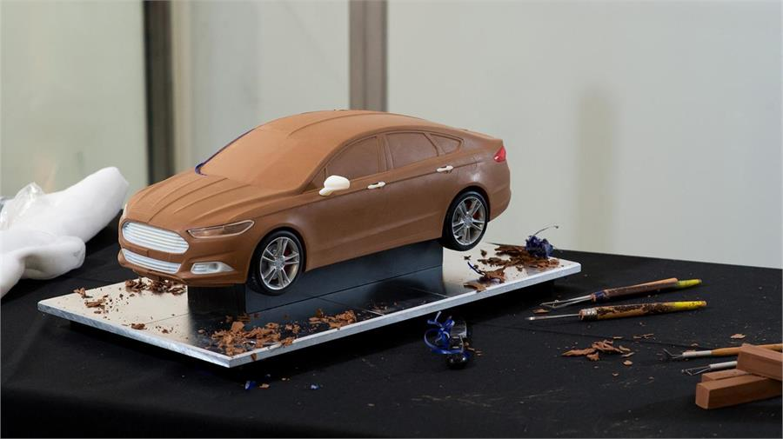
Learning through prototypes
Clay models
Evaluate shape, proportions, and physical form.
5,127 prototypes
Dyson’s reported development process for its first cyclonic vacuum.
8
Notes:
SLIDE 8 | Learning through prototypes
TIME 13:30–15:00 (1.5 minutes)
SPEAKING CUES
• Clay model tests physical form, not road performance.
• Photo shows a Ford clay model, do not call this particular model full-size.
• Dyson reports 5,127 prototypes; the lesson is learning, not the count.
TRANSITION
An accepted design still has to become a repeatable and dependable product.
STUDY SCRIPT
Automotive design gives us a familiar example. Clay models allow designers to examine a vehicle's physical form, proportions, and surfaces. Manufacturers also use full-size models alongside digital methods. This particular photograph shows a Ford clay model in a studio. We should be precise about what it can establish: it supports design evaluation, while road performance, durability, and safety require other forms of testing.
Dyson offers a complementary example of functional experimentation. The company reports that James Dyson developed 5,127 prototypes while working towards his first cyclonic vacuum cleaner. One early experiment attached a simple cardboard cyclone to an existing vacuum.
We do not need thousands of prototypes for every product. The useful principle is to match the experiment to the uncertainty, learn from the result, and make the next revision more informed. A discarded design can be a valuable outcome when it prevents a larger investment in the wrong approach.
SOURCES
https://media.ford.com/content/fordmedia/feu/gb/en/news/2016/10/13/molding-a-more-sustainable-future--how-ford-recycles-clay-to-red.html
https://www.coches.net/noticias/el-arte-de-modelar-en-arcilla
https://www.dyson.com/james-dyson

Slide 9
4. Development & Testing
Core Goal
Build a repeatable product and establish dependable performance.
Key Activities
Engineering, integration, production preparation, functionality, security and reliability testing.
Main Question
Does it meet requirements and serve its intended purpose?
Output
A release-ready product supported by documented test evidence.
9
Notes:
SLIDE 9 | 4. Development & Testing
TIME 15:00–18:00 (3 minutes)
SPEAKING CUES
• Development and testing overlap.
• Verification = requirements; validation = intended use.
• Discuss component variation and system interactions.
• Samsung: describe findings and response without guessing an internal failure story.
TRANSITION
A dependable product needs an equally deliberate route to adoption.
STUDY SCRIPT
Development turns the selected design into a system that can be delivered repeatedly. For hardware, that includes detailed engineering, controlled components, assembly processes, calibration, and production acceptance tests. For software, it includes implementation, installation, error handling, compatibility, and recovery from failures.
Integration matters because individually successful components can behave differently when combined. In a monitoring device, the enclosure, electronics, firmware, connectivity, and data-processing pipeline all contribute to the final result. The team needs to evaluate the complete product as well as its parts.
Verification asks whether the product meets its specified requirements. Validation asks whether it meets user needs in the intended setting. A device can meet a laboratory specification but still be difficult to install or interpret. We need evidence for both questions.
Testing should cover normal use and relevant failure conditions. It should also account for variation between units, batches, environments, or user groups. Define the acceptance criteria before judging the final results, and preserve enough traceability to understand which version produced them.
The Samsung Galaxy Note7 illustrates the consequences of battery failures and the importance of improving the testing system. Following incidents and recalls, Samsung investigated the batteries and introduced an eight-point battery safety check and additional safeguards. The documented lesson is that component and manufacturing quality require deliberate attention, alongside ordinary functionality.
For air-quality devices, field evaluation is particularly important because operating conditions can differ from the development environment. Performance claims should match the conditions and application that the evidence supports. For example, EPA's cited sensor-testing framework has a specific outdoor, fixed-site, non-regulatory scope. We should not automatically transfer it to every monitoring use.
Collaboration at this stage depends on clear handovers and a willingness to make defects visible. A test result that challenges the schedule still deserves attention because it changes what we can responsibly claim about the product.
SOURCES
https://news.samsung.com/us/Samsung-Electronics-Announces-Cause-of-Galaxy-Note7-Incidents-in-Press-Conference
https://www.epa.gov/air-sensor-toolbox/air-sensor-performance-targets-and-testing-protocols

Slide 10
5. Launch & Commercialization
Core Goal
Bring the product to users through a sustainable route to adoption.
Key Activities
Pilot releases, pricing, distribution, marketing, sales, onboarding and support.
Main Question
Will customers adopt the solution and continue obtaining value?
Output
A supported release and evidence of adoption and customer value.
10
Notes:
SLIDE 10 | 5. Launch & Commercialization
TIME 18:00–20:00 (2 minutes)
SPEAKING CUES
• Availability, onboarding and support are part of launch.
• Windows figure is Microsoft-reported.
• Do not attribute the success to marketing alone.
TRANSITION
Launch exposes the product to a wider range of real-world conditions.
STUDY SCRIPT
Launch brings several disciplines together. The product must be available through a suitable channel, customers must understand its purpose, and the organisation must support purchasing, installation, onboarding, and ongoing use.
A staged release or pilot can expose difficulties before the deployment becomes much larger. For laboratory equipment, the product might perform well but require more training or installation support than expected. For business software, missing integration could prevent users from making it part of their routine.
Windows 95 offers a recognisable commercialization example. Microsoft coordinated a highly visible introduction with midnight retail openings around the world. The company reports seven million copies sold in the first five weeks. That result reflected the overall offering, existing demand, and the surrounding market. It does not prove that publicity alone caused success.
The lesson is to prepare the route to customers alongside the product. A launch plan should identify who the first users are, what they need to succeed, who helps when something goes wrong, and what evidence will justify expansion.
For a research product, the route may be an institutional service, a licence, a partner, a spinout, or an open-source release with funded maintenance. In each case, successful use matters more than the announcement itself. Sales and support colleagues can help R&D understand why interested users do or do not complete adoption.
SOURCES
https://news.microsoft.com/announcement/launch-of-windows-95/

Slide 11

6. Iteration & Maintenance
Core Goal
Sustain value using evidence from actual operation.
Key Activities
Monitor outcomes, gather feedback, fix issues, manage upgrades and retirement.
Main Question
What should we improve, maintain, replace, or stop?
Hubble servicing, 1993
Corrective optics and a replacement camera improved image quality.
11
Notes:
SLIDE 11 | 6. Iteration & Maintenance
TIME 20:00–22:30 (2.5 minutes)
SPEAKING CUES
• Hubble: corrective optics and replacement camera in 1993.
• Serviceability was part of the original design.
• Connect to sensor substitution, versioning and re-evaluation.
TRANSITION
Continued operation also tells us whether the product has found a sustainable place in the market.
STUDY SCRIPT
The lifecycle continues after release. Actual operation exposes the product to more conditions and behaviours than the development team can anticipate. User feedback, support requests, failure reports, and usage patterns become new evidence.
The Hubble Space Telescope makes the value of maintenance unusually visible. After deployment in 1990, a flaw in the primary mirror impaired image quality. In 1993, astronauts installed corrective optics and a replacement camera during the first servicing mission. Subsequent missions continued to repair and upgrade the observatory.
Look at the comparison of the galaxy M100. It shows the improvement between the original camera and its replacement. Hubble had been designed for servicing in space, including components astronauts could replace. That capability helped preserve and extend its scientific value.
For a much smaller product, the same principle may involve access to a replaceable component, software updates, calibration records, and a clear support policy. If a sensor becomes unavailable, a substitute might fit mechanically yet behave differently. We need to evaluate the change before carrying forward the existing processing and performance claims.
Maintenance also includes knowing when to retire a product. Users may depend on stored data, established workflows, or compatibility with other systems. Advance notice, export options, and a migration path help them plan the transition.
The output is an updated roadmap. Some evidence leads to a small correction. Other evidence takes us back to discovery and suggests a different product. The soft skill here is maintaining an effective feedback loop between users, support, operations, and development so that learning survives the initial launch.
SOURCES
https://science.nasa.gov/missions/hubble/hubble-celebrates-30th-anniversary-of-servicing-mission-1/

Slide 12
Product–market fit
Problem–solution fit
Does the proposed solution address an important need?
Fitness for purpose
Does it perform adequately in the intended setting?
Product–market fit
Will a defined customer group adopt and sustain its use?
Stronger signals: continued use, renewals, recommendations, and expansion.
Pilot participation and positive feedback are early evidence.
12
Notes:
SLIDE 12 | Product–market fit
TIME 22:30–24:30 (2 minutes)
SPEAKING CUES
• Problem–solution fit, fitness for purpose and market fit are distinct.
• Pilot participation and praise are early signals.
• Repeated value and sustainable support are stronger evidence.
TRANSITION
The same evidence-based approach connects every phase.
STUDY SCRIPT
Product–market fit is the point at which a defined customer group receives enough recurring value to choose the solution and sustain its use. It is something we investigate across the lifecycle rather than declare complete on launch day.
Three questions help separate the evidence. Problem–solution fit asks whether the proposed solution addresses an important need. Fitness for purpose asks whether it performs adequately in the intended setting. Product–market fit asks whether a repeatable customer group will adopt and continue supporting its use.
A successful technical pilot answers some questions, but not all of them. Participants may be unusually enthusiastic, receive intensive help, or use temporary funding. Stronger evidence can include continued use, renewals, recommendations, or expansion across similar customers. We should also understand whether supporting those customers is operationally and economically sustainable.
For example, a school-monitoring pilot could produce good measurements while nobody takes responsibility for reviewing or acting on the results. That observation may change the reporting, onboarding, integration, or target customer. It gives R&D a different question to investigate.
For publicly funded and open-source products, sustained organisational commitment or funded maintenance may be more relevant than commercial renewal. The central idea remains the same: examine whether the solution continues to create value under realistic conditions.
SOURCES

Slide 13
Thank You!
Zvonimir Anić
Smart Sense
zvonimir.anic@smart-sense.hr
www.smart-sense.hr

