Slide 3
WP2 Competency Framework for Teamworking of Researchers
T2.1 Mapping of competency frameworks for promoting teamwork and lifelong learning in researchers’ curricula (M1- M6)
T2.2 Co-creation of the NextAIRE Competency Framework (M4 - M12)
T2.3 Co-production of a lifelong learning Personal career development plan (PDP) and the “soft skills” curriculum and training material (M7 - M36)
T2.4 Recruitment of R&I Talents (M4-M15)

Slide 4
T2.1 & T2.2 Update
D2.2 Training Curriculum and Competency Framework was submitted in M12. This included:
    T2.1 Mapping of competency frameworks for promoting teamwork and lifelong learning in researchers’ curricula (M1- M6)
An update of this deliverable will be submitted by the end of the project, including ongoing co-creation and validation of the competency Framework.
    Co-creation workshop - Sarajevo Summer School
    Industry workshop - autumn 2026
    Additional workshop - Summer School 2027

Slide 5
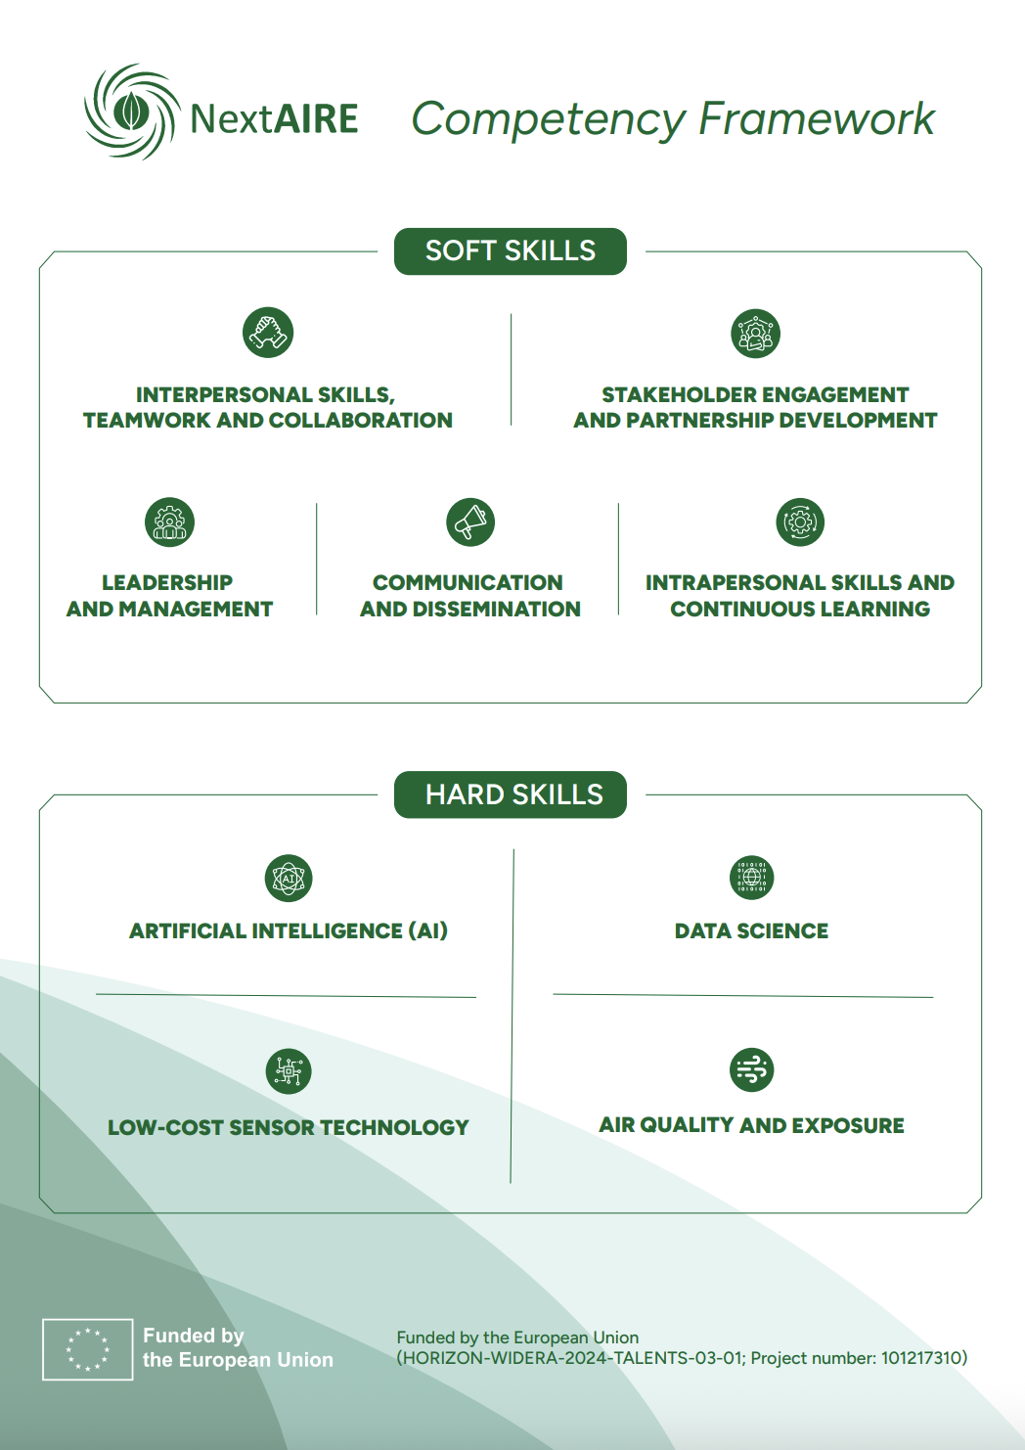
Overview: Soft Skills
Notes:
Soft skills are an important part of professional development, especially in R&I environments that bring together experts from different disciplines, institutions, and sectors. Technical knowledge is still essential, but researchers also need to work well with others, communicate clearly, adapt to change, and find practical solutions to complex challenges. In addition, they need to be able to present their work and explain research results in a way that is understandable and relevant not only to other experts, but also to stakeholders and the wider public.

Slide 6
Overview: Hard Skills
Notes:
Hard skills cover the technical competencies R&I Target Talents need to work effectively in AQ research and innovation. They were identified and prioritised through the co-creation workshops carried out under Task T2.2, involving research performing organisations, public sector bodies, industry and SMEs.
Four competency areas were defined: AI, Data Science, LCS Technology, and AQ and Exposure .

Slide 7
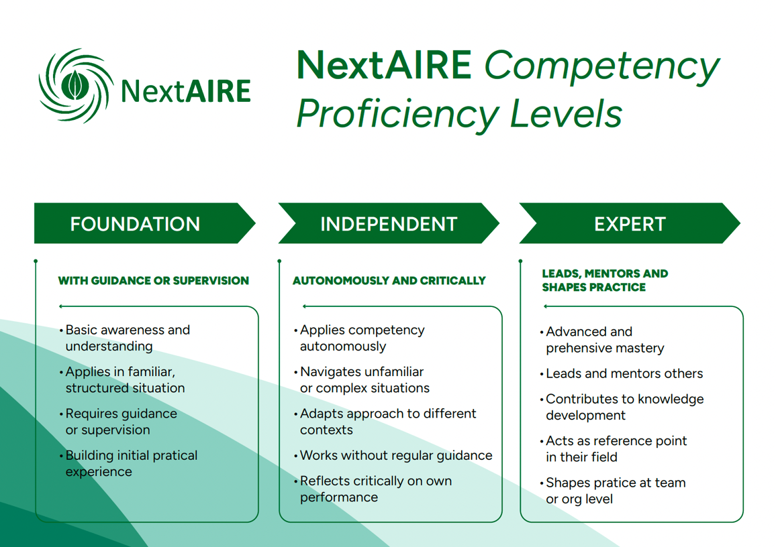
Notes:
Each competency within the NextAIRE Competency Framework is described across three proficiency levels, applicable to both the Hard Skills and Soft Skills pillars. These levels provide a shared reference for self-assessment, PDP design, and progress tracking throughout the project, as shown in the figure below.

Slide 8
T2.3 Update
D2.1 Career Development Plan was submitted in M6
    The Career Development Plan will be updated with reference to the Competency Framework submitted in M12.
The Training curriculum was submitted as part of D2.2 Training Curriculum and Competency Framework.
The Training materials and activities will be implemented throughout the remainder of the project.
    Hybrid approach: seminars, activities during secondments etc.

Slide 9
T2.4 Recruitment of R&I Talents
D2.3 1st Secondments Report was submitted in M12.
Identification of Talents in collaboration with partners.
Organisation and adaptation of the secondment matrix according to project and partner needs.

Slide 10
Next Steps
Organise remaining co-creation activities.
Explore how the validated competency framework can influence the lifelong personal career development plan in T2.3.
Link this work with the Evaluation Plan in WP6
Plan the training activities and materials for the soft competency skills
Preparation for Milestone 7 Recruitment of R&I Target Talents in M15.
    Completion of the recruitment phase of the R&I Target Talents to be trained

Slide 11














Consortium

Slide 12
Thank You!
Name: Jon Switters
Organisation: The Lisbon Council
Email: jon.switters@lisboncouncil.net
Website: https://lisboncouncil.net/

