Slide 1

Malaysia’s First Vape Juice Subscription Service

Slide 2
“A Malaysian vape juice subscription service that helps our users discover their next favourite Malaysian vape juices.”
- VapeClubMY’s Motto

Slide 3
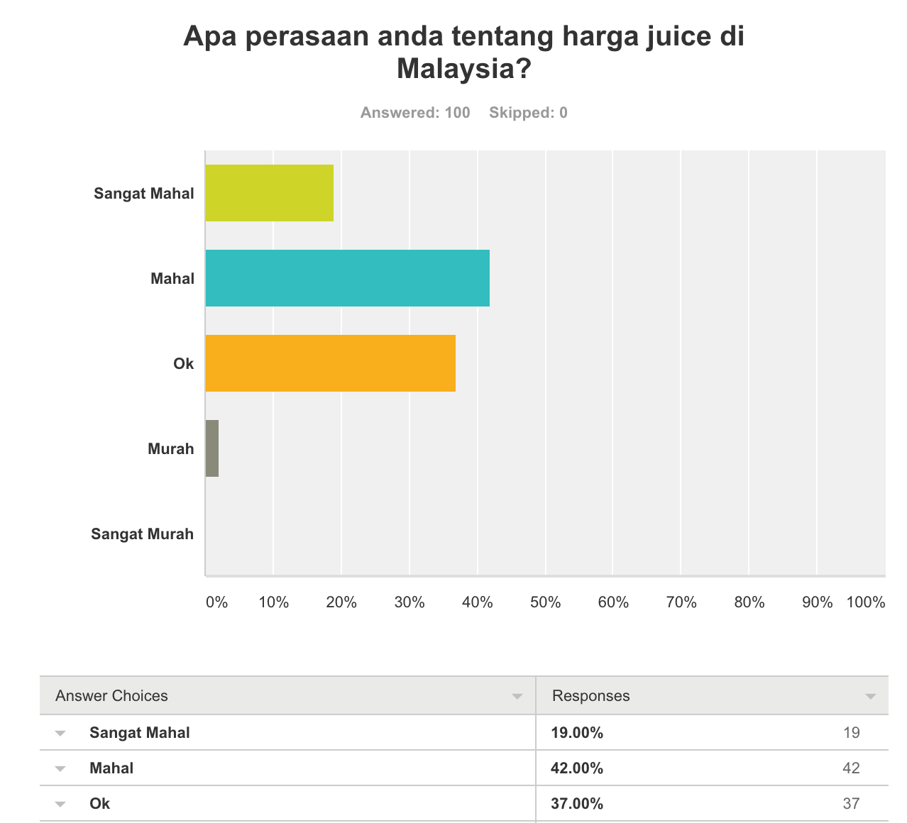

Slide 4
So How Do Vapers In Malaysia Deal with this?
61% of Vapers
think that the e-liquids in Malaysia are expensive/very expensive.
They opt for cheaper juices that do not guarantee food grade material..

Slide 5





Brands
and more to come….

Slide 6


What’s In It For Malaysian Vapers?
Discover the wide variety of Malaysian vape juices sent to your doorstep every month at up to 30% discount off retail.
No clones/bullshit. Original juices direct from brewers. Cancel anytime.

Slide 7
What’s In It For Brewers?
VapeClubMY provides instant reach to subscribers (local & international) for brewers to showcase their best products. We also conduct subscriber surveys to get their feedback on your juices.

Slide 8
What’s In It For Retailers in Malaysia?
Don’t know what juices to carry? VapeClubMY aims to help Malaysians discover the best juices in Malaysia. Once our subscribers find a juice that they really like, they will tell their favourite retail outlet to carry these juices!

Slide 9




What’s In It For Distributors/Vapers out of Malaysia?
Instead of having to wait for expos to discover Malaysian juices, you can subscribe to our service and get a box of new Malaysian flavours every month!

Slide 10
We’re launching this month!
To celebrate our launch, we’re giving away 3 VapeClubMY boxes. To participate, please visit
http://vapeclubmy.com and sign up to our list to stand a chance to get a free box when we launch!

Slide 11
Use Cases
Roger
Roger is a college student that is happy that vaping has helped him stop smoking cigarettes.
Sadly, he has very low allowance and have to save money for his university degree. So, he vapes poor quality e-liquids.
Ever since he became a member of VapeClubMY, he is now able to afford to vape higher quality e-liquids that has a safety guarantee at the same price as before.
Ian
Ian is a very busy white collar working class man and works late nights every day.
He has very little time for his family, let alone the time to visit retail outlets where high quality liquids are frequently distributed at.
Hence, he opts for online shops that sell low quality e-liquids that is delivered to his doorstep.
Ever since he became a member of VapeClubMY, he receives a range of a different high quality liquids every month, without having to visit a retail store.

Slide 12
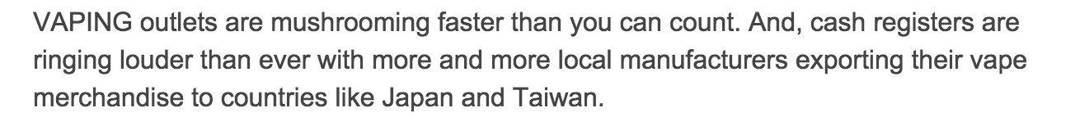

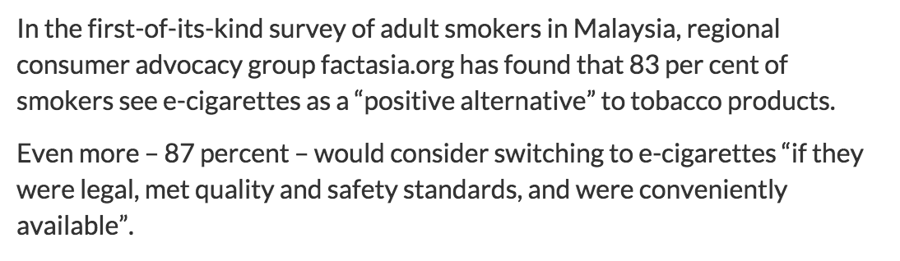

Why Do This Now?

Slide 13
Market Segmentation
Total Available Market :
1 Million Vapers In Malaysia (rapidly growing)
Segmented Addressable Market :
10% (100k) of Vapers with online banking facilities and familiar with eCommerce
Target SOM :
3% Market Share of all Vapers In Malaysia by June 2016

