Slide 1

By Jupiter!
A Whirlwind Tour of JUnit 5!

Slide 2
Stephen “Steve” Gelman
  Software Engineer
  Application Security Specialist
  Code Janitor
  sgelman@nextpoorslob.com
  @NextPoorSlob
  https://github.com/NextPoorSlob/JUnit5-Presentation-Sample-Code

Slide 3
Introduction

Slide 4
Proper Testing
Writing tests to cover your application code
  Can triple the size of your codebase
  Takes time to write and maintain
  Adds complexity to a project
Why test?

Slide 5


But Before We Start….

Slide 6


Slide 7

“The koala tea of Mercy is not strain’d.”

Slide 8

“The QUALITY of mercy is not strain’d.”
– Portia
  ACT IV, SCENE I. Venice. A court of justice.
The Merchant of Venice
by William Shakespeare

Slide 9

Why We Write Tests
To insure
QUALITY
Is the code ACCURATE? Does the code return the correct results?
Is the code FUNCTIONAL? Does the code perform the correct task?
Is the code MAINTAINABLE? Can the code change without breaking?

Slide 10

Why We Write Tests
As
DOCUMENTATION
Tests serve as documentation
JIRAs are hard to search
Ditto for Wikis
Sharepoint? Oy!

Slide 11
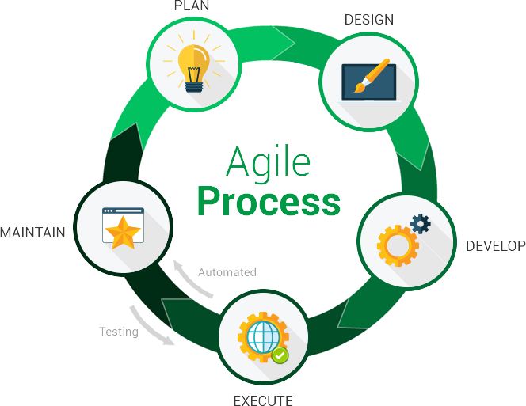
Why We Write Tests
To be more
AGILE
Make refactoring a safer process
Facilitate small, incremental changes
Find defects sooner

Slide 12
JUnit 5 Presentation Goals
Identify the pieces
Show how to include the libraries to run it
Give examples of the basic features
List the advanced features
Eat or drink something I’ll regret tomorrow

Slide 13
JUnit 5 =
JUnit Platform + JUnit Jupiter + JUnit Vintage
Where:
  JUnit Platform: test engine + test engine API
  JUnit Jupiter¹: Programming API + extension model
  JUnit Vintage²: test engine for JUnit 3 + 4
  ¹Most people mean JUnit Jupiter when saying JUnit 5
  ²Some JUnit 4 extension features don’t work properly: rules.

Slide 14
Why Move To JUnit 5?
Gentle migration: JUnit 3 and 4 work with the vintage engine
Enhanced reporting tools
Fine-grained execution control
Dependency injection
Multiple executions of tests with different values
Test templates, dynamic tests, and an extension framework
Works with Kotlin

Slide 15
Alternative Testing Frameworks
JUnit 4
NGTest
Groovy
Spock

Slide 16
Recap of the Introduction
We test to ensure quality
JUnit 5 is a powerful tool to help
There are alternative tools, each with advantages and disadvantages.
See more Shakespeare!

Slide 17
Running JUnit 5

Slide 18
Dependencies
Maven
<!-- Combine the API and Engine -->
<dependency>
<groupId>org.junit.jupiter</groupId>
<artifactId>junit-jupiter</artifactId>
<version>5.4.0</version>
<scope>test</scope>
</dependency>
Gradle
dependencies {
TestImplementation
'org.junit.jupiter:junit-jupiter:5.4.0'
}
test {
useJUnitPlatform()
}

Slide 19
Samples
Running JUnit 5 in Maven
Running JUnit 5 in Gradle
Running JUnit 5 along with JUnit 4 in Maven
Running JUnit 5 with SpringBoot, Spring Test, and Mockito

Slide 20
Running JUnit 5 in Maven
Example: a010-solo-maven
Running JUnit5 without any additional libraries is simple:
1. Add a dependency:
org.junit.jupiter:junit-jupiter:5.4.0
2. Use maven-surefire-plugin version 2.22.1 or higher.

Slide 21
Running JUnit 5 in Gradle
Example: a011-solo-gradle
Running JUnit5 without any additional libraries is simple in Gradle as well:
1. Add dependency:
org.junit.jupiter:junit-jupiter:5.4.0
2. Add useJUnitPlatform() command to the test task

Slide 22
Adding in JUnit 4 in Maven
Example: a020-junit4-and-5-maven
In addition to JUnit 5 dependencies
1. Add dependency:
junit:junit:4.12
2. Add dependency:
org.junit.vintage:junit-vintage-engine:5.4.0

Slide 23
Running JUnit 5 with SpringBoot, Spring Test, and Mockito
Example: a030-spring-test-mockito-maven
The spring-boot-starter-parent sets the versions:
org.springframework.boot:spring-boot-starter-parent:<version>
org.springframework.boot:spring-boot-starter-web
org.springframework.boot:spring-boot-starter-test
org.mockito:mockito-junit-jupiter

Slide 24
Recap: Running Junit 5
Add the proper libraries to the project
Verify the Maven Surefire plugin is 2.22.1 or +
Add the junitPlatform() command to the test task

Slide 25
JUnit 5 Features

Slide 26
@DisplayName
b010-display-names-and-nesting-maven
DisplayNamesAsSentencesTest
IntegerCalculatorTest
DisplayNamesGeneratedCustomTest

Slide 27
Nested Tests
b010-display-names-and-nesting-maven
LifeCycleDemoATopLevelOnlyTest
LifeCycleDemoBNestedTest

Slide 28
Execution Control
@Ignore → @Disabled(“This is a comment!”)
@Enabled… or @Disabled...
  ...OnOs({LINUX, WINDOWS, MAC})
  ...OnJre({Java_8, JAVA_9})
  ...IfSystemProperty(named = "os.arch", matches = ".*64.*")
  @...IfEnvironmentVariable(named = "ENV", matches = "staging-server")

Slide 29
Custom Tagging And Filtering
b040-tagging-and-filtering-maven
Roll your own custom annotations as tags
Any annotation can be combined in a custom tag, even an @Enabled or @Disabled tag
EndToEndTest Tag: UserAcceptanceTest
Flash Tag: UltraFastTest

Slide 30
Assumptions
b040-tagging-and-filtering-maven
Beefed up featured seen in JUnit 4
An Assumption must be true or JUnit Jupiter will disable the test
AssumptionTest shows the 3 basic flavors

Slide 31
Ordering Test Execution Sequence
b050-ordering-maven
@TestMethodOrder sequences execution order
Alphanumeric: by test method signature
Order annotation: @Order(1)
Random: JUnit 5’s pseudo-random sequencer
Roll your own using the MethodOrderer interface

Slide 32
Exception Handling
b060-exception-handling-maven
Exception handled is turbocharged
No more @Test(expected=MyException.class)
assertThrows(MyException.class, () → {
statement throwing MyException
}

Slide 33
Lambdas
b070-lambdas-maven
A lambda is:
An anonymous function
A first-class object
Can be assigned to a variable
JUnit 5 uses lambdas in:
Assertions
Assumptions

Slide 34
Recap: Basic New Features
Display names and display name generators
Nested tests and the test life-cycle
Execution control with tags and assumptions
Exception handling
Lambdas
But wait! There’s more….

