Slide 1
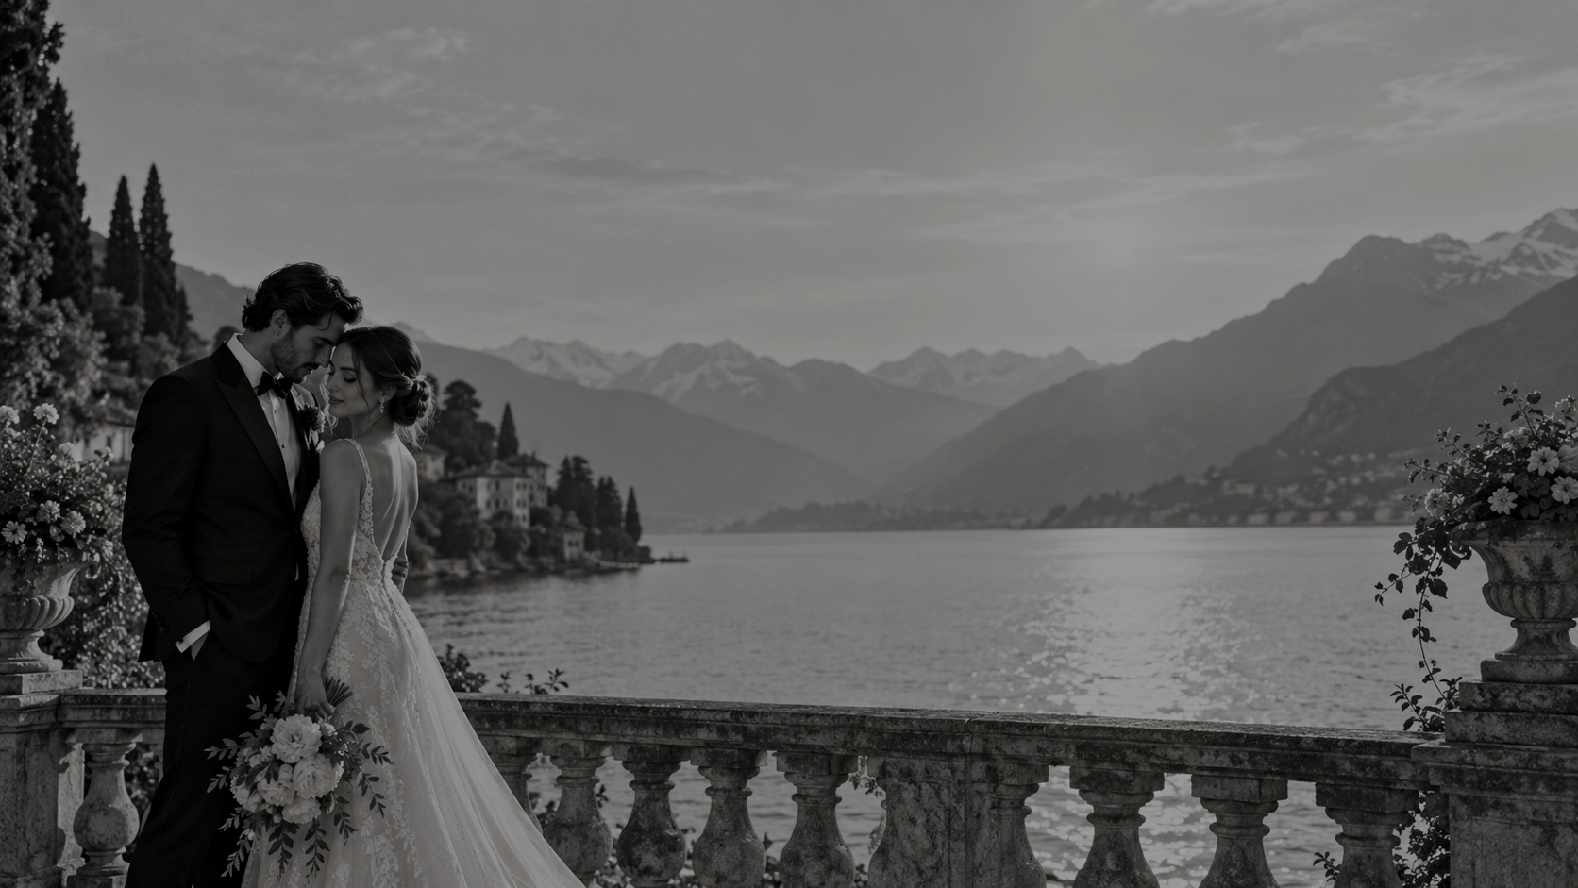

WEDDING COLLECTIONS 2026
01

Slide 2
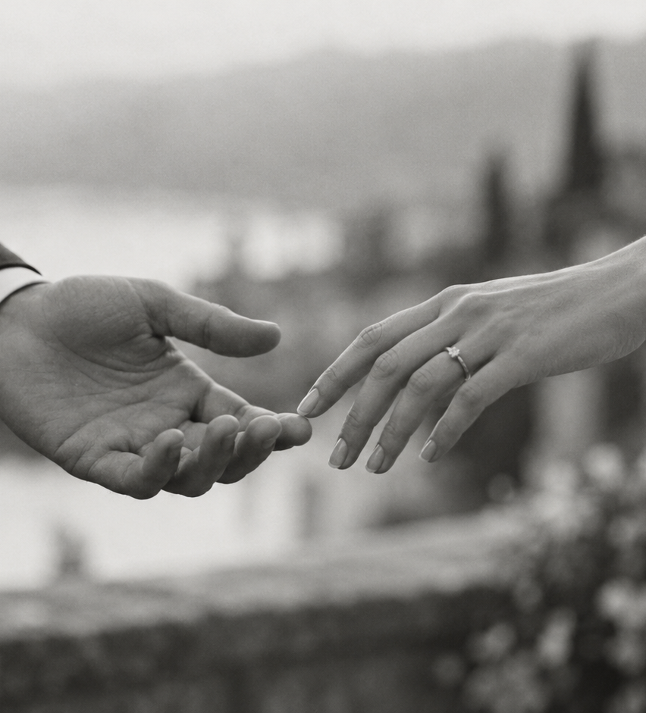
WHERE REFINED IMAGERY
MEETS GENUINE EMOTION.
Timeless wedding photography, thoughtfully created to preserve the beauty and feeling of your day – exactly as it was lived.
For those drawn to photographs that reveal more the longer you look.

Slide 3
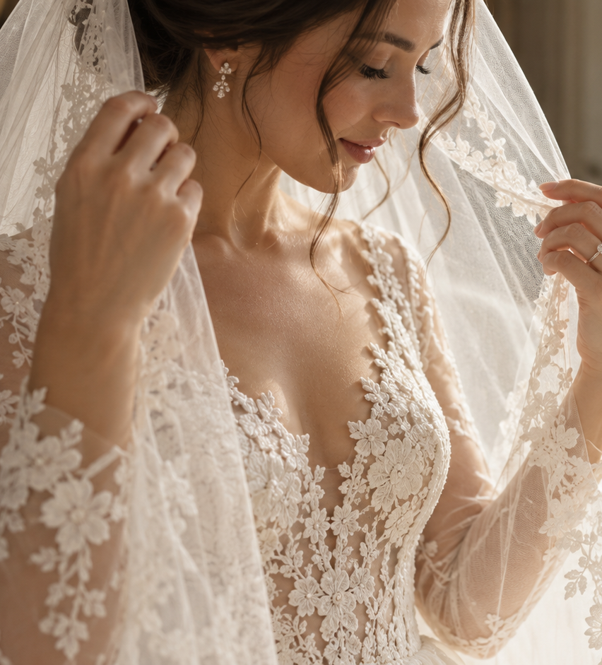
BONJOUR
I’m so glad my work resonates with you, and that you’re considering me to document such a meaningful chapter of your story. Being invited into something as intimate as a wedding day is a privilege I deeply cherish.
A wedding unfolds through so many layers – the people, the gestures, the moments long anticipated and those that happen quietly in between. I’m drawn to all of it, allowing the day to reveal itself naturally.
My work blends the honesty of documentary photography with the refinement of an editorial eye, where genuine emotion meets beautiful light and thoughtful composition.
Ultimately, I want your photographs to become more than a record of the day – to hold its feeling, its energy and everything that made it uniquely yours.
I look forward to getting to know you and capturing your love in a way that feels entirely your own.

Slide 4
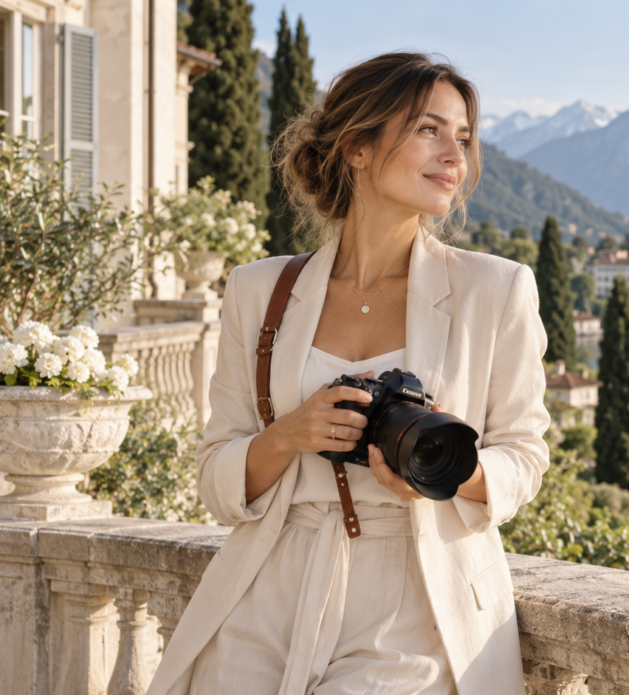
BEHIND THE LENS
Hi, I’m Emra.
With Bosnian roots and a Swiss upbringing, I'm the creative mind behind EM Photography.
Photography is my way of noticing the world more deeply. I’m drawn to landscapes, light, atmosphere and the subtle details that make a moment feel alive.
That same sensitivity shapes the way I photograph people. I’m deeply inspired by love in all its forms – fleeting expressions, quiet tenderness and the gestures that often go unnoticed.
I’m passionate about creating vibrant, emotional and layered images – photographs you can return to again and again, revealing something more with every look.
A FEW PERSONAL NOTES
Quiet landscapes inspire me.
Coffee is a non-negotiable.
Forever curious about the world.
Little paws have my whole heart.
Drawn to the softness of golden hour.

Slide 5
LOVE NOTES
“Every celebration has its own rhythm.
Getting to know you beforehand allows me to understand what matters most – the people, the energy, your priorities and the way you want the day to unfold.
When your wedding arrives, I photograph with a calm, observant presence – attentive to the moments everyone sees, but equally to those unfolding quietly around them: nervous hands, a glance across the room, a familiar embrace, laughter between friends.
When guidance is needed, I’ll gently step in. The rest of the time, I want you to forget about the camera, stay close to the people you love and live the day fully.
There is intention behind the scenes, with space for everything spontaneous in between.”
S & A
Commentaire client à insérer

Slide 6
WEDDING COLLECTIONS
Considered collections,
tailored to your day.
Choose the level of coverage that fits your celebration.
HALF DAY WEDDING
FULL DAY WEDDING
EXTENDED WEDDING
CHF 1'500.-
CHF 2'700.-
CHF 3'200.-
4 HOURS / 180+ IMAGES
8 HOURS / 400+ IMAGES
10 HOURS / 600+ IMAGES
A focused coverage of the key chapters – ideal when you want depth without documenting the entire day.
The complete rhythm of the day, from the quieter beginning to the celebration, with space for details, people and everything in between.
An extended story of your celebration – from preparations to the late evening atmosphere, captured with a calm and consistent presence.
EVERY COLLECTION INCLUDES
Private online gallery | High-resolution individually edited images | Printing rights | Travel within Switzerland
ADDITIONAL HOUR
CHF 350.- / h
07

Slide 7
CIVIL CEREMONY & INTIMATE CELEBRATIONS
For the chapters shaped by
intimacy and intention.
Thoughtful coverage for more intimate celebrations, in Lausanne and throughout Switzerland.
CIVIL CEREMONY
INTIMATE WEDDING / ELOPEMENT
CHF 850.-
CHF 1'200.-
2 HOURS / 80+ IMAGES
3 HOURS / 130+ IMAGES
A refined and intimate coverage of your civil ceremony, your closest people and a short portrait chapter around the celebration.
Flexible and intimate coverage shaped around the two of you, your ceremony and the atmosphere of the day.
EVERY COLLECTION INCLUDES
Private online gallery | High-resolution individually edited images | Printing rights | Travel within Switzerland
ADDITIONAL HOUR
CHF 350.- / h
08

Slide 8
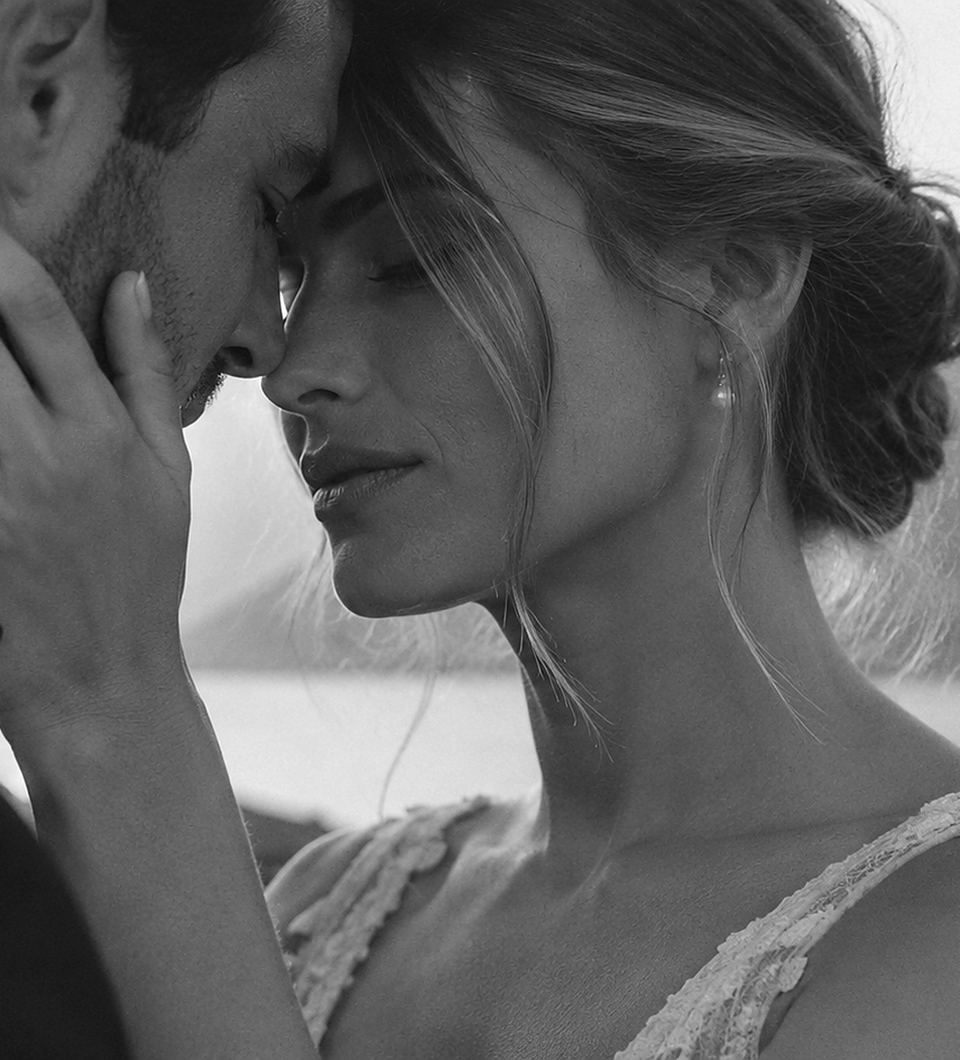
COLLECTIONS
Portraits & Lifestyle session
1 hour coverage
20+ edited photographs

Slide 9
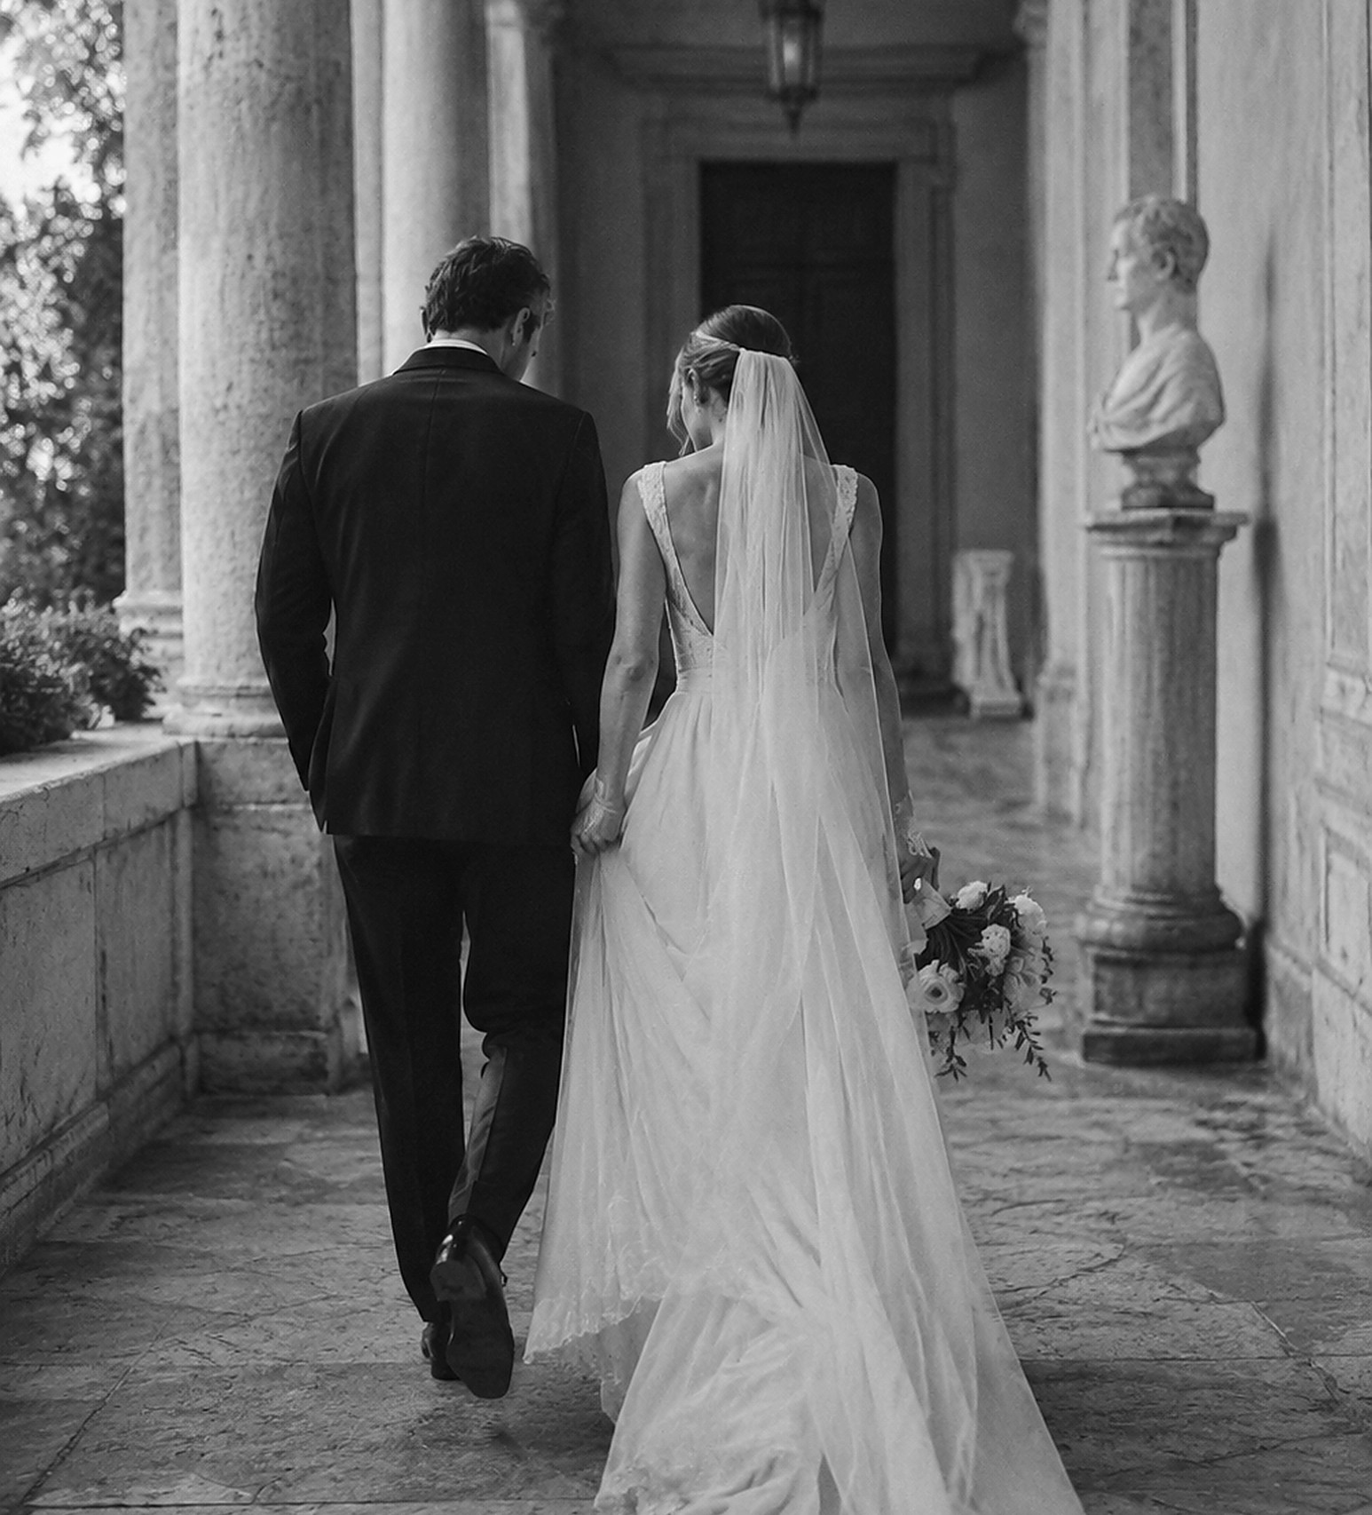
COLLECTIONS
Civil Ceremony
2 hours coverage
80+ edited photographs

Slide 10
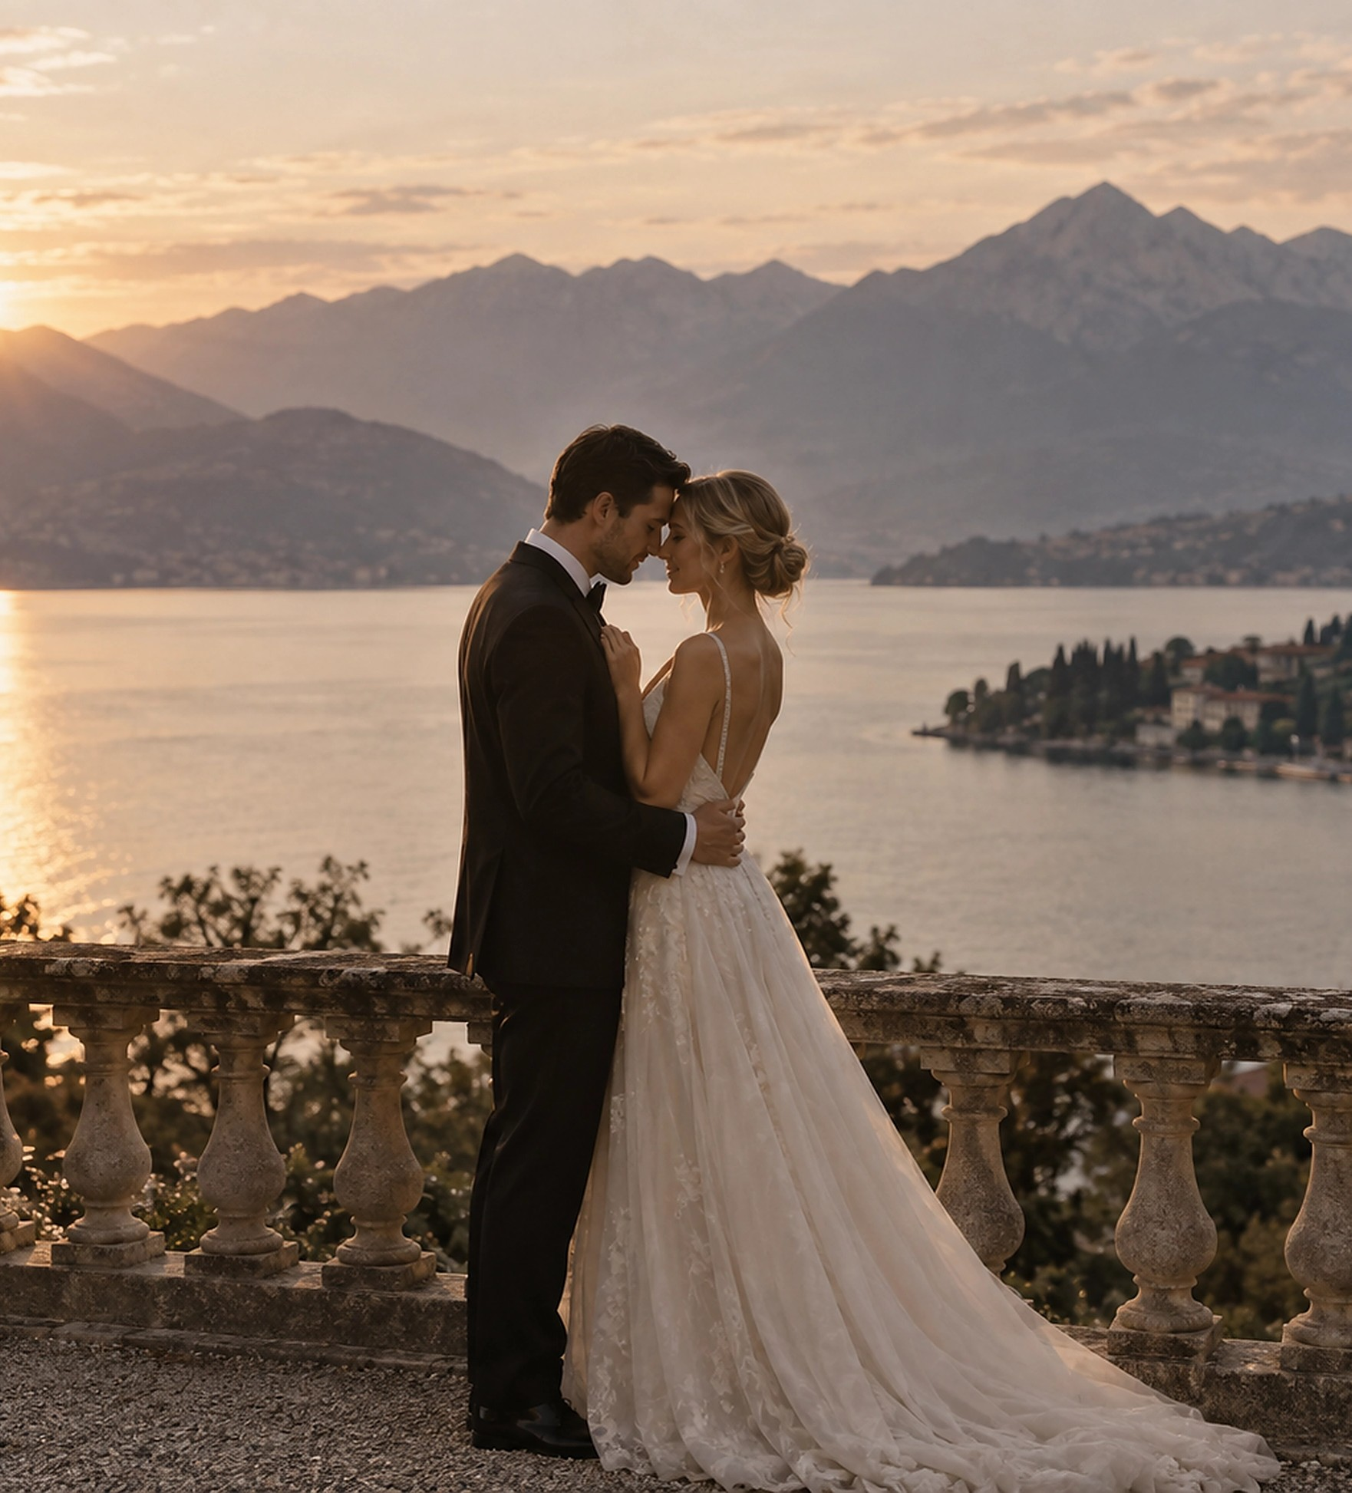
COLLECTIONS
Elopement & Intimate Wedding
3 hours coverage
120+ edited photographs

Slide 11
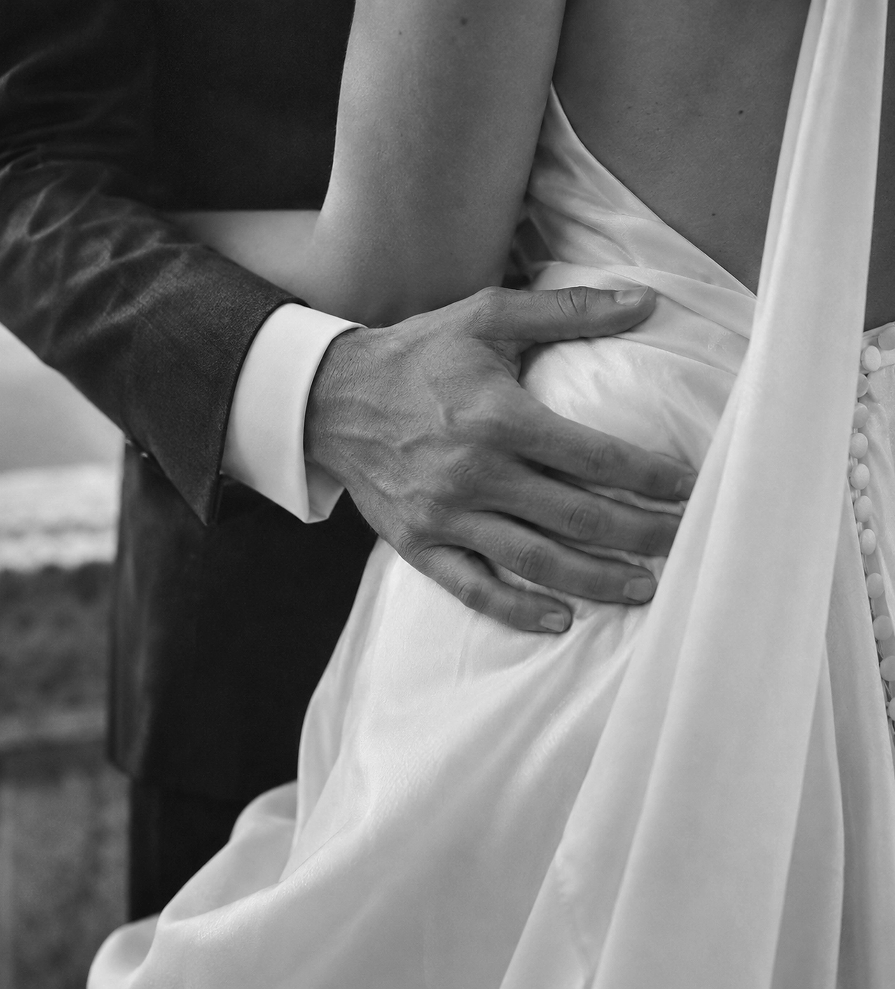
COLLECTIONS
Wedding Story — Half Day
4 hours coverage
180+ edited photographs

Slide 12
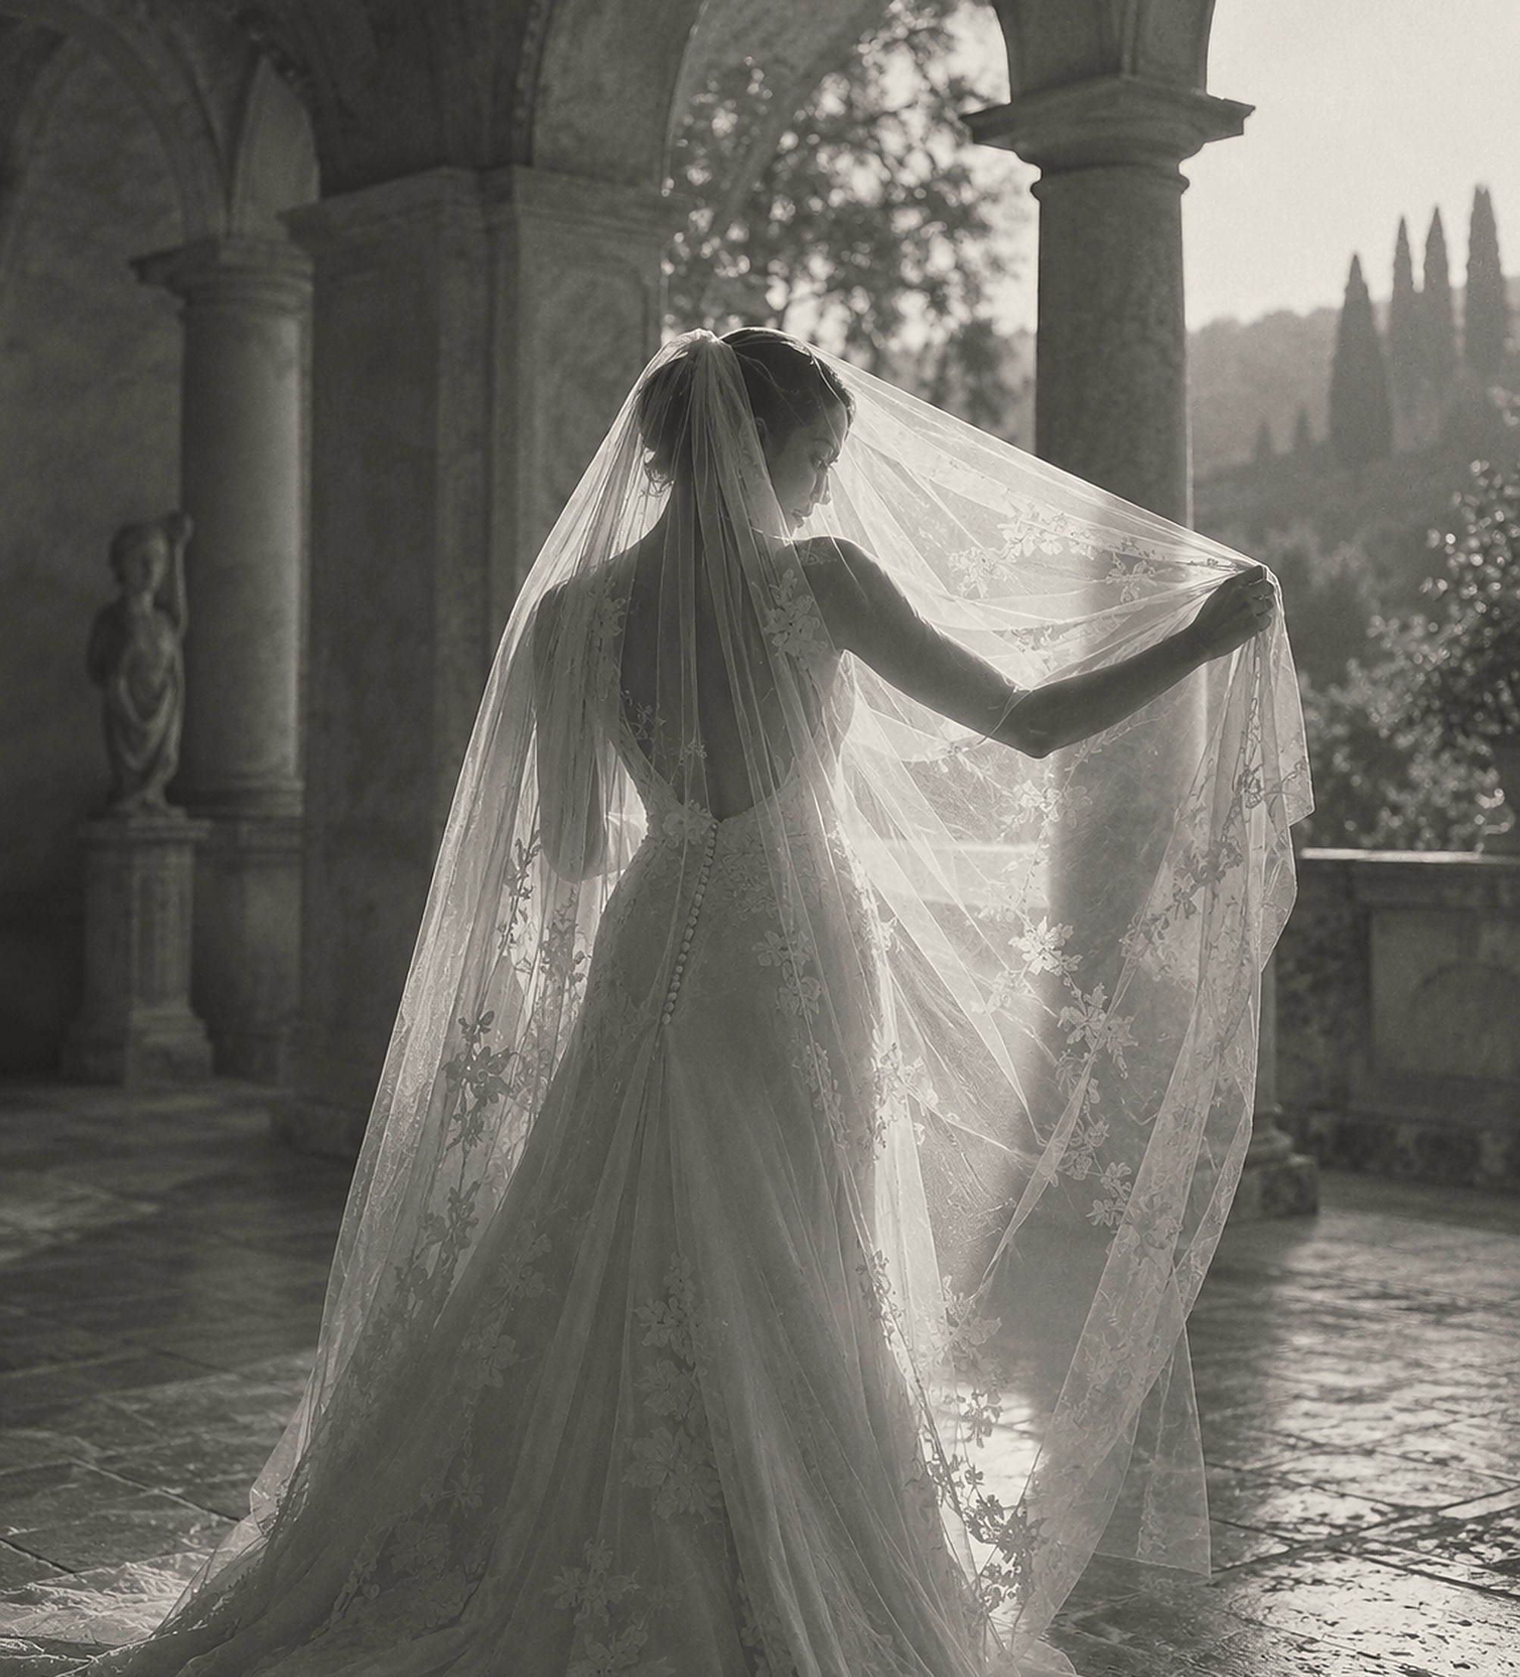
WEDDING STORY — FULL DAY
Full Day Wedding Photography
A thoughtful coverage of your celebration, from the meaningful details to the unforgettable moments.
8 hours of wedding coverage
400+ edited photos in high resolution
One photographer
Preview photos after the wedding
Printing rights
Private online gallery
ADD’S ON
ENGAGEMENT / DAY AFTER
let’s get casual pictures exploring everywhere we can alongside your wedding itself.
CHF 4’900*
CHF 450 - Hour
*travel fees are included all over Switzerland
(**Accommodation may be required depending on the location and coverage schedule and will be discussed in advance).
HOURLY ADD ON : CHF 350 - Additional hour

Slide 13
YOUR DAY
Every celebration has its own rhythm.
Getting to know you beforehand allows me to understand what matters most – the people, the energy, your priorities and the way you want the day to unfold.
When your wedding arrives, I photograph with a calm, observant presence – attentive to the moments everyone sees, but equally to those unfolding quietly around them: nervous hands, a glance across the room, a familiar embrace, laughter between friends.
When guidance is needed, I’ll gently step in. The rest of the time, I want you to forget about the camera, stay close to the people you love and live the day fully.
There is intention behind the scenes, with space for everything spontaneous in between.
Be fully in it. I'll take care of remembering it.

Slide 14
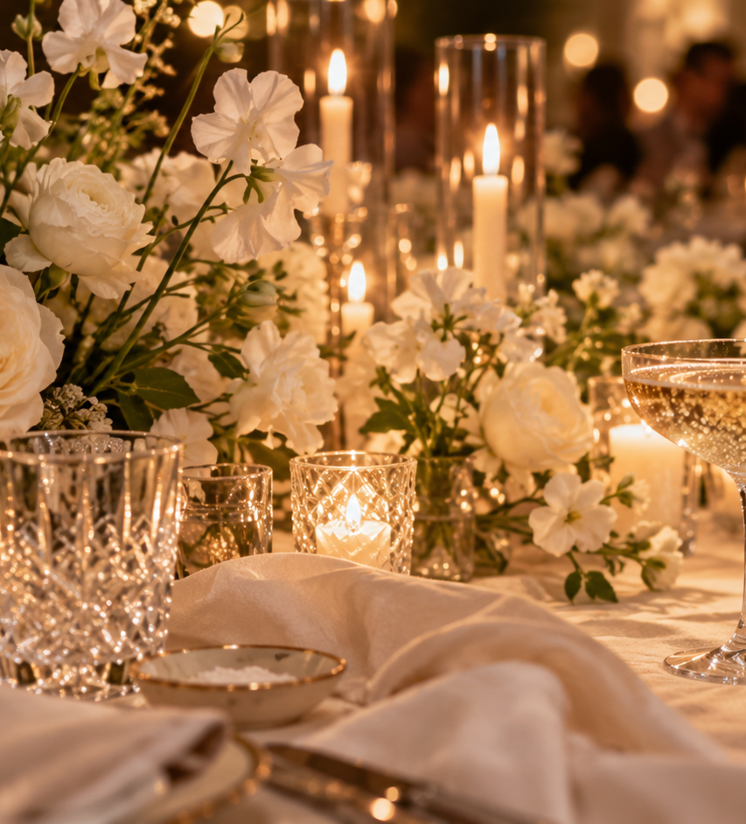
WHAT FOLLOWS
01 - CONNECT
Choose the collection that feels right for your celebration and let’s connect – in person or over a call – to talk through your plans, your vision and what matters most to you.
If it feels like the right fit, your date is officially reserved once the agreement is signed and the retainer is received.
02 - PREPARE
Around one month before your wedding, we’ll refine the timeline together, go through your photography priorities and review the details that matter most.
A final check-in shortly before the day allows us to confirm everything, make any last adjustments and ensure you feel fully prepared.
03 - EXPERIENCE
When the day arrives, embrace it fully.
Be present, enjoy every moment and let yourself be carried by the people, emotions and energy around you. I’ll be there to observe, anticipate and gently guide when needed, allowing everything to unfold naturally while you simply enjoy your day.
04 - RELIVE
After your wedding, each photograph is carefully selected and individually edited in line with my signature approach – natural, refined and true to the feeling of the day.
Your complete gallery will be delivered through a private online gallery within five weeks, ready to be revisited, shared and relived for years to come.
06

Slide 15
  A FINAL NOTE
Long after the celebration has passed, photographs become a way back to it.
Not only to how everything looked, but to the people who were there, the atmosphere around you and the moments you may not have noticed as they unfold.
Sometimes, the photographs that matter most are the quietest ones.
A look.
A hand reaching for another.
Someone you love laughing across the room.
A moment you never realised I had seen.
Knowing these images may become part of how you remember this chapter years from now is one of the most meaningful parts of what I do.
Thank you for considering me to tell this part of your story.
09

