Slide 1
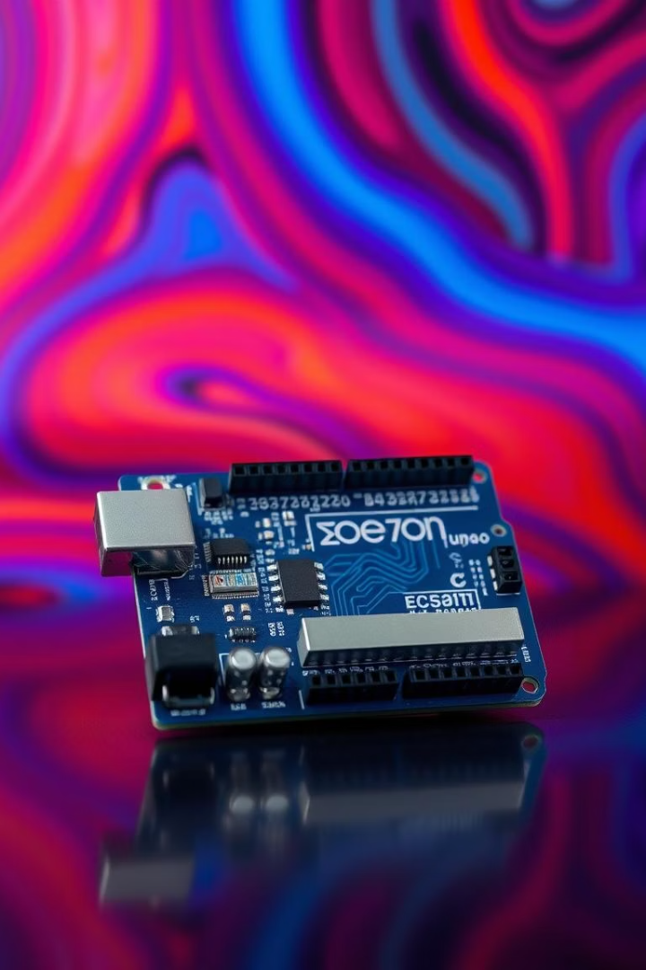


Welcome to the Arduino Programming Workshop!
Date
Presenter
5th May 2025
Aman Sonwani
Sintu Hazarika
Rohit Kumar

Slide 2
What We’ll Cover Today
1
2
3
4
Arduino Basics
Setup
Programming
Project
What is an Arduino?
Installing Arduino software
Writing your first program
Example uses and sketches

Slide 3
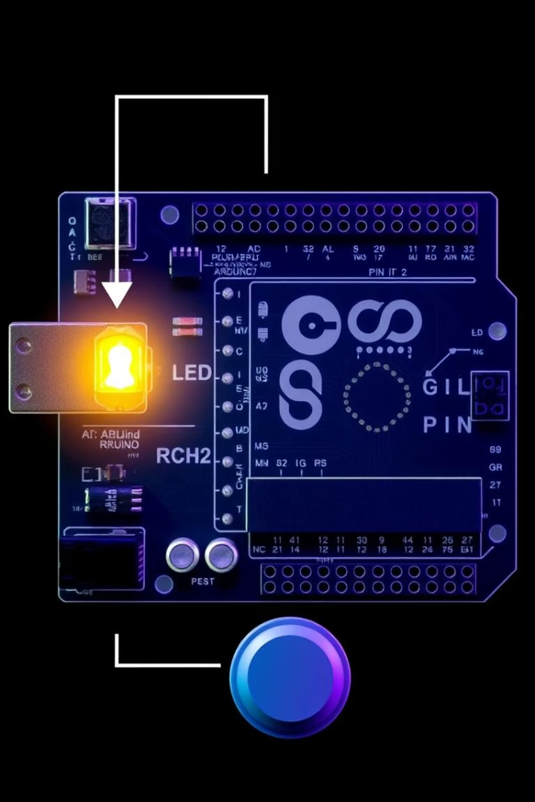
Introduction to Arduino
Open-source Platform
Beginner Friendly
Hardware and software combined
Large supportive community
Variety
Arduino Mega , Arduino UNO , ESP32 etc.

Slide 4
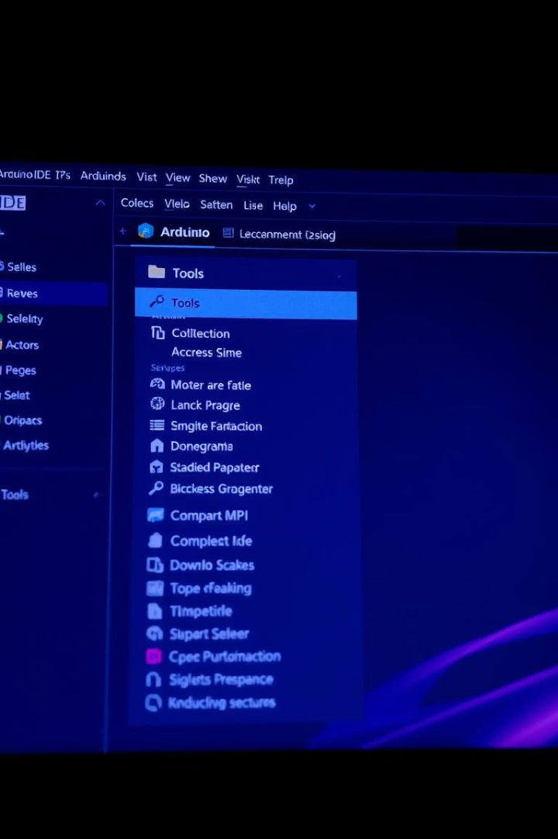



Getting started with Arduino
& Arduino IDE
Download
Connect
From arduino.cc, free software
Arduino to computer via USB
Configure
Select board and correct port

Slide 5


Your First Arduino Sketch
setup()
loop()
Runs once at start
Runs repeatedly
Setup the connections.
Runs the commands and generate outputs.
Assign Pin to Connections using PinMode()
Function.
Runs multiple times as a loop to generate
Output number of times.
Assign other components to control variables.
Runs multiple times as a loop to generate
Output number of times.

Slide 6
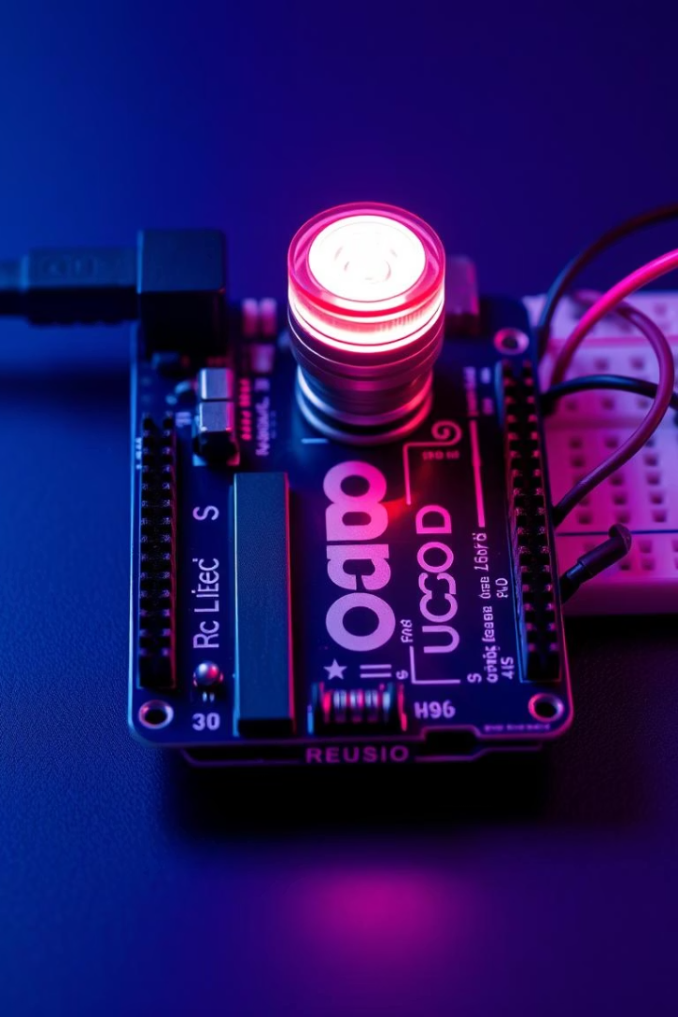
Demo: Blinking LED
Goal
Materials
Turn Led ON and OFF using arduino
Arduino, LED, breadboard, wires
Steps
Build circuit and upload code

Slide 7
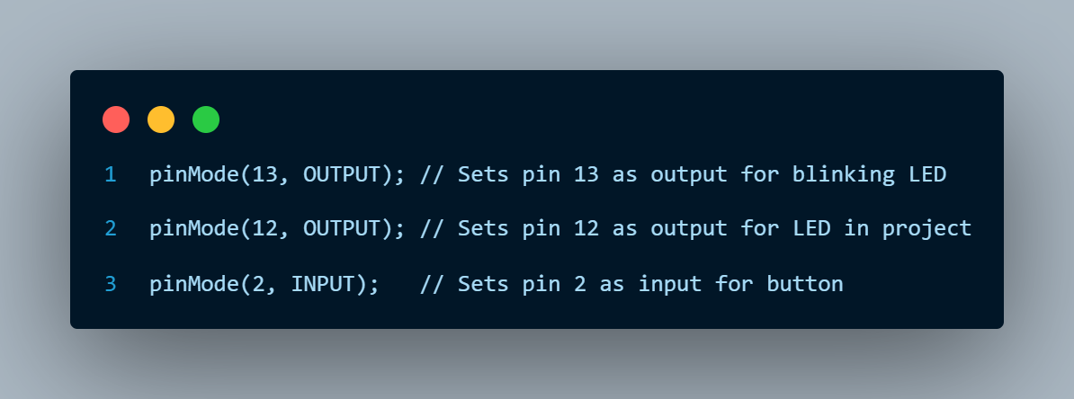


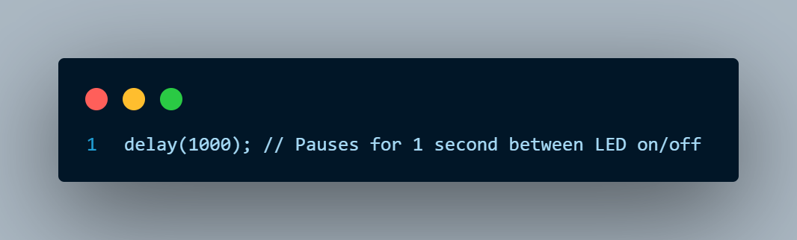


Functions used while programming
pinMode
Sets pin as output
digitalWrite
Turns LED on/off
delay
Pauses for 1 second

Slide 8
Do the connections & Code
1
LED
Connect the LED’s anode (longer leg) to Arduino pin 9.
Connect the LED’s cathode (shorter leg) to GND on the Arduino.
Power: Connect the Arduino to your computer via a USB cable.
2
Steps to run
Open the Arduino IDE.
Copy and paste the code above into a new sketch.
Connect your Arduino to your computer.
In the IDE, go to Tools > Board and select your board (e.g., Arduino Uno).
Go to Tools > Port and select the correct port.
Click the Upload button (right arrow) to upload the code.
The LED on pin 9 should start blinking (on for 1 second, off for 1 second).

Slide 9
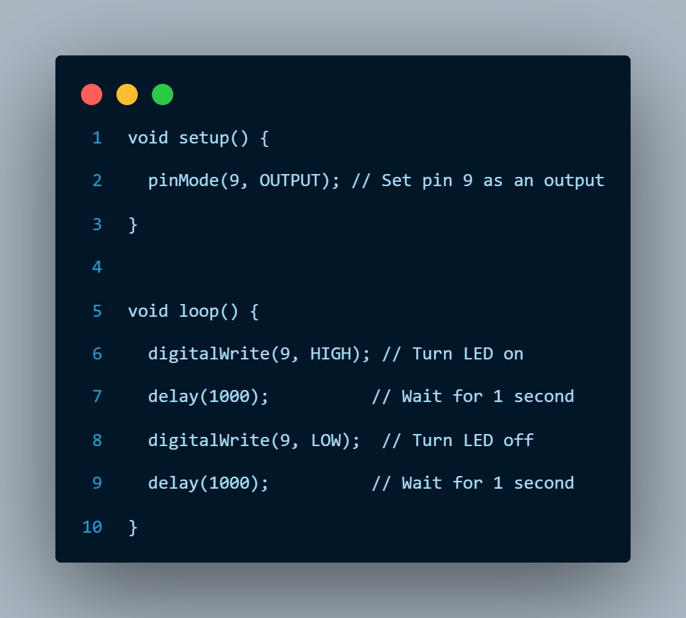
Code for LED Blinking

