Slide 1
AFRICA DEVELOPMENT CONFERENCE 2026 · TRACK 3 · TEAM 16
63,259
Votes That
Never Existed
EC8A polling-unit forms expose a result inversion in Nigeria's 2023 presidential election.
E Don Kast reads them automatically — in real time, running parallel to INEC's IReV.
✦ Electoral Act 2026 now mandates real-time IReV transmission. E Don Kast enforces it.
Olufemi Olamijulo · Rhoda Oluwarantimi Oni · Dela Michel
E DON KAST
app.edonkast.com
Real-Time Election Verification · StayGIS LLC

Slide 2
Nigeria's 2023 Presidential Election · Checks & Accountability · Majority Rules, Not Manipulation
The Law Changed. The Gap Remains.
Track 3 core:
Majority rules — not manipulation, not litigation.
THE LAW — Electoral Act 2026
HOW NUMBERS CHANGE
Section 60(3) now mandates:
EC8A
EC8A signed at polling unit
"The presiding officer shall electronically transmit the results from each polling unit to the IReV portal in real time…"
Party agents witness. Form is authoritative.
LGA
LGA collation centre
⚠ The loophole: a 'communication failure' exemption allows manual EC8A to override IReV — undefined, undocumented, unenforced.
One officer. Behind closed doors. Numbers can change.
OUT
Official INEC declaration
E Don Kast closes this loophole — independent extraction from the same photos IReV already holds.
Discrepancy only surfaces months later in court.
IReV already has the photos. E Don Kast now reads them and makes divergence visible instantly.
ADC 2026 Hackathon · Track 3: Checks, Accountability & Judicial Independence · Team 16 · E Don Kast / StayGIS LLC

Slide 3
Ward 4 (Rumuodomaya) · Obio-Akpor LGA · Rivers State
The Evidence: Numbers
Ward 4 EC8A forms record 4,432 LP votes. INEC declared only 3,829 LP votes for the ENTIRE LGA — a single ward recorded more LP votes than INEC credited to all 48.
4,432
3,829
−64,692
+63,259
LP VOTES · WARD 4
LP VOTES · FULL LGA
LP VOTES MISSING
APC VOTES ADDED
EC8A forms recorded
INEC officially declared
LGA EC8A vs declared
INEC declared vs EC8A
Source: CCIJ / Veza News — 169,328 EC8A forms digitized from Obio-Akpor LGA [PRI1, INV1]
Part of five Rivers State LGAs where EC8A forms show 110,000+ more APC votes than recorded at polling units. [INV1]
ADC 2026 Hackathon · Track 3: Checks, Accountability & Judicial Independence · Team 16 · E Don Kast / StayGIS LLC

Slide 4
Polling Unit 32/15/04/015 · Ward 4, Rumuodomaya · Primary Source Evidence
A Polling Agent's Cry for Help
EXHIBIT A — DocumentCloud · PU 32/15/04/015
AUTHOR
To: The Director ICT
INEC, Rivers State
Sir,
I, Okafor Sophia, polling agent of Labour Party
at Ward 4 Rumuodomaya, write to report that
the presidential result booklets were NOT made
available at nine (9) polling units in this ward
on election day, 25th February 2023.
I request your urgent investigation into this
matter as results cannot be collated without
these booklets.
Signed: Okafor Sophia
Date: 28-02-2023
Okafor Sophia
LP Polling Agent, Ward 4, Rumuodomaya
ADDRESSED TO
INEC ICT Director
Rivers State — on record
DATE FILED
28 Feb 2023
3 days after polling day — contemporaneous
KEY FINDING
9 polling units
Had NO result booklets on election day
This is not a reconstruction — it is contemporaneous evidence of suppression filed on election day and archived on DocumentCloud.
ADC 2026 Hackathon · Track 3: Checks, Accountability & Judicial Independence · Team 16 · E Don Kast / StayGIS LLC

Slide 5
Production Platform · AI Extraction Layer · Parallel to INEC IReV
The Solution: E Don Kast + AI
ALREADY IN PRODUCTION
NEW — Machine Learning OCR Layer
E Don Kast · app.edonkast.com
1
Observer photographs EC8A
✓
Interactive Nigeria-wide results map (StayGIS PMTiles)
Same workflow as IReV upload — no new hardware required
✓
EC8A photo submission by party agents and observers
✓
Geographic drilldown: State → LGA → Ward → Polling Unit
2
ML model extracts votes
✓
Issue reporting: BVAS failures, security incidents
Computer vision & deep learning OCR reads handwritten LP & APC figures; cross-checks numbers vs words column
✓
AWS S3 (Africa region) backend, production API
✓
Authenticated collectors + public open submissions
3
Divergence flagged instantly
E Don Kast crowd total vs IReV declaration — any gap surfaces immediately, not months later in court
Tech stack: Flask · AWS Africa · Next.js · Mapbox PMTiles · claude-sonnet-4-6 ML model · Open-source · Portable
The Electoral Act 2026 mandates IReV transmission. E Don Kast is the independent verification layer that enforces it.
ADC 2026 Hackathon · Track 3: Checks, Accountability & Judicial Independence · Team 16 · E Don Kast / StayGIS LLC

Slide 6
Who Must Act — and Who Can Make It Happen
The Actor
INEC
Civil Society
& Media
Diaspora
& Donors
PRIMARY REGULATOR
VERIFICATION PARTNERS
FUNDERS & VALIDATORS
Section 78 CFRN: transparent result collation required
CCIJ digitized 169k EC8A forms — infrastructure already exists
1.7M Nigerians in US — verify results from home wards via platform
Electoral Act 2026 now legally mandates EC8A transmission — INEC must implement
Dataphyte, Veza News: publish discrepancy analysis on election night
$50K funds Phase 1: NIDO, NANAF, state-chapter diaspora networks
IReV portal upgradeable for crowd-sourced verified images
Citizen reporters with phones become election observers at scale
StayGIS LLC: fully independent — no party affiliation, open methodology
BVAS logs must become publicly auditable in real time
LP legal coalition: EC8A forms as court-ready documentary evidence
Portable: Kenya, Ghana, Senegal legal frameworks already reviewed
ADC 2026 Hackathon · Track 3: Checks, Accountability & Judicial Independence · Team 16 · E Don Kast / StayGIS LLC

Slide 7
90 Days to Live Deployment · Ekiti Jun 20 · Osun Aug 15 · National 2027
Implementation Plan
PHASE 01 · Days 1–30
PHASE 02 · Days 31–60
PHASE 03 · Days 61–90
Data & Platform
Pilot Election
Ekiti — Jun 20, 2026
Scale & Policy
Osun — Aug 15, 2026
Deploy E Don Kast with CCIJ 169k-form archive as live simulation
Train 500 citizen observers with mobile uploader
Scale to 3,000+ observers for Osun deployment
Obio-Akpor 2023 data proves pipeline — known outcome = ground truth
Real-time aggregation vs official collation — live election
Submit accuracy report to INEC and National Assembly
Sign SERAP MOU — discrepancy outputs tribunal-ready
Discrepancy alerts to registered media partners
Draft INEC regulation — mandatory EC8A structured exports
Harden deep learning OCR pipeline → 95%+ accuracy
Post-election accuracy audit and public report
Launch diaspora crowdfund for 2027 elections
KPI: Dashboard live + SERAP MOU signed
KPI: ≥85% ward totals verified within 6 hrs
KPI: Bill tabled; Phase 2 crowdfund at $50k+
ADC 2026 Hackathon · Track 3: Checks, Accountability & Judicial Independence · Team 16 · E Don Kast / StayGIS LLC

Slide 8
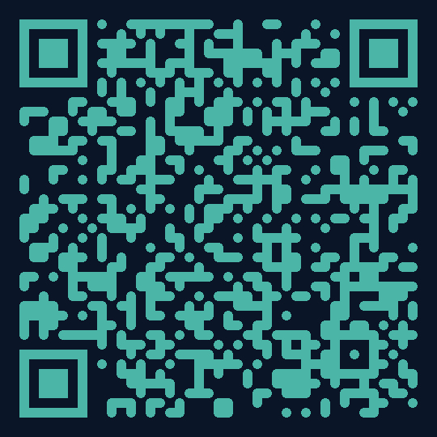
LIVE DEMO — Hold the EC8A form. Scan. Watch it count.
SCAN TO SUBMIT
Our Ask
INEC Partnership
01
Access to IReV upload API for real-time EC8A verification and instant discrepancy flagging
$50k Phase 1 Seed
02
Fund Obio-Akpor pilot via diaspora networks (NIDO, NANAF, state-chapter associations) — 90-day deployable
edonkast-ocr-production.up.railway.app
Media Amplification
Dashboard: /dashboard
03
Dataphyte, Veza News, Premium Times as live distribution partners for election-night discrepancy reporting
Legislative Coalition
04
Support EC8A mandatory real-time disclosure amendment under Electoral Act 2026 Section 60 — close the loophole
femi@staygis.com · app.edonkast.com · ADC 2026 · Track 3 · Team 16 | Olufemi Olamijulo · Rhoda Oluwarantimi Oni · Dela Michel

