Slide 1
RSM IN KUWAIT
Voice of Clients
Phase 1
What the platform could do at version 1,
and what it can do now.
Survey · Reports · Dashboard

Slide 2
THE WORK
Three things changed
Version 1 collected the three scores and showed them. Phase 1 is the product around that.
01
02
03
The survey
The report
The dashboard
A client can finish it by voice or on screen, in English or Arabic, without guessing the scale.
The team downloads a branded report for the year, a date range, one metric, or one partner.
Invites, follow-up, roles, rankings and the responses themselves sit in one place.
Voice of Clients · Phase 1
2 / 11

Slide 3
THE FULL LIST
Version 1, and what the survey gained
Feature
Version 1
Phase 1
Already in version 1
Voice survey and typed survey
✓
✓
CSAT, CES and NPS, with a comment
✓
✓
English and Arabic
✓
✓
An insight on every response
✓
✓
Ask Your Data
✓
✓
Public scores for the website
✓
✓
Signed-in overview of the results
✓
✓
Added to the survey
New opening and split-screen steps, on a phone as well as a desk
✓
Every score is visible. The drag slider is gone. Answers can be reviewed
✓
Voice host you can preview, in English or Arabic
✓
Hold, end and live captions on the voice call
✓
An invite fills in the name, company and role
✓
A testimonial ask when the overall result is positive
✓
Added to outreach
Tracked invite to one person or a list, naming the service
✓
Opens, starts and completions
✓
Reminders you can stop, and turn back on
✓
Thank-you email with the three scores
✓
Team email copies the partner and managers, in Kuwait time
✓
A negative result raises a separate alert
✓
One overall result: Positive, Neutral or Negative
✓
CRM can send the invite and receive the scores
✓
A private page of that client’s scores
✓
Directory of departments, services and staff
✓
If the same person replies again in the quarter, the latest score counts
✓
Voice of Clients · Phase 1
3 / 11

Slide 4
THE FULL LIST
What the dashboard and the reports gained
Feature
Version 1
Phase 1
Added to the dashboard
Email code on every sign-in
✓
Roles for admin, CX and surveyor, plus roles you create
✓
A partner sees only their own clients
✓
Change your own password
✓
Audit log
✓
Filter by period, company, department, service, partner and manager
✓
Separate CSAT, NPS and CES pages
✓
Leaderboard by department, partner and manager
✓
Excel and CSV, from responses and from the invite tracker
✓
Exclude or delete a response
✓
Read the voice transcript beside the scores
✓
Testimonials library
✓
Escalations board for low scores
✓
Ask Your Data can draw a chart, and can answer invite questions
✓
A warning when voice credits run low
✓
Response rate beside surveys sent and received
✓
Added to reports and the website
Annual report, with a written narrative and the year before
✓
A report for the exact dates you choose
✓
One page each for CSAT, NPS and CES, using the same filters
✓
A three-page report for one partner
✓
Weekly, monthly and quarterly packs by email
✓
A reviews showcase on the website. Name and company only
✓
Voice of Clients · Phase 1
4 / 11

Slide 5

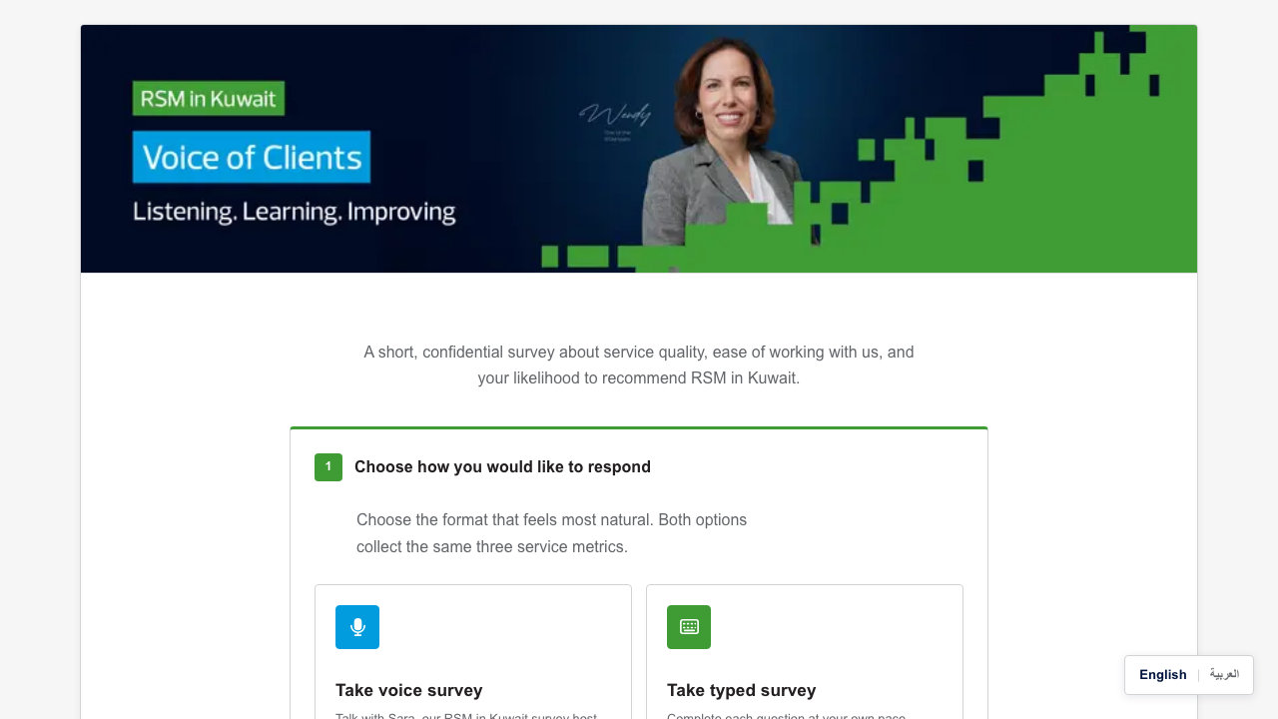
SURVEY
How a client starts
Version 1
Phase 1
Voice of Clients · Phase 1
5 / 11

Slide 6

SURVEY
How a score is given
Version 1
Phase 1
Drag the slider
1
2
3
4
5
The handle sat on a number before anyone had answered.
Voice of Clients · Phase 1
6 / 11

Slide 7


SURVEY
The host, and the typed steps
English or Arabic host
Who the feedback is from
Voice of Clients · Phase 1
7 / 11

Slide 8
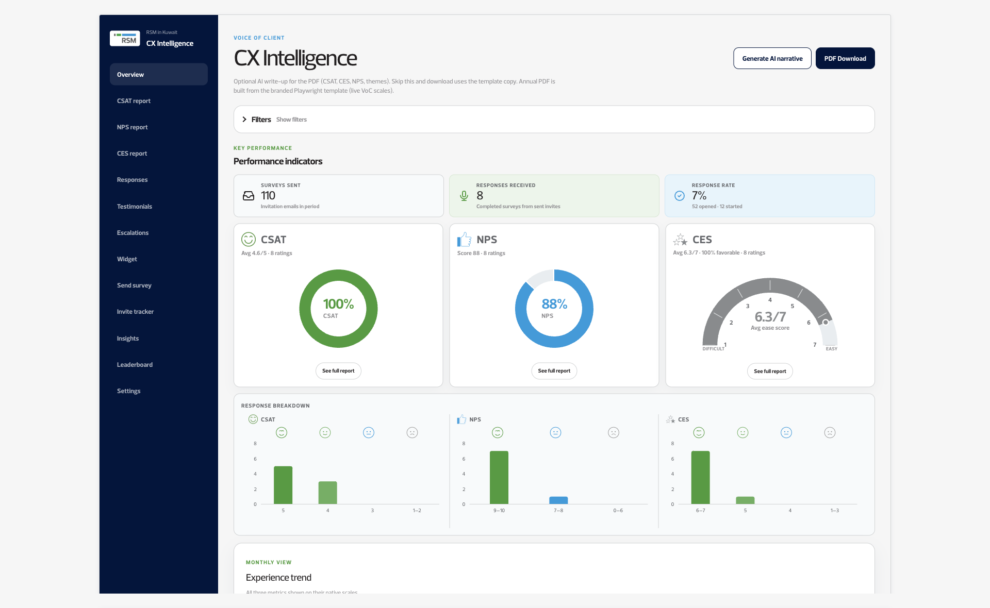
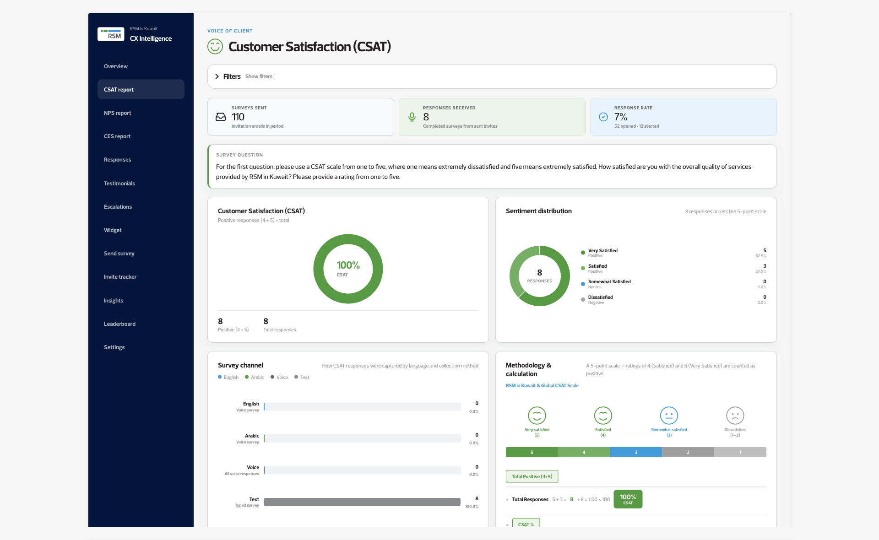
DASHBOARD
The view the team opens
Voice of Clients · Phase 1
8 / 11

Slide 9
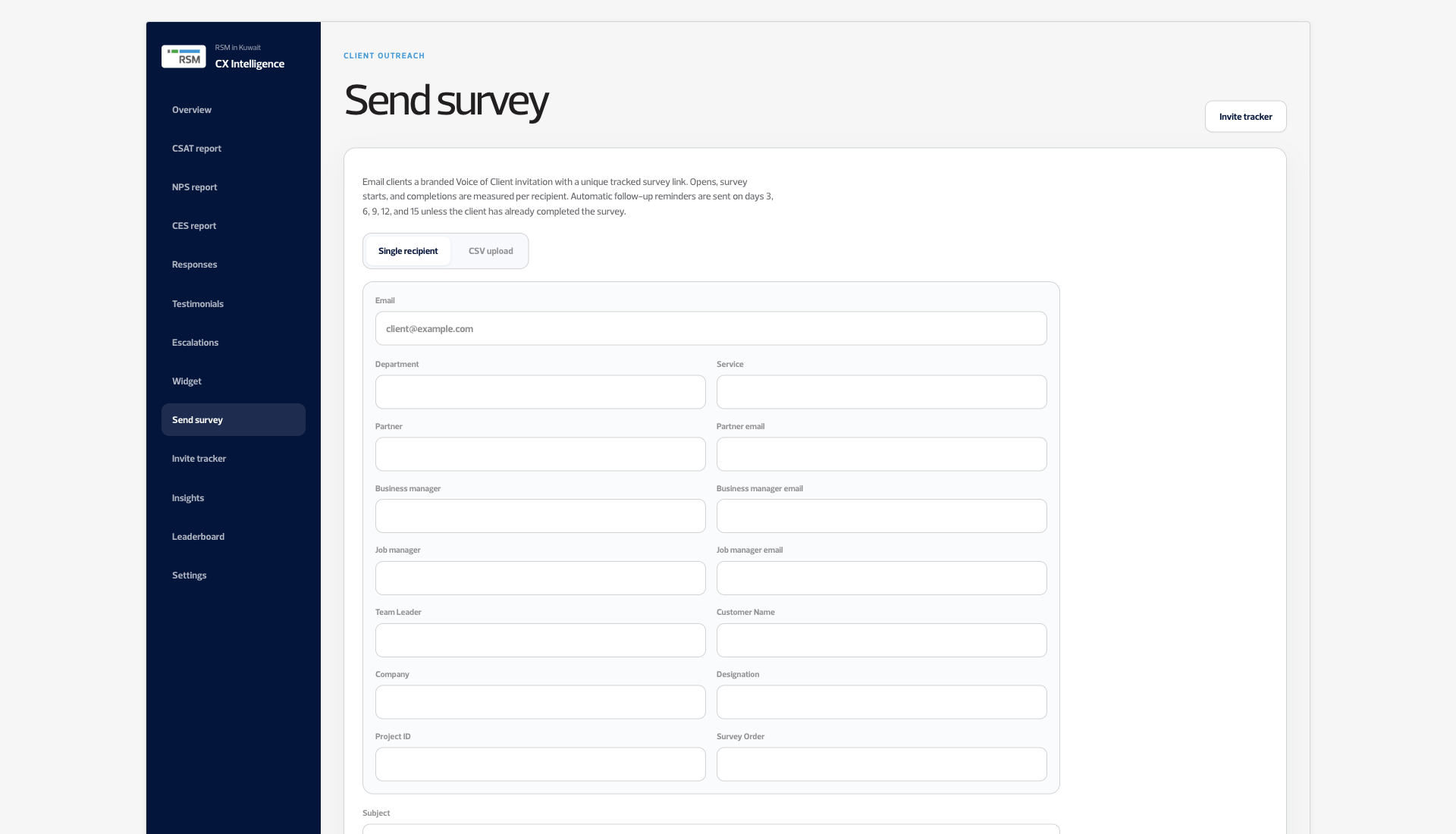

DASHBOARD
Send a survey, and see who leads
Voice of Clients · Phase 1
9 / 11

Slide 10
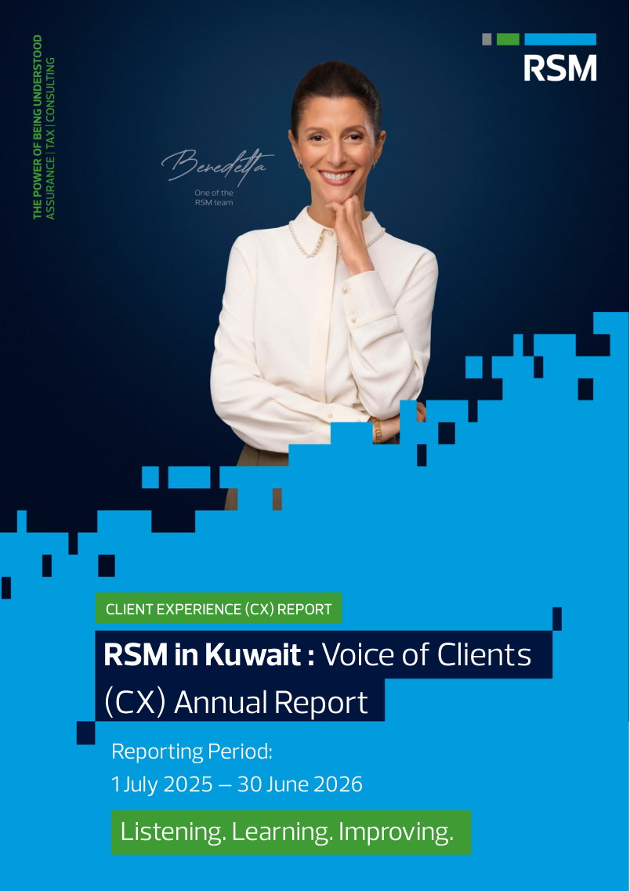
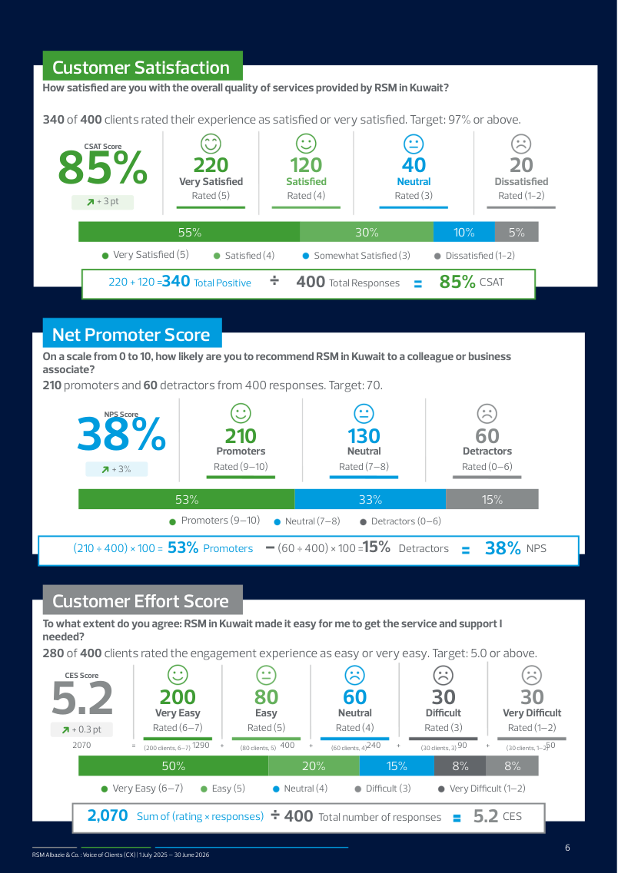

NEW IN PHASE 1
Reports you can hand over
Version 1 downloaded one PDF of the dashboard. Phase 1 builds these.
Annual
The year, with the year before
One metric, one page
Voice of Clients · Phase 1
10 / 11

Slide 11
PHASE 1
The tool is no longer
only a survey.
A client finishes in English or Arabic, by voice or by typing.
The team invites, reminds, and hands over a report.
A partner opens the dashboard and sees their own clients.
RSM in Kuwait · Voice of Clients

