Slide 1
RSM IN KUWAIT
Voice of Clients
Phase 1
What the platform could do at version 1,
and what it can do now.
Survey · Reports · Dashboard

Slide 2
PHASE 1
Six changes, not a checklist
Version 1 collected CSAT, CES and NPS. Everything after that sits in one of these six.
Survey
Voice
Outreach
New screens, and a number the client taps instead of dragging a slider.
The host can be sampled in English or Arabic before the call starts.
Tracked invites and reminders, then a thank-you that includes the scores.
Dashboard
Reports
Access
Filters, a ranking, and a page of its own for each of the three scores.
A branded file for the year, any dates, one metric, or one partner.
An email code at sign-in. A partner sees only their own clients.
Voice of Clients · Phase 1
2 / 11

Slide 3

SURVEY
How a client starts
They choose a short voice conversation, or the same three questions on screen.
Voice of Clients · Phase 1
3 / 11

Slide 4

SURVEY
A traditional scale
Each score is a button. The label above it says what that number means.
Voice of Clients · Phase 1
4 / 11

Slide 5

SURVEY
English or Arabic host
The client can hear a short sample of the host in either language before the call.
Voice of Clients · Phase 1
5 / 11

Slide 6

SURVEY
Who is answering
Name, company and role are one step, and an invite can fill them in already.
Voice of Clients · Phase 1
6 / 11

Slide 7
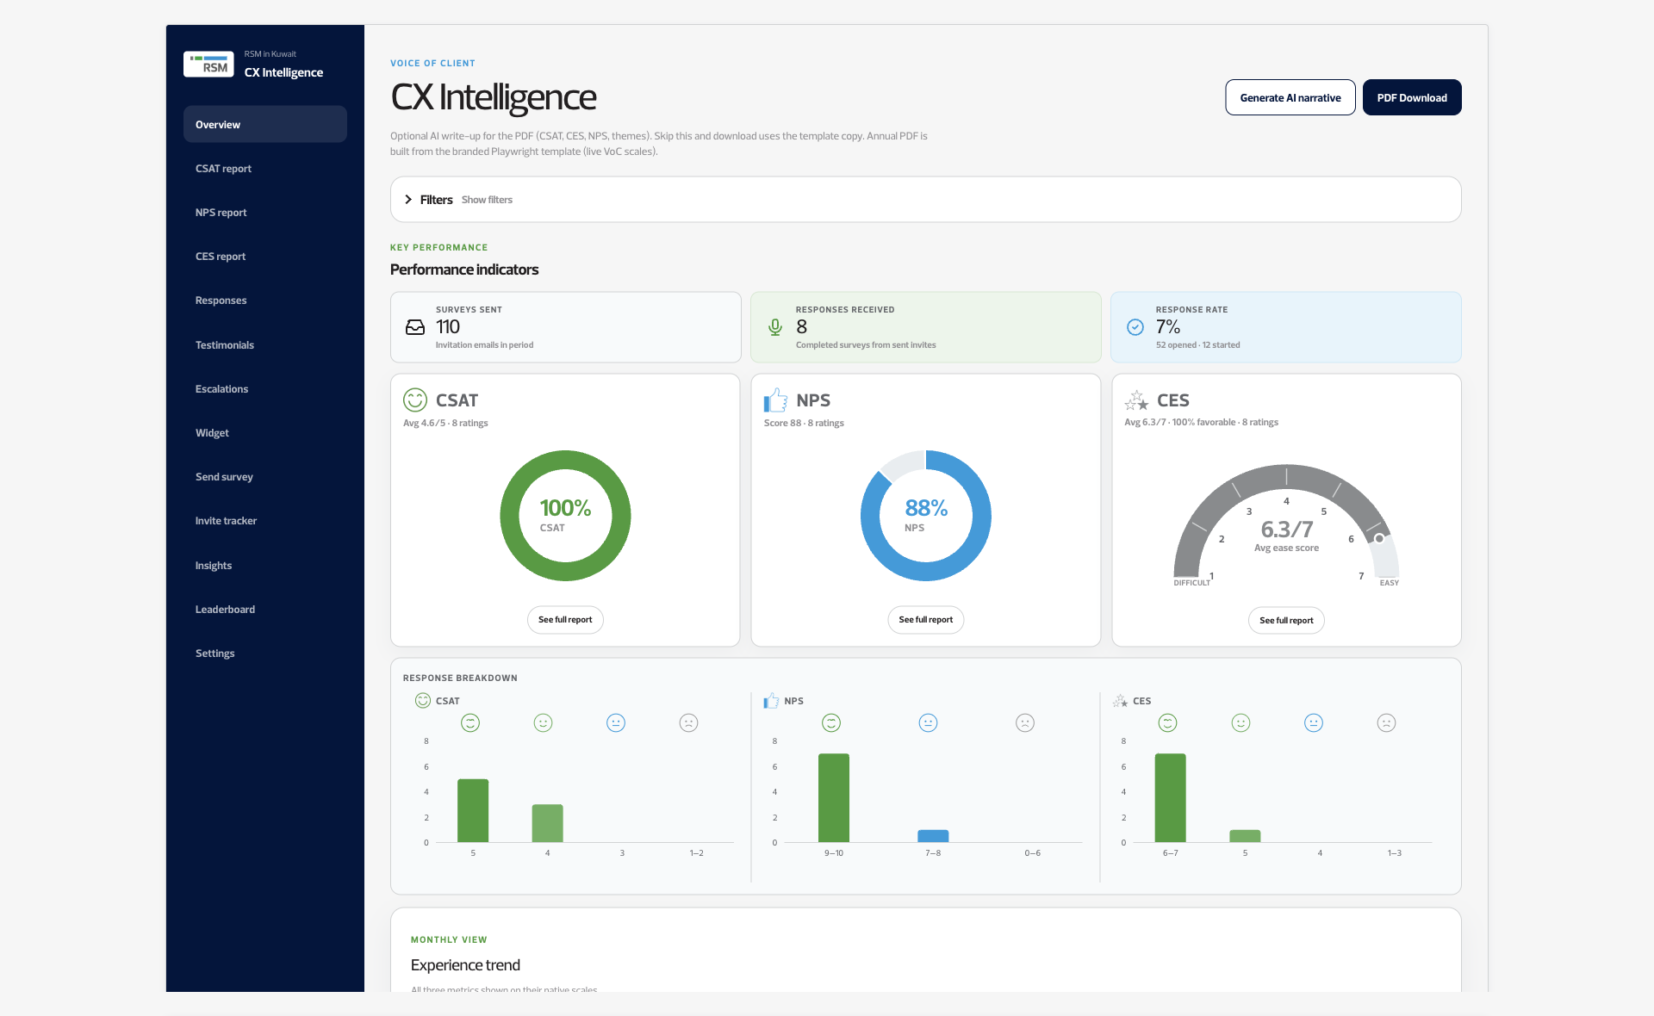
DASHBOARD
The view the team opens
Surveys sent, responses received and the response rate sit beside CSAT, NPS and CES.
Voice of Clients · Phase 1
7 / 11

Slide 8
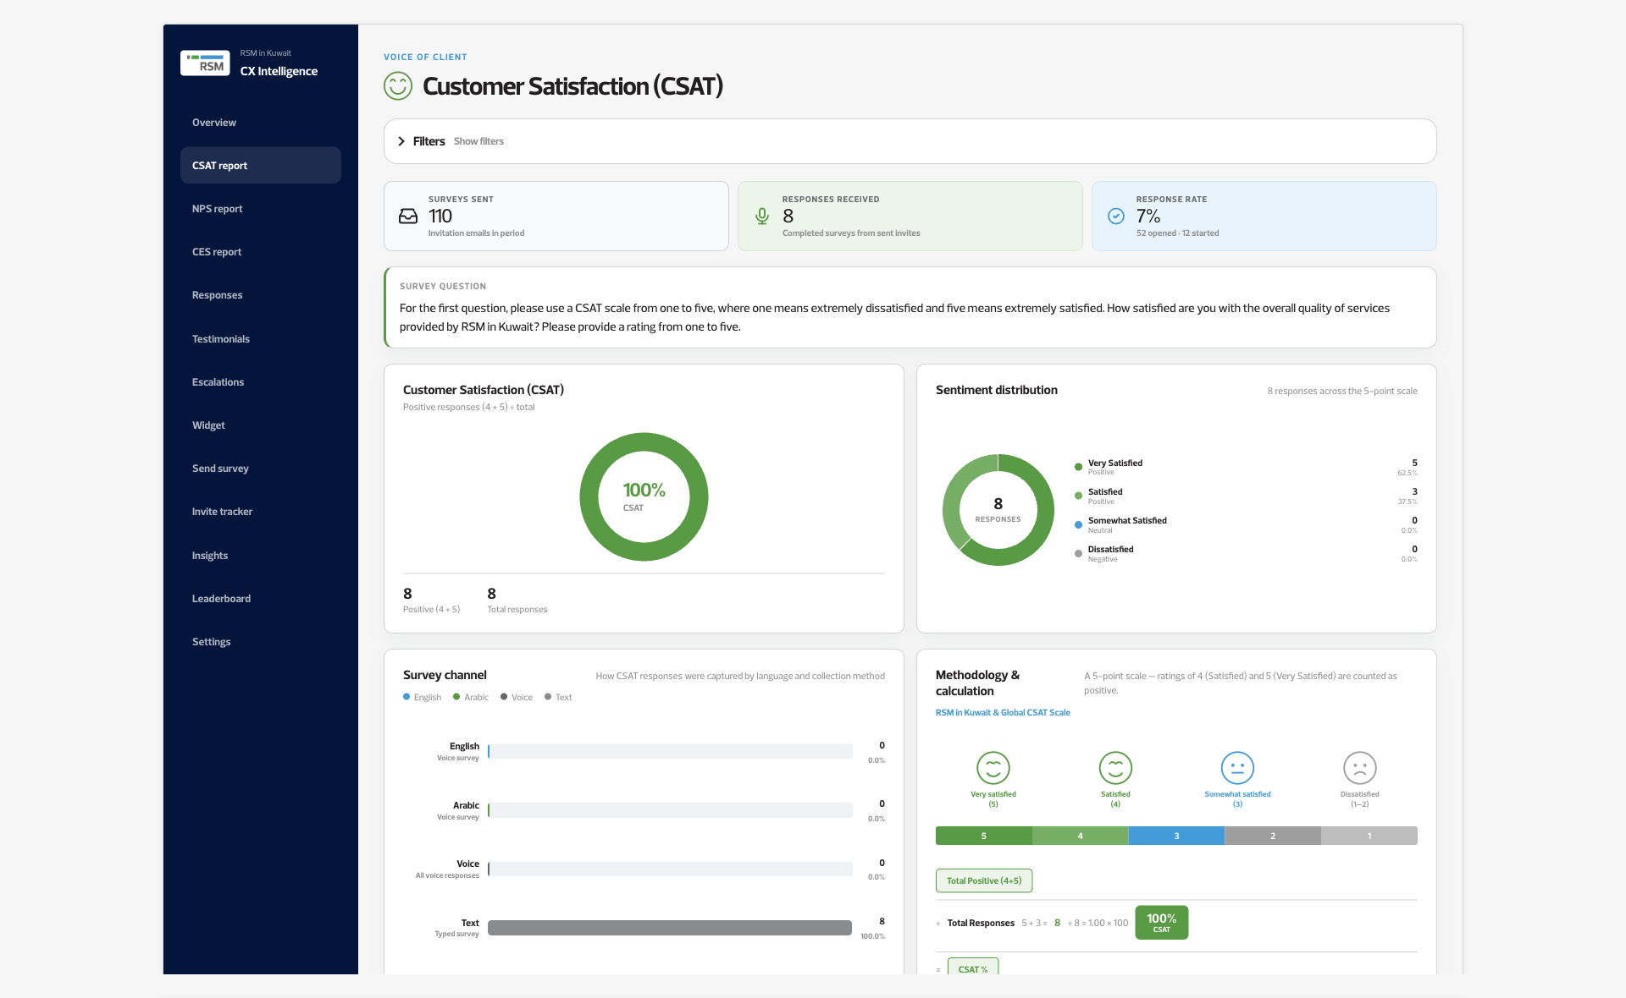
DASHBOARD
One metric, one page
CSAT, NPS and CES each open on their own page, using the same filters as the overview.
Voice of Clients · Phase 1
8 / 11

Slide 9
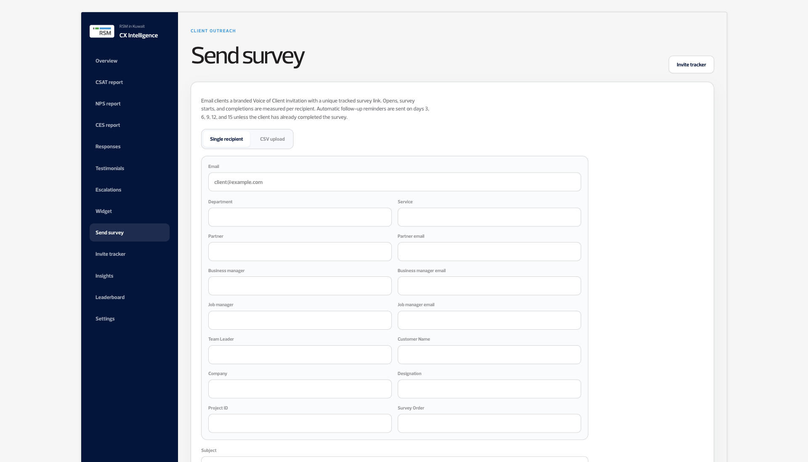
DASHBOARD
Sending the survey
An invite goes to one person or a list, and it names the service being rated.
Voice of Clients · Phase 1
9 / 11

Slide 10

DASHBOARD
Who is ahead
Departments, partners and managers are ranked when a group has enough responses.
Voice of Clients · Phase 1
10 / 11

Slide 11

REPORTS
The report that downloads
This is the CSAT page. NPS, CES, the annual report and a partner report are built the same way.
Voice of Clients · Phase 1
11 / 11

