Slide 1
RSM IN KUWAIT
Voice of Clients
Phase 1
What the platform could do at version 1,
and what it can do now.
Survey · Reports · Dashboard

Slide 2
VERSION 1 AND PHASE 1
What was already there, and what the survey gained
Feature
Version 1
Phase 1
Already in version 1
Voice survey and typed survey
✓
✓
CSAT, CES and NPS, with a comment
✓
✓
English and Arabic
✓
✓
An insight on every response
✓
✓
Ask Your Data
✓
✓
Public scores for the website
✓
✓
Signed-in overview of the results
✓
✓
Added to the survey
New opening and split-screen steps, on a phone as well as a desk
✓
A traditional scale: every score is a button, then a review of the answers
✓
Voice host you can preview, in English or Arabic
✓
Hold, end and live captions on the voice call
✓
An invite fills in the name, company and role
✓
A testimonial ask when the overall result is positive
✓
Added to outreach
Tracked invite to one person or a list, naming the service
✓
Opens, starts and completions
✓
Reminders you can stop, and turn back on
✓
Thank-you email with the three scores
✓
Team email copies the partner and managers, in Kuwait time
✓
A negative result raises a separate alert
✓
One overall result: Positive, Neutral or Negative
✓
CRM can send the invite and receive the scores
✓
A private page of that client’s scores
✓
Directory of departments, services and staff
✓
If the same person replies again in the quarter, the latest score counts
✓
Voice of Clients · Phase 1
2 / 12

Slide 3
VERSION 1 AND PHASE 1
What the dashboard and the reports gained
Feature
Version 1
Phase 1
Added to the dashboard
Email code on every sign-in
✓
Roles for admin, CX and surveyor, plus roles you create
✓
A partner sees only their own clients
✓
Change your own password
✓
Audit log
✓
Filter by period, company, department, service, partner and manager
✓
Separate CSAT, NPS and CES pages
✓
Leaderboard by department, partner and manager
✓
Excel and CSV, from responses and from the invite tracker
✓
Exclude or delete a response
✓
Read the voice transcript beside the scores
✓
Testimonials library
✓
Escalations board for low scores
✓
Ask Your Data can draw a chart, and can answer invite questions
✓
A warning when voice credits run low
✓
Response rate beside surveys sent and received
✓
Added to reports and the website
Annual report, with a written narrative and the year before
✓
A report for the exact dates you choose
✓
One page each for CSAT, NPS and CES, using the same filters
✓
A three-page report for one partner
✓
Weekly, monthly and quarterly packs by email
✓
A reviews showcase on the website. Name and company only
✓
Voice of Clients · Phase 1
3 / 12

Slide 4

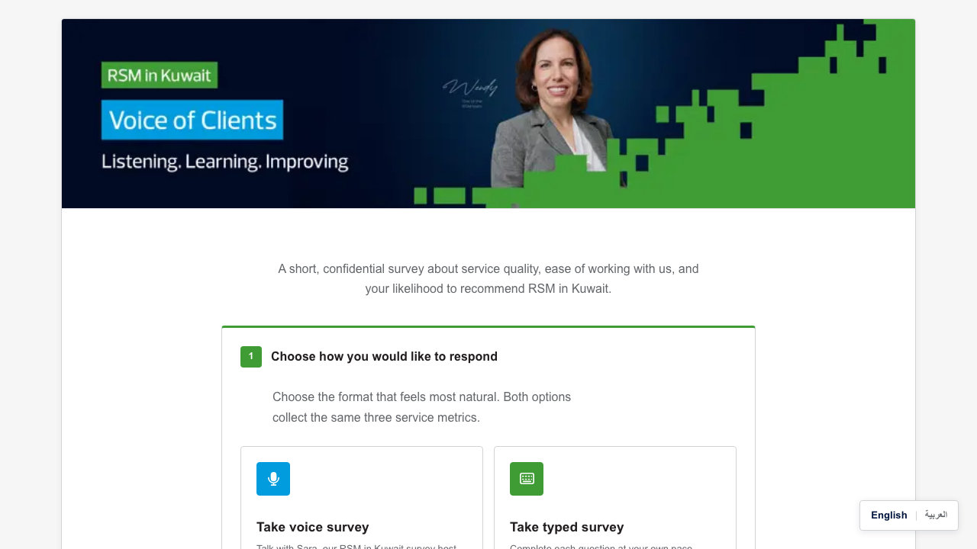
NEW IN PHASE 1
How a client starts
Version 1 on the left. Phase 1 on the right. Same choice of voice or typed, on a new screen.
Version 1
Phase 1
Voice of Clients · Phase 1
4 / 12

Slide 5

NEW IN PHASE 1
A traditional scale
Each score is a button. The label above it says what that number means.
Voice of Clients · Phase 1
5 / 12

Slide 6

NEW IN PHASE 1
English or Arabic host
The client can hear a short sample of the host in either language before the call.
Voice of Clients · Phase 1
6 / 12

Slide 7

NEW IN PHASE 1
Who is answering
Name, company and role are one step, and an invite can fill them in already.
Voice of Clients · Phase 1
7 / 12

Slide 8
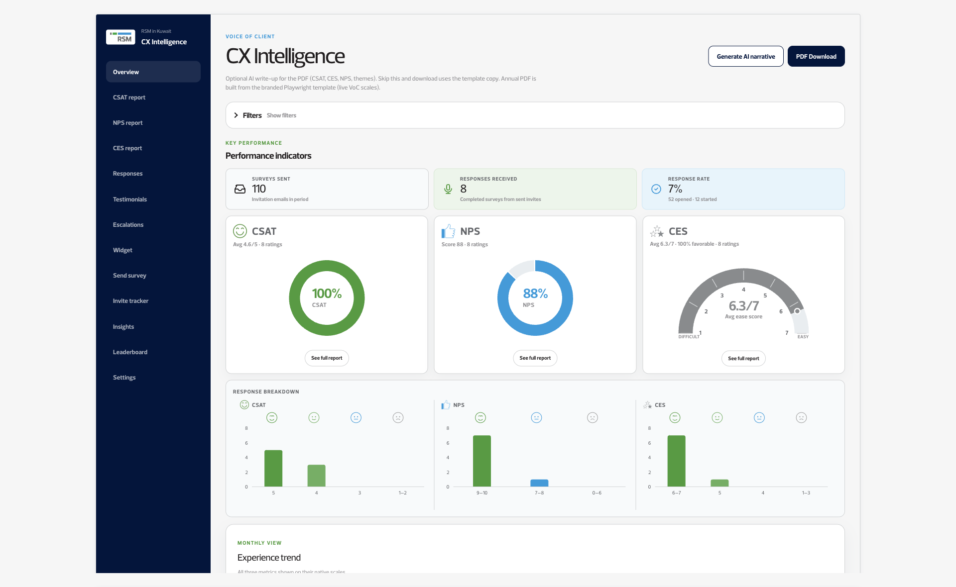
NEW IN PHASE 1
The view the team opens
Surveys sent, responses received and the response rate sit beside CSAT, NPS and CES.
Voice of Clients · Phase 1
8 / 12

Slide 9
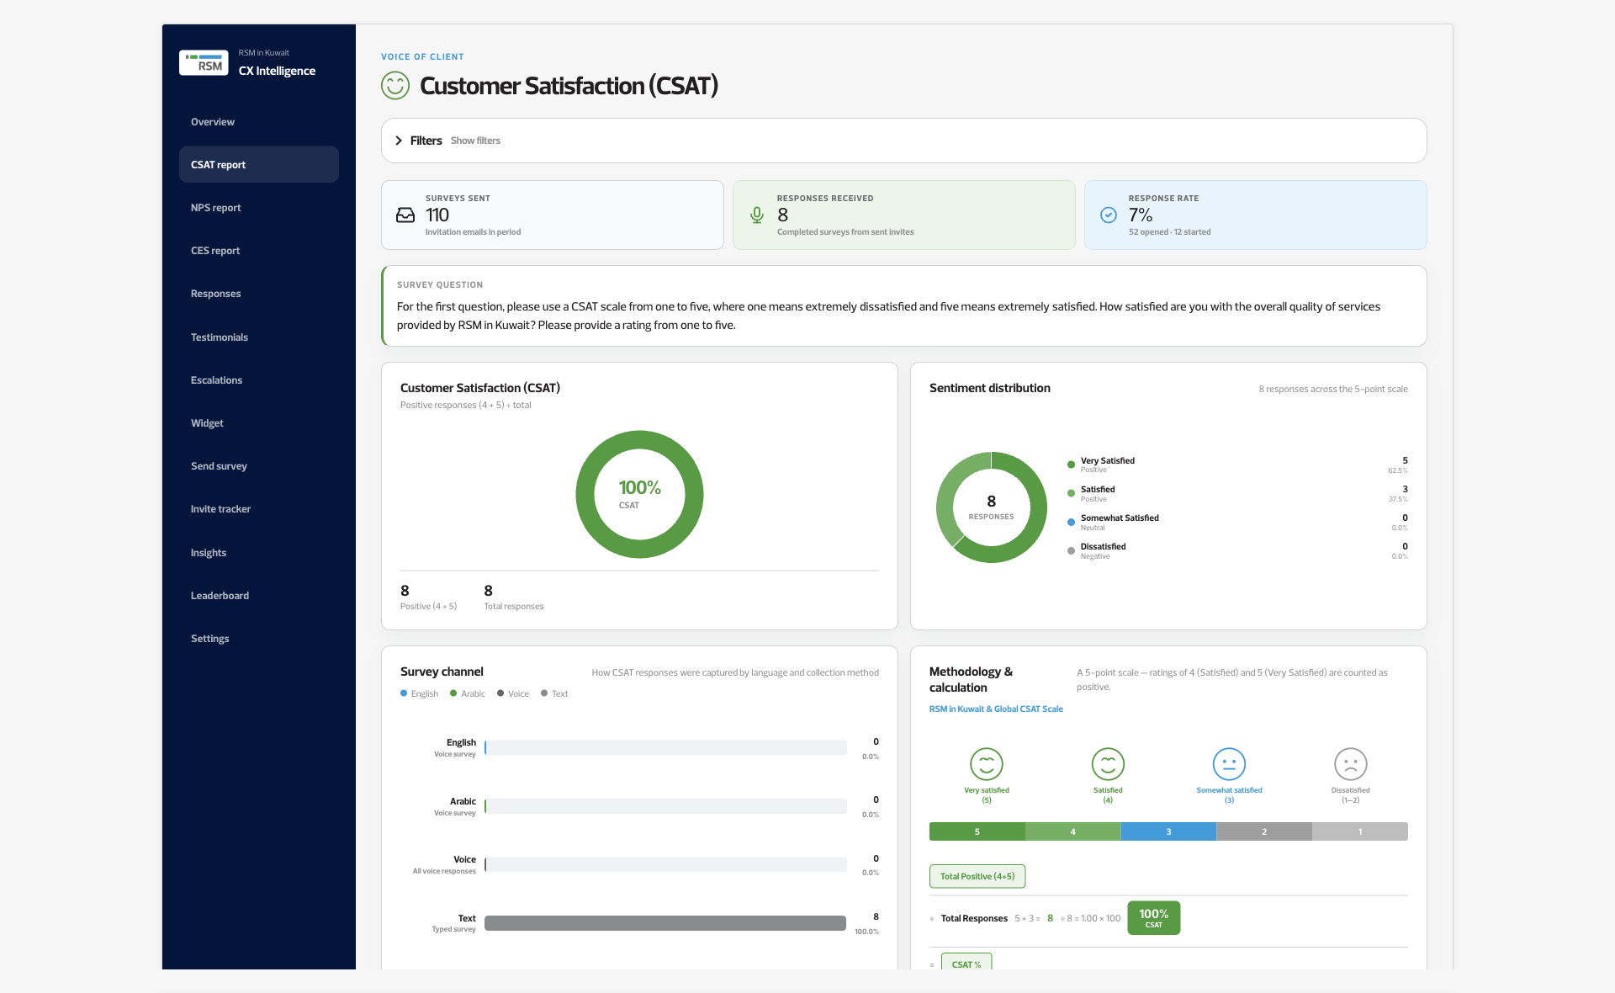
NEW IN PHASE 1
One metric, one page
CSAT, NPS and CES each open on their own page, using the same filters as the overview.
Voice of Clients · Phase 1
9 / 12

Slide 10
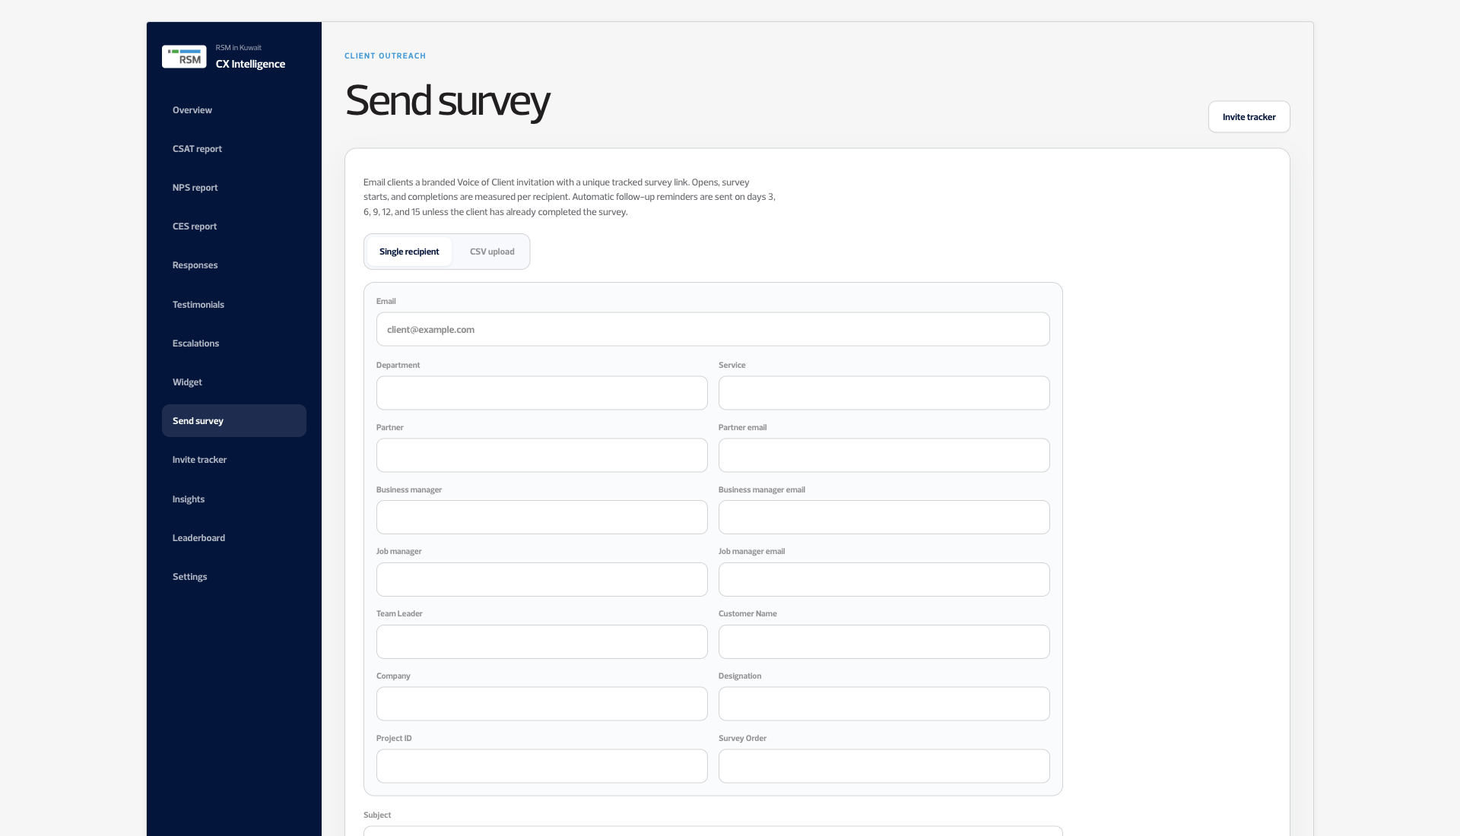
NEW IN PHASE 1
Sending the survey
An invite goes to one person or a list, and it names the service being rated.
Voice of Clients · Phase 1
10 / 12

Slide 11

NEW IN PHASE 1
Who is ahead
Departments, partners and managers are ranked when a group has enough responses.
Voice of Clients · Phase 1
11 / 12

Slide 12

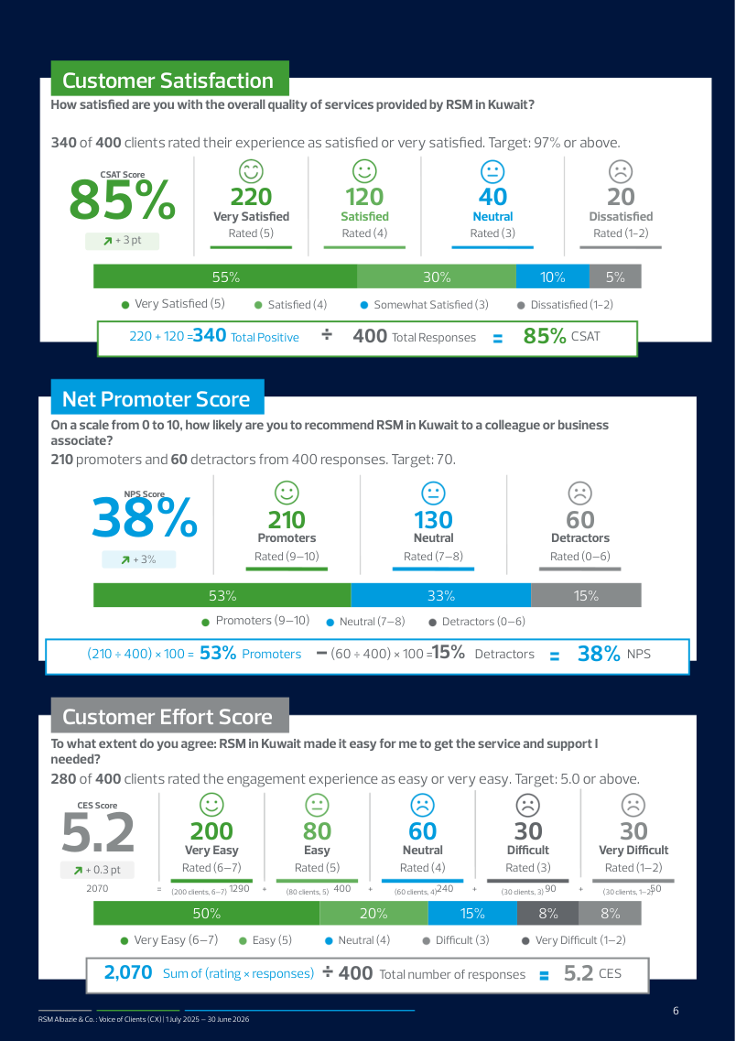

NEW IN PHASE 1
Reports you can hand over
Version 1 downloaded one PDF of the dashboard. Phase 1 builds these.
Annual
The year, with the year before
One metric, one page
Voice of Clients · Phase 1
12 / 12

