Slide 1
RSM IN KUWAIT
Voice of Clients
Phase 1
What the platform could do at version 1,
and what it can do now.
Survey · Reports · Dashboard

Slide 2
PHASE 1
Six changes, not a checklist
Version 1 collected CSAT, CES and NPS. Everything after that sits in one of these six.
Survey
Voice
Outreach
New screens, and a number the client taps instead of dragging a slider.
The host can be sampled in English or Arabic before the call starts.
Tracked invites and reminders, then a thank-you that includes the scores.
Dashboard
Reports
Access
Filters, a ranking, and a page of its own for each of the three scores.
A branded file for the year, any dates, one metric, or one partner.
An email code at sign-in. A partner sees only their own clients.
Voice of Clients · Phase 1
2 / 22

Slide 3
VERSION 1 AND PHASE 1
What was already there, and what the survey gained
Feature
Version 1
Phase 1
Already in version 1
Voice survey and typed survey
✓
✓
CSAT, CES and NPS, with a comment
✓
✓
English and Arabic
✓
✓
An insight on every response
✓
✓
Ask Your Data
✓
✓
Public scores for the website
✓
✓
Signed-in overview of the results
✓
✓
Added to the survey
New opening and split-screen steps, on a phone as well as a desk
✓
A traditional scale: every score is a button, then a review of the answers
✓
Voice host you can preview, in English or Arabic
✓
Hold, end and live captions on the voice call
✓
An invite fills in the name, company and role
✓
A testimonial ask when the overall result is positive
✓
Added to outreach
Tracked invite to one person or a list, naming the service
✓
Opens, starts and completions
✓
Reminders you can stop, and turn back on
✓
Thank-you email with the three scores
✓
Team email copies the partner and managers, in Kuwait time
✓
A negative result raises a separate alert
✓
One overall result: Positive, Neutral or Negative
✓
CRM can send the invite and receive the scores
✓
A private page of that client’s scores
✓
Directory of departments, services and staff
✓
If the same person replies again in the quarter, the latest score counts
✓
Voice of Clients · Phase 1
3 / 22

Slide 4
VERSION 1 AND PHASE 1
What the dashboard and the reports gained
Feature
Version 1
Phase 1
Added to the dashboard
Email code on every sign-in
✓
Roles for admin, CX and surveyor, plus roles you create
✓
A partner sees only their own clients
✓
Change your own password
✓
Audit log
✓
Filter by period, company, department, service, partner and manager
✓
Separate CSAT, NPS and CES pages
✓
Leaderboard by department, partner and manager
✓
Excel and CSV, from responses and from the invite tracker
✓
Exclude or delete a response
✓
Read the voice transcript beside the scores
✓
Testimonials library
✓
Escalations board for low scores
✓
Ask Your Data can draw a chart, and can answer invite questions
✓
A warning when voice credits run low
✓
Response rate beside surveys sent and received
✓
Added to reports and the website
Annual report, with a written narrative and the year before
✓
A report for the exact dates you choose
✓
One page each for CSAT, NPS and CES, using the same filters
✓
A three-page report for one partner
✓
Weekly, monthly and quarterly packs by email
✓
A reviews showcase on the website. Name and company only
✓
Voice of Clients · Phase 1
4 / 22

Slide 5

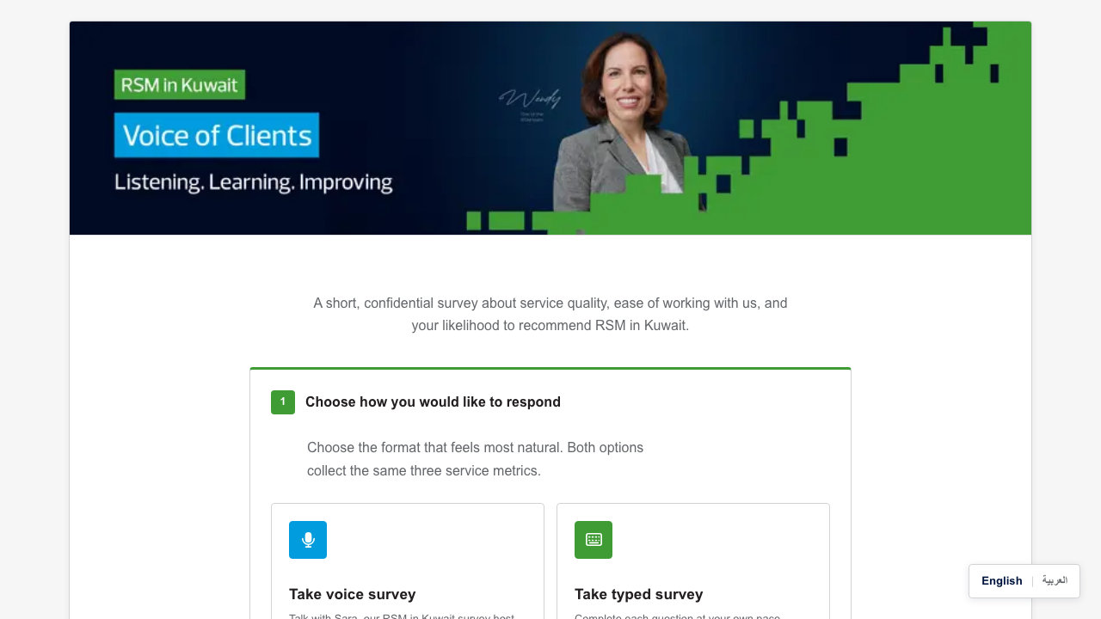
NEW IN PHASE 1
How a client starts
Version 1 on the left. Phase 1 on the right. Same choice of voice or typed, on a new screen.
Version 1
Phase 1
Voice of Clients · Phase 1
5 / 22

Slide 6
NEW IN PHASE 1
The survey a client opens
This is the page they land on. Voice or typed, both ask the same three questions.
Voice of Clients · Phase 1
6 / 22

Slide 7

NEW IN PHASE 1
A traditional scale
Each score is a button. The label above it says what that number means.
Voice of Clients · Phase 1
7 / 22

Slide 8

NEW IN PHASE 1
English or Arabic host
The client can hear a short sample of the host in either language before the call.
Voice of Clients · Phase 1
8 / 22

Slide 9

NEW IN PHASE 1
Who is answering
Name, company and role are one step, and an invite can fill them in already.
Voice of Clients · Phase 1
9 / 22

Slide 10
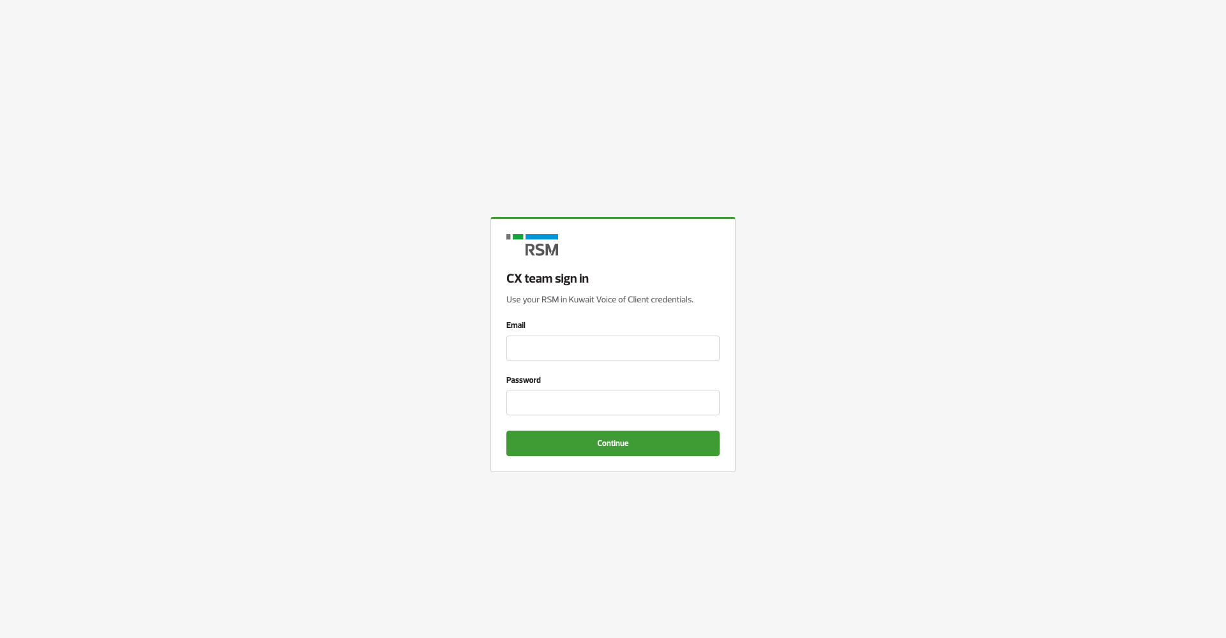
NEW IN PHASE 1
Sign in, then an email code
Password is the first step. The next step is a code sent to that person’s email.
Voice of Clients · Phase 1
10 / 22

Slide 11
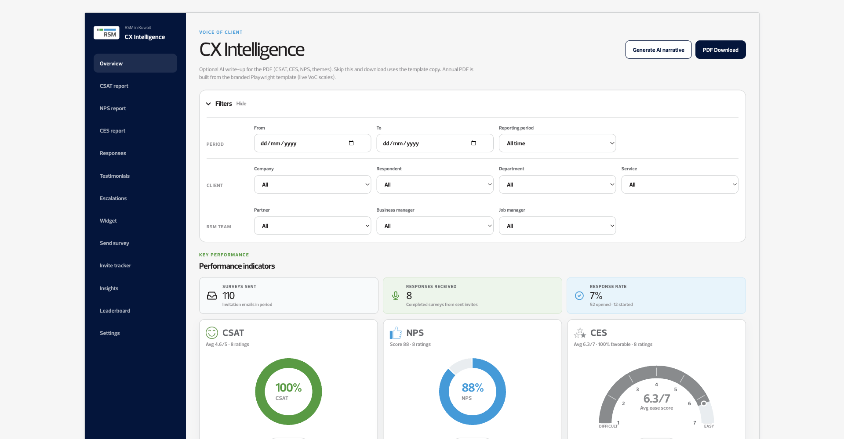
NEW IN PHASE 1
Filters on the overview
Dates, company, department, service, partner and manager narrow the same scores.
Voice of Clients · Phase 1
11 / 22

Slide 12
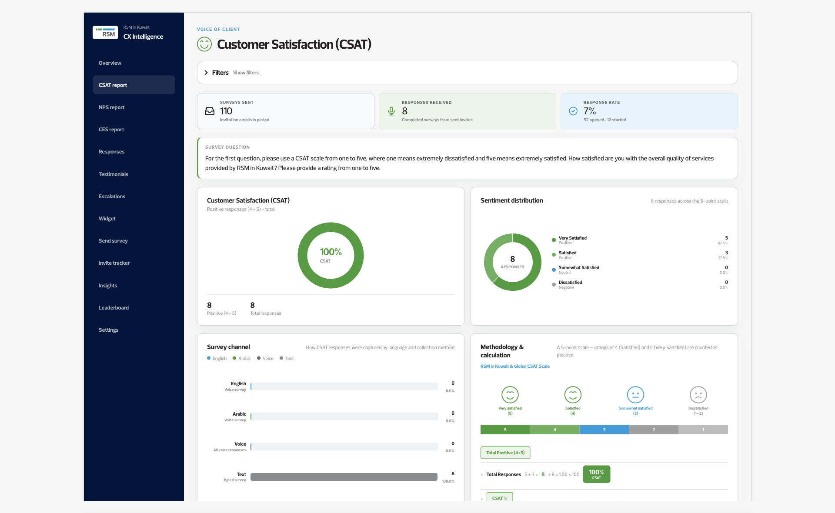
NEW IN PHASE 1
A page for CSAT
CSAT opens on its own, with the channel mix and how the score is calculated.
Voice of Clients · Phase 1
12 / 22

Slide 13
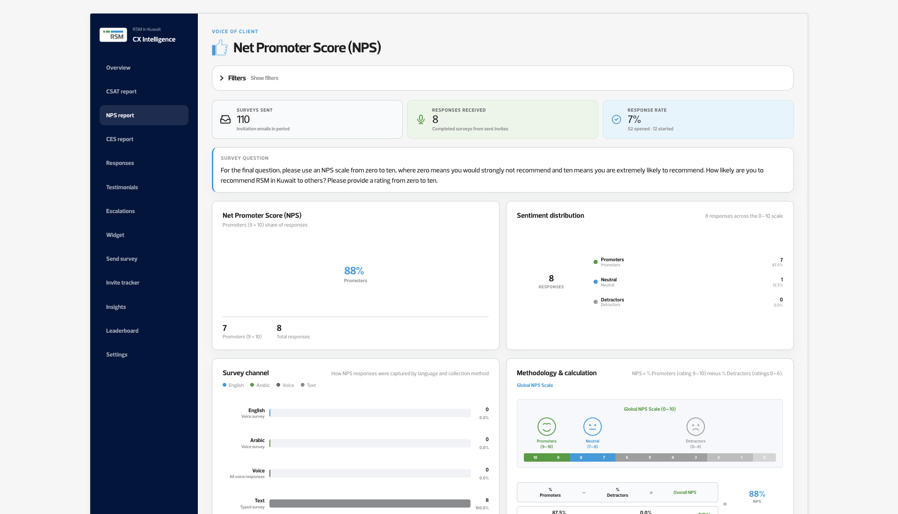
NEW IN PHASE 1
A page for NPS
NPS has the same kind of page. CES does too.
Voice of Clients · Phase 1
13 / 22

Slide 14
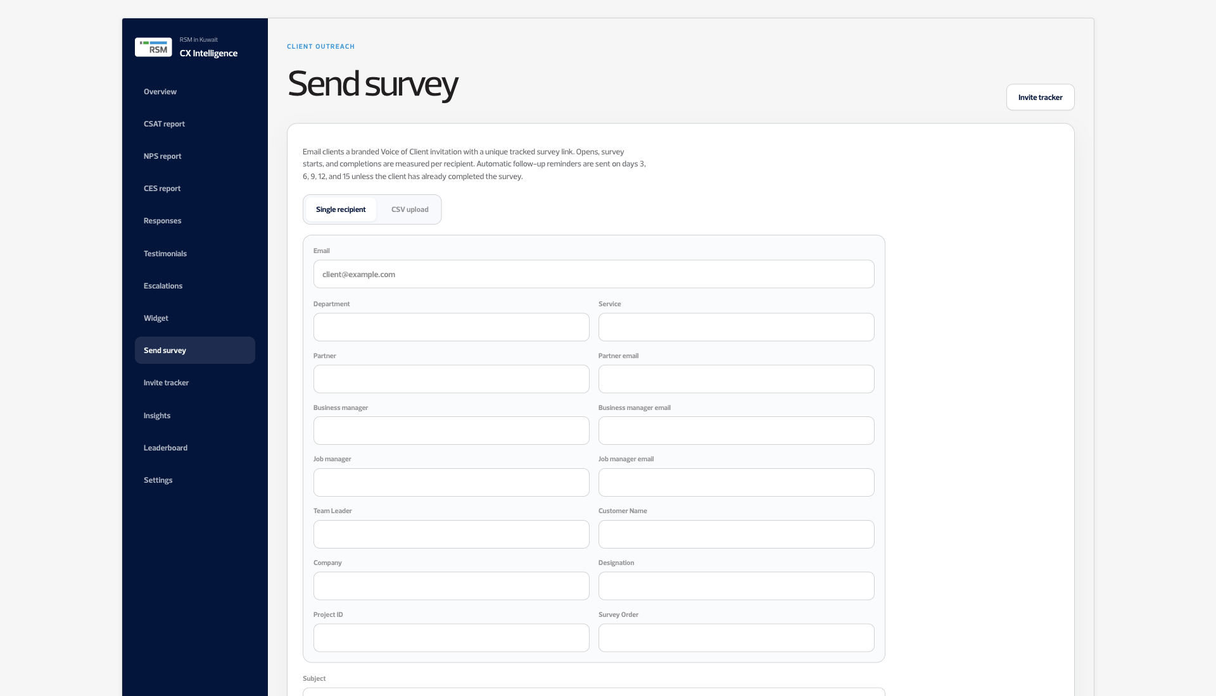
NEW IN PHASE 1
Sending the survey
An invite goes to one person or a list, and it names the service being rated.
Voice of Clients · Phase 1
14 / 22

Slide 15
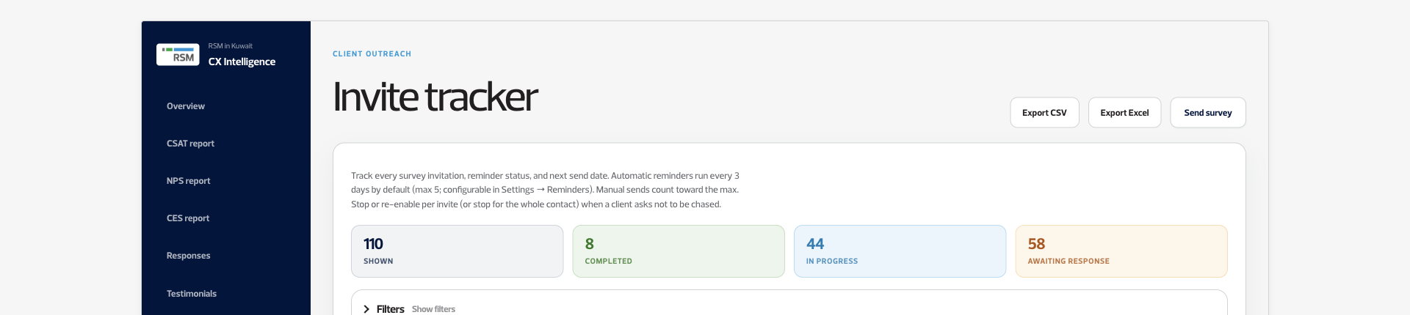
NEW IN PHASE 1
Who has replied
Sent, completed, still in progress, and still waiting, with Excel export on the same page.
Voice of Clients · Phase 1
15 / 22

Slide 16
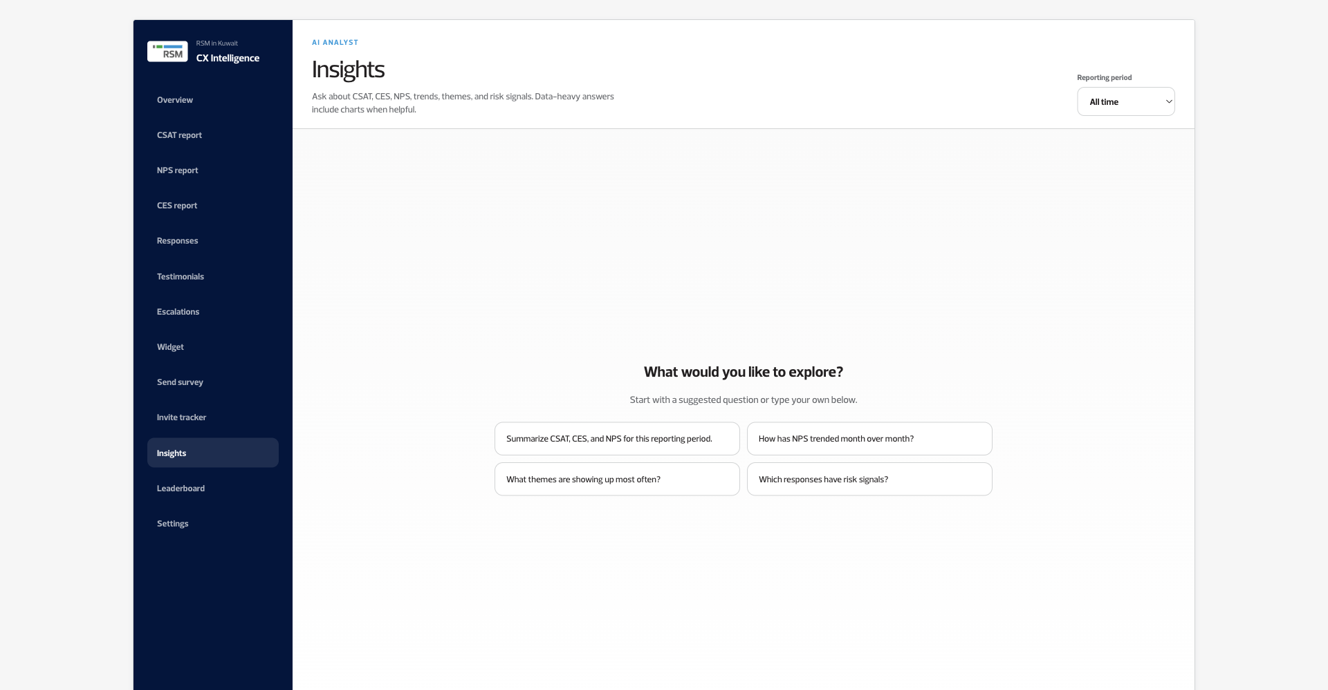
NEW IN PHASE 1
Ask Your Data
Ask about the scores, the themes, or who has not replied. A chart can come back with the answer.
Voice of Clients · Phase 1
16 / 22

Slide 17

NEW IN PHASE 1
Who is ahead
Departments, partners and managers are ranked when a group has enough responses.
Voice of Clients · Phase 1
17 / 22

Slide 18
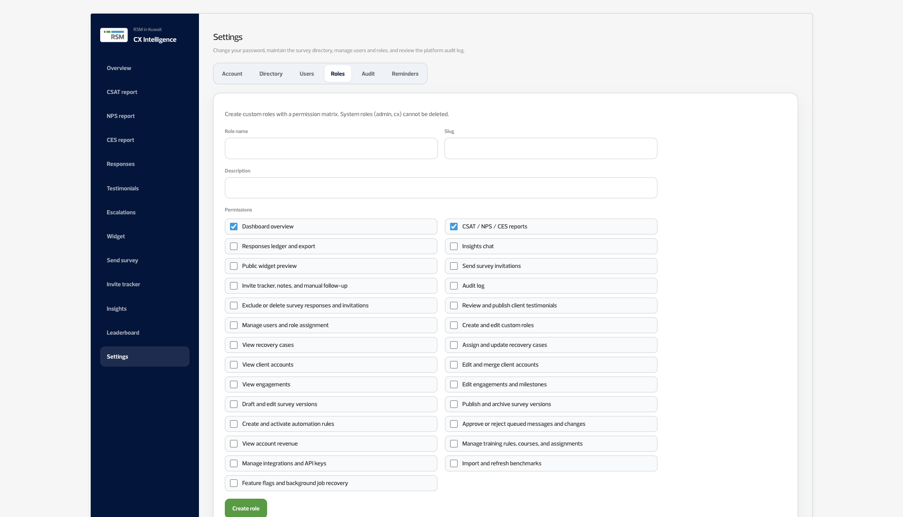
NEW IN PHASE 1
Roles you define
A new role gets only the ticks you choose. A partner can be limited to their own clients.
Voice of Clients · Phase 1
18 / 22

Slide 19
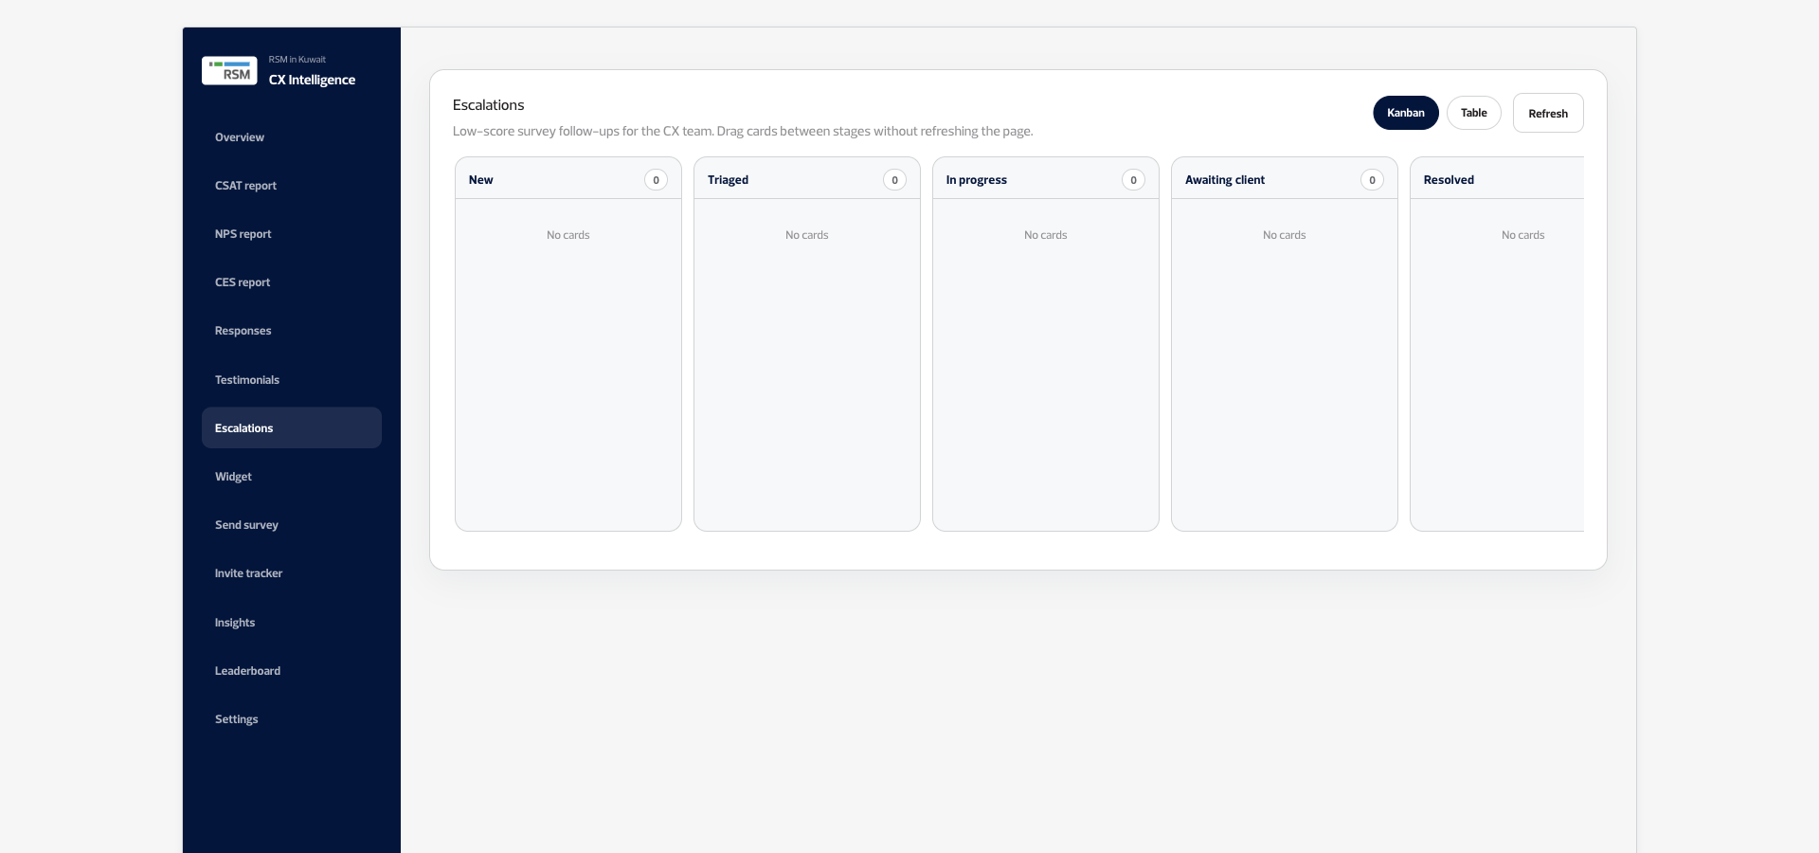
NEW IN PHASE 1
Low scores, followed up
A needs-attention survey can move across the board, from new to resolved.
Voice of Clients · Phase 1
19 / 22

Slide 20
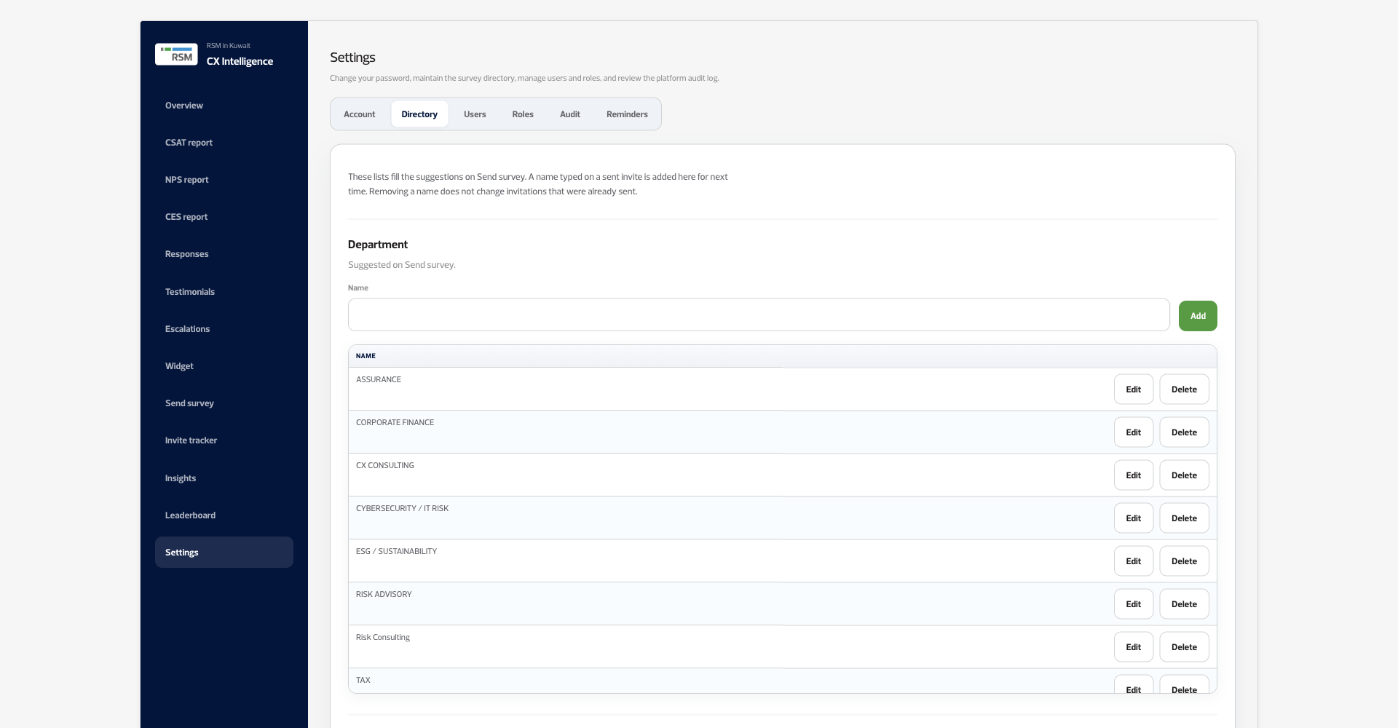
NEW IN PHASE 1
Staff and services, remembered
Departments, services and people are saved here, and the next invite can reuse them.
Voice of Clients · Phase 1
20 / 22

Slide 21
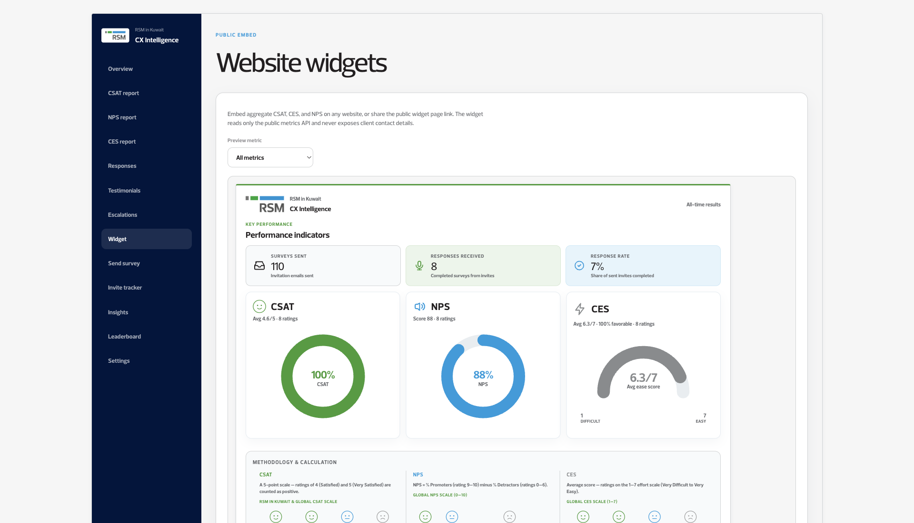
NEW IN PHASE 1
Scores on the website
CSAT, NPS and CES can be embedded. Names, emails and phone numbers stay off this page.
Voice of Clients · Phase 1
21 / 22

Slide 22

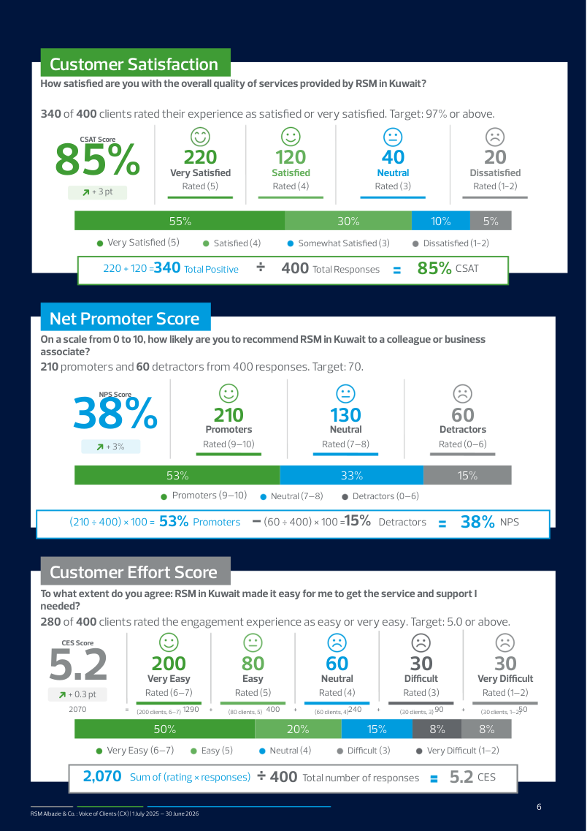

NEW IN PHASE 1
Reports you can hand over
Version 1 downloaded one PDF of the dashboard. Phase 1 builds these.
Annual
The year, with the year before
One metric, one page
Voice of Clients · Phase 1
22 / 22

