Slide 1
RSM IN KUWAIT
Voice of Clients
Phase 1
What the platform could do at version 1,
and what it can do now.
Survey · Reports · Dashboard

Slide 2
PHASE 1
What actually changed
Version 1 already had the survey, the three scores, the report pages, and the score widget.
Survey
Voice
Outreach
The opening, the typed steps and the rating scale were redesigned.
The host step now plays a short sample in English or Arabic.
A positive result can ask for a testimonial. A negative result alerts the team.
Dashboard
Reports
Access
A leaderboard, an escalations board, and roles that limit what each person sees.
Branded files for the year, any dates, one metric, or one partner.
An email code at sign-in. A partner sees only their own clients.
Voice of Clients · Phase 1
2 / 14

Slide 3
VERSION 1 AND PHASE 1
What was already there, and what the survey gained
Feature
Version 1
Phase 1
Already in version 1
Voice survey and typed survey
✓
✓
CSAT, CES and NPS, with a comment
✓
✓
English and Arabic
✓
✓
An insight on every response
✓
✓
Ask Your Data, including charts
✓
✓
Public score widget
✓
✓
Signed-in overview
✓
✓
CSAT, NPS and CES report pages
✓
✓
Tracked invites, a list import, and the invite tracker
✓
✓
A thank-you email after a completed invite
✓
✓
CRM can send the invite
✓
✓
Changed or added on the survey
The opening screen and the typed steps were redesigned
✓
A traditional scale: every score is a button, then a review of the answers
✓
The voice host can be sampled before the call
✓
Hold, end and live captions on the voice call
✓
An invite fills in the name, company and role
✓
A testimonial ask when the overall result is positive
✓
Added to outreach
Reminders can be stopped and turned back on
✓
The invite email names the service
✓
Team email copies the partner and managers, in Kuwait time
✓
A negative result raises a separate alert
✓
Positive, Neutral or Negative from the combined score
✓
A private page of that client’s scores
✓
Directory of departments, services and staff
✓
If the same person replies again in the quarter, the latest score counts
✓
Voice of Clients · Phase 1
3 / 14

Slide 4
VERSION 1 AND PHASE 1
What the dashboard and the reports gained
Feature
Version 1
Phase 1
Added to the dashboard
Email code on every sign-in
✓
Roles for admin, CX and surveyor, plus roles you create
✓
A partner sees only their own clients
✓
Change your own password
✓
Audit log
✓
Service and manager filters, as well as department and partner
✓
Leaderboard by department, partner and manager
✓
Excel export of responses and of the invite tracker
✓
Exclude or delete a response
✓
Read the voice transcript beside the scores
✓
Testimonials library
✓
Escalations board for low scores
✓
Ask Your Data can answer invite questions
✓
A warning when voice credits run low
✓
Added to reports and the website
Annual report, with a written narrative and the year before
✓
A report for the exact dates you choose
✓
A one-page PDF for CSAT, NPS or CES
✓
A three-page report for one partner
✓
Weekly, monthly and quarterly packs by email
✓
A reviews showcase on the website. Name and company only
✓
Voice of Clients · Phase 1
4 / 14

Slide 5

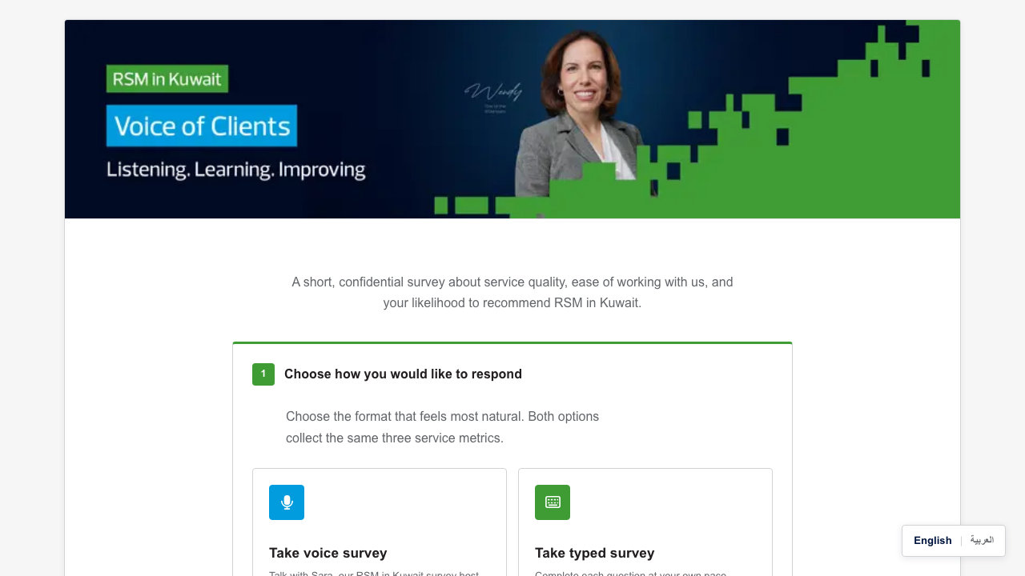
CHANGED IN PHASE 1
How a client starts
Version 1 on the left. Phase 1 on the right. Same choice of voice or typed. The screen was redesigned.
Version 1
Phase 1
Voice of Clients · Phase 1
5 / 14

Slide 6
CHANGED IN PHASE 1
The survey a client opens
This screen was redesigned. Choosing voice or typed was already there.
Voice of Clients · Phase 1
6 / 14

Slide 7

CHANGED IN PHASE 1
A traditional scale
The slider was replaced. Each score is a button, with its meaning written above it.
Voice of Clients · Phase 1
7 / 14

Slide 8

CHANGED IN PHASE 1
The voice host
The host step was redesigned. The client can play a short sample in English or Arabic.
Voice of Clients · Phase 1
8 / 14

Slide 9

CHANGED IN PHASE 1
The typed steps
These steps were rebuilt as a split screen. An invite can fill the fields in.
Voice of Clients · Phase 1
9 / 14

Slide 10

NEW IN PHASE 1
Who is ahead
Departments, partners and managers can be ranked. This page was not in version 1.
Voice of Clients · Phase 1
10 / 14

Slide 11
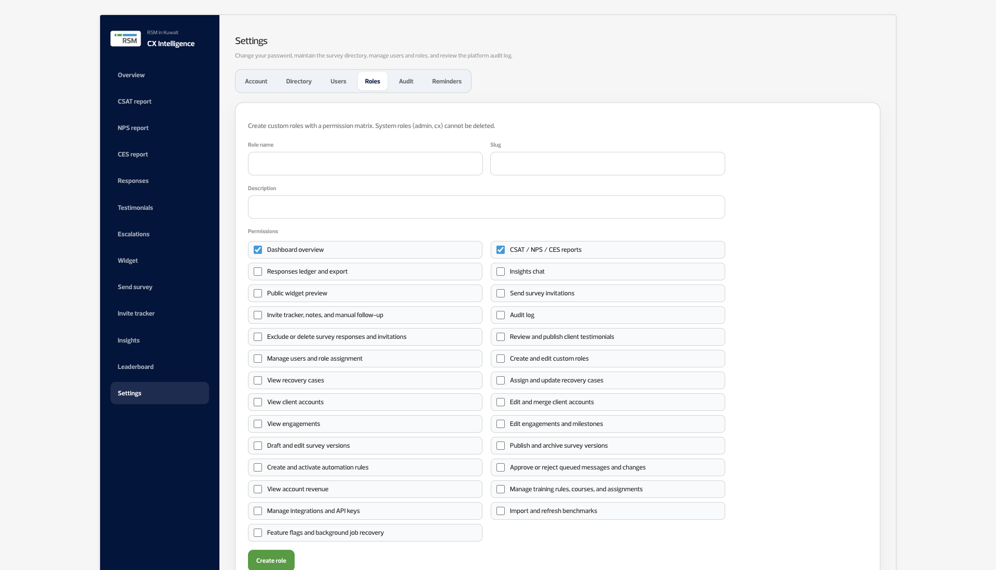
NEW IN PHASE 1
Roles you define
A role gets only the ticks you choose. A partner can be limited to their own clients.
Voice of Clients · Phase 1
11 / 14

Slide 12
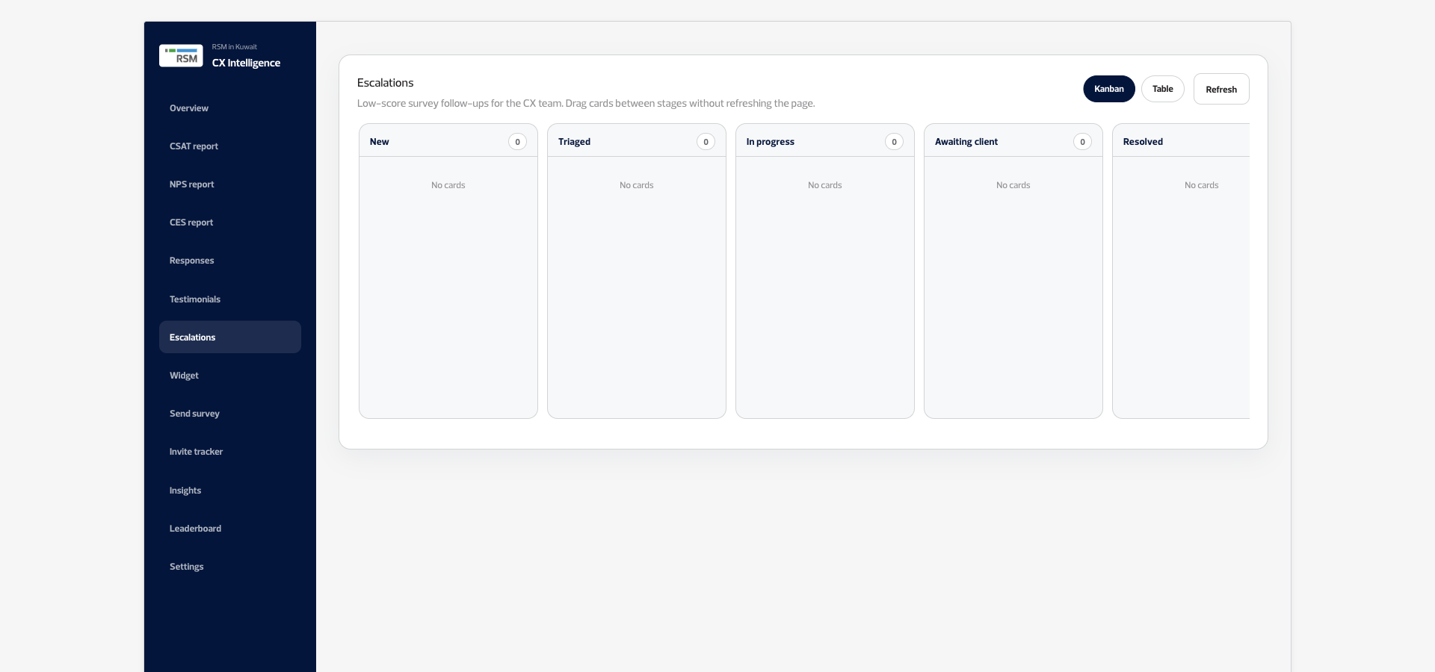
NEW IN PHASE 1
Low scores, followed up
A needs-attention survey can move across a board, from new to resolved.
Voice of Clients · Phase 1
12 / 14

Slide 13
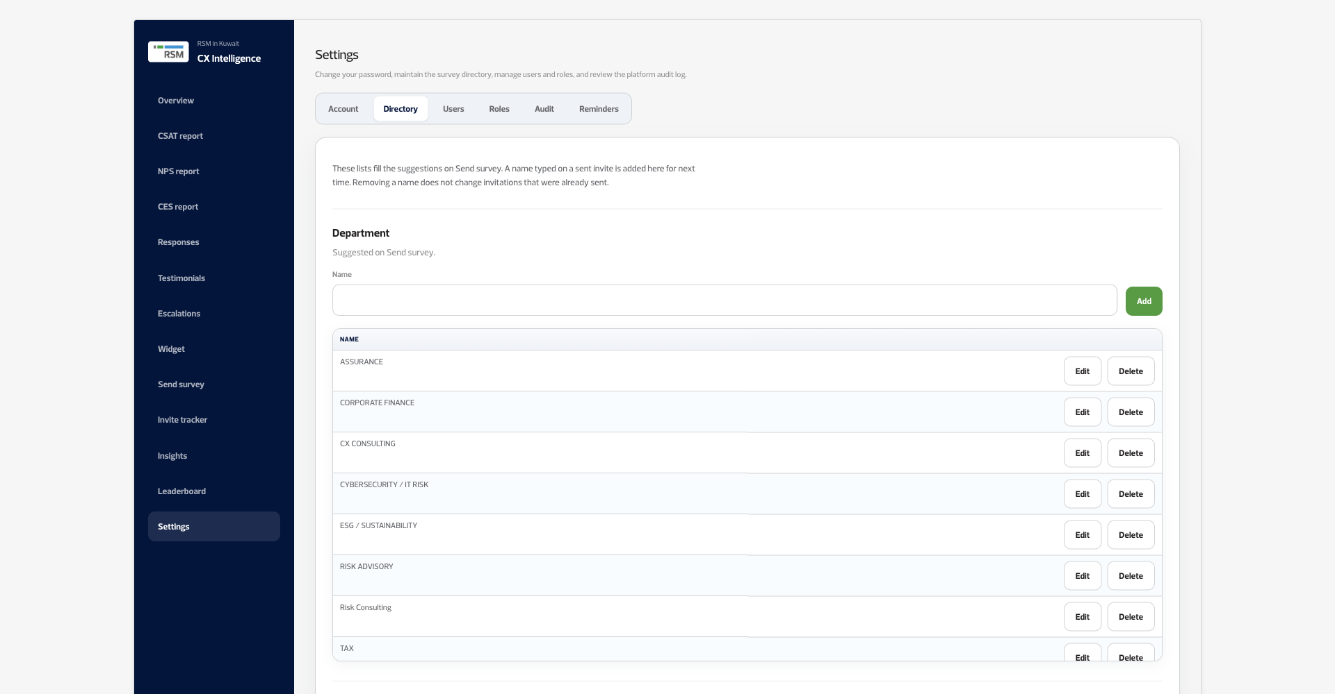
NEW IN PHASE 1
Staff and services, remembered
Departments, services and people are saved here, and the next invite can reuse them.
Voice of Clients · Phase 1
13 / 14

Slide 14

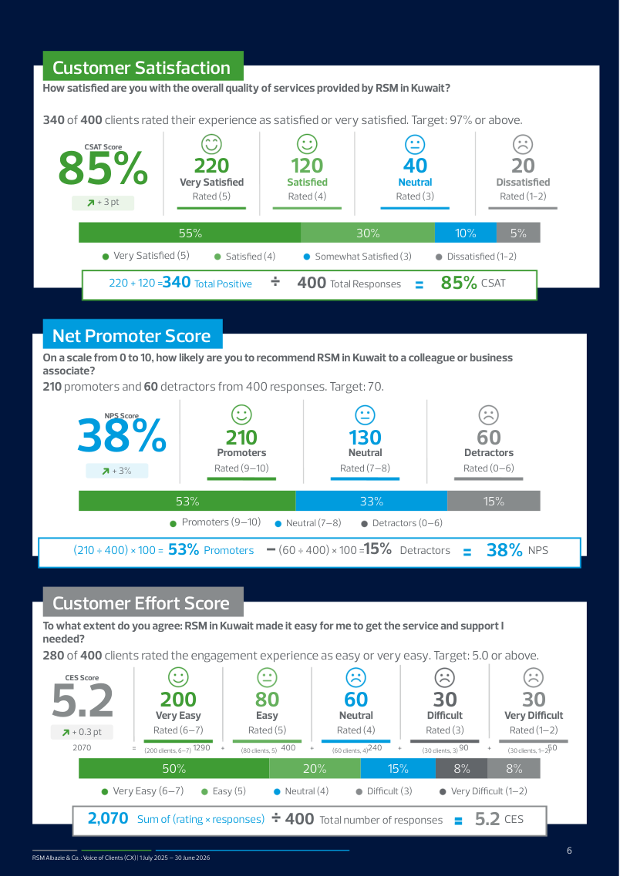

NEW IN PHASE 1
Reports you can hand over
Version 1 downloaded one PDF of the dashboard. Phase 1 builds these.
Annual
The year, with the year before
One metric, one page
Voice of Clients · Phase 1
14 / 14

