Slide 1
RSM IN KUWAIT
Voice of Clients
Phase 1
What the platform could do at version 1,
and what it can do now.
Survey · Reports · Dashboard

Slide 2
PHASE 1
What actually changed
Version 1 already had the survey, the three scores, the report pages, and the score widget.
Survey
Voice
Outreach
The opening, the typed steps and the rating scale were redesigned. An invite fills in the name and company.
The host step now plays a short sample in English or Arabic.
One thank-you from the portal. A good result asks for a testimonial. A low result emails the partner.
Dashboard
Reports
Access
A leaderboard, a low-score board, and a login that shows each partner only their own clients.
Branded files for the year, any dates, one metric, or one partner, with a written narrative on the annual file.
An email code at sign-in. A partner or job manager sees only their own clients.
Voice of Clients · Phase 1
2 / 20

Slide 3
VERSION 1 AND PHASE 1
What was already there, and what the survey gained
Feature
Version 1
Phase 1
Already in version 1
Voice survey and typed survey
✓
✓
CSAT, CES and NPS, with a comment
✓
✓
English and Arabic
✓
✓
An insight on every response
✓
✓
Ask Your Data, including charts
✓
✓
Public score widget
✓
✓
Signed-in overview
✓
✓
CSAT, NPS and CES report pages
✓
✓
Tracked invites, a list import, and the invite tracker
✓
✓
A thank-you email after a completed invite
✓
✓
CRM can send the invite
✓
✓
Changed or added on the survey
The opening screen and the typed steps were redesigned
✓
A traditional scale: every score is a button, then a review of the answers
✓
The voice host can be sampled before the call
✓
Hold, end and live captions on the voice call
✓
An invite fills in the name, company and role
✓
A testimonial ask when the overall result is positive
✓
Added to outreach
Reminders every 3 days, up to 5, never on Friday or Saturday
✓
Reminders can be stopped and turned back on
✓
The invite email names the service
✓
The invite records service, partner, both managers, project and survey order
✓
An admin can delete a duplicate invite
✓
Team email copies the partner and managers, in Kuwait time
✓
A negative result raises a separate alert
✓
Positive, Neutral or Negative from the combined score
✓
A private page of that client’s scores
✓
Directory of departments, services and staff
✓
If the same person replies again in the quarter, the latest score counts
✓
Voice of Clients · Phase 1
3 / 20

Slide 4
VERSION 1 AND PHASE 1
What the dashboard and the reports gained
Feature
Version 1
Phase 1
Added to the dashboard
Email code on every sign-in
✓
Roles for admin, CX and surveyor, plus roles you create
✓
A partner or job manager sees only their own clients
✓
Change your own password
✓
Audit log
✓
Service and manager filters, as well as department and partner
✓
Leaderboard by department, partner and manager
✓
Excel export of responses and of the invite tracker
✓
Exclude or delete a response
✓
Read the voice transcript beside the scores
✓
Testimonials library
✓
Escalations board for low scores
✓
Ask Your Data can answer invite questions
✓
A warning when voice credits run low
✓
Added to reports and the website
Annual report, with a written narrative and the year before
✓
A report for the exact dates you choose
✓
A one-page PDF for CSAT, NPS or CES
✓
A three-page report for one partner
✓
Larger type, in the RSM layout, ready to share
✓
Weekly, monthly and quarterly packs by email
✓
A reviews showcase on the website. Name and company only
✓
Voice of Clients · Phase 1
4 / 20

Slide 5

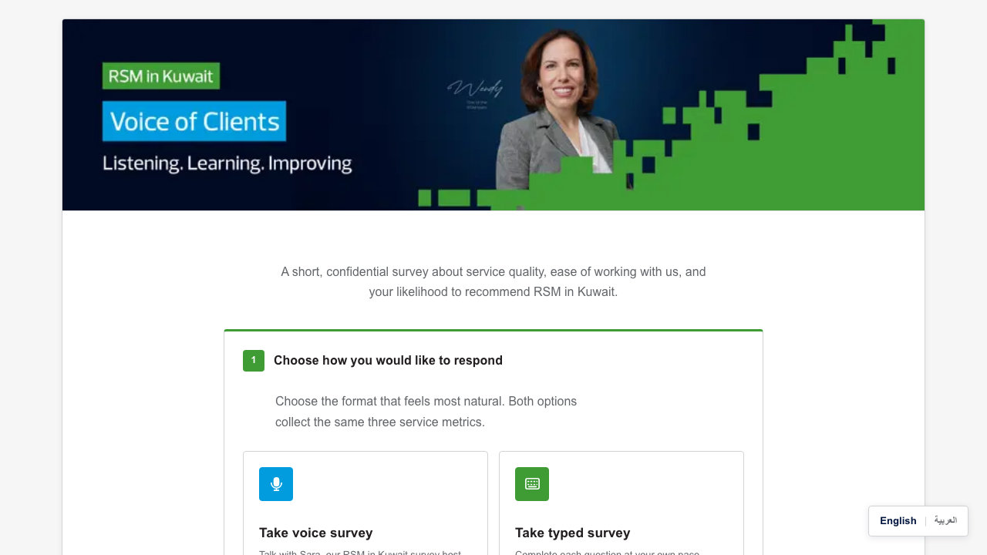
CHANGED IN PHASE 1
How a client starts
Version 1 on the left. Phase 1 on the right. Same choice of voice or typed. The screen was redesigned.
Version 1
Phase 1
Voice of Clients · Phase 1
5 / 20

Slide 6
CHANGED IN PHASE 1
The survey a client opens
This screen was redesigned. Choosing voice or typed was already there.
Voice of Clients · Phase 1
6 / 20

Slide 7

CHANGED IN PHASE 1
A traditional scale
The slider was replaced. Each score is a button, with its meaning written above it.
Voice of Clients · Phase 1
7 / 20

Slide 8

CHANGED IN PHASE 1
The voice host
The host step was redesigned. The client can play a short sample in English or Arabic.
Voice of Clients · Phase 1
8 / 20

Slide 9

CHANGED IN PHASE 1
The typed steps
These steps were rebuilt as a split screen. An invite fills in the name, company and role. The client can still edit them.
Voice of Clients · Phase 1
9 / 20

Slide 10

NEW IN PHASE 1
Who is ahead
Departments, partners and managers can be ranked for a chosen period. This page was not in version 1.
Voice of Clients · Phase 1
10 / 20

Slide 11
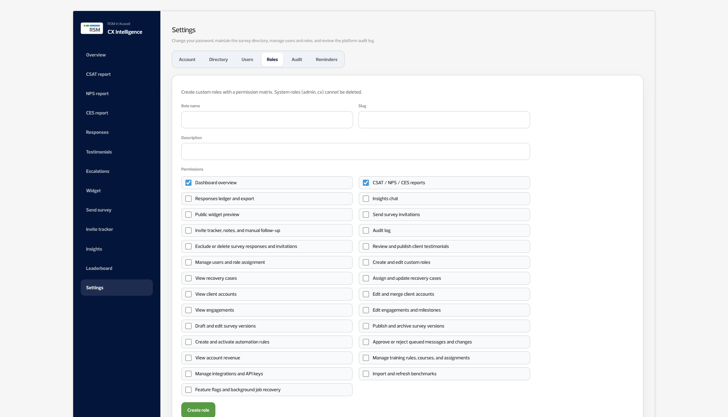
NEW IN PHASE 1
Each person sees their own work
A partner or job manager signs in and sees only the clients tied to them. Leadership and the CX team see the whole firm.
Voice of Clients · Phase 1
11 / 20

Slide 12
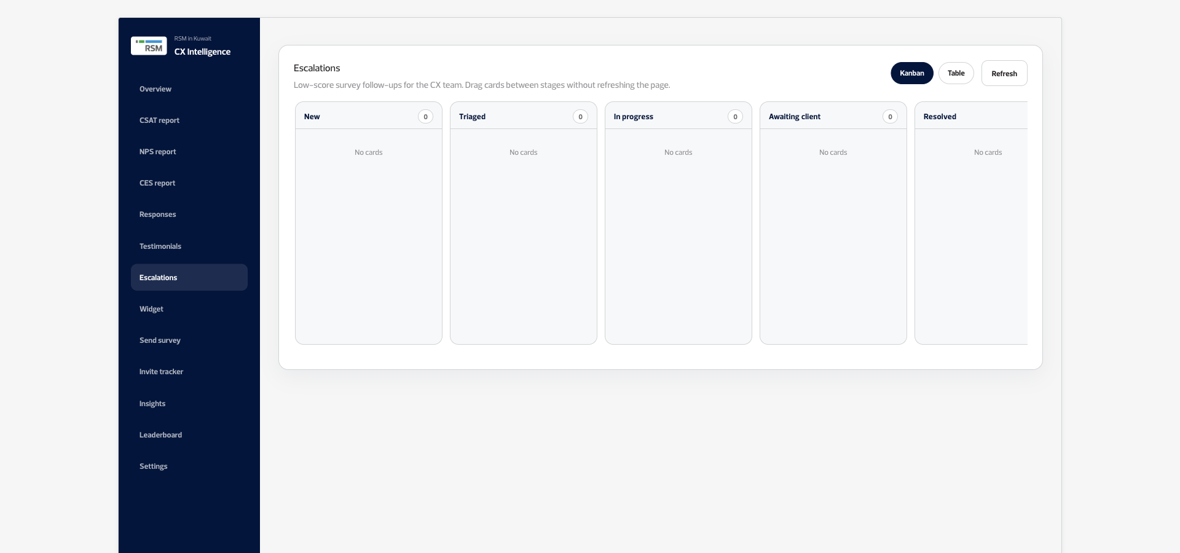
NEW IN PHASE 1
A low score is flagged
CSAT of 2 or below, CES of 3 or below, or NPS of 6 or below is flagged. A negative result emails the partner. Training assignment is the next step, and is not live here.
Voice of Clients · Phase 1
12 / 20

Slide 13
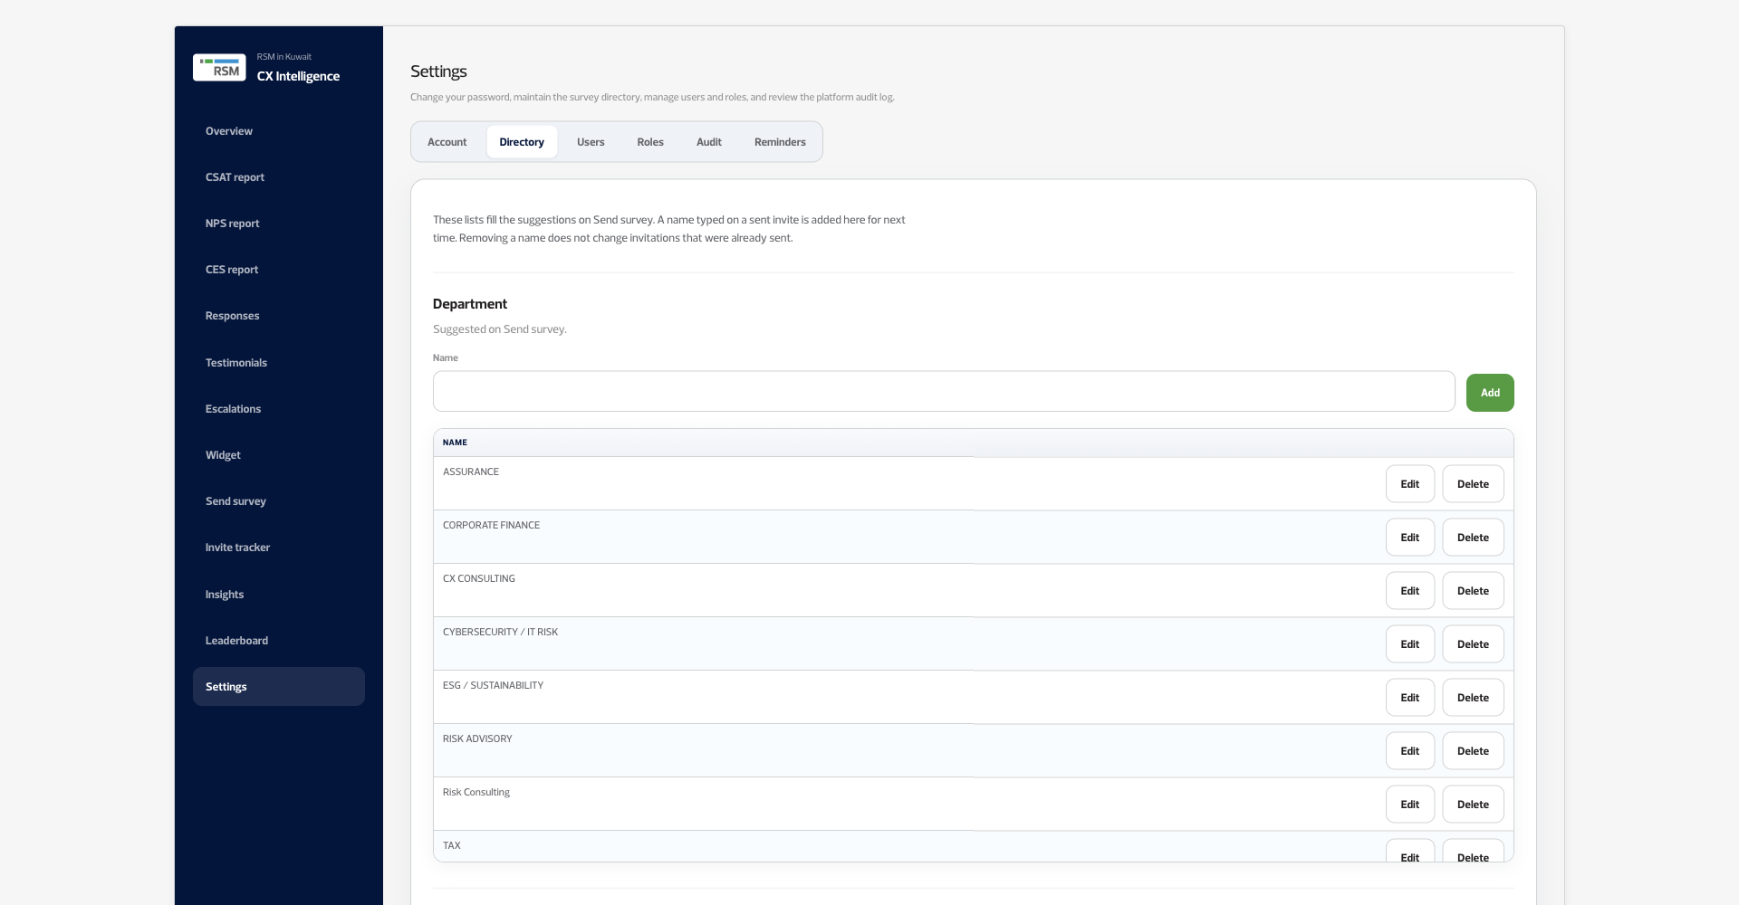
NEW IN PHASE 1
Staff and services, remembered
Departments, services and people are saved here, and the next invite can reuse them.
Voice of Clients · Phase 1
13 / 20

Slide 14
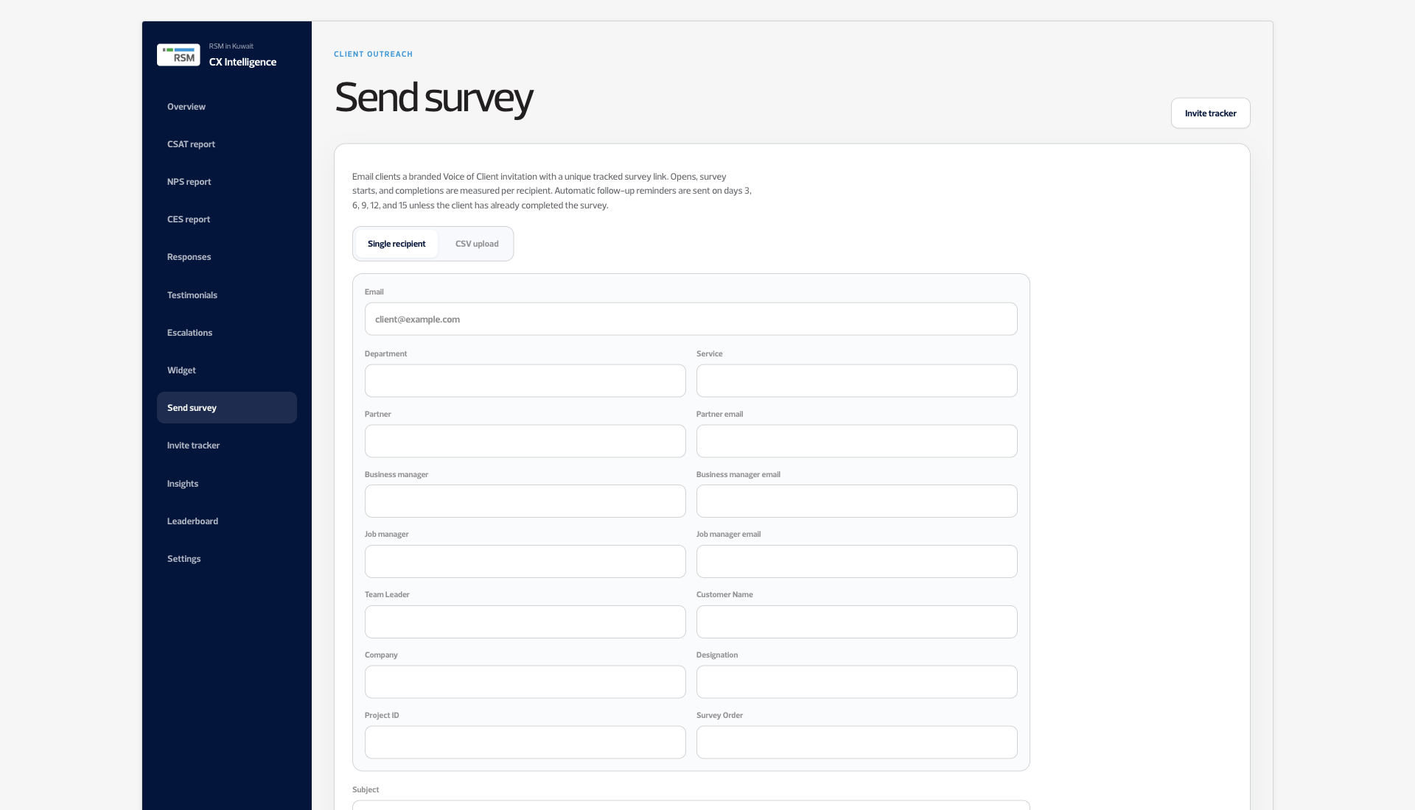
ADDED IN PHASE 1
The invite carries the engagement
Service, partner, both managers, project and survey order travel with the invite. This page was already there. These fields were added.
Voice of Clients · Phase 1
14 / 20

Slide 15
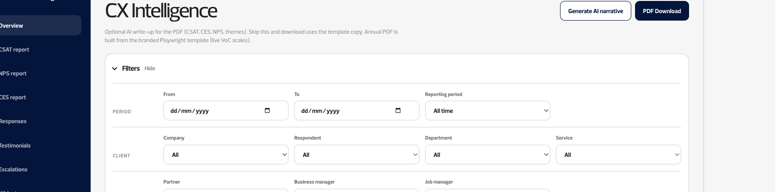
ADDED IN PHASE 1
Filters on the results
Date, department, service, partner and manager. The overview page itself was already in version 1.
Voice of Clients · Phase 1
15 / 20

Slide 16
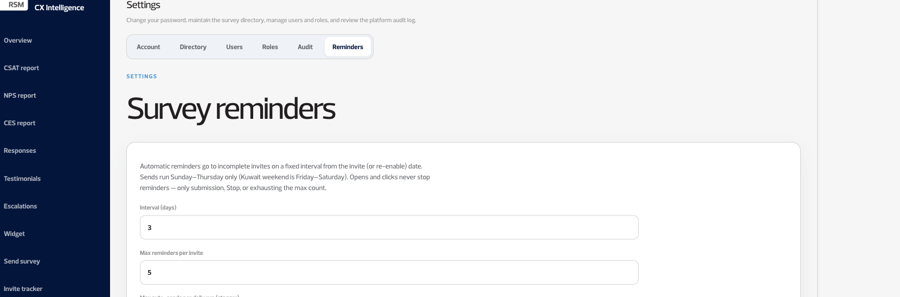
ADDED IN PHASE 1
A reminder every 3 days
Someone who has not finished gets a reminder every 3 days, up to 5 times. Friday and Saturday are skipped.
Voice of Clients · Phase 1
16 / 20

Slide 17
NEW IN PHASE 1
A testimonial, without waiting
One thank-you email leaves the portal. When the combined score is above 80% of 22, that email asks for a testimonial. The comment box stays optional.
01
02
03
A good result
They wrote a comment
No comment
The combined CSAT, CES and NPS score is above 80% of 22. The thank-you then includes the ask.
AI drafts a short testimonial from those words. The client approves or edits it, and chooses name and where it may be published.
The same thank-you asks for a written testimonial or a video link instead.
Voice of Clients · Phase 1
17 / 20

Slide 18
NEW IN PHASE 1
Clean up a bad invite or a bad response
For admins. A duplicate invite can be removed so the reminder stops. A wrong response can be taken out of the scores.
INVITE
RESPONSE
Delete a duplicate invite
Remove a wrong response
An incomplete or repeated invitation can be deleted. Follow-up reminders stop. A survey response that already came in is kept.
An admin can exclude a response from the scores, or delete it, so a corrected response can take its place.
Voice of Clients · Phase 1
18 / 20

Slide 19
PHASE 1
What each system owns
Survey reminders stay in the portal. The partner’s task, and any training that follows, stay in RSM’s system.
PORTAL
RSM SYSTEM
Client communication and the numbers
The partner’s task
The invite, the survey reminder, and the single thank-you. The dashboards, the leaderboard, and the reports a partner can share.
Raising the task, closing it, and assigning training. The training link is not live in the portal. RSM’s side is still to be connected.
Voice of Clients · Phase 1
19 / 20

Slide 20

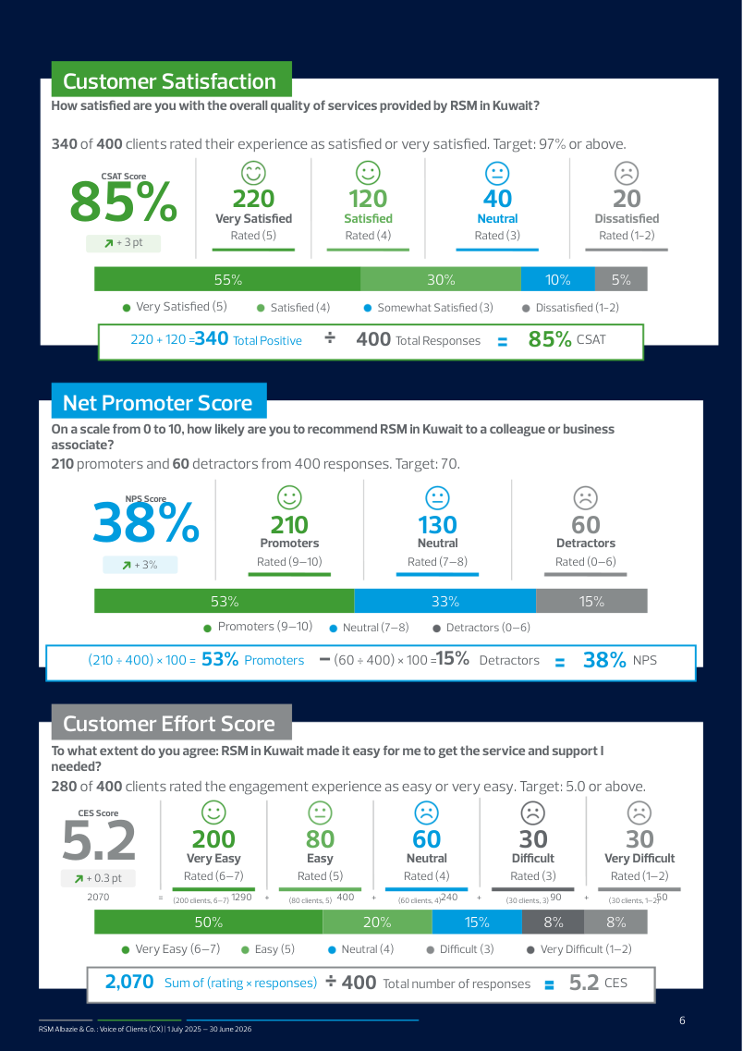

NEW IN PHASE 1
Reports you can hand over
Version 1 downloaded one PDF of the dashboard. These use a larger RSM layout. The annual file adds a written narrative. A separate file covers only the dates you choose.
Annual, with a narrative
The year, with the year before
One metric, one page
Voice of Clients · Phase 1
20 / 20

