Slide 1
HACKFEST 2026
By Innovation Council
NIMO
The Product Truth Agent
Team Matrix Slayers
Ignite Ideas. Build the future.
Notes:
NIMO is our answer to the Product Truth Agent problem. Give it a retail product record and it finds the web page that really is that product, codes the characteristics NIQ needs, and explains every answer.

Slide 2
01 / STORY
Problem & Solution Overview
Linking a retail record to the right product page, and reading that page correctly, is still done by hand.
01
02
PROBLEM STATEMENT
TARGET AUDIENCE
One product appears on dozens of pages with different names, pack sizes and promotions. Picking the true page and coding its 13 characteristics is manual, slow and easy to get wrong on look-alikes: a 2-pack, a refill, a sister variant.
NIQ coding and data-quality teams who link retailer records to products and characteristics, and the analysts and clients downstream who depend on that coding being right.
03
04
YOUR SOLUTION
VALUE PROPOSITION
NIMO reads a retail record (description, brand, barcode, retailer), finds the page that is that product, names its module, fills only the characteristics that apply and explains each answer. It writes the submission file itself, in the exact qa format.
It proves identity instead of guessing: the same barcode on the page confirms it, a different one rules it out. It remembers every product it has confirmed, so a repeat costs a lookup, not a search. And every answer comes with its evidence.
BEFORE → AFTER
Before: a coder opens pages one by one. After: all 412 qa products resolved in one run, 114 confirmed by barcode, each with its reasoning.
Notes:
Today a coder does this by hand, page by page, and look-alikes get through. NIMO does the whole chain and writes the submission file itself. The key difference: it proves identity with the barcode where it can, and remembers what it has already resolved.

Slide 3
02 / SOLUTION
Detailed Solution
Rules and evidence do most of the work. The model is used only where judgement is needed.
A
B
C
INNOVATION & ORIGINALITY
SCALABILITY
ROLE OF AI & COST EFFECTIVENESS
Barcode first. A page showing the record's barcode is accepted; a different barcode is rejected, however similar the text looks.
A memory of products. Every confirmed product is stored. On the re-run, 111 of the 412 qa rows were answered from memory, with no search at all.
Reasoning you can check. Each sentence is built from a recorded field, so it cannot claim anything the evidence does not show.
Cheaper as it grows. A product seen once is a lookup the next time, so the cost per row falls as the registry fills.
Built for large runs. Every step is cached and resumable. 412 rows ran in 107 minutes on free search engines, and a re-run gives a byte-identical file.
Any list, any machine. An Excel file with a description and brand goes through the same pipeline. Search works through SearxNG or the Brave API, with no Docker needed.
Two narrow jobs. The model breaks ties between close candidates, answering with a number that points at one of them, never a URL. It also reads evidence into characteristic values.
Checked, not trusted. It is only asked for characteristics that apply to the module, and every value must be in NIQ's allowed list.
Low cost. About 1M tokens for all 412 rows, and none on a re-run.
ONE ROW, END TO END
Record › memory check › web search › fetch pages › match › module › characteristics › reasoning › qa output row
Notes:
Three ideas. Barcode first, so identity is proven rather than guessed. A memory of products, so repeats are cheap. And reasoning built from recorded fields, so it can be checked. The model only does two narrow jobs, and everything it says is validated.

Slide 4
03 / DEMO
How It Works
From one product record to one validated output row.
01
02
03
04
INPUT
INTELLIGENCE
ACTION
OUTCOME
A product record: description, brand, barcode, retailer, country. From the qa sheet, the web form or any Excel file.
Registry lookup, five search strategies, barcode rules, a calibrated match score, a module classifier, and the LLM for ties and characteristics.
Searches the web, fetches candidate pages safely, confirms barcodes, keeps only the characteristics that apply and validates every value.
One row per product in the exact qa format: URL, module, 13 characteristics and the reasoning. Plus a searchable results page.
KEY FEATURES
TECH STACK
DEMO LINK OR SCREENSHOTS
Identity proven by barcode
Remembers every resolved product
Every answer cites its evidence
Python 3.12, pydantic, httpx, FastAPI
SearxNG or the Brave Search API
NIQ CIS LLM (hack-fest-gpt-5.6-luna)
Live UI: uv run python -m nimo.ui --live
Results page: site_qa.html, opens offline
github.com/Nexxex-Aditya/NIMO · screenshots next
Notes:
One record goes in; one validated row comes out. In between: the registry check, web search, page fetching, matching with barcode rules and a calibrated score, the module, the characteristics that apply, and the reasoning. Next slide shows two real rows.

Slide 5
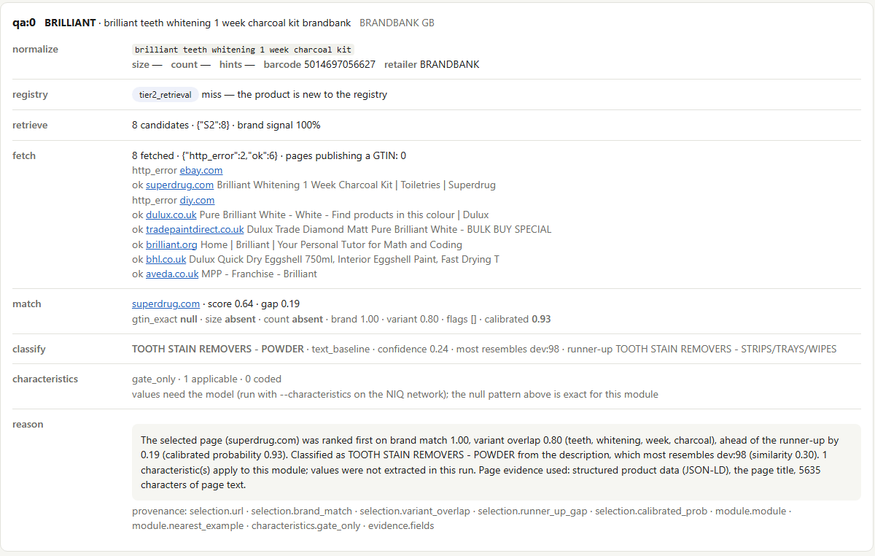
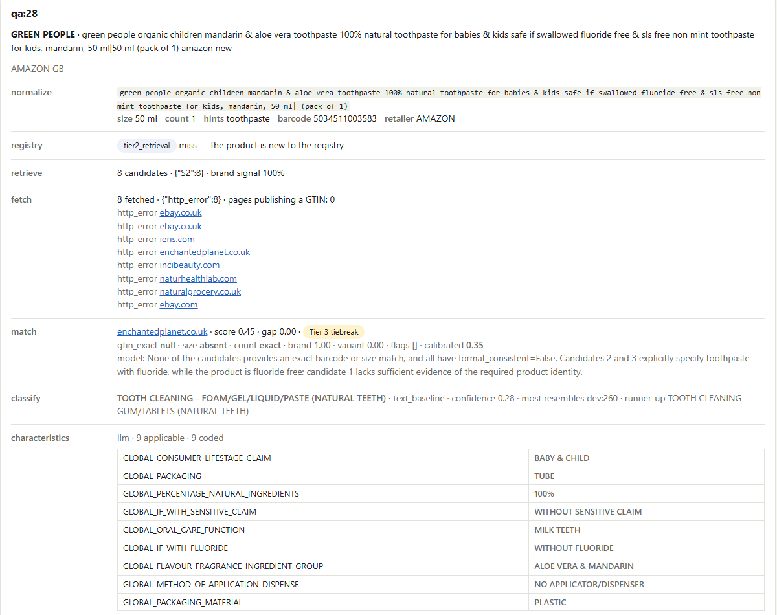
03 / DEMO
What a Result Looks Like
Two real rows from NIMO's results page. Every line names the pipeline step that produced it.
QA:0 · THE RIGHT PAGE AMONG LOOK-ALIKES
QA:28 · CHARACTERISTICS CODED BY THE MODEL
The brand word ‘Brilliant’ also brought back paint pages and a tutoring site. NIMO picked the Superdrug product page, at a calibrated 0.93, and says why.
Green People kids’ toothpaste: 9 applicable characteristics coded, all within NIQ’s allowed values. The record says fluoride free; the output says WITHOUT FLUORIDE.

Slide 6
04 / IMPACT
Impact & Future Scope
What it delivered on the qa set, where else it applies, and what we would do next.
01
02
03
IMPACT
MARKET POTENTIAL / USE CASES
NEXT STEPS
412 of 412 qa products resolved end to end; 114 confirmed by the page's own barcode.
Brand homepages given as answers: 100 before our fix, 0 after.
Module accuracy 80.3% on the labelled set. A match confidence of 0.93 means about 93 in 100 are right.
Any catalogue that must be tied to the web: new product onboarding, retailer assortment checks, price and availability tracking, attribute enrichment. Other categories need new vocabularies and guidelines, not new code.
Run search, pages and the model on one network. Learn the 32 modules missing from the labelled data from page evidence. Agree with NIQ how a blank URL scores against a wrong one, then switch on abstention, which is already built.
TEAM & ROLES
Team Matrix Slayers
412 / 412 ROWS
Aditya Samal · Build lead · Architecture, pipeline, evaluation and demo
Notes:
Results on the full qa set, the use cases beyond oral care, and what we would do next. All numbers are measured and recorded in our decision log.

Slide 7
Thank You

