Slide 1
0
Normalize
NIMO
1
Registry memory
2
Retrieve
The Product Truth Agent
3
Fetch & extract
4
Match
Finds the web page that is the product, codes its characteristics, and shows the evidence for every answer.
5
Classify module
6
Characteristics
7
Reason
8
Assemble
Team Matrix Slayers · NielsenIQ Innovation Portal hackathon · September 2026
Notes:
NIMO resolves a retail product record to the one web page that is that product, identifies its module, codes the characteristics that apply, and explains every answer from recorded evidence. The column on the right is the pipeline you will see in the demo; stage 1, in amber, is the memory that lets repeat products skip the expensive stages.

Slide 2
THE PROBLEM
One product, many pages — which one is true?
The same toothpaste appears on retailers, marketplaces, brand sites and barcode directories under different names, sizes and promotions. The task has two stages, and the second is where most of the score lives.
1
2
3
4
Find the page
Identify the module
Decide what applies
Code the values
the single URL that is this product — not a look-alike, a listing or a homepage
one of 59 oral-care modules, e.g. TOOTH CLEANING - PASTE
which of the 13 characteristics exist for that module — the rest must stay empty
from page, image and guideline evidence, inside the organizers' vocabulary
Judged on
the right URL
not fooled by similar or misleading matches
clear, transparent reasoning
beyond keyword matching
Notes:
From the brief: the agent must choose the most likely product URL, distinguish it from similar or misleading matches, and explain itself. The dataset guide adds the second stage — module, applicable characteristics, values. A non-applicable characteristic must be left empty; a plausible guess there is scored as wrong.

Slide 3
WHAT THE DATA ACTUALLY GAVE US
We measured the dataset before designing anything
0
377 / 412
3 columns
candidate web pages supplied — PRODUCT_URL is empty in every row
dev barcodes destroyed by an Excel number format (rounded to 3 digits)
EXTERNAL_CODE, NAN_KEY and ITEM_CODE all carry the rounding — NAN_KEY collides across products
→ Built our own retrieval: 5 query strategies, fetch, extract
→ A rounded barcode is never used as an identifier
→ Row identity is our own row_uid, never NAN_KEY
187
21 / 50
0
ground-truth values are '&'-joined (e.g. ANTI BACTERIAL & WHITENING)
retailer strings a regex mis-parses — one silently: 'BOOTS (GB) (HOMESCAN)' → '(HOMESCAN)'
rows with URL ground truth
→ Validation per component — the organizers' own answers pass
→ A hand-reviewed 50-entry table instead of a pattern
→ Evaluation from the barcode itself: a page's GTIN confirms or refutes it
Notes:
Every one of these was found by measuring the real workbook, and each changed the design. The barcode rounding is the big one: 377 of 412 dev barcodes are holes, while qa's are clean — so dev cannot be used to tune anything barcode-based, and a rounded value used as a key would merge unrelated products.

Slide 4
ARCHITECTURE
Eight deterministic stages; the model is a bounded part
LLM
0
Normalize
1
Registry memory
2
Retrieve
3
Fetch & extract
4
Match
brand, size, pack count, variant words; every stripped token recorded
Tier 0 by barcode, Tier 1 by identity within a block; a hit skips search
5 strategies via Brave Search API or self-hosted SearxNG, cache-first
robots, pacing, SSRF check per redirect; JSON-LD first
hard rules, calibrated score; Tier 3 model tiebreak picks an index
registry hit: skip stages 2, 3, 4
LLM
5
Classify module
6
Characteristics
7
Reason
8
Assemble
char-4-gram nearest centroid; cites its nearest labelled row
applicability gate, one model call with the pack shot, validator
composed from the typed record — every clause tagged with its source
exact qa schema, byte-identical xlsx + csv, explorer page
Every stage writes a typed artifact keyed by row_uid: resumable after any interruption, and a warm re-run produces a byte-identical submission.
Notes:
Nine boxes, stage 0 to 8. The model appears in exactly two places, both bounded: the Tier-3 tiebreak, whose answer is an index into candidates the deterministic layer already chose, and characteristic extraction, whose answer is validated against the organizers' vocabulary. A registry hit jumps from stage 1 straight to classification.

Slide 5
DESIGN STANCE
Why a pipeline, not an autonomous agent
 | Autonomous agent loop | NIMO pipeline
Reproducible | a different trajectory every run | same input → same output; warm re-run byte-identical
Debuggable | a transcript | a typed record per stage: which feature misfired is visible
Cost | model reads every candidate page | rules first; the model sees ≤ 3 structured candidates, only when needed
Transparent | chain-of-thought | reasoning composed from recorded fields, each clause cited
Safe | page text can steer the agent | page text is delimited data; the model's answer is an index, never a URL
Considered and rejected on measurement: a learned GNN (no multi-hop structure, 412 rows cannot train it — Union-Find gives the graph answer with no training), hyperbolic RAG (the taxonomy is 3 levels, fully enumerable), pure-LLM ranking of raw HTML (discards the barcode, size and pack-count signals that decide identity).
Notes:
The brief rewards transparent reasoning and the evaluation is a 412-row batch, so reproducibility and per-stage traceability decide the architecture. The model is used where it adds judgement, and is fenced so it cannot introduce a URL or a value outside the allowed set.

Slide 6
MEMORY
Resolve once, answer from memory: the entity registry
Tier | Trigger | Cost
0 · exact | barcode already resolved | milliseconds
1 · similar | identity similarity ≥ 0.75 inside a size/brand block | milliseconds
2 · retrieval | miss — search, fetch, match | seconds
3 · model | top candidates too close to call | one call
111 of 412
qa rows answered straight from the registry on the re-run — search, fetch and match skipped
Confirmed-same products are merged with Union-Find — deterministic, no training data.
Written only on barcode-confirmed identity, and every write is audit-logged.
Tier 1 is precision-first: on 20 hand-checked pairs it accepts 3 of 4 true duplicates and 0 of 14 look-alikes (Sensodyne Pronamel Extra Fresh vs Whitening differ by two words).
115
resolved products in memory, each with the rows folded into it and the page that proved it
Notes:
Production catalogs repeat. Without memory every re-observation costs the full search and model bill. The registry turns a second sighting into a lookup. Tier 0 cannot fire inside a single pass of this dataset — no two qa rows share a barcode — so its value shows on the re-run, where it answered 111 rows from memory.

Slide 7
RETRIEVAL
Finding candidates on a real, hostile web
S2
barcode + brand
finds the retailers that publish structured data
S3
brand + variant + size
the product-name query
S4
site:retailer
the row's own retailer domain
S5
description verbatim
fallback
S1
bare barcode
last — digit strings match phone prefixes
Free engines, engineered: rotation, per-engine circuit breaker, early exit, cache — 412 qa rows in 107 minutes, zero failures.
Brave Search API when Docker is unavailable: cache-first over every harvested answer, capped per run.
Pages about the product — homepages, listings, barcode directories — never fill the fetch budget.
Notes:
The dataset gave us no candidate pages, so retrieval is ours. Measured on our own output: 100 of 412 qa answers were brand homepages, because the barcode query returned the brand's homepage and those filled the fetch budget before the product-name query ran. Pages about the product no longer count toward the budget; homepages went from 100 to zero and product pages from 271 to 377.

Slide 8
MATCHING
Hard rules first, then a score that means a probability
Page GTIN = our barcode
accept — identity by identifier
Page GTIN ≠ our barcode
reject — however similar the text
Size or pack count differ
demote — 2-pack ≠ single, 75 ml ≠ 100 ml
Refill, travel, bundle, sample
demote — a different SKU of the line
Homepage, listing, directory
demote — about the product, not of it
Everything else: weighted brand, variant, format, retailer and market features — market is scored, never a filter.
Isotonic fit on 236 pages whose own barcode labels them right or wrong · held-out calibration error 0.068
Notes:
The barcode is the strongest identity signal, so it is a rule, not a weight. For pages without one, the weighted score is calibrated: we fitted it against 236 pages that publish a barcode, so 'confidence 0.93' means about 93 in 100 such picks are the product. The label comes from the identifier, not from the score, so the oracle cannot leak into what it measures.

Slide 9
MODULE CLASSIFICATION
80.3% module accuracy — a model chosen on the long tail
Macro is the headline
The top 4 modules are 77% of rows. Complement NB is within 2 points overall and 11 behind on macro — it buys the head by dropping the tail.
Character 4-grams, not words
+8 points: the data writes toothpaste as 'tooth paste', 't/paste', 'pste'.
BRAND measured out
Adding it costs 7.5 points: Oral-B makes brushes, heads and paste.
It cites its evidence
Each prediction names its nearest labelled row — a citation a person can open.
Notes:
MODULE is the only fully labelled column, so this is where we could measure properly. We report macro accuracy first because overall accuracy would have picked a model that ignores the rare modules. Adding page titles as module evidence was also measured on the full dev harvest and lost accuracy, so the module comes from the description.

Slide 10
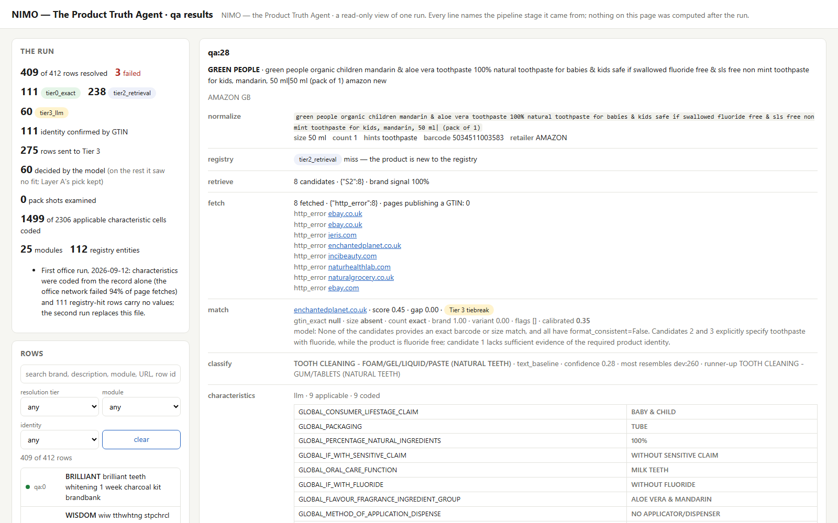
CHARACTERISTICS
The model proposes, the vocabulary disposes
1
Applicability gate — ours, before and after the model
Only characteristics that apply to the module are asked; a volunteered one is dropped. Under predicted modules: precision 0.955, recall 0.928.
2
One call per row, with the pack shot
Only that row's guidelines, the page excerpt around ingredients and pack terms, and the product image (636 of 824 rows have one).
3
Validated against the organizers' list
Per '&' component: reproduces their counts exactly — 1,719 values accepted, the 2 known data errors refused.
4
Practice over prose where they differ
qa:28, real output from the model on the NIQ network: Green People children's mandarin & aloe vera toothpaste → BABY & CHILD · TUBE · 100% · MILK TEETH · WITHOUT FLUORIDE · ALOE VERA & MANDARIN
Measured defaults where the coders' practice departs from the written guideline (e.g. fluoride).
Notes:
Characteristics are most of the scored surface. The applicability gate is deterministic, so the model can never fill a characteristic that does not exist for the module. Every value it proposes is checked against the organizers' vocabulary; what it said and was refused is recorded. The screenshot is a real row from our office run on the internal model.

Slide 11
REASONING
Reasoning composed from recorded fields — never generated
“The selected page (superdrug.com) was ranked first on brand match 1.00, variant overlap 0.80 (teeth, whitening, week, charcoal), ahead of the runner-up by 0.19 (calibrated probability 0.93). Classified as TOOTH STAIN REMOVERS - POWDER from the description, which most resembles dev:98 (similarity 0.30). … Page evidence used: structured product data (JSON-LD), the page title, 5635 characters of page text.”
No invented claims
Every number in the text is a field's value — tested.
No injection surface
Page text is never quoted; only validated fields are cited.
qa:0 — BRILLIANT teeth whitening 1 week charcoal kit. The brand word also found paint pages and a tutoring site; the matcher ranked the Superdrug product page first.
Absence is stated, not guessed
Provenance tags stored with the text
“No evidence for FLUORIDE; left empty” — as in the organizers' own sample.
selection.url
selection.brand_match
selection.variant_overlap
selection.runner_up_gap
selection.calibrated_prob
module.module
module.nearest_example
evidence.fields
Notes:
The brief scores transparent reasoning. A generated explanation can say something no evidence supports; a composed one cannot, because it can only render fields the pipeline recorded. The test suite checks that every number in the text is the string form of a field, and that a record with no fluoride evidence produces no fluoride claim.

Slide 12
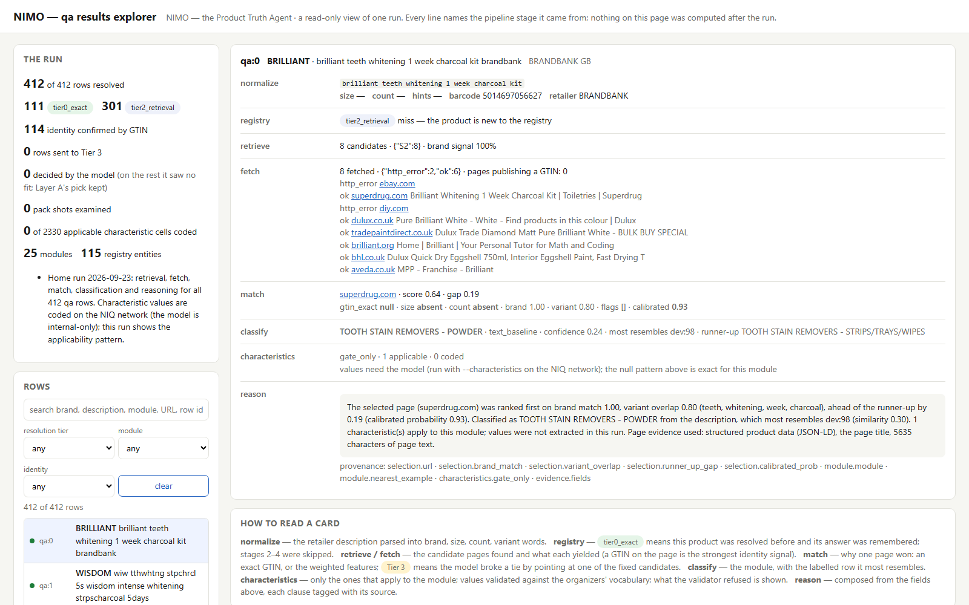
THE WORKING PROTOTYPE
Three ways to use it
Live interface
Run any dataset row, or type a new product and watch it resolve end to end.
uv run python -m nimo.ui --live
Results explorer
The whole 412-row run in one self-contained page, searchable and filterable.
uv run python -m nimo.site --sheet qa
Your own Excel file
Any .xlsx / .csv with RETAILER_DESC and BRAND, through the same pipeline.
Results explorer: every row's evidence, stage by stage — one HTML file, opens with no server.
uv run python -m nimo.run --input my.xlsx --live
Notes:
The interface runs the same composed pipeline as the batch CLI — it adds nothing that could drift. In the demo: a dataset row, then the same row again to show the registry answering from memory, then a new product typed in and resolved live through the Brave Search API.

Slide 13
RESULTS AT A GLANCE
Measured, not asserted
412 / 412
114
111
0
qa rows resolved end to end
answers confirmed by the page's own barcode
rows answered from registry memory on re-run
brand homepages submitted (was 100)
80.3%
0.068
68.6%
827
module accuracy, leave-one-out (49.7% macro)
held-out calibration error of the match score
characteristics, first run, record-only — before page evidence and practice defaults
automated tests, zero network — strict typing
Notes:
Each number is recorded in the decision log with how it was measured. The 68.6% characteristic figure is the honest first measurement: it came from a run on a network that blocked 94% of page fetches, so the model coded mostly from the record; the page cache and measured practice defaults were built for exactly that gap.

Slide 14
BUILT TO BE TRUSTED
Safety and engineering discipline
Untrusted page text is data
Deterministic
delimited in every prompt; injection fixtures are a permanent test class
the submission xlsx was byte-identical across two different laptops
The model cannot invent a URL
Resumable
its answer schema has an index, no URL field; out-of-range is refused
one typed artifact per row per stage; an interruption loses nothing
SSRF checks on every redirect hop
Fail loud
private and metadata addresses refused before connecting
one failure choke point; a failed row is blank, never half-filled
Pinned model, hard token budget
Strict
a spent budget aborts the run instead of throttling silently
mypy --strict, ruff, 827 tests with zero network calls
Audit-logged memory
Every decision logged
every registry write is traceable and reversible
what was measured, what was rejected and why — docs/02-decision-log.md
Notes:
The design has two exposed surfaces — web text reaching the model, and URLs we did not choose — and each has a structural control rather than a prompt instruction. On the engineering side, the strongest single check is determinism: the same run on two machines produced a byte-identical submission file.

Slide 15
HONEST LIMITS AND NEXT STEPS
What we know we have not solved
Limits
Next
32 of 59 modules never appear in the labelled data, so the classifier cannot emit them (interdental brushes among them).
The model is NIQ-internal and the NIQ network blocks most retail pages, so evidence is harvested outside and carried in as caches.
The Tier-3 tiebreak's gain is not yet measured with page evidence in hand.
Many retailers serve bot walls to any polite crawler (156 hosts in the last run).
Unseen modules from page evidence: the lever is measured (qa:259), the stage that reads pages is where it belongs.
Run the whole pipeline inside one network that reaches both the model and the web.
Confirm with the organizers: URL vs page title in PRODUCT_URL, and how a blank URL is scored against a wrong one (abstention is built, switched off).
Grow the registry across catalogs — every resolved product makes the next sighting a lookup.
Notes:
We would rather state these than have them found. The biggest structural one is the unseen modules; the biggest environmental one is that the model and the open web live on different networks, which we bridged with carried caches rather than hid.

Slide 16
Thank you
NIMO — the Product Truth Agent · Team Matrix Slayers
Code, docs and decision log
github.com/Nexxex-Aditya/NIMO
Run it
uv sync · uv run python -m nimo.ui --live
Notes:
Everything shown is in the repository, including the decision log that records every measurement and every rejected alternative.

