Slide 1
Defect Reporting and Tracking

Slide 2
Agenda
What is Bug
Defect Report
Structure
Life cycle of Bug
Bug Tracking
Conclusion
Examples

Slide 3

What is Bug
In testing process when a tester executes the test cases he might observe that the actual test results do not match from the expected results. The variation in the expected and actual results is known as defects, or bug.
Term "bug“ used to describe inexplicable defects has been a part of engineering jargon for many decades and predates computers and computer software; it may have originally been used in hardware engineering to describe mechanical malfunctions.
Defect is difference between expected and actual result

Slide 4
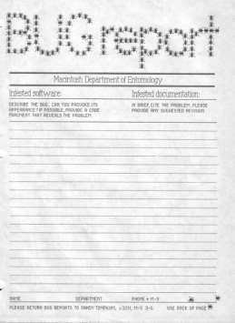
Defect Report
A major test objective is to identify defects. Once identified, defects need to be recorded, monitored, reported and corrected.
After uncovering a defect (bug), testers generate a formal defect report.
Bug report is a technical document that describes failure mode in system under test .

Slide 5

Structure
Defect report or Bug report consists of the following information:
ID – Unique identifier given to the defect.
Project – Project name
Product – Product name
Release Version – Release version of the product
Detected Build Version – Build version of the product where the defect was detected
Summary – Brief summary of the defect
Description – Detailed description of the defect.
Steps to Replicate – Step by step description of the way to reproduce the defect.
Actual Result – The actual result you received when you followed the steps.
Expected Results – The expected results.
Attachments – Attach any additional information like screenshots and logs.
Remarks – Any additional comments to the defect.
Reported By – The name of the person who reported the defect.

Slide 6
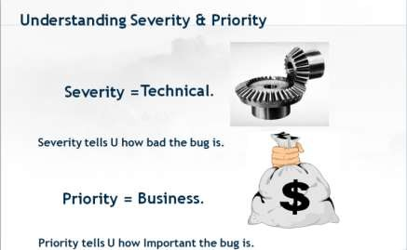
Structure
Assigned To – The name of the person that is assigned to analyze/fix the defect.
Fixed by – This field includes the details of the developer who fixed it like Name and
ID
Date Closed – This includes the Date when the bug is closed
Severity: Based on the severity (Critical, Major or Minor) it tells us about impact of the defect or bug in the software application
Priority: Based on the Priority set (High/Medium/Low) the order of fixing the defect
can be made.

Slide 7
Structure
DEFECT SEVERITY CLASSIFICATION:
Critical - this defect is causing system failure. Nothing can proceed further.
Major - highly severe defect, is causing the system to collapse, however few parts of the system are still usable, and/or there are a few workarounds for using the system in the collapsed state too
Medium - is causing some undesirable behavior, however system / feature is still usable to a high degree
Low - is more of a cosmetic issue. No serious impedance to system functionality is noted.
DEFECT PRIORITY CLASSIFICATION:
High: Must be fixed in any of the upcoming builds but should be included in the release.
Medium: May be fixed after the release / in the next release.
Low: May or may not be fixed at all

Slide 8
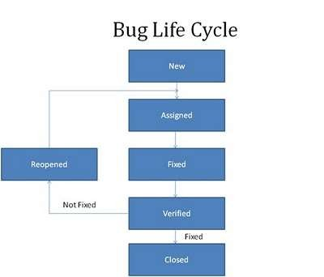
Life cycle of bug
Defect life cycle is a cycle which a defect goes through during its lifetime. It starts when defect is found and ends when a defect is closed, after ensuring it’s not reproduced. Defect life cycle is related to the bug found during testing.
The bug has different states in the Life Cycle. The Life cycle of the bug can be shown diagrammatically as follows:

Slide 9

Status
New - When a defect is logged and posted for the first time
Assigned - After the tester has posted the bug, the lead of the tester approves that the bug is genuine and he assigns the bug to corresponding developer and the developer team.
Open - At this state the developer has started analyzing and working on the defect fix.
Fixed - When developer makes necessary code changes and verifies the changes then he/she can make bug status as ‘Fixed’ and the bug is passed to testing team.
Verified - The tester tests the bug again after it got fixed by the developer.
Reopened - If the bug still exists even after the bug is fixed by the developer, the tester changes the status to “reopened”. The bug goes through the life cycle once again.
Closed bug - Once the bug is fixed, it is tested by the tester. If the tester feels that the bug no longer exists in the software, he changes the status of the bug to “closed”. This state means that the bug is fixed, tested and approved.

Slide 10

Bug tracking
Bug tracking is a process used by quality assurance personnel and programmers to keep track of software problems and resolutions.
Bug tracking is important since complex software products can have tens of thousands of defects (or possibly more). Managing, evaluating and prioritizing these defects is a time consuming task. To help with this task, development teams use bug tracking software which are database systems that store defects and help team members manage issues.
Bug tracking systems include a database, which keeps track of facts pertaining to each bug. These facts might include the time a bug was reported, its severity, incorrect program behavior, details on how to recreate the bug,who reported the bug and what the programmers did to fix it. Bug tracking systems are associated with a bug's life cycle, which is tracked through the status assigned to each bug.

Slide 11

Conclusion
A software bug can cause faulty functionality, instability or even failure within an application or program. Fortunately, during the development phase, the software testing and quality assurance (QA) process addresses bug issues. The primary mission of testing teams and individual software testers is to comb through a program’s code in order to detect mistakes and defects.
Defect reporting and tracking - it's very important and responsible part of testers work.
Quality indicators for good bug reports
– Clear for understanding(especially the summary)
– Actionable by development
– Move quickly from opened to closed
– Include only one problem per report

Slide 12
Example
Defect Report
# | Summary | Steps to reproduce | Actual Result | Expected Result | Severity | Priority
1 | New Comment Page – Active check box is checked in by default | Log in to app Click on “New” link | “Active” checkbox is checked in by default | Active check box should be disabled by default. | High | High
2 | New Comment Page- “Active” checkbox becomes active after page refresh | Log in to app Click on “New” link Check off “Active” check box Click “Refresh” link | “Active” checkbox becomes checked in | “Active” checkbox should be checked off by default | Medium | Medium

Slide 13
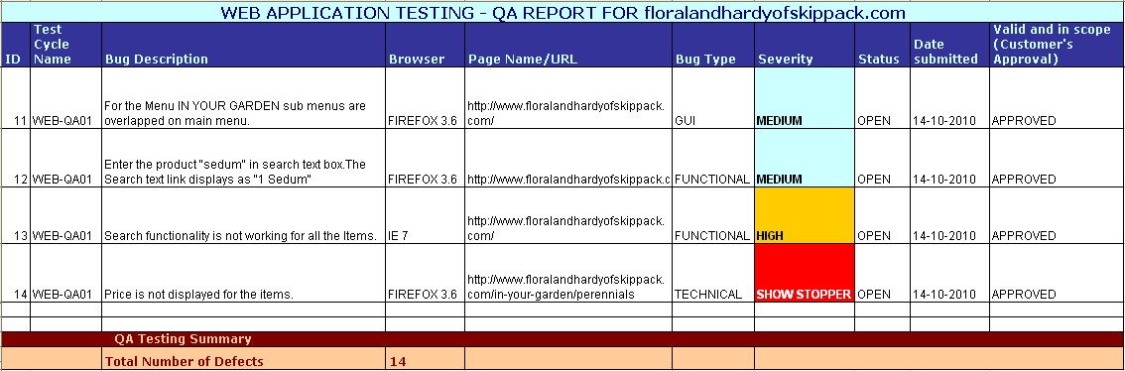
Example
Defect Report

Slide 14
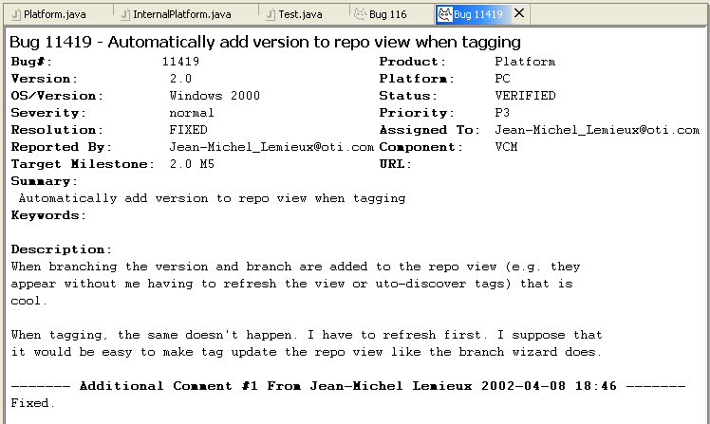
Example

Slide 15
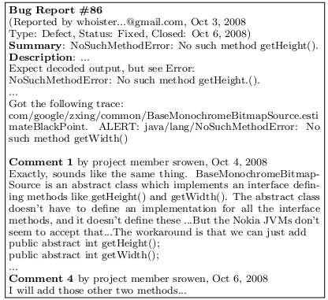
Example

Slide 16

Thank you for attention

