Slide 1
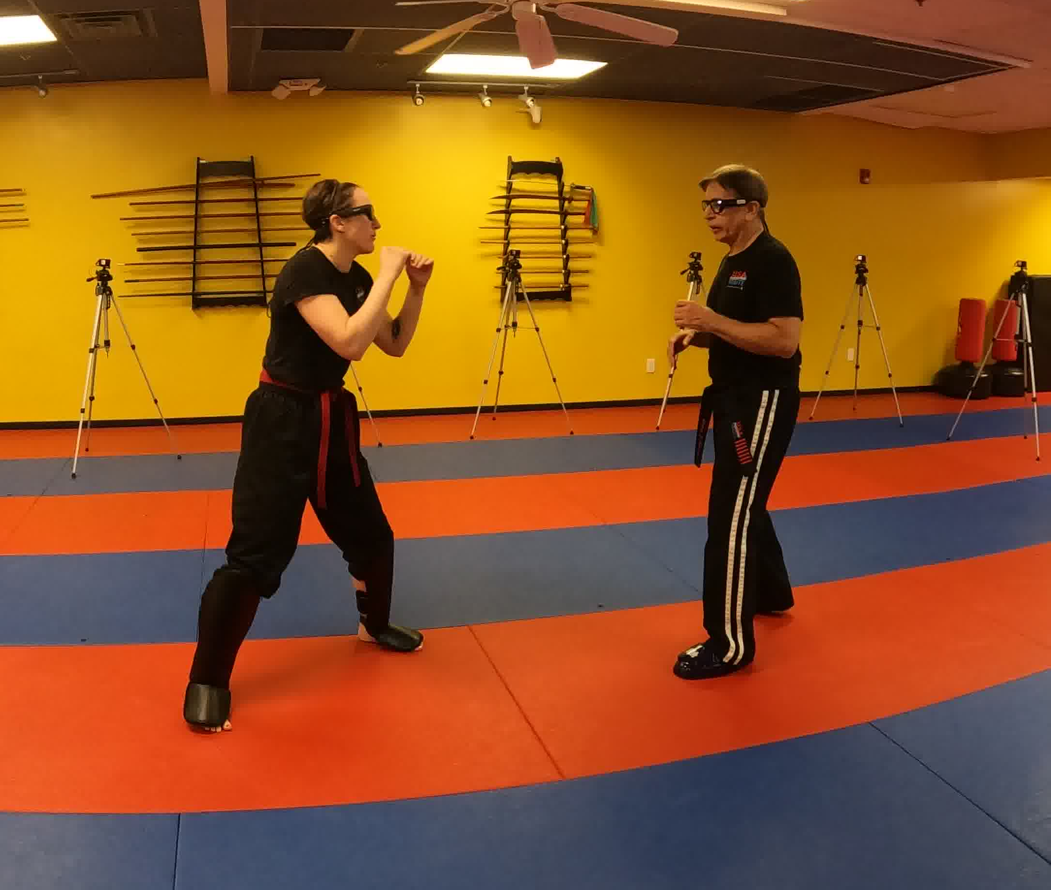
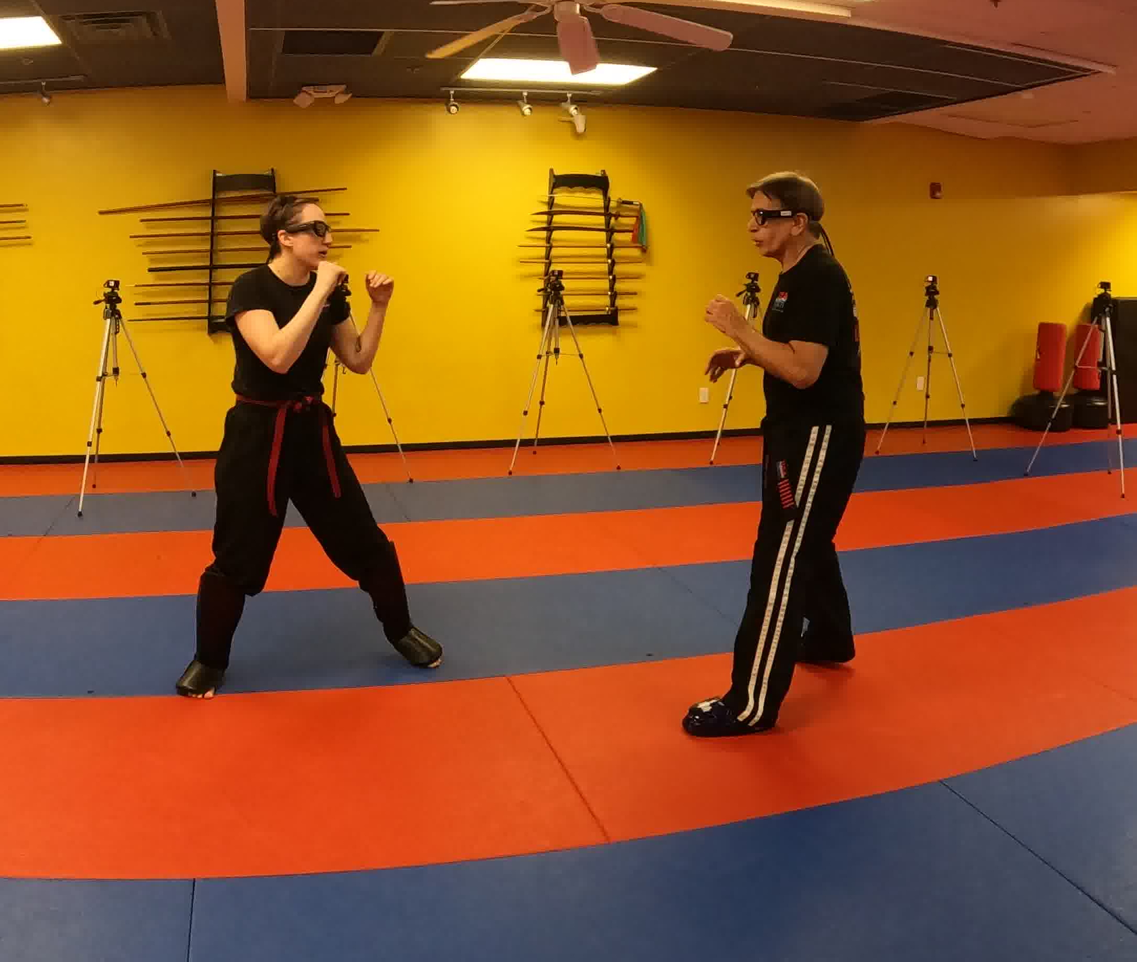
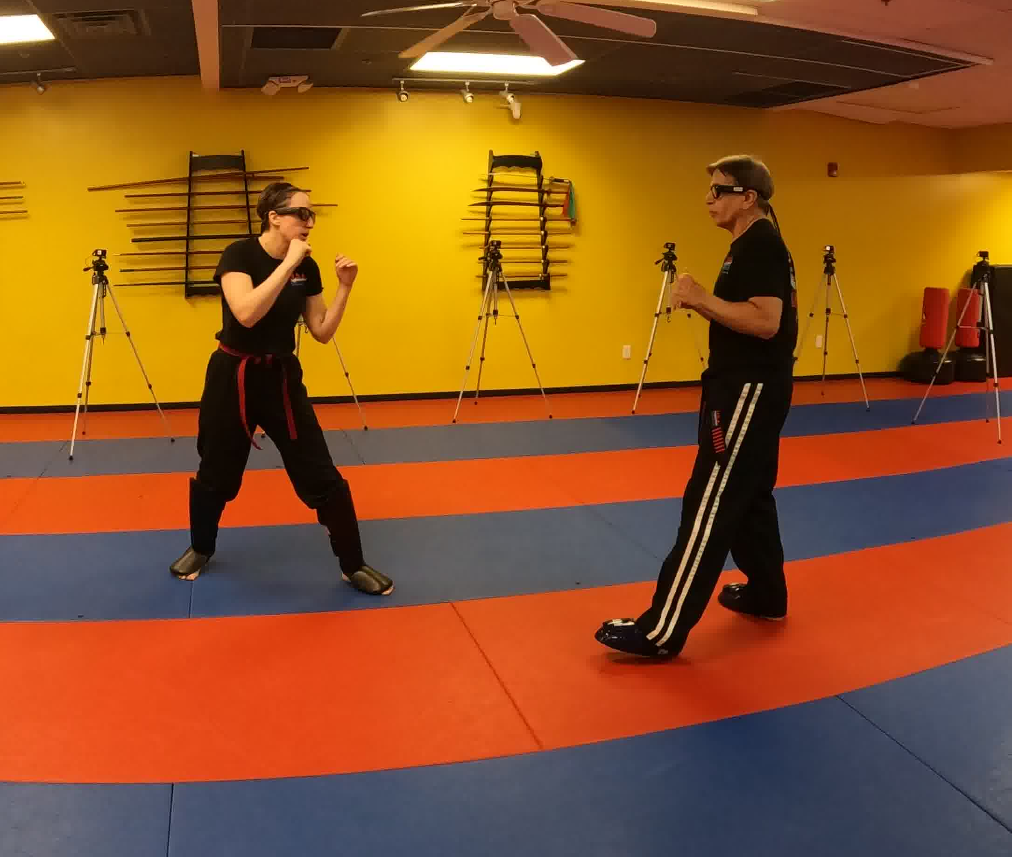
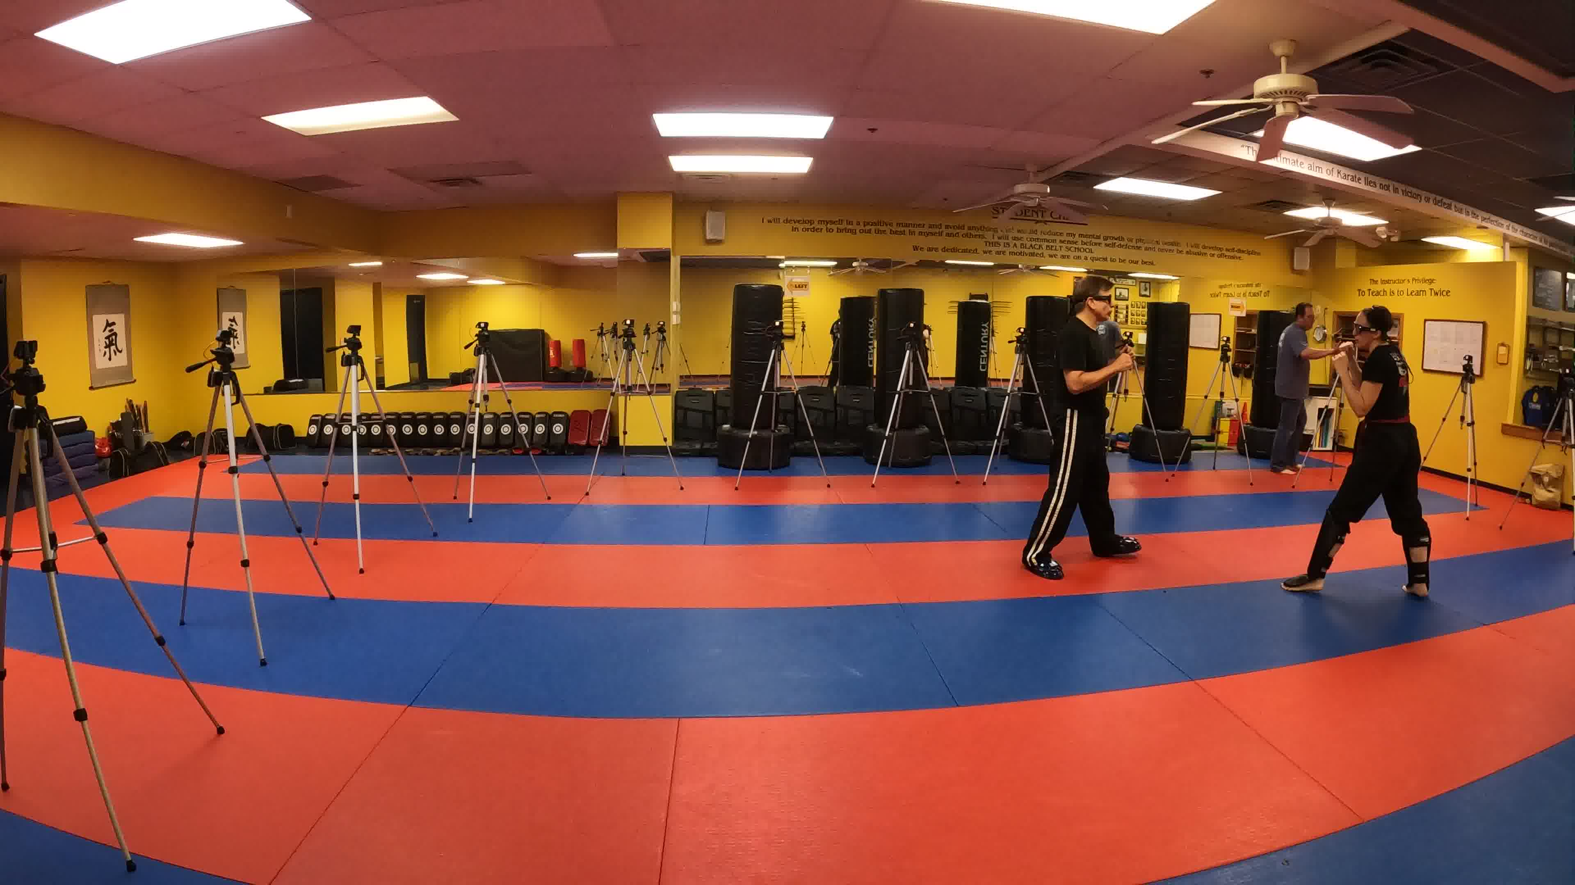
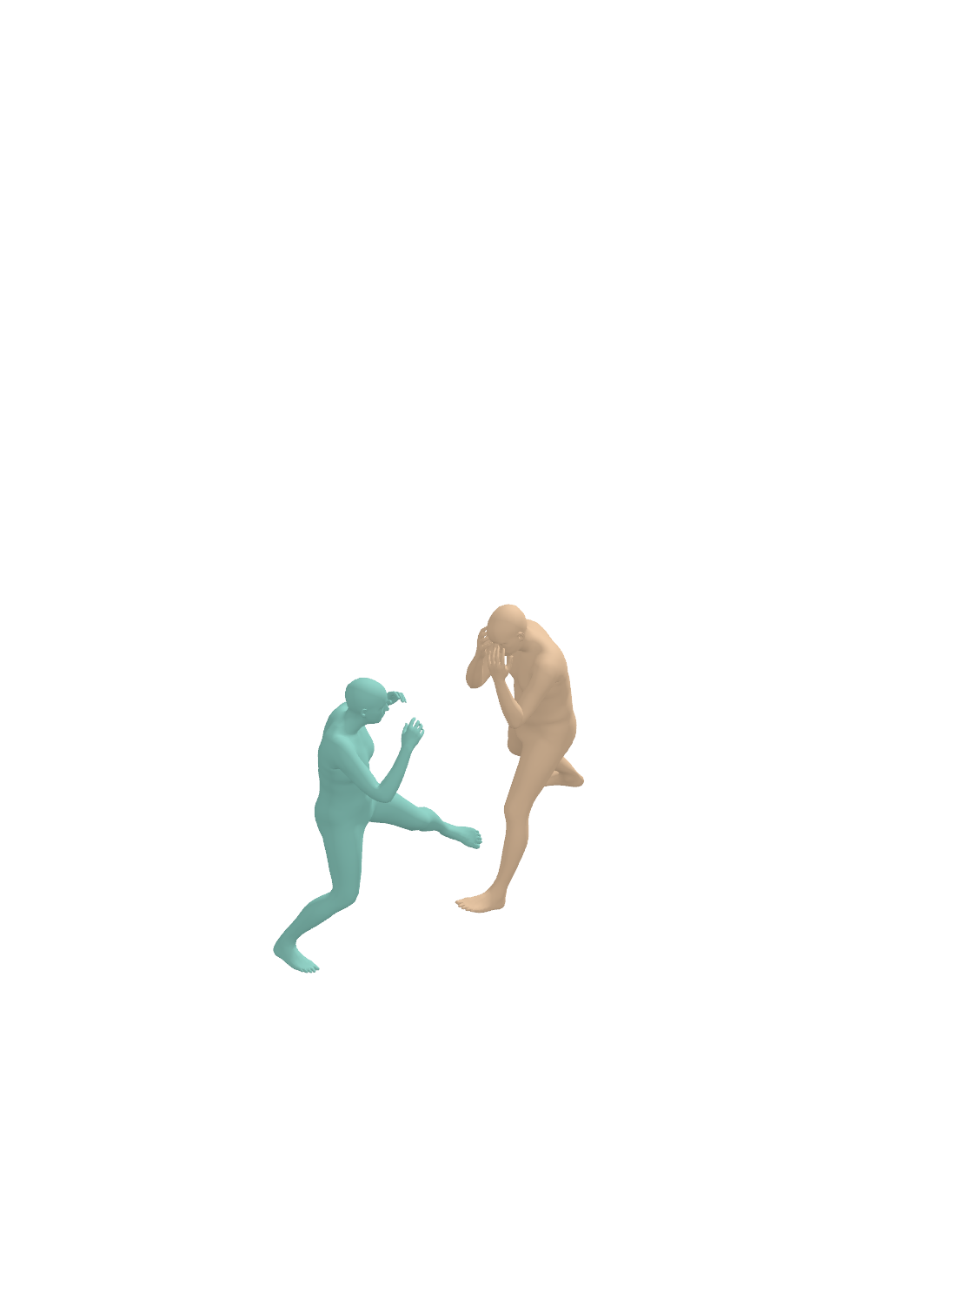
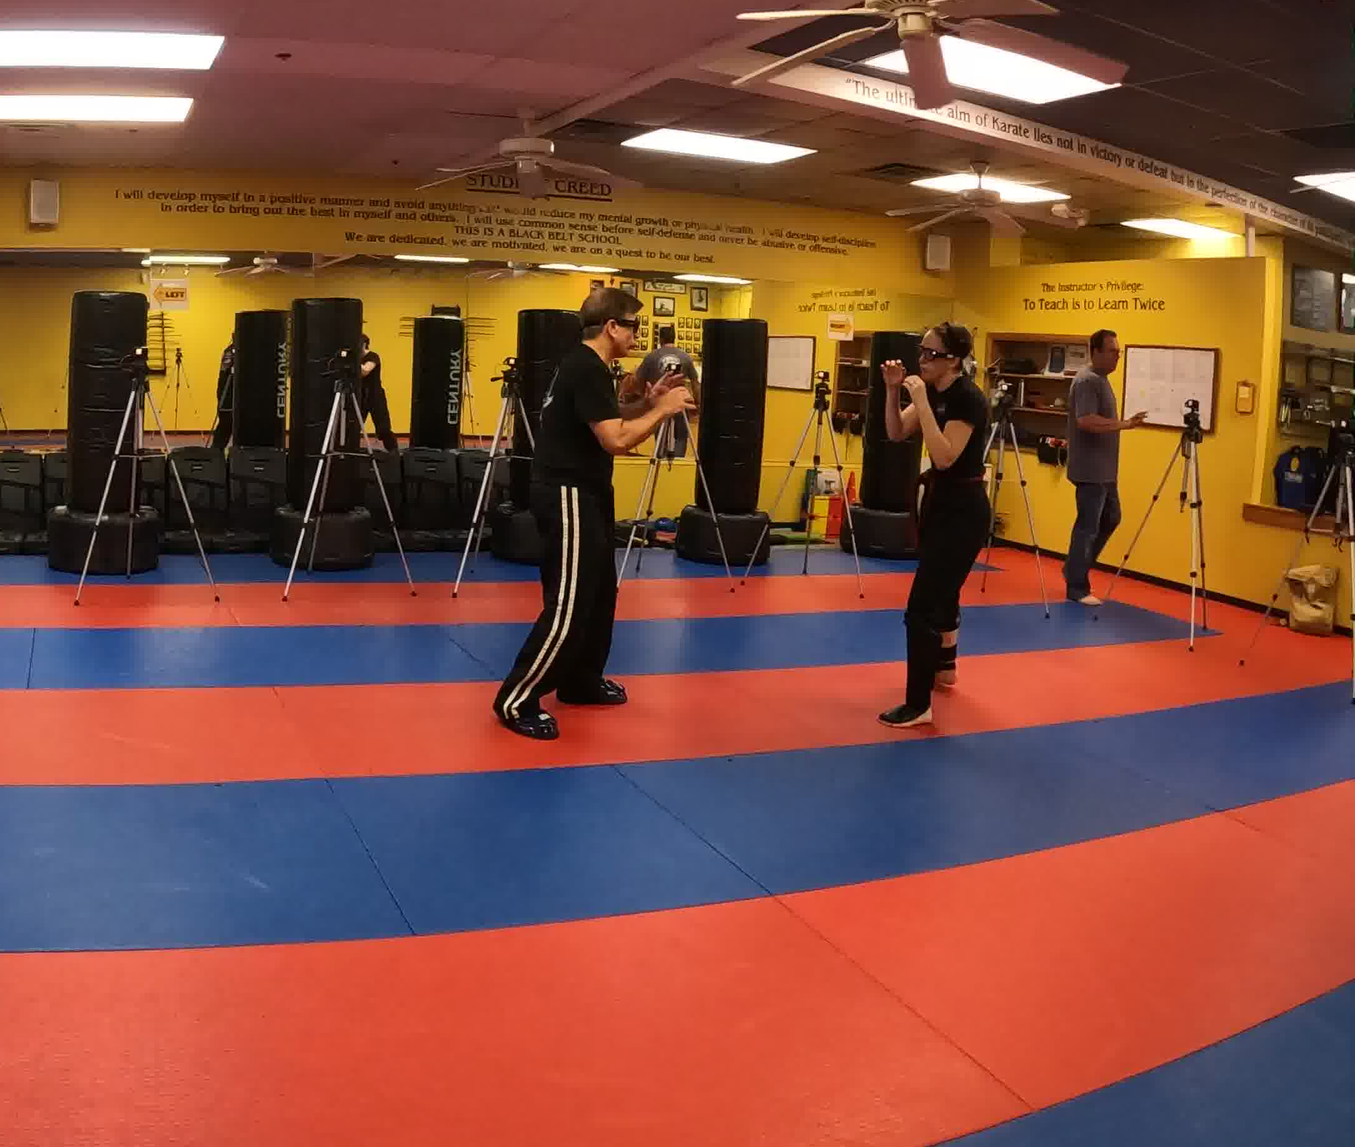
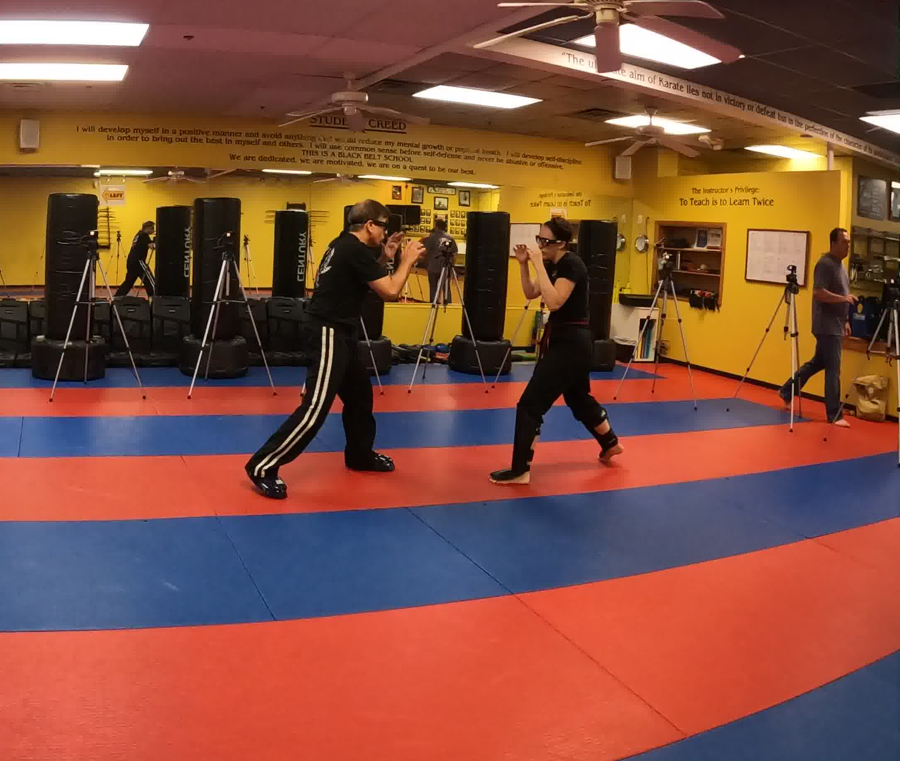
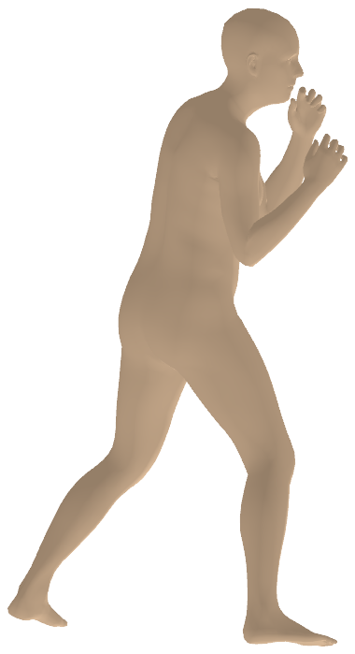
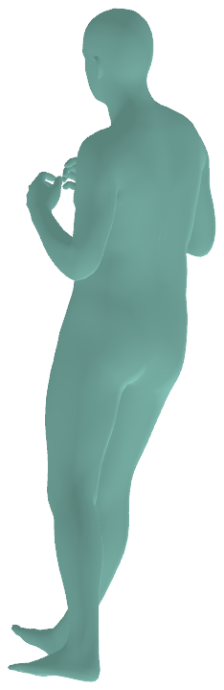
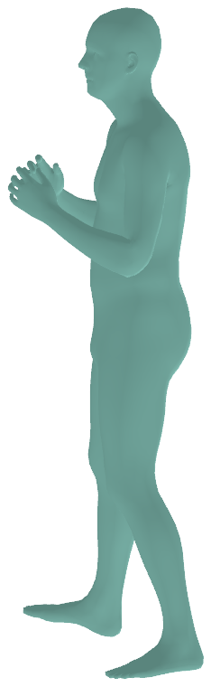
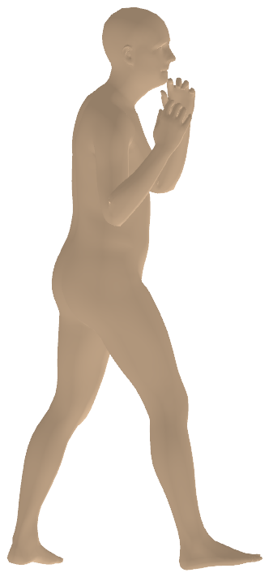
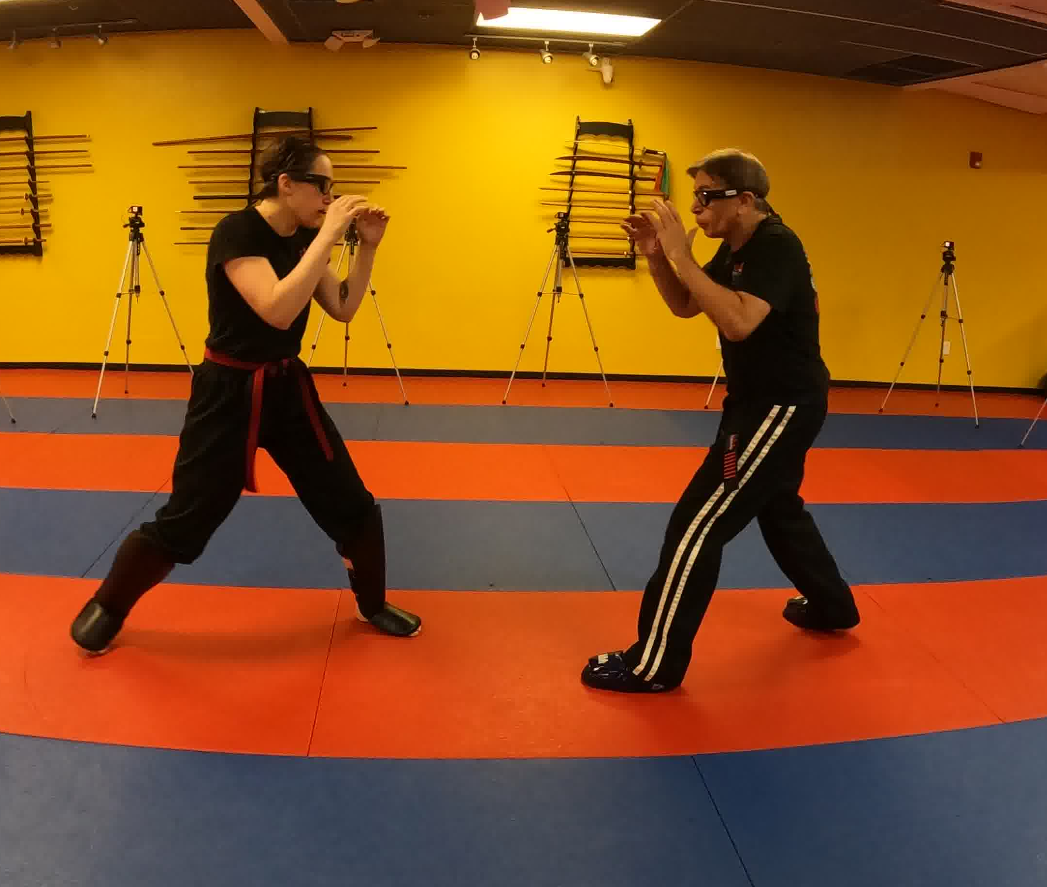
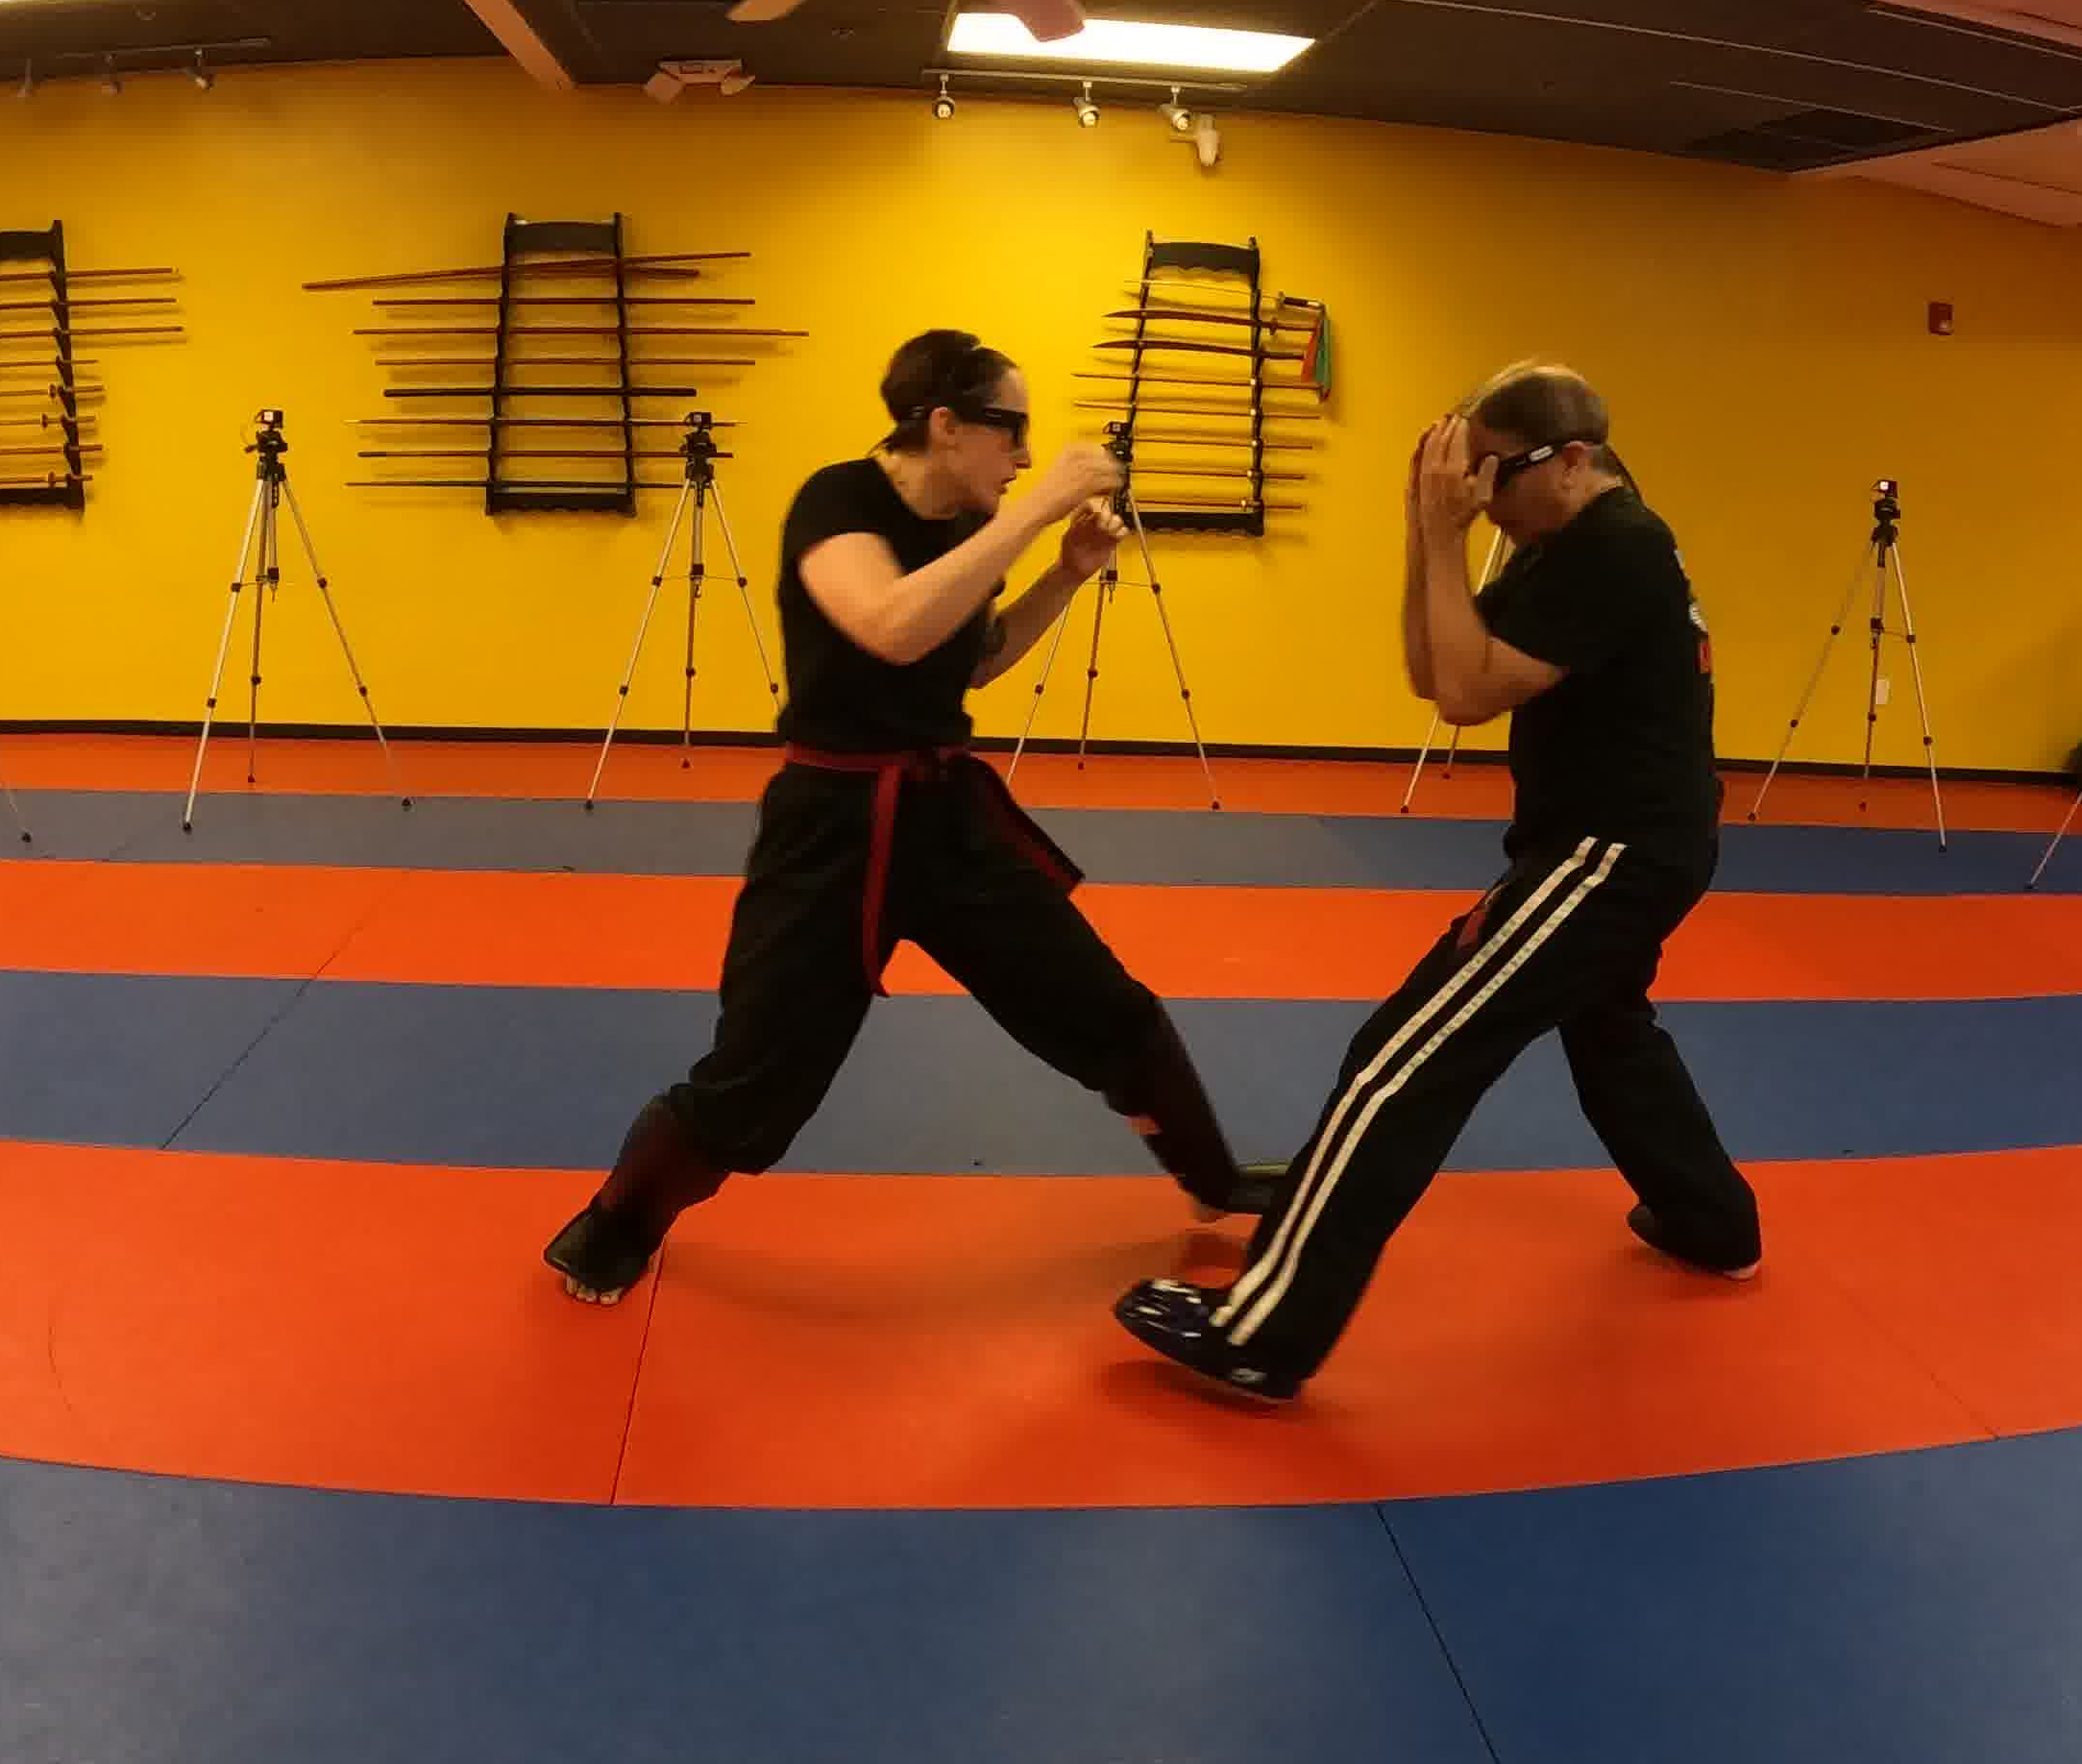
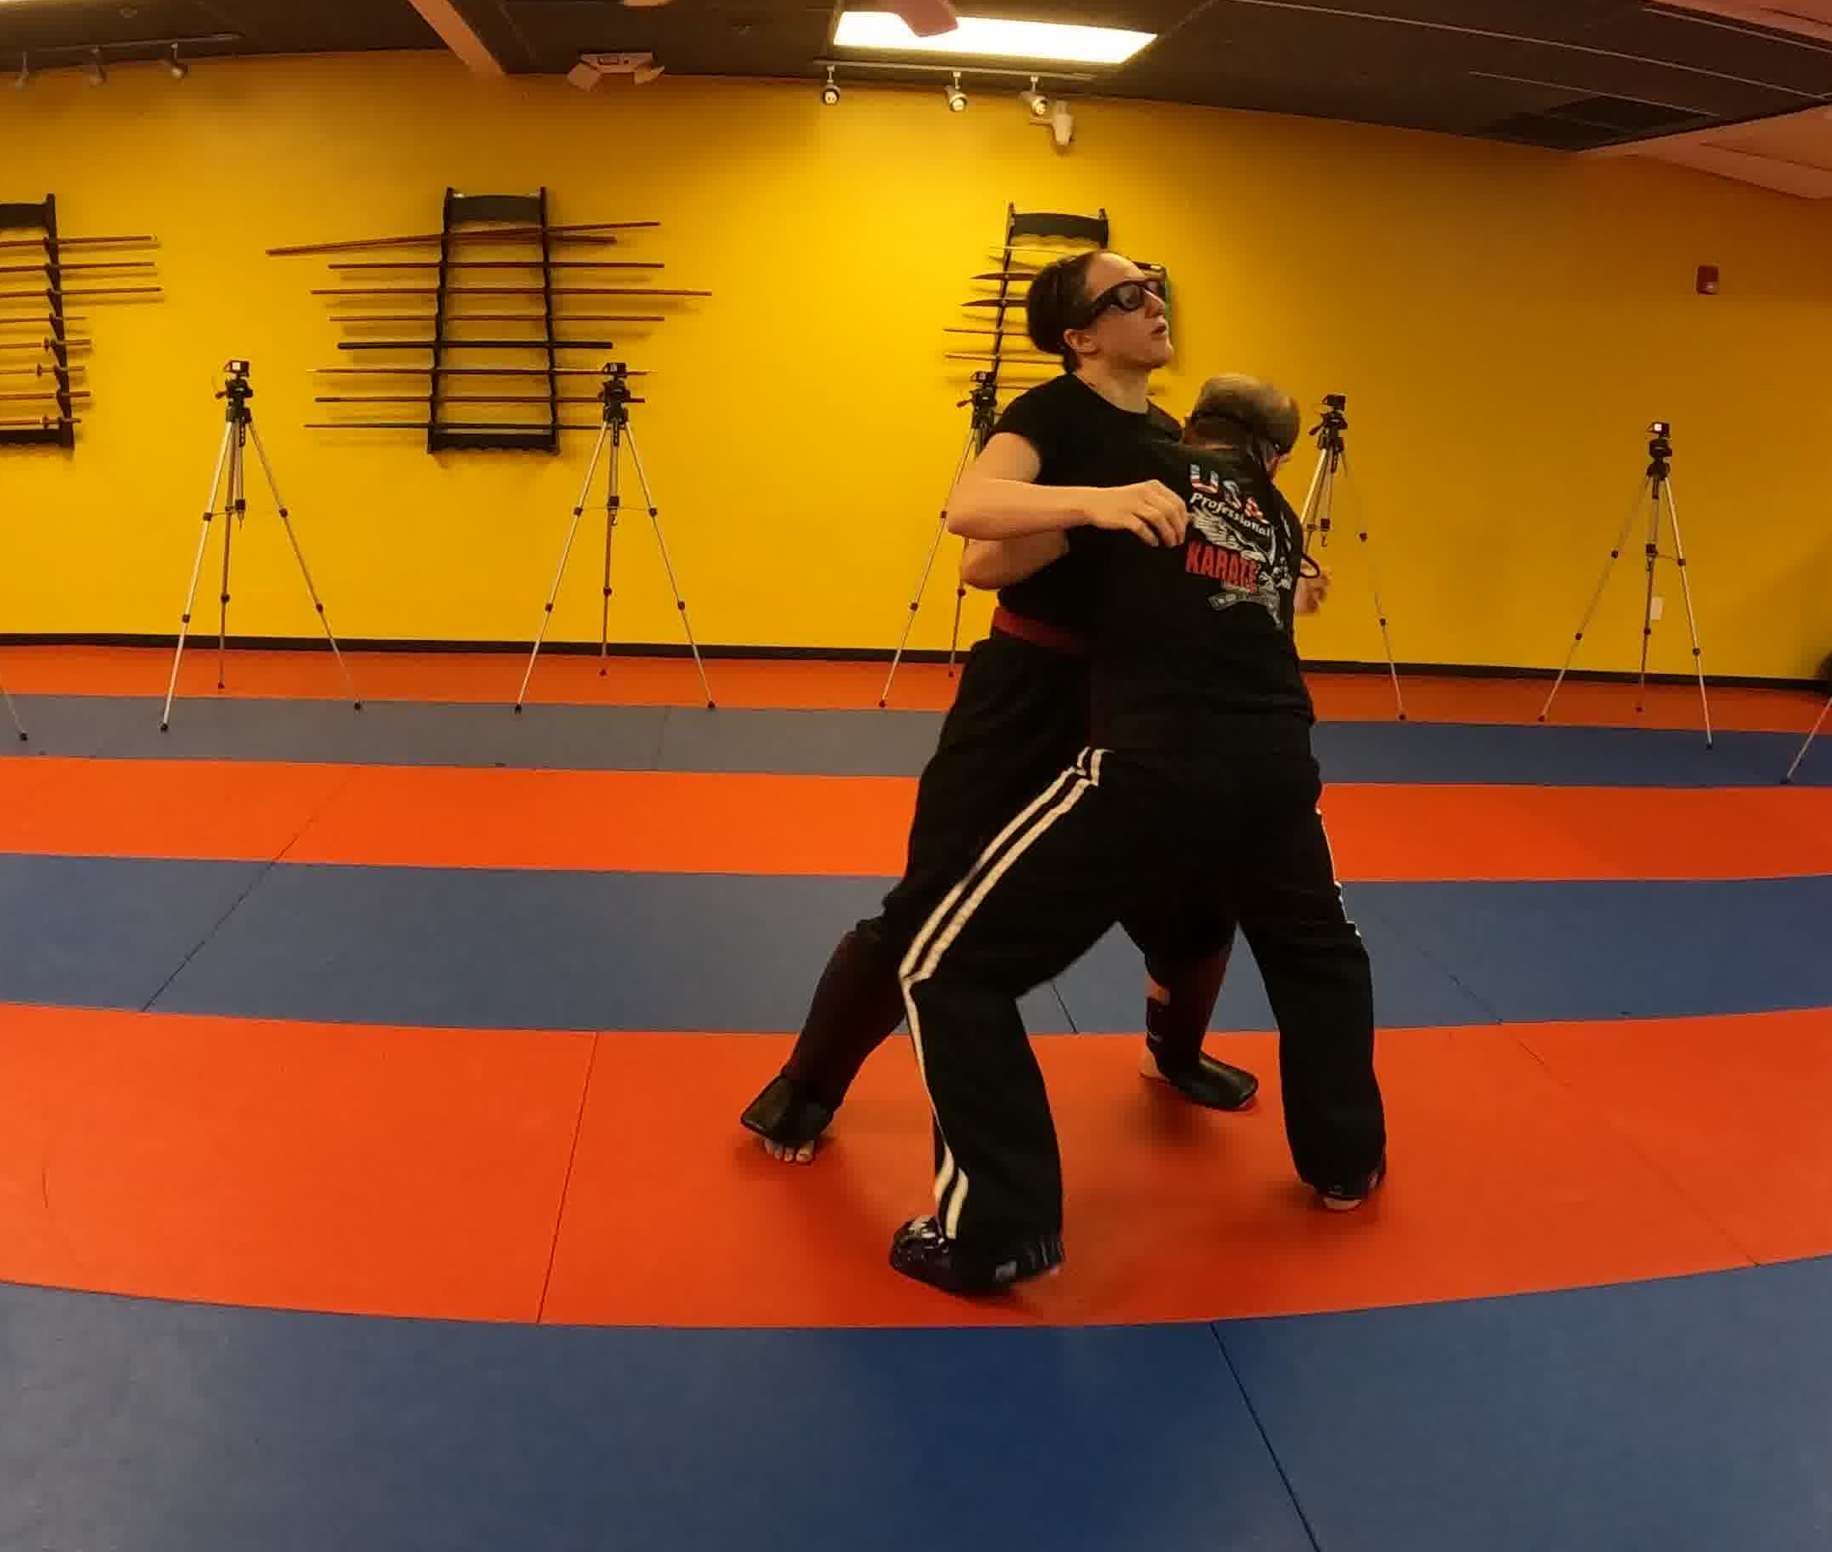
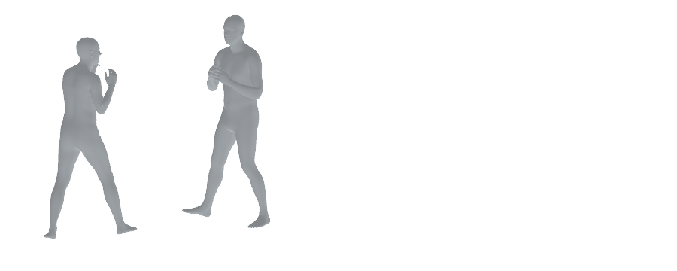

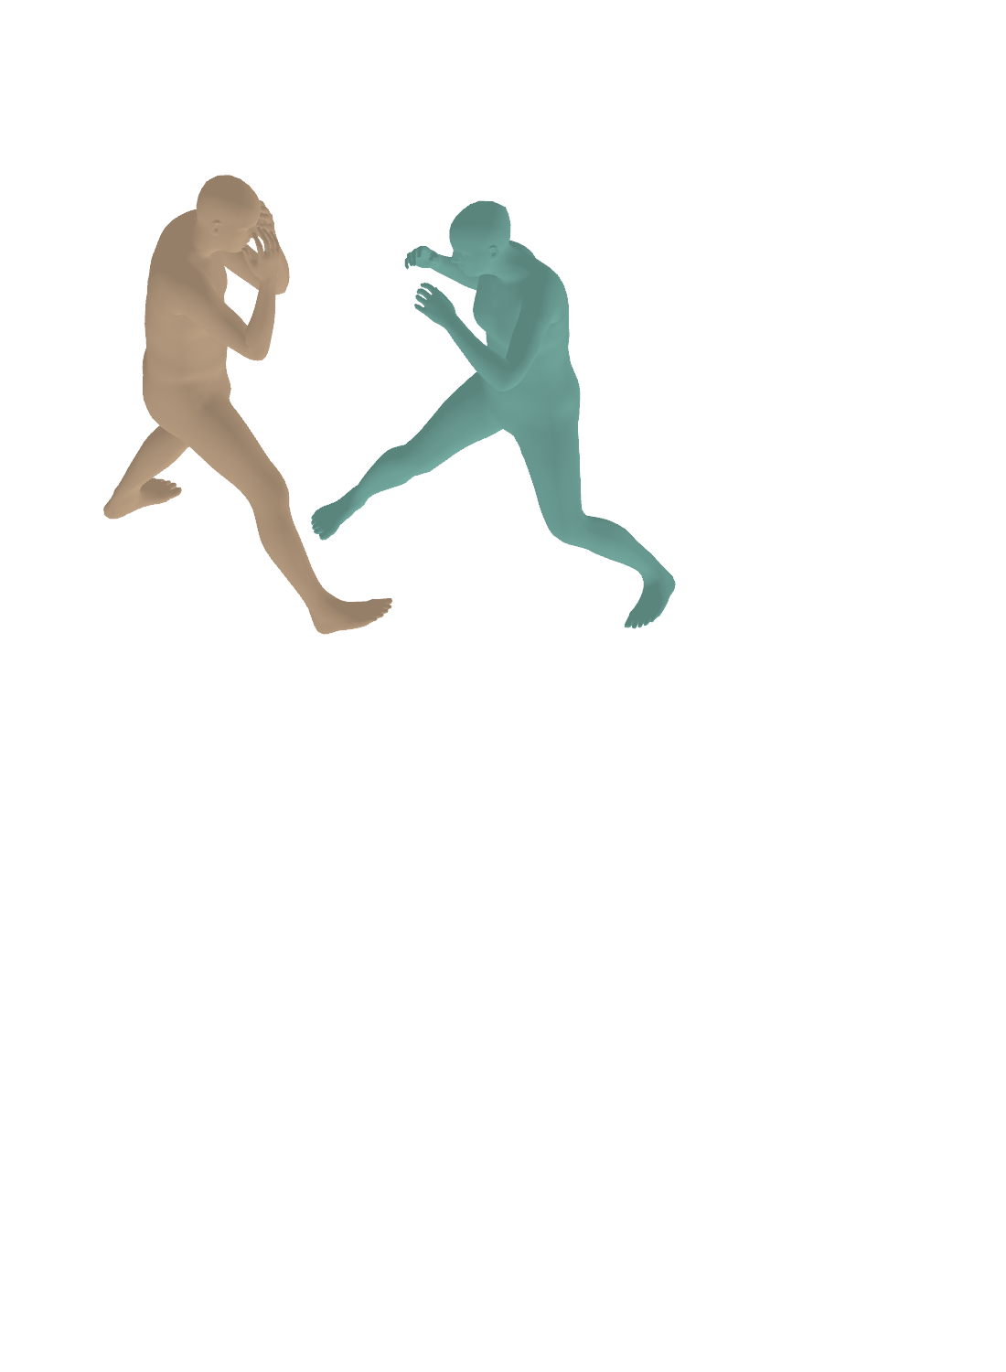
Multi-shot video
Feature & token
construction
Alignment–state decoupling
Repeated at each detected transition
Camera–human consistency
Streaming output
Shot 1
New-shot frame
I_{b}
Alignment path
History-conditioned · Temporary
Camera alignment
World-frame output
T_{b}^{align} = C̃_{b} (C_{b}^{r})⁻¹
Schematic illustration
…
Previous state
Alignment token construction
Z_{b}^{align}
S_{b−1}
T_{b}^{align}
Shot 2
Semantic
Camera
alignment
Temporal
context
C̃_{b}
Shot transition
Recurrent
decoder
Camera
latent
residual
Shot 2
Read only
Native tokens
S̃_{b}
Geometry-based person association
…
Image
encoder
Not propagated
Previous shot
New shot (aligned)
Last-frame predictions
First-frame predictions
Shot transition
Reconstruction path
Reset at cut · Updated within shot
Shot 3
New-shot outputs
Initial state
Camera
C_{b}^{r}
Pelvis position · Torso orientation
Root-centered joint configuration
Shot 1
Native tokens
Shot 3
…
Image
tokens
Human
prompts
Camera
token
S∅
Recurrent
decoder
Humans
ℋ_{b}^{r}
Matched pairs
Persistent IDs
Z
F_{b}
H_{b}
p₀
Y
Person-guided translation
World coordinates
Time
At cut only
State
S_{b}^{r}
Current + past RGB
One shared translation
X
Same boundary-frame tokens
Δ_{b}
Cameras · Humans · Identities
Recurrent state update for t > b
Online shot-transition
detector
Shot-transition signal
Later-frame tokens
t > b
Frozen
Trainable
Camera + all humans · relative geometry preserved
Past outputs remain unchanged
Notes:
Editable Shot3R pipeline redrawn from the figure and the v040 drawing brief supplied in this conversation.
ARTICLE FIGURE 2: SCHEMATIC WORLD-FRAME OUTPUT ILLUSTRATION. Only the final Output panel differs geometrically from V2. The Input/association/refinement panels retain their V2 evidence. Output camera centres/orientations use the previously audited static calibration for cam18/cam15/cam19. Shot 1 versus Shot 3: 6.355 degrees; Shot 1 versus Shot 2: 179.427 degrees; Shot 2 versus Shot 3: 177.929 degrees. These poses are annotation-derived static PnP calibration, not model camera predictions. The existing frame-125 predicted meshes for persistent IDs 0/1 are transformed together using calibrated_cam19_c2w @ inverse(predicted_frame125_c2w). Shapes, articulation, inter-person layout and camera-local coordinates are preserved; no GT human geometry, pelvis target or per-person registration is used. The calibrated panel is a representation/geometry illustration and must not be presented as uncorrected method performance. The visible subtitle explicitly reads Illustration—not raw output. RGB source crop choices do not change physical camera extrinsics. Camera glyphs use full-source fisheye corner rays; their lengths are display scales. The grid is a display aid, not reconstructed background. Original caches, metrics and earlier PPT versions remain untouched. Text/arrows/camera lines/grid remain editable; humans are a replaceable transparent render. This uses the existing supplementary train-side multicut case_01 for illustration only. See asset_provenance.json for explicit calibration and human-gauge transforms.
Information flow: the same boundary frame is processed with shared base decoder weights but separate states. Only the independently reinitialized recurrent state propagates; the temporary historical state terminates. Three alignment tokens enter the recurrent decoder before the camera residual. Prediction-based person association uses pelvis position, torso orientation, and root-centered joint configuration. The person-guided translation yields a shared camera–human transform; it is not per-person pose optimization or scene optimization. The image encoder and recurrent decoder are marked frozen. The token construction and camera residual are marked trainable.
The diagram uses generic backbone labels as requested. Source attribution for the inherited pretrained architecture should be retained in the manuscript or caption.
Suggested caption: Overview of Shot3R. At a shot transition, the first new-shot frame is processed by two paths with shared backbone weights: a history-conditioned alignment path estimates inter-shot alignment, while an independently reinitialized reconstruction path supplies the only state propagated to subsequent frames. Prediction-based person association and a shared camera–human transform connect new-shot predictions to the existing world frame without accessing future frames or revising past outputs.
REVISION 2026-09-08 — based only on the two attachments provided in this chat.
The nine decisions in Shot3R_Pipeline_图文对齐修改确认清单_20260908(2).md are implemented at figure level.
1. Added a lightweight online shot-transition detector, current/past RGB input and dashed control links.
2. Clarified that the two boundary paths receive the same native input tokens; frozen/learned legend is restrained.
3. Added subsequent-frame input and an explicit recurrent-state feedback loop; reset is used only at a cut. No geometry output is fed back into state.
4. Kept the original coarse alignment arrangement: prior state, alignment-token construction, frozen decoder, trainable camera residual and temporary-state termination.
5. Kept all three alignment tokens; removed small Attention/MLP internals instead of adding a token-detail panel.
6. Labelled previous-shot last-frame predictions and aligned new-shot first-frame predictions. Matching supplies persistent IDs and matched pairs.
7. Shared translation acts jointly on the camera and all people; no extra rotation fit, per-person registration or scene optimisation is introduced.
8. Added Repeated at each detected transition and Past outputs remain unchanged.
9. Removed the redundant footer and used the space for control, recurrence and whitespace.
All nine RGB thumbnails, the enlarged boundary frame, the four association meshes, the two translation mini-scenes and the calibrated output illustration are retained from the original deck. The output illustration geometry and image placement have not been changed. The illustration is not raw model-performance evidence.
All newly added boxes, labels, control/data arrows, symbols and loops are native editable PowerPoint objects. RGB photographs and human renderings remain individually replaceable embedded images.
The latest manuscript files referred to in the checklist were not attached; they were not inspected or edited. This revision does not alter the paper, experimental results, training, model weights or checkpoint. The original uploaded PPTX remains untouched.

