Slide 1
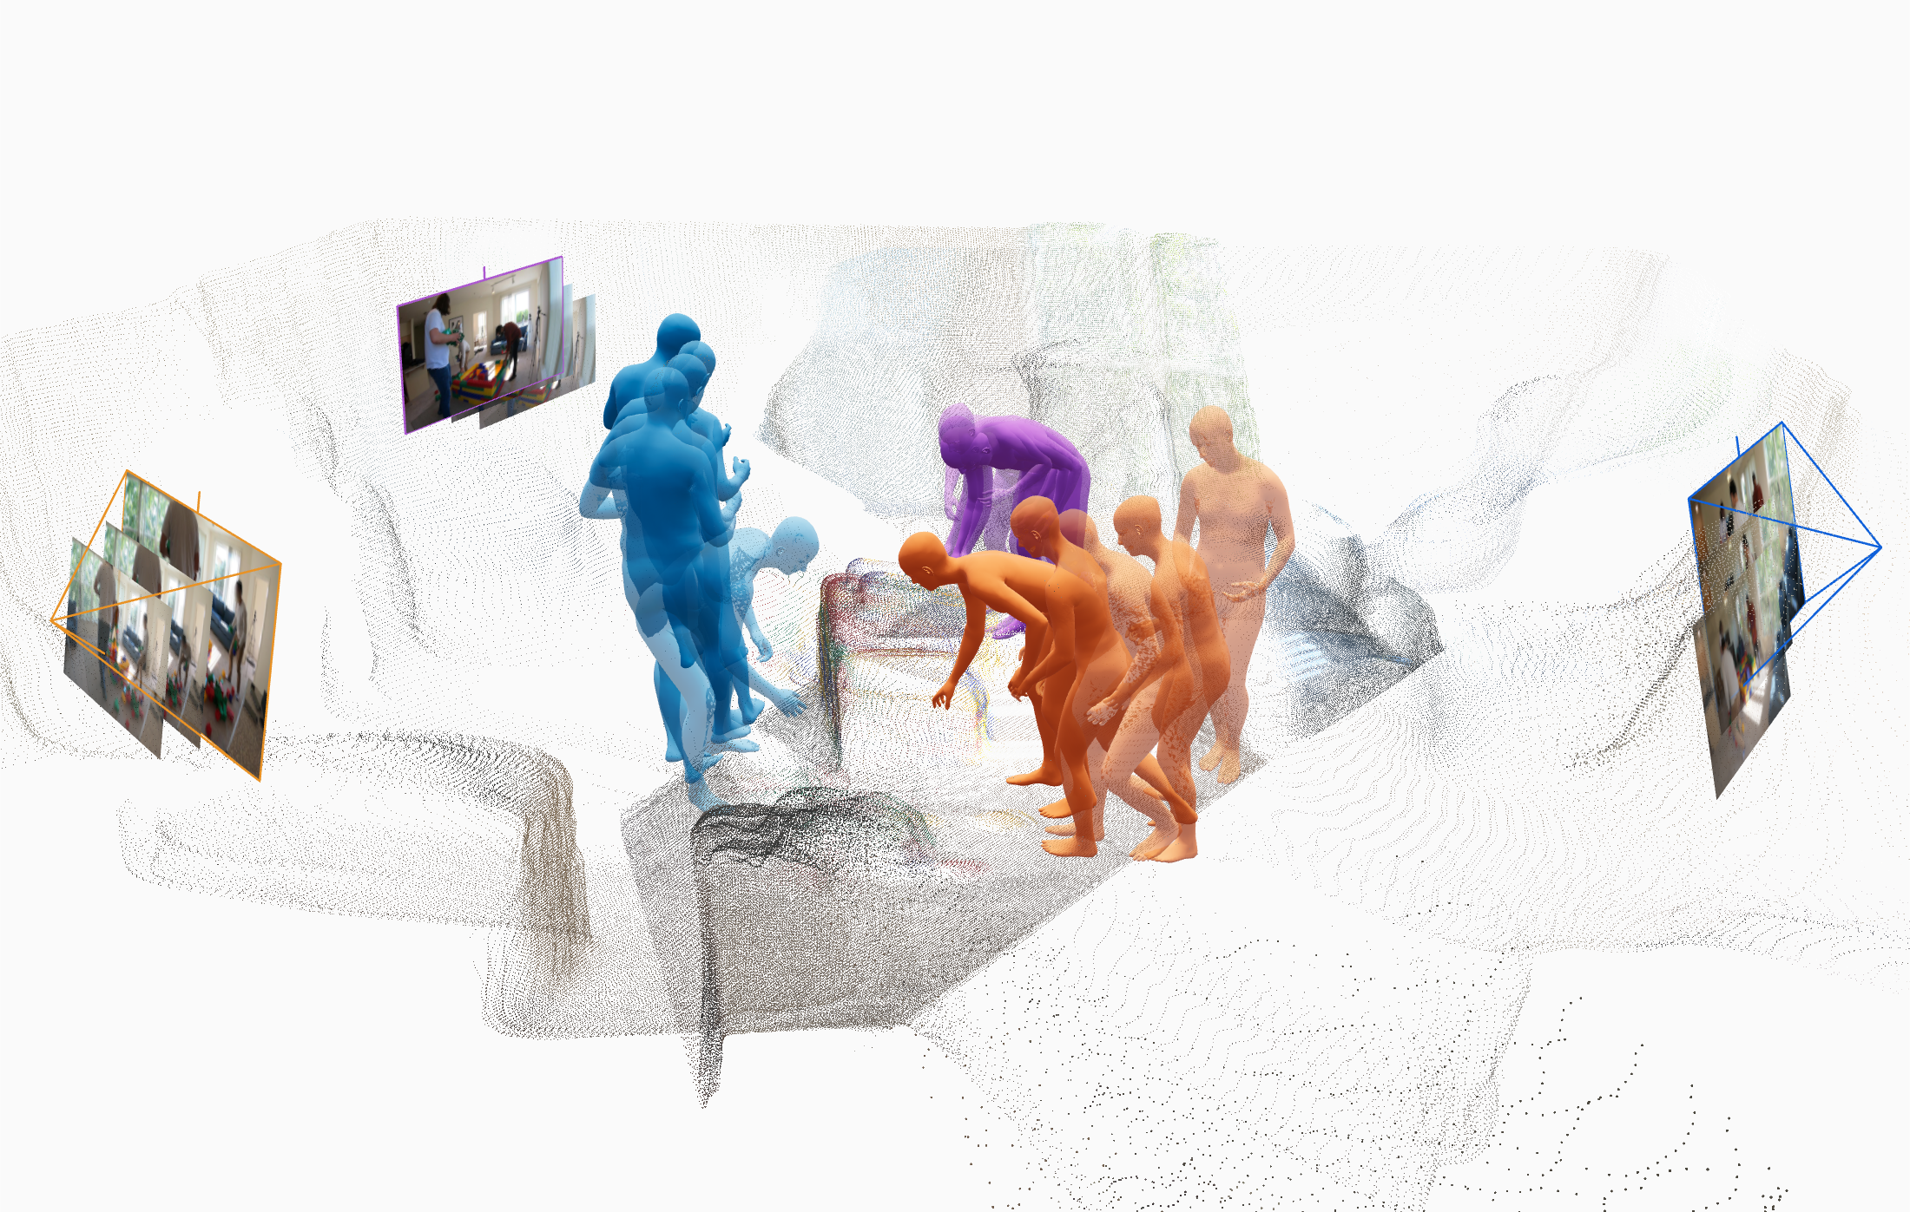
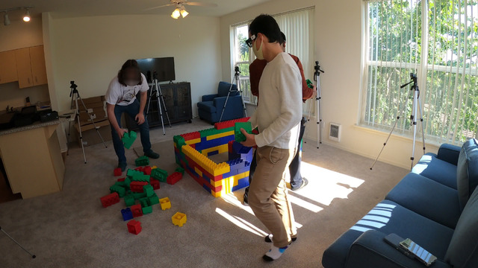
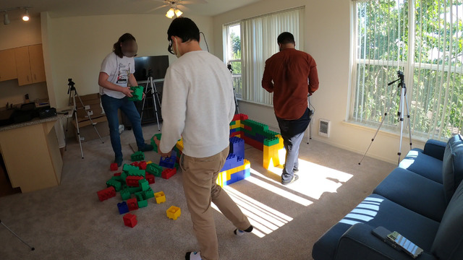
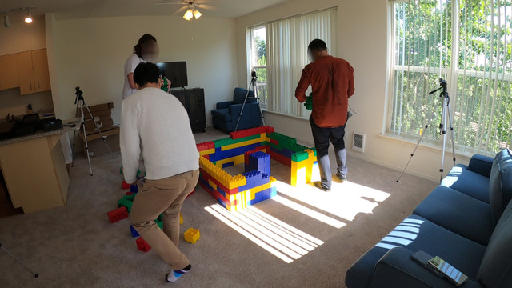
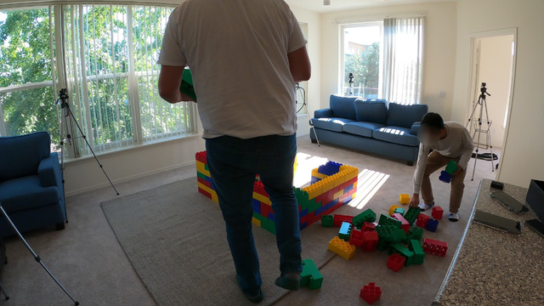
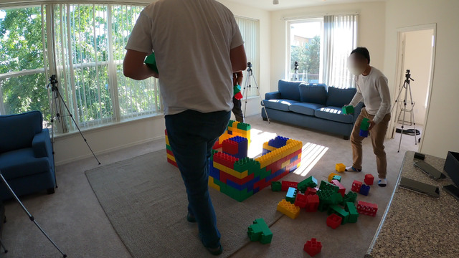
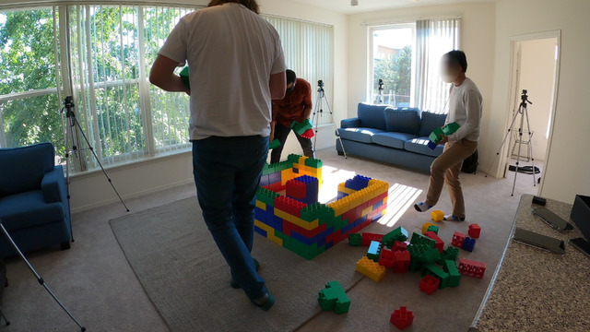
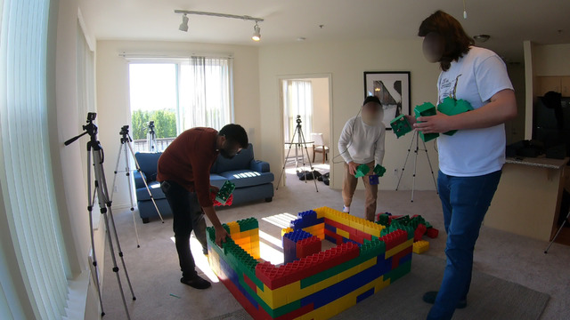
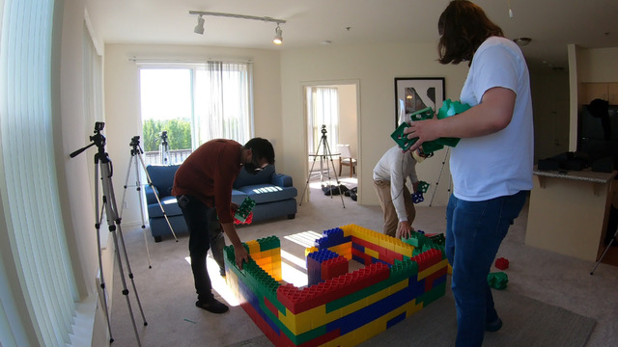
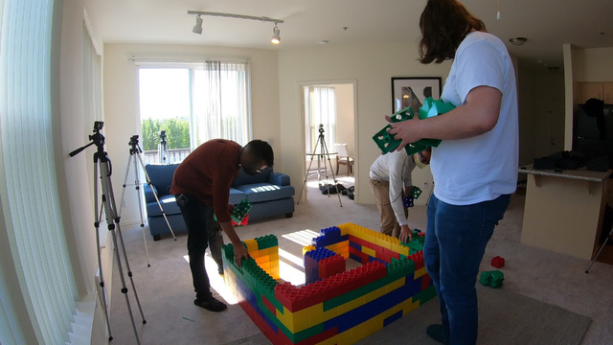
Streaming 4D
Reconstruction
Multi-shot
0°
Frames 0, …, t − 1
99°
177°
Frames t, …, t + n − 1
Frames t + n, …
Shot 2
Shot 1
Shot 2
Shot 3
CUT
CUT
Streaming video
Notes:
CAMERA-IMAGE-PLANE REVISION / 相机代表帧整合修改
- Removed the independent top row of three representative photographs.
- Reused exactly the same source representative photographs at the 0°, 99° and 177° camera positions, as independent perspective image planes.
- All new camera frustum lines, outlines, camera centers, angle labels and badges are native editable PowerPoint objects.
- The orange 99° camera was redesigned as a thin-line frustum; the original baked-in icon and label are covered by two separately editable, narrowly bounded white masks. The original reconstruction image bytes are unchanged.
- The original right-hand baked-in camera is occluded by the new corresponding 177° image plane. The obsolete native 0° camera and detached 177° angle label were removed.
- The reconstruction image, human poses, motion ghosts, person colors, point cloud and blocks were not regenerated or changed. Only the original reconstruction picture was moved upward.
- Bottom video frames, shot labels, two CUT markers and the streaming-direction arrow are unchanged except for a common upward translation.
- The source 99° angle is retained; no conversion to 90° is implied.
- Canvas height was reduced after removing the top row.
EDITABILITY / 可编辑范围
- Each camera + photograph is a separate named group. Ungroup to edit camera rays, angle text, outline and photo separately.
- The three perspective photographs are independent image objects, not a flattened slide. The unwarped originals remain available in the middle frame of each bottom shot group.
- The central reconstruction in the supplied PPT is already one composite picture. This revision preserves that structure and does not claim its individual humans or point-cloud points are editable.
SOURCE PROVENANCE / 论文使用说明
- Source notes identify the central reconstruction imagery as illustrative/generated, not measured reconstruction output. This revision adds no empirical reconstruction results.
- For empirical claims in the final paper, replace illustrative visual assets with author-produced reconstruction outputs.
TEMPORAL NOTATION REVISION / 时间帧区间修改（v7）
- The three isolated t labels were replaced by native editable frame-index ranges near the corresponding image stacks.
- 0°: Frames 0, …, t − 1. 99°: Frames t, …, t + n − 1. 177°: Frames t + n, … .
- t is the first frame after the 0°→99° cut. n is the duration of the 99° shot in frames. Cut boundaries are t−1→t and t+n−1→t+n, with no missing or duplicated indices.
- Frame indices start at zero. These are symbolic intervals, not measured timestamps; no frame rate or duration in seconds is assumed.
- The two smooth arrows follow the approved preview and are native cubic Bezier paths with native end arrowheads; no rasterized slide was substituted.
- All original photographs, image stacks, reconstruction, human poses/ghosts, camera groups, angle labels, axes, and the lower streaming-video strip are preserved. The original composite reconstruction remains a raster image.
EDITABLE LAYOUT REVISION v9 / 去白边与等比例放大
- Edited the author-uploaded PowerPoint directly. Right-hand blank canvas removed; all original objects enlarged uniformly by 1.288775x. No flattened-slide image was inserted.
- Original text boxes, editable cubic-Bezier arrows, angle badges, shot panels, photographs, and CUT/streaming groups retain their native PowerPoint structure.
- Multi-shot remains native text, now bold blue, with a 22 pt pre-scaling size.
- All embedded source image bytes are unchanged. The upper reconstruction remains the original composite raster picture; its people, point cloud, and embedded camera images are not individually vector-editable.
- Only canvas, object scaling and subtitle emphasis were changed; source shot content, frame ordering, temporal annotations and reconstruction imagery were preserved.

