Slide 1
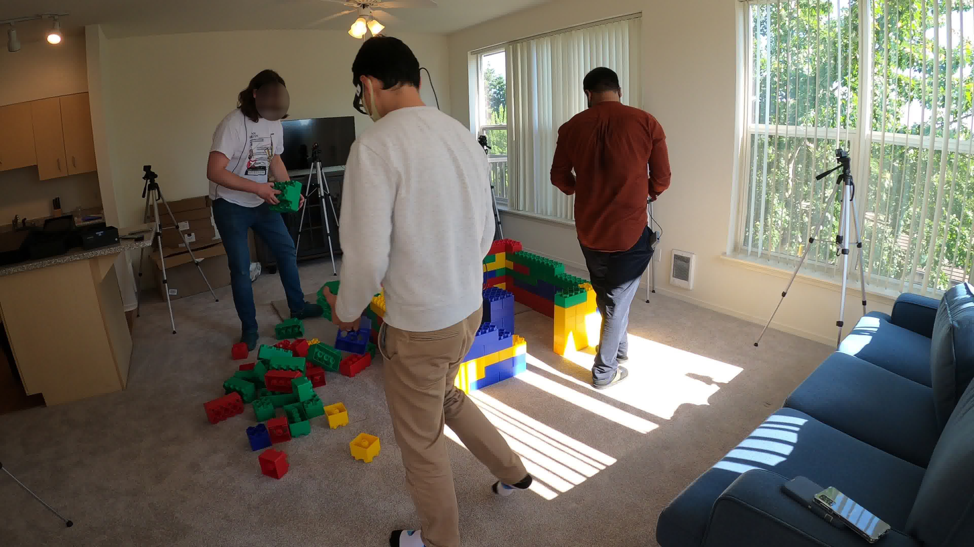
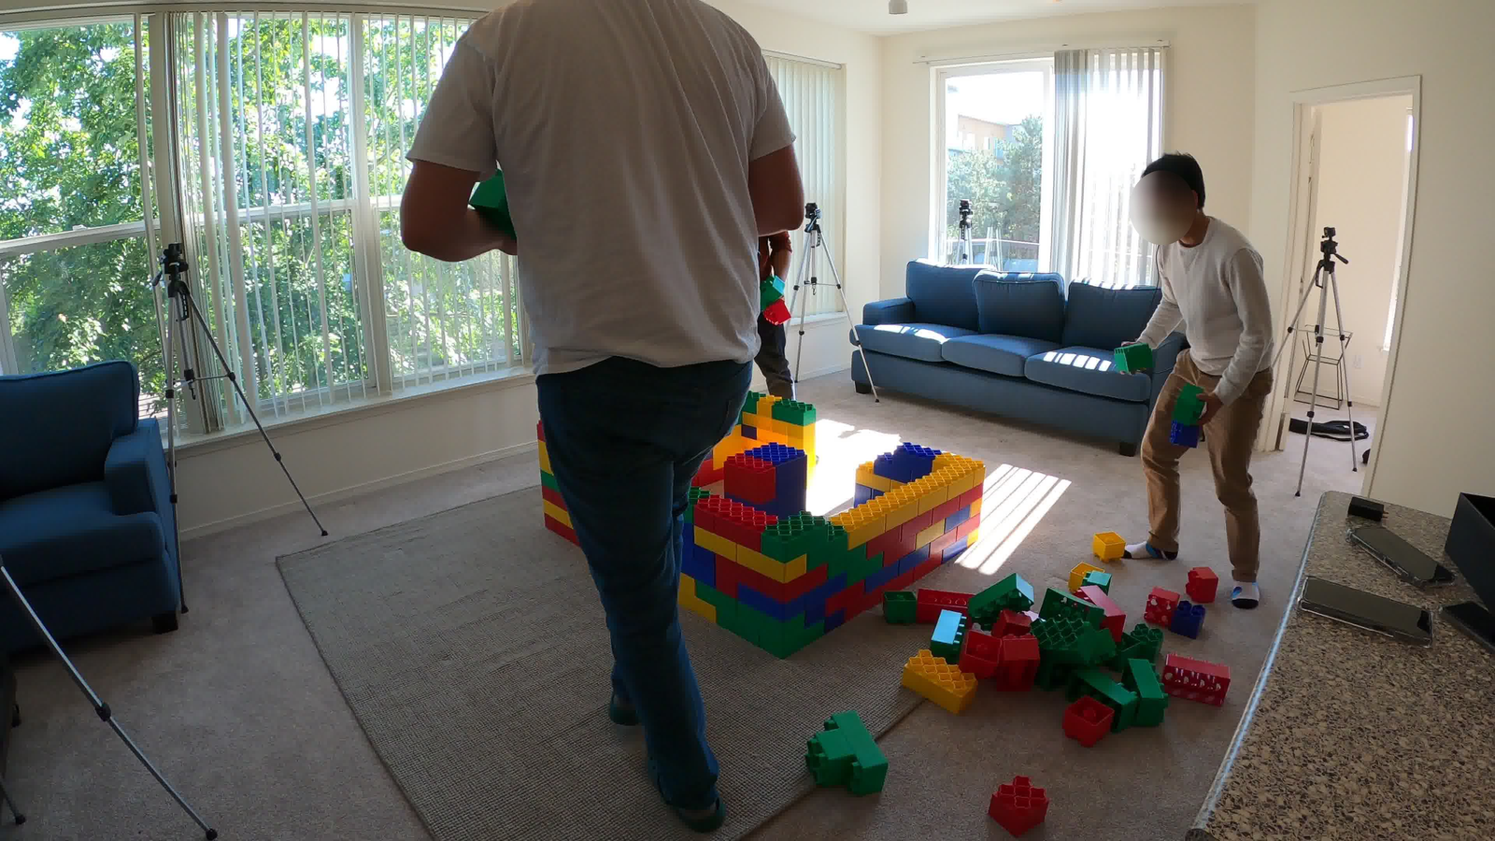
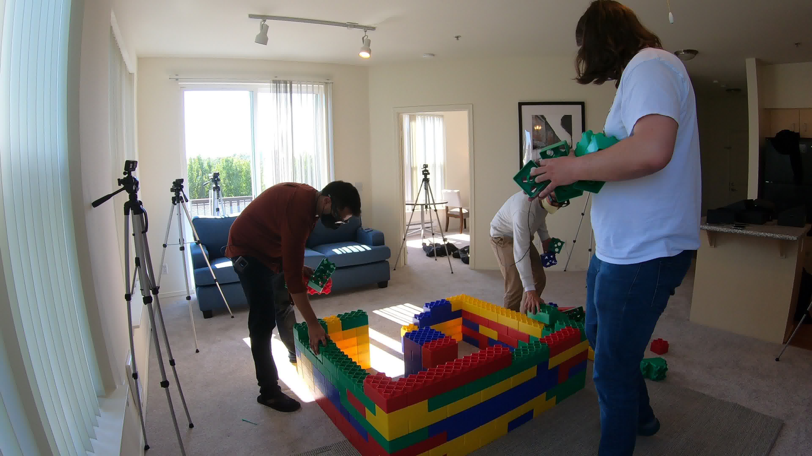
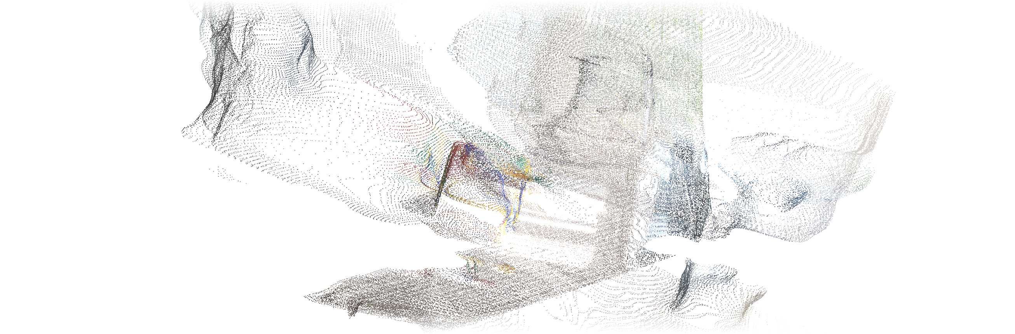












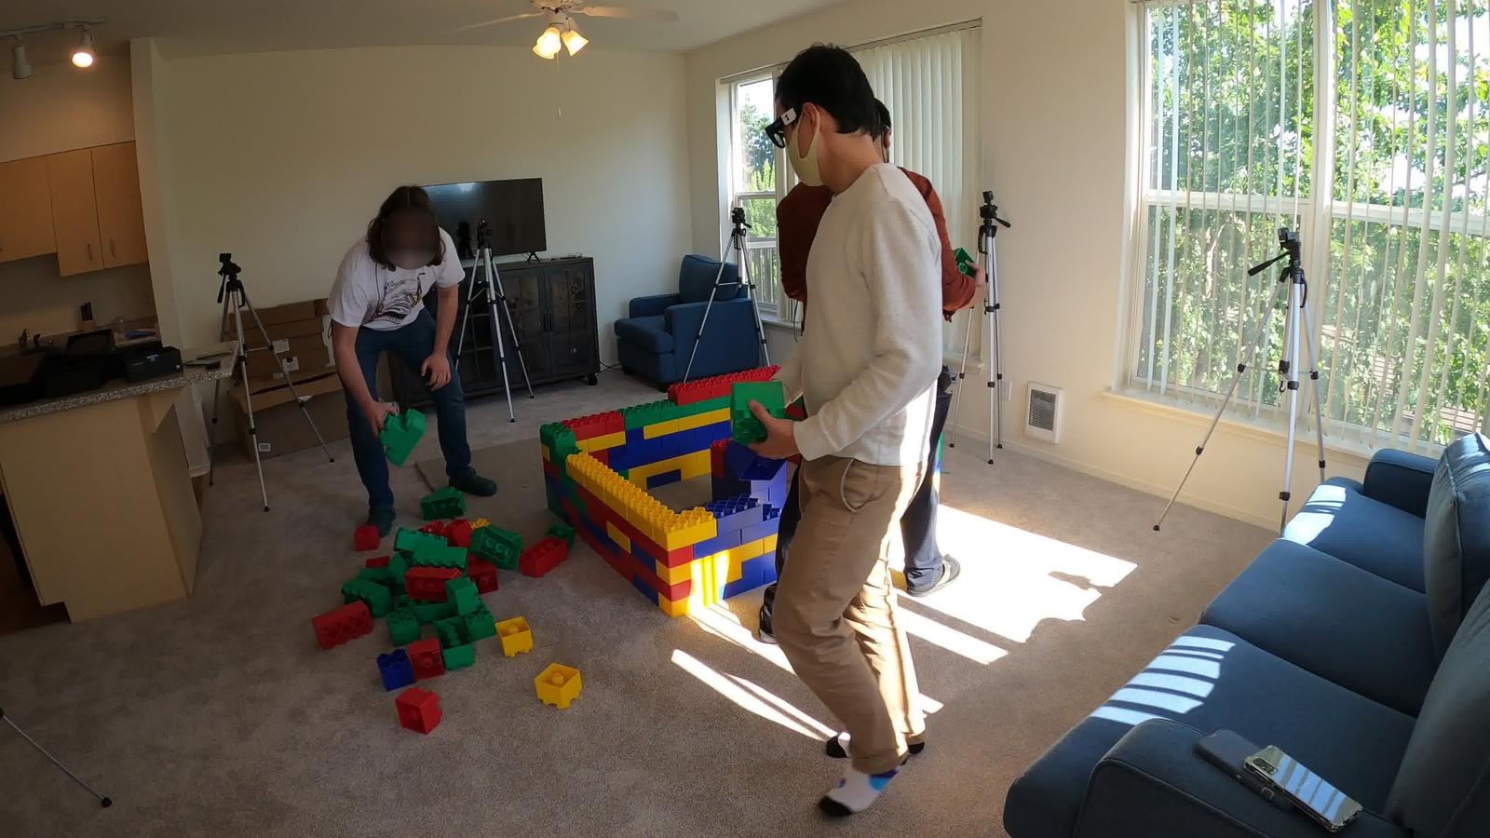
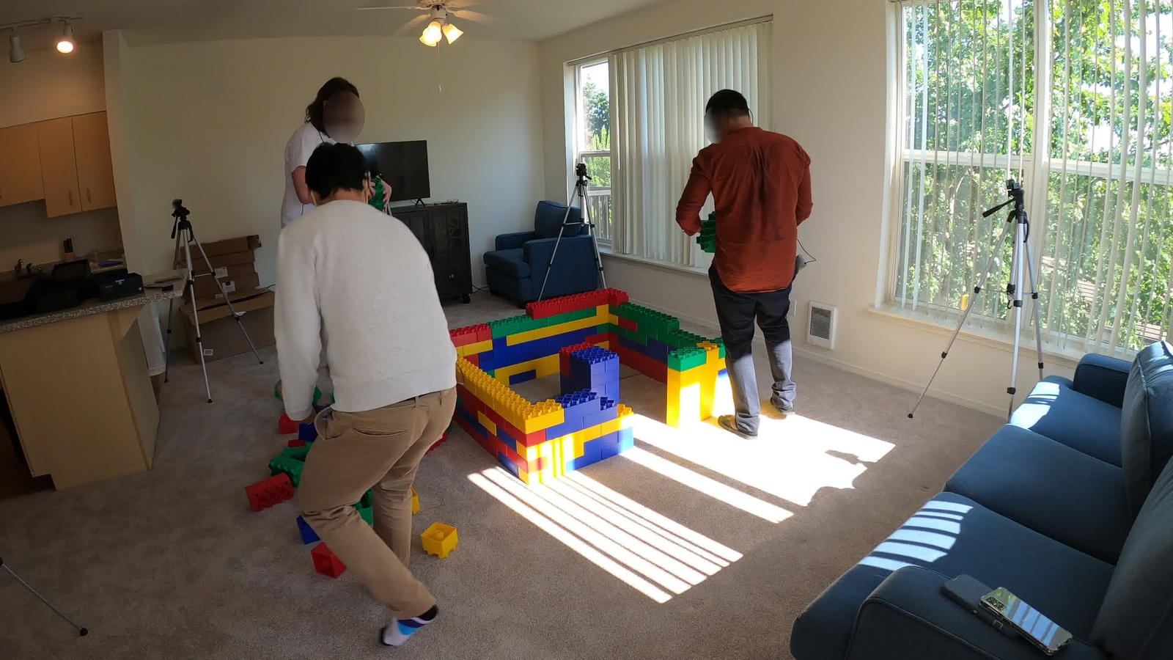
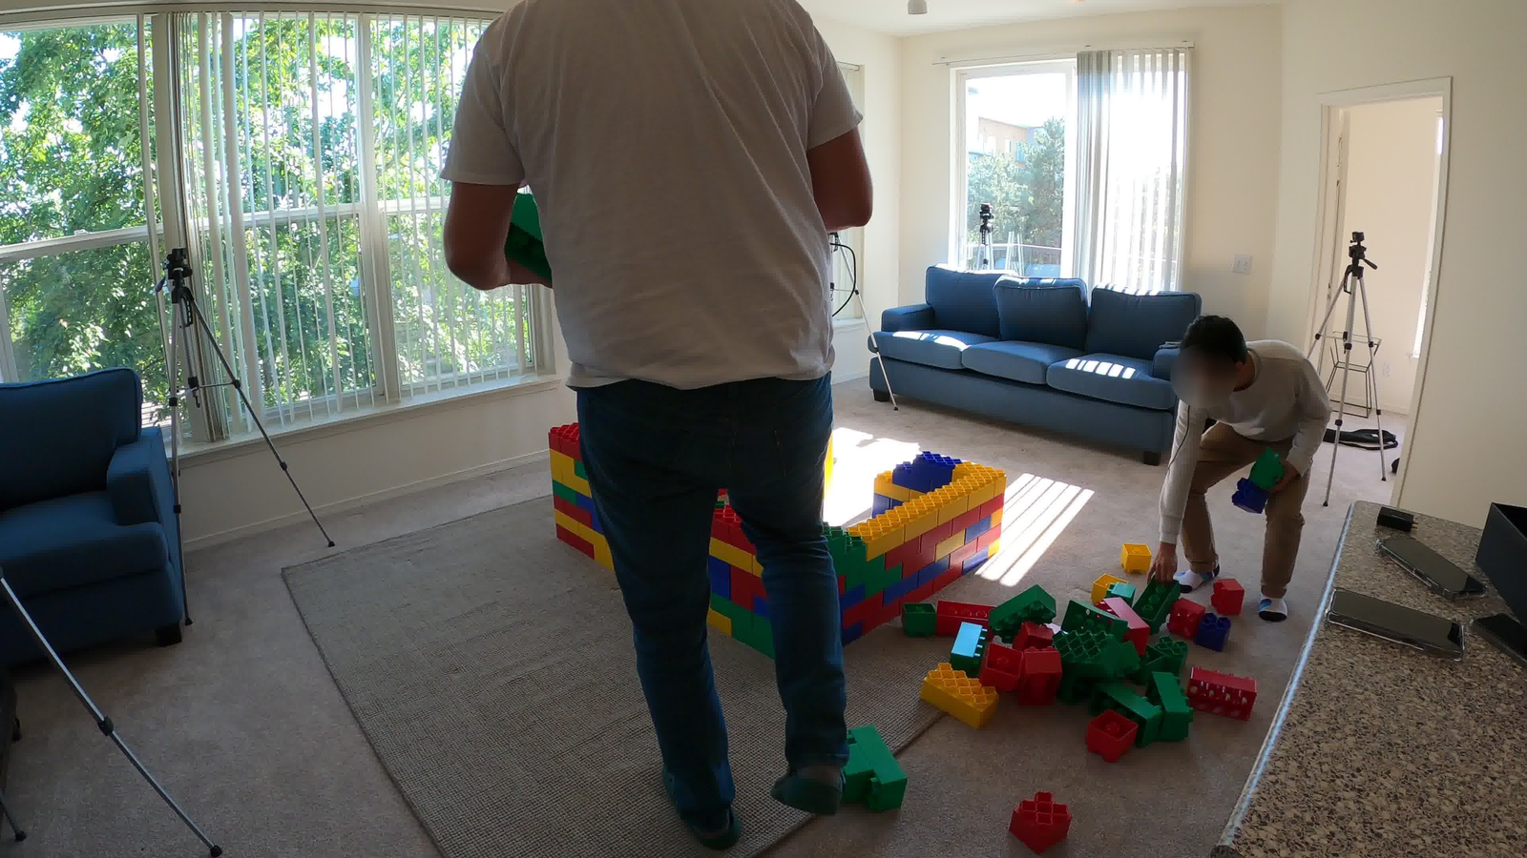
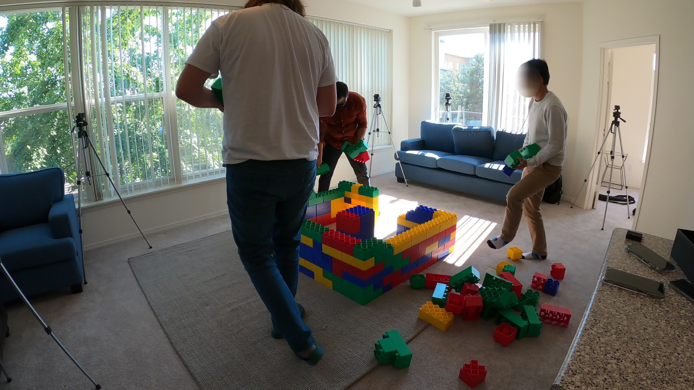
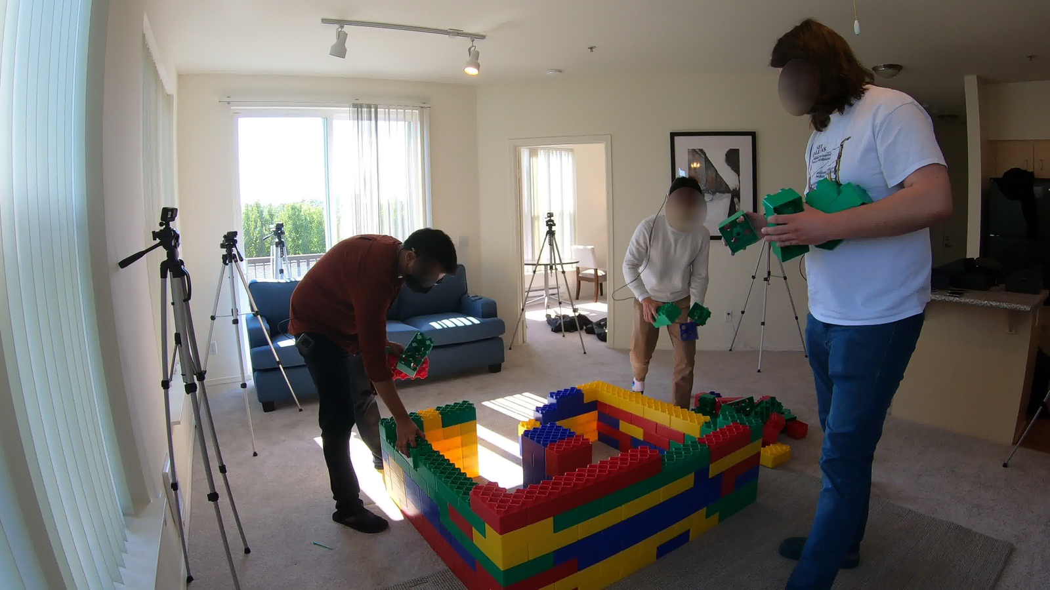
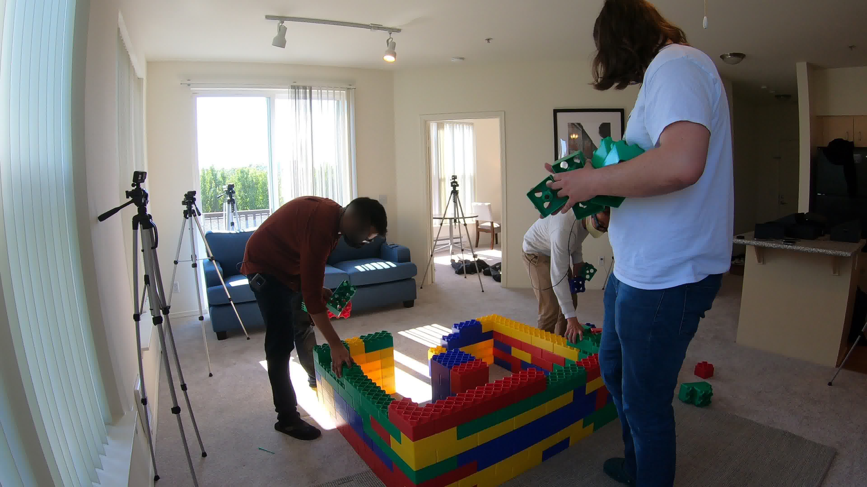
SH
T3R
Streaming Multi-Shot 4D Human-Scene Reconstruction from Monocular Video
Shot 1 · 0°
Shot 2 · 99°
Shot 3 · 177°
CUT
CUT
World-frame
reconstruction
3 people · 4 times
1 world frame.
Actual prediction
Faint: earlier poses
0° → 177° replay
0°
Solid: latest mesh
177°
Z
Y
99°
X
Online
multi-shot
stream
Shot 1 · 0°
Shot 2 · 99°
Shot 3 · 177°
Consistent
4D reconstruction
CUT
CUT
● Person ID 0
● Person ID 1
● Person ID 2
Camera symbols indicate source viewpoints; positions are schematic.
Notes:
Real source RGB: cam03 251/261/271; cam06 281/291/301; cam04 311/321/331. Center: four real times 251/261/311/331 from the prior 0-to-177-degree BRIDGE3R inference. Historical alpha 0.20/0.32/0.48, final 1.0. Camera symbols schematic. See README and render_settings.json.

