Slide 1
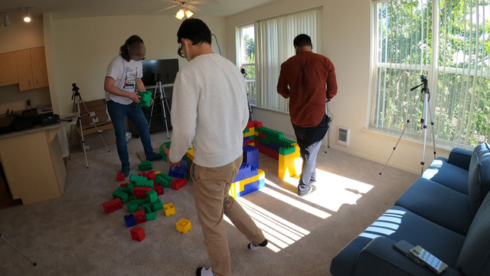
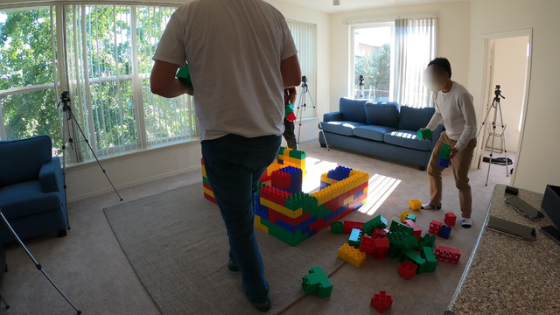
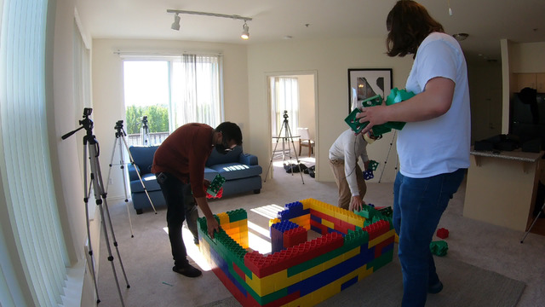
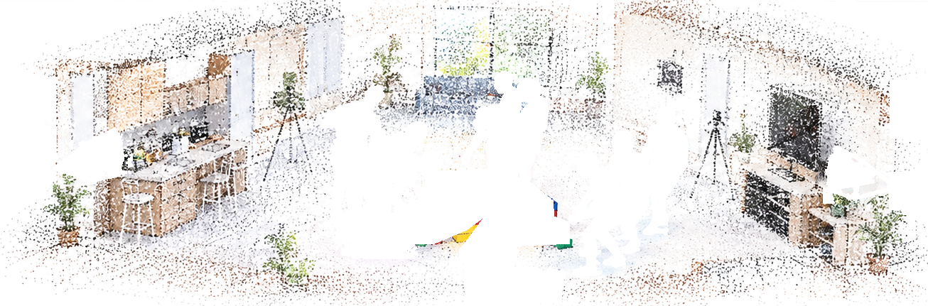
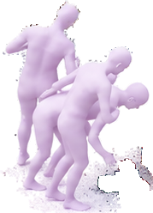
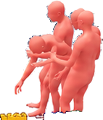
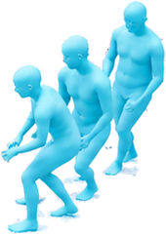
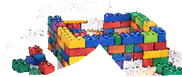
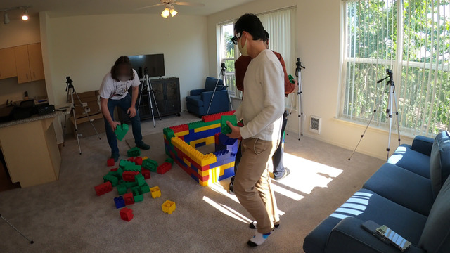
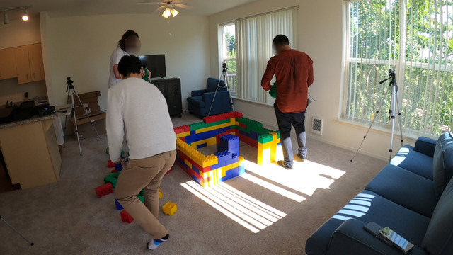
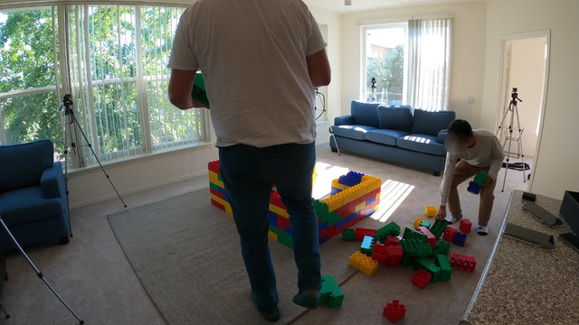
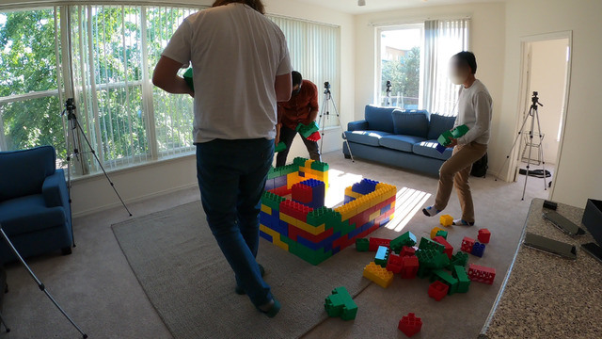
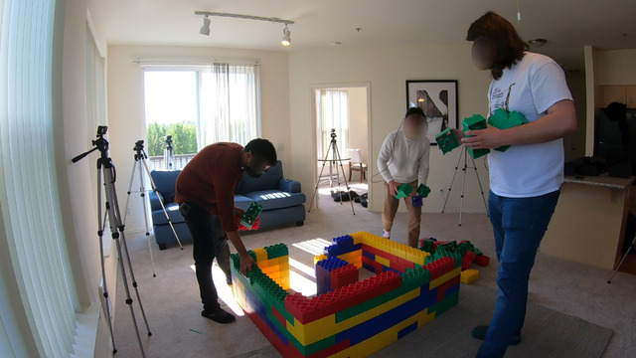
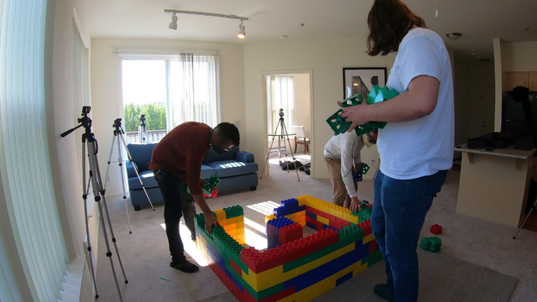
SH
T3R
Streaming Multi-Shot 4D Human-Scene Reconstruction from Monocular Video
Shot 1 · 0°
Shot 2 · 99°
Shot 3 · 177°
CUT
CUT
World-frame
reconstruction
3 shots · 2 cuts ·
1 world frame.
0°
177°
Z
Y
99°
X
Online
multi-shot
stream
Shot 1 · 0°
Shot 2 · 99°
Shot 3 · 177°
Consistent
4D reconstruction
CUT
CUT
Notes:
EDITING NOTES / 编辑说明
This slide is genuinely editable but is NOT all-vector.
Editable native PowerPoint objects: all text, header/logo geometry, shot tags, panels, CUT arrows, camera symbols, coordinate axes, dots and timeline containers.
Raster objects: the 9 original photo crops, point-cloud background, block rendering, and the three color-coded human-motion groups. They are separate image objects and can be moved, resized, cropped, or replaced. Human joints and individual overlapped time steps are not editable meshes.
照片：来自用户提供的九宫格图片，逐行对应 Shot 1/2/3，保持每行原始帧顺序。上方三张大图各使用对应行的第 2 帧。
中间渲染：从本次对话已有的生成式 teaser 中提取；不是真实 3D 点云文件或新测量结果。最终论文应替换为作者实际重建输出。
三色人体动作各为一组透明 PNG，而非逐帧人物或 SMPL 网格。分层为可见像素的拆分，移动图层不会恢复原来被遮挡的背景。
Use Home > Select > Selection Pane to locate named groups. Click into a group or ungroup to edit its children. Right-click a photograph and use Change Picture to replace it.

